Slide 1
B.Tech Major Project Presentation
ChurnGuide: AI Customer Analytics and Churn Prediction
Multi-business churn modelling, explanation and segmentation
Presented by: [Student names - to be added]
Guide: [Name and designation - to be added]
Department of [to be added], [College name - to be added] | [Month Year]
Notes:
Placeholders are intentional. Fill in student names, roll numbers, guide, department, college and date before presenting.

Slide 2
Contents
• Project Objectives
• Introduction to the Problem
• Background
• Methodology
• Results and Findings
• Conclusion and Future Work
• References
• Q & A
ChurnGuide | AI Customer Analytics & Churn Prediction
2

Slide 3
Project Objectives (1/2)
• Predict customer churn from tabular snapshot data
• Work across business domains, not one dataset
• Give a risk score for one customer or a whole portfolio
ChurnGuide | AI Customer Analytics & Churn Prediction
3

Slide 4
Project Objectives (2/2)
• Explain predictions with model sensitivity
• Group customers into behavioural segments
• Keep evaluation honest: held-out test, clear limits
ChurnGuide | AI Customer Analytics & Churn Prediction
4

Slide 5
Introduction: The Churn Problem
• Churn = customer stops or cancels the service
• Losing customers costs recurring revenue
• Keeping customers is often cheaper than finding new
• Early warning lets teams act in time
ChurnGuide | AI Customer Analytics & Churn Prediction
5

Slide 6
Introduction: Why Machine Learning
• Many attributes interact: tenure, contract, charges
• Rules of thumb miss these interactions
• Models learn risk from historical outcomes
• Output: a probability, not a yes/no guess
ChurnGuide | AI Customer Analytics & Churn Prediction
6

Slide 7
Introduction: Gap and Approach
• Business teams lack ML skills and tools
• Tools often fixed to one data schema
• ChurnGuide: upload CSV, map columns, train, score
• Runs locally; data stays on the computer
ChurnGuide | AI Customer Analytics & Churn Prediction
7

Slide 8
Background: Data and Models
• Public telecom data: 7,043 customers, 26.5% churned
• Logistic Regression, Random Forest, Gradient Boosting
• Cross-validation to compare models fairly
• ROC-AUC measures ranking quality
ChurnGuide | AI Customer Analytics & Churn Prediction
8

Slide 9
Background: Explanation and Segments
• Sensitivity: change an input, watch the probability move
• Associations only, not proof of cause
• K-Means groups customers by tenure and charges
• Segments suggest where to focus retention
ChurnGuide | AI Customer Analytics & Churn Prediction
9

Slide 10
Methodology: System Pipeline
1. Upload CSV and choose the churn column
2. Check columns and data types
3. Stratified 80/20 train/test split (seed 42)
4. Train and compare three models by 5-fold CV
5. Score, explain and segment customers
ChurnGuide | AI Customer Analytics & Churn Prediction
10

Slide 11
Methodology: Leakage Control
• Imputation, scaling, encoding inside one Pipeline
• Fitted on training data only
• Model chosen by training-fold CV ROC-AUC
• Test set used once, for the final report
ChurnGuide | AI Customer Analytics & Churn Prediction
11

Slide 12
Methodology: Model Selection
Model | Mean CV ROC-AUC
Logistic Regression | 0.8463
Random Forest | 0.8446
Gradient Boosting (winner) | 0.8493
Telecom project, 80% training partition, stratified 5-fold CV
ChurnGuide | AI Customer Analytics & Churn Prediction
12

Slide 13
Methodology: Explanation and Scoring
• Sensitivity: input vs typical customer baseline
• Missing values filled from saved baselines
• TotalCharges recomputed with tenure or charges
• Risk cut-offs: 0.60 (single), 0.65 (bulk)
ChurnGuide | AI Customer Analytics & Churn Prediction
13

Slide 14
Results: Held-Out Telecom Performance
Metric | Value
Accuracy | 0.7984
Precision | 0.6585
Recall | 0.5000
F1 | 0.5684
ROC-AUC | 0.8465
• 1,409 unseen customers
• Recall 50%: half of churners missed
• Lower threshold: to validate
ChurnGuide | AI Customer Analytics & Churn Prediction
14

Slide 15
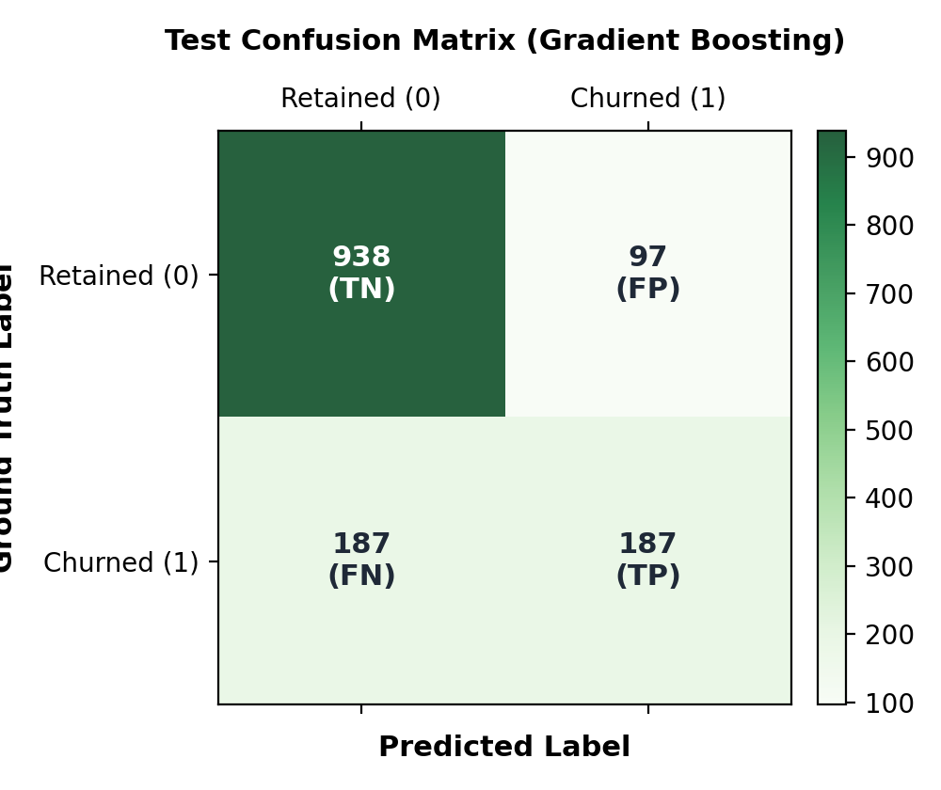
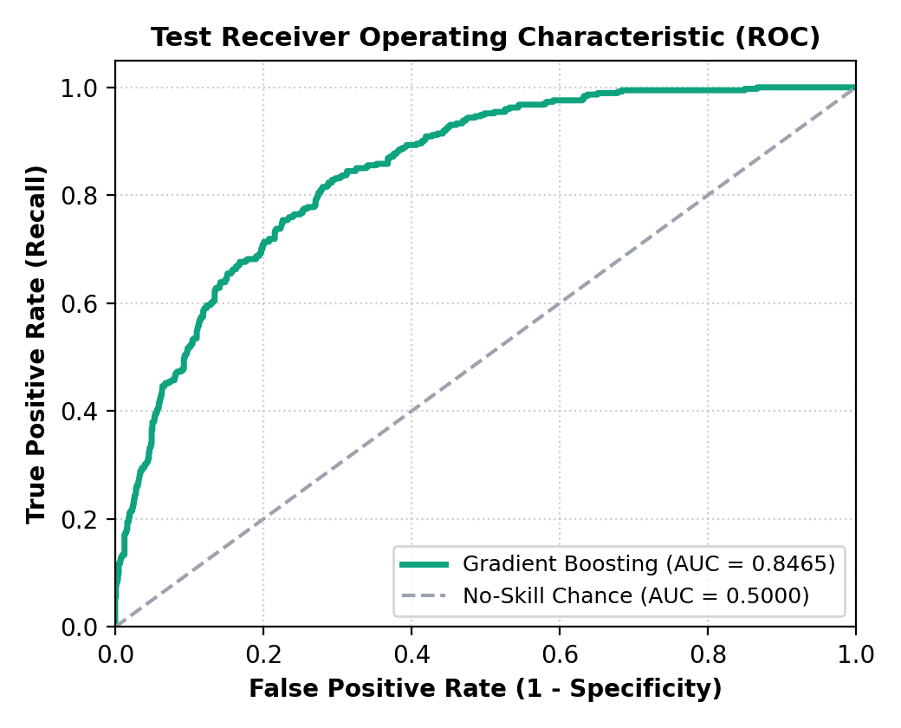
Results: Confusion Matrix and ROC
TN 938 | FP 97 | FN 187 | TP 187
Held-out ROC-AUC 0.8465
ChurnGuide | AI Customer Analytics & Churn Prediction
15

Slide 16
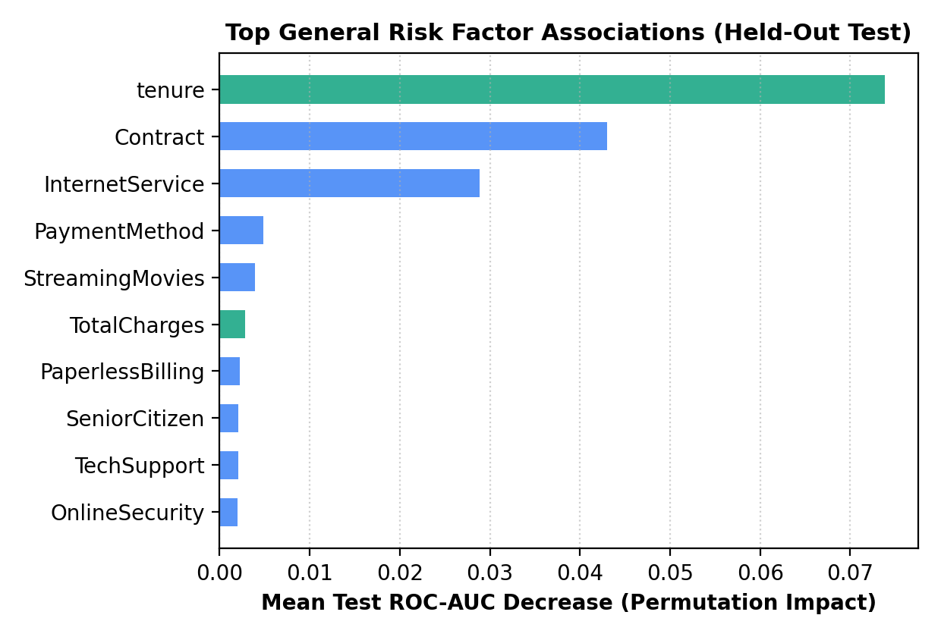
Results: Feature Importance
• Tenure ranks highest
• Then Contract, InternetService
• Drop in test ROC-AUC
• Reliance, not cause
ChurnGuide | AI Customer Analytics & Churn Prediction
16

Slide 17
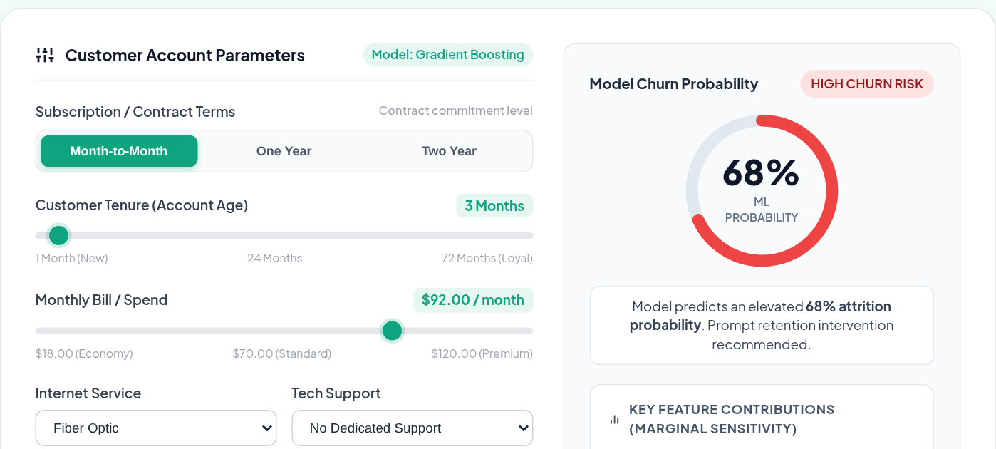
Results: Live Simulator, High-Risk Profile
Month-to-month contract, short tenure: high churn probability
ChurnGuide | AI Customer Analytics & Churn Prediction
17

Slide 18
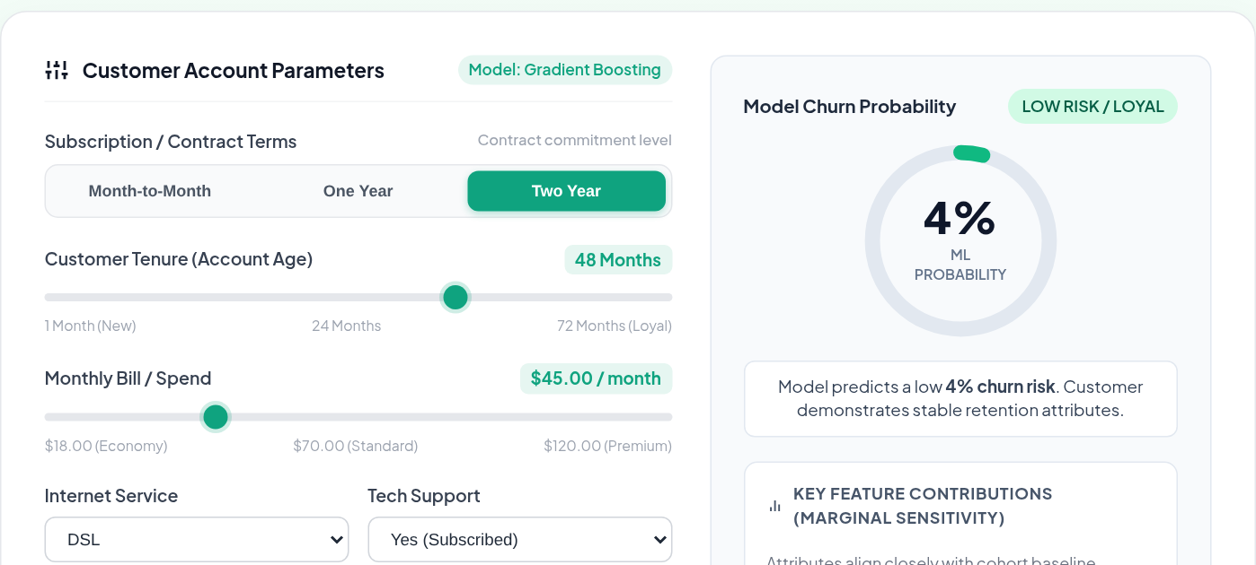
Results: Live Simulator, Loyal Profile
Two-year contract, long tenure: low churn probability
ChurnGuide | AI Customer Analytics & Churn Prediction
18

Slide 19
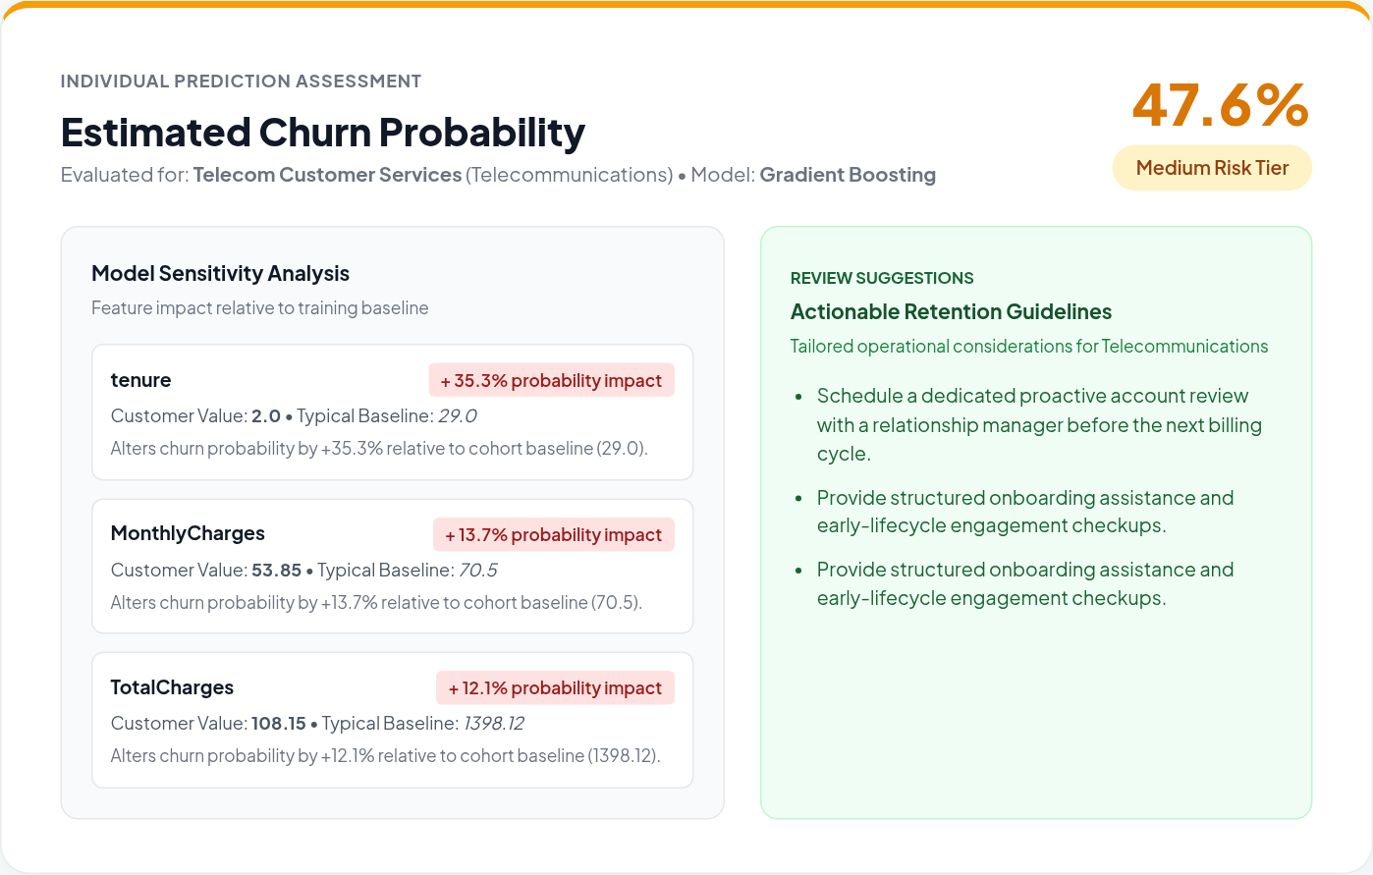
Results: Single Customer Predictor
• Full profile input
• Probability and risk tier
• Top drivers by sensitivity
• Review suggestions
ChurnGuide | AI Customer Analytics & Churn Prediction
19

Slide 20
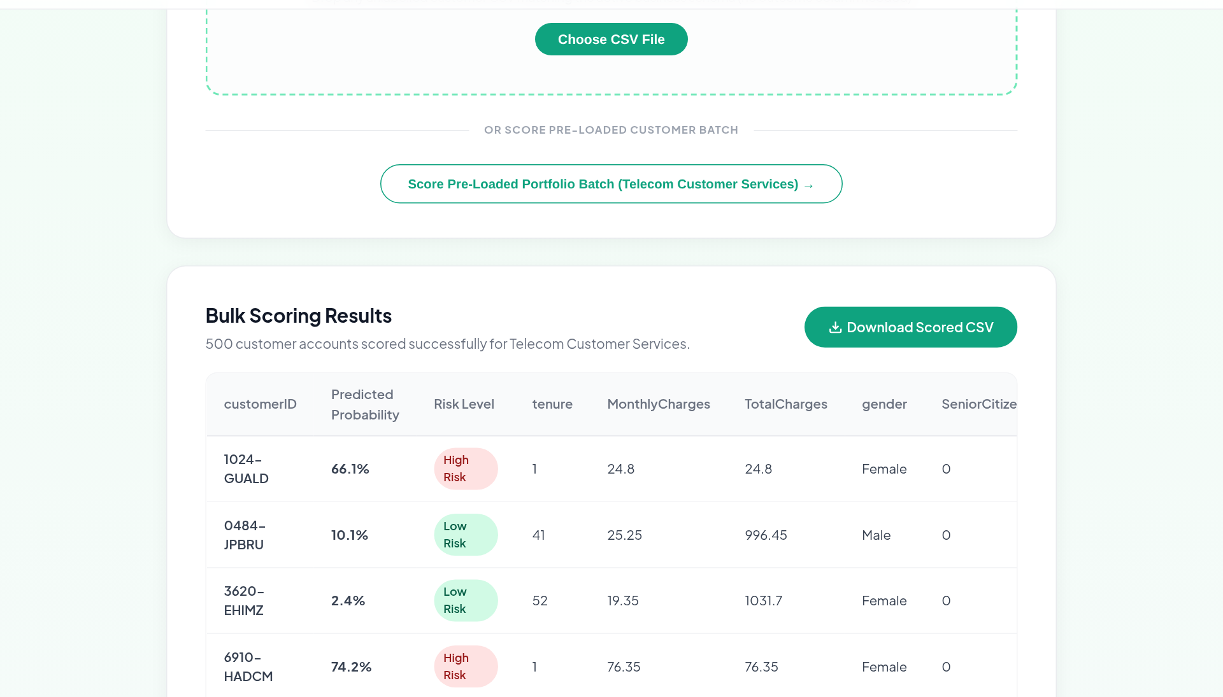
Results: Bulk Portfolio Scoring
• 500 customers scored
• Risk level per account
• Download scored CSV
ChurnGuide | AI Customer Analytics & Churn Prediction
20

Slide 21
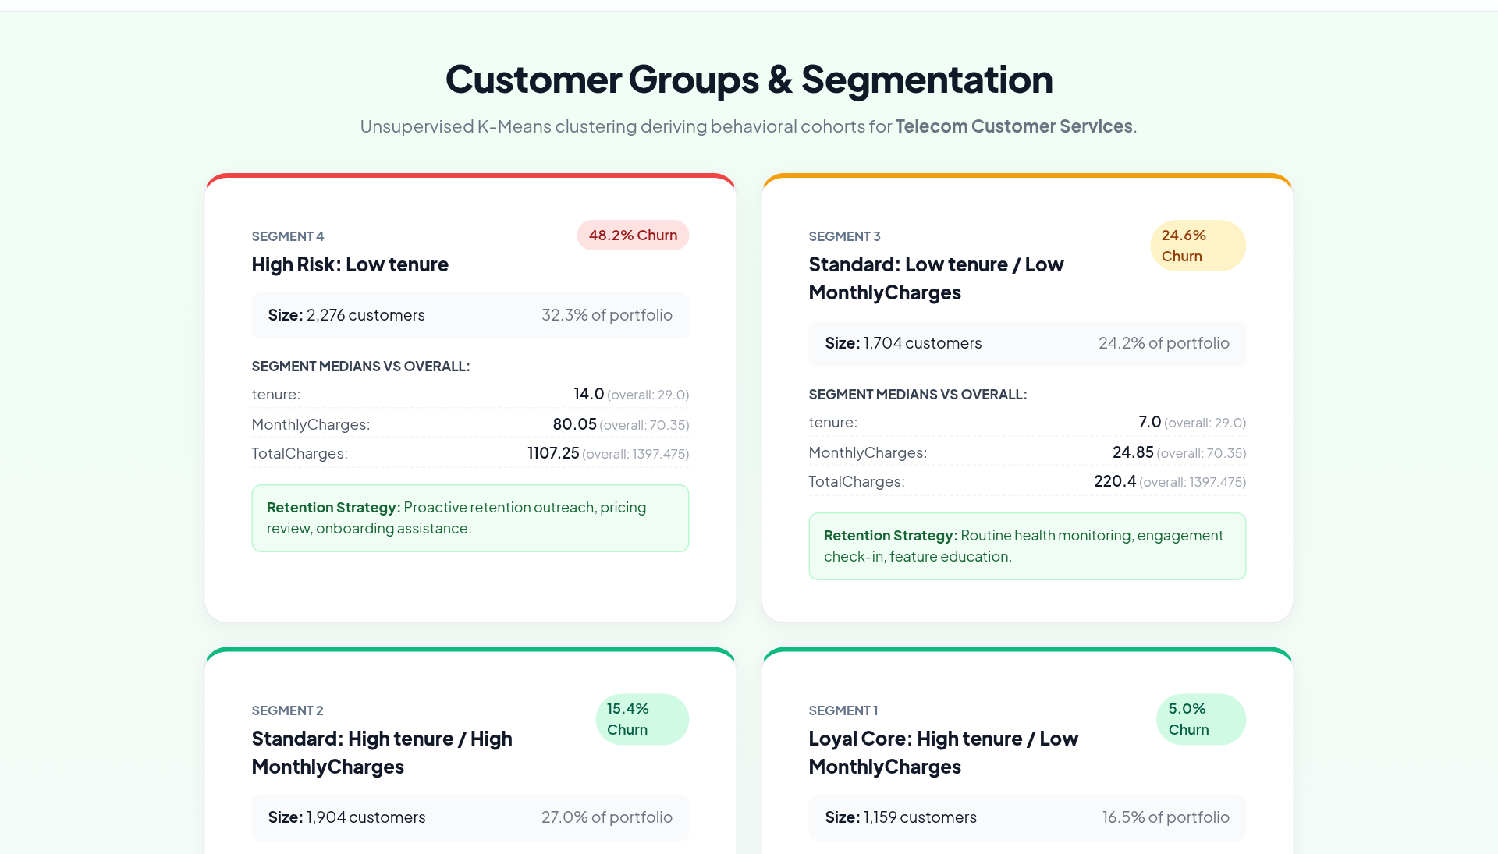
Results: Customer Segments
Segment | Churn
Low tenure, high risk | 48.2%
Low tenure, low charge | 24.6%
High tenure, high charge | 15.4%
Loyal core | 5.0%
ChurnGuide | AI Customer Analytics & Churn Prediction
21

Slide 22
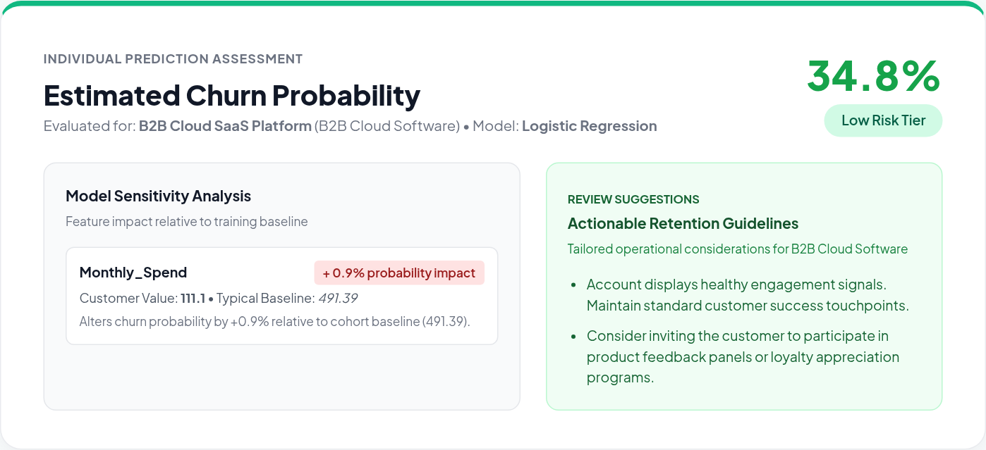
Results: Second Domain (Synthetic)
• B2B SaaS: 1,200 generated accounts
• Logistic Regression won
• Held-out AUC 0.6894
• Accuracy 0.6542
• Synthetic: schema test only
ChurnGuide | AI Customer Analytics & Churn Prediction
22

Slide 23
Conclusion
• End-to-end churn platform with a simple web interface
• Gradient Boosting held-out AUC: 0.8465
• Scoring, explanation and segmentation in one place
• Results are modest on recall; limits are stated
ChurnGuide | AI Customer Analytics & Churn Prediction
23

Slide 24
Limitations and Future Work
• Snapshot data only; no time-based validation
• Sensitivity is not causal or SHAP
• Synthetic SaaS data needs real data to validate
• Next: threshold tuning, time-series, richer explanations
ChurnGuide | AI Customer Analytics & Churn Prediction
24

Slide 25
References
• Pedregosa et al. (2011). Scikit-learn: Machine Learning in Python. JMLR 12.
• Breiman, L. (2001). Random Forests. Machine Learning 45(1), 5-32.
• Friedman, J. H. (2001). Greedy function approximation: a gradient boosting machine. Annals of Statistics 29(5), 1189-1232.
• IBM Telco Customer Churn sample dataset (public).
ChurnGuide | AI Customer Analytics & Churn Prediction
25

Slide 26
Questions?
Q & A

Slide 27
Thank You
ChurnGuide

