Slide 1

WEBSQL
References
G. Mihaila. WebSQL - an SQL-like query language for the WWW, MSc. Thesis, University of Toronto, 1996
G. Arocena, A. Mendelzon, G. Mihaila. Applications of a Web Query language, Proceedings of the 6th International WWW Conference, Santa Clara, California, April 1997.

Slide 2
Scenarios...
Find about PCs from IBM
  query: +IBM +“personal computer” +price
  can we restrict search to www.ibm.com ?
Find a good music store
  should I ask yahoo or hotbot or lycos or … ?
Find pages about databases within 2 links from Joe’s webpage
Find recent web pages with title “Bob’s Music Store”

Slide 3
Users of WebSQL
End Users – Front end available for searching the web, Query to search web.
Application developers – Primary users for WebSQL. They can embed WebSQL library calls into there programming language similar to SQL calls with C and C++ programs.

Slide 4
Web Query Problems
SE queries don’t exploit structure of data
SE queries don’t exploit link topology of data
Source selection hard
  different search engines have different functionalities, idiosyncratic behaviour
  different search engines good at different tasks

Slide 5
WebSQL
Integrate structure/topology constraints with textual retrieval
Virtual graph model of document network
Need to combine navigation and querying
Query Language that utilizes document’s structure and can accept constraints on link topology

Slide 6
Cont…
Model web as relational database
Use two relations Document and Anchor
Document relation has one tuple for each document in the web and the anchor relation has one tuple for each anchor in each document

Slide 7
WebSQL- cont..
SQL-like query language for extracting information from the web.
Capable of systematic processing of either all the links in a page, all the pages that can be reached from a given URL through paths that match a pattern, or a combination of both.
Provides transparent access to index servers

Slide 8
Data Model
Relational
Each web object is a tuple in a Document
  {url, title, text, type, length, modification info}
Hyperlinks are tuples in Anchor
  {base, href, label}

Slide 9
Link Types
WebSQL helps to automate navigation process, using Path regular Expression.
Link Types
Local : Destination document resides in same server as the document from which it originated.
denoted by –>
Global : Destination document resides in same server as the document from which it originated.
denoted by =>
#> and = represent internal link within same document and path of length zero.

Slide 10
Cont..
Any web object is identified with Uniform Resource locator i.e. URL and whose interpretation depends on its type (HTML, ps, image etc).
Web servers provide information like type, length and last modification date.
HTML doc has title and text.
Base is the URL of HTML document containing the link, href is the referred document and label is the link description.

Slide 11
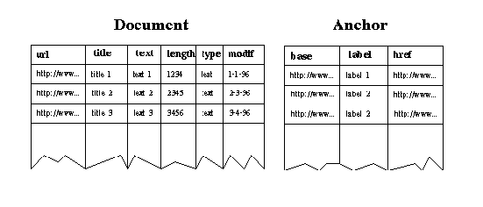

Slide 12
Query: Find all the pairs of URLs of documents with the same title.
Standard SQL Query Vs WebSQL
SELECT d1.url, d2.url FROM Document d1, Document d2 WHERE d.title = d2.title AND NOT (d1.url = d2.url)
This is not possible as there is no way to enumerate all documents.

Slide 13
Cont..
SELECT d1.url, d2.url FROM Document d1 SUCH THAT d1 MENTIONS “database", Document d2 SUCH THAT d2 MENTIONS “database" WHERE d.title = d2.title AND NOT (d1.url = d2.url)
SUCH THAT … MENTIONS construct defines a materialized portion of web that mentions some keyword in text.

Slide 14
MENTIONS and CONTAINS
MENTIONS and CONTAINS do string matching in the FROM and WHERE clause resp.
MENTIONS implementation consist of a query to one of the global index servers ( Google, Alta Vista, Excite , HotBot etc.)
MENTIONS returns the set of all documents that contain that string

Slide 15
Example
Retrieves the title and the URL of all the documents that are pointed to from the document whose URL is ``http://www.somewhere.com'' and that reside in the same server
SELECT d.url, d.title FROM Document d SUCH THAT "http://www.somewhere.com" -> d

Slide 16
Examples of Path Regular Expressions

Slide 17
Regular exp | Meaning
-> -> => -> | => ->* => ->* = | #> | -> | Path of length three composed of two local links followed by one global link Path of length one, either local or global Local paths of any length Path composed of one global link followed by any number of local links Local paths of length zero or one

Slide 18
Search for pages related to databases in the web site of the Department of Computer Science of the University of Toronto:
SELECT d.url FROM Document d SUCH THAT "http://www.cs.toronto.edu" ->* d, WHERE d.text CONTAINS "database" OR d.title CONTAINS "database"

Slide 19
Find Employment job opportunities for software engineers
SELECT d1.url, d1.title, d2.url. d2.title FROM Document d1 SUCH THAT d1 MENTIONS "employment job opportunities", Document d2 SUCH THAT d1 =|->|->-> d2 WHERE d2.text CONTAINS "software engineer"

Slide 20
Find the pages describing the publications of some research group
SELECT a1.href, d2.title FROM Document d1 SUCH THAT "http://www.university.edu/~group" ->* d1, Anchor a1 SUCH THAT base = d1, Document d2 SUCH THAT a1.href -> d2, WHERE a1.label CONTAINS "papers"

Slide 21
Find URLs and titles of pages with links to zip files.
SELECT d1.url, d1.title FROM Document d1 SUCH THAT "http://www.university.edu/~group" ->* d1, Anchor a1 SUCH THAT base = d1, WHERE filename(a1.href) CONTAINS "ps.gz" OR filename(a1.href) CONTAINS "ps.Z";,

Slide 22
The Labels of all Hyperlinks to Postscript Files
SELECT a.label
FROM Anchor a SUCH THAT base = "http://www.SomeDoc.html"
WHERE a.href CONTAINS ".ps.Z";

Slide 23
Documents about Databases
SELECT d.url, d.title
FROM Document d SUCH THAT "http://www.OtherDoc.html" ->|=> d
WHERE d.title CONTAINS "databases";

Slide 24
User-defined link types
Find documents from a set of documents mention the word ``Canada''
DEFINE LINK [next] AS label CONTAINS "Next";
SELECT d.url FROM Document d SUCH THAT "http://the.starting.document" [next]* d, WHERE d.title CONTAINS "Canada";

Slide 25
Defining the Content of a Full-text Index
Restrict a search in such a way that only links that point to documents that are deeper in a hierarchy are traversed
DEFINE LINK [Deeper] AS server(href) = server(base) AND path(href) CONTAINS path(base);
SELECT d.url, d.text FROM Document d SUCH THAT "http://the.document.to.test" [Deeper]* d;

Slide 26
Finding Broken Links in a Page
SELECT a.href
FROM Anchor a SUCH THAT base = "http://the.document.to.test"
WHERE protocol(a.href) = "http" AND doc(a.href) = null;

Slide 27
Finding all the Missing Images
SELECT d.url, a.href
FROM Document d SUCH THAT "http://the.document.to.test"
->* d, Anchor a SUCH THAT base = d
WHERE protocol(a.href) = "http" AND doc(a.href) = null
AND file(a.href) CONTAINS ".gif";

Slide 28
If you are about to delete a page from a web, you may be interested in knowing which are the pages that refer to it, thus avoiding potential broken links. The following query finds such pages:
SELECT d.url
FROM Document d SUCH THAT "http://the.starting.doc" ->* d,
Anchor a SUCH THAT base = d
WHERE a.href = "http://the.next.deleted.doc";

Slide 29
Finding References from Documents in Other Servers
Assume you have a page with some links to pages in other sites and you want to know if your site is referenced from those pages or from pages referenced by them.
SELECT d.url
FROM Document d SUCH THAT "http://the.starting.doc" ->* d, document d1 such that d=>|->=>d1 Anchor a SUCH THAT base = d1 WHERE a.href = “your server";

Slide 30
Finding References to Documents in Other Servers
With a query similar to the previous one, you can find all the references to documents in other servers:
SELECT a.href
FROM Document d SUCH THAT "http://the.starting.doc" ->* d,
Anchor a SUCH THAT base = d
WHERE NOT server(a.href ) = server(d.url);

Slide 31
Find all HTML documents about “hypertext”
SELECT d.url, d.title, d.length, d.modif FROM document d SUCH THAT d mentions “hypertext” WHERE d.type =“text”/html”
Find all links to applets from documents about java
SELECT y.lebel, y.href FROM document x SUCH THAT x MENTIONS “java” ANCHOR y SUCH THAT base = x WHERE y.label CONTAINS “applet”

Slide 32
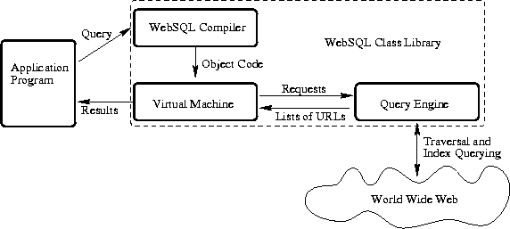

Slide 33
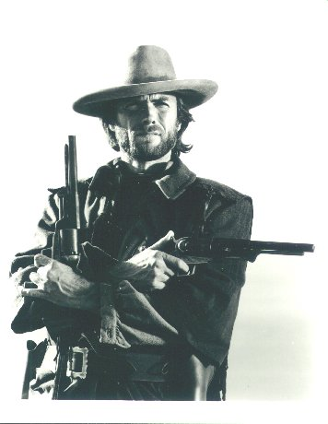
The Good
Idea of using structure and constraints in answering queries
Topologies can be useful
Can be used for Link maintenance

Slide 34

The Bad
Too complicated (especially syntax)
  Easy to write queries that explore the entire web.
Does end user care for topology constraint,
besides domain constraint?
Remote accesses cause huge slow down
  Check topology constraints at search engine?

Slide 35

The Ugly
How to avoid back links?
Fuzzy queries
  Find me “good”, “inexpensive” Chilean restaurants that are “close by”

