Slide 1
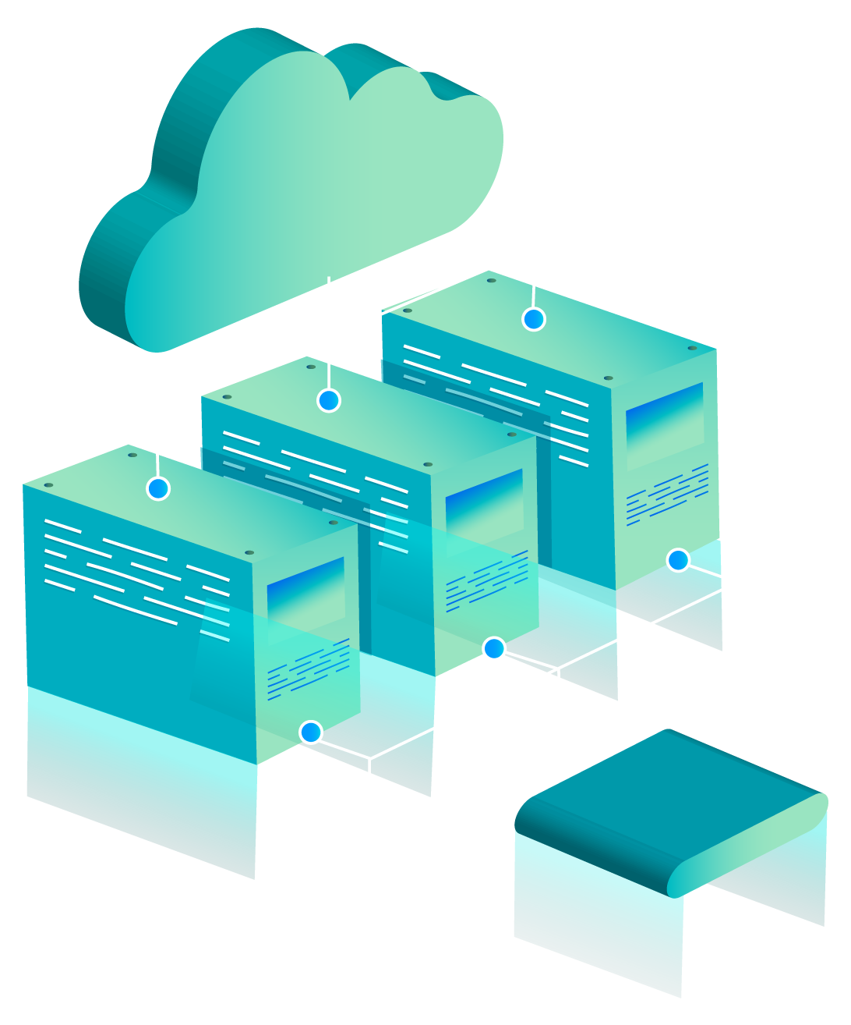
Cloud Computing and Autonomous AI: Pioneering the Era of Intelligent and Automated Systems
Cloud Computing and Autonomous AI: Pioneering the Era of Intelligent and Automated Systems

Slide 2
TABLE OF CONTENTS
01
Introduction and Background of the topic
03
02
04
Scope of the Topic
Objectives of the Topic
Presentation of the chosen Technology

Slide 3
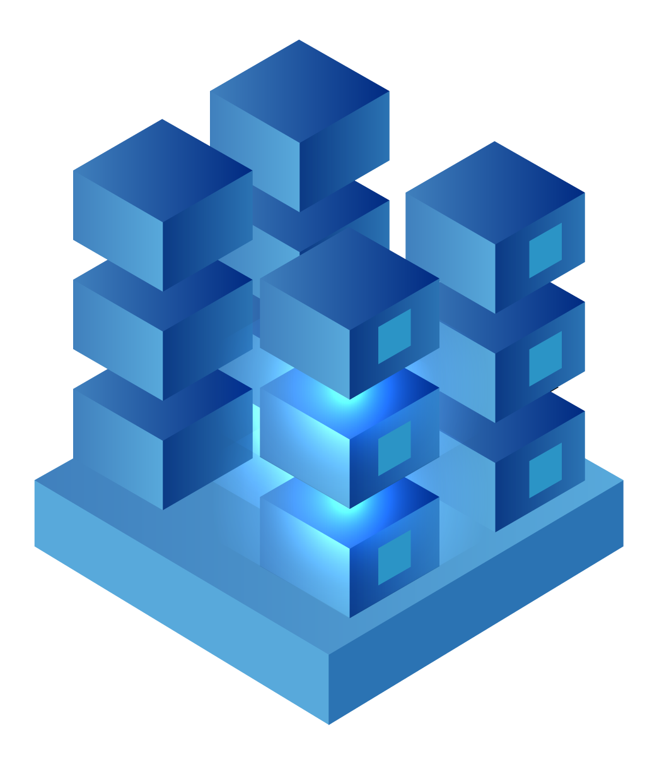
01
INTRODUCTION AND BACKGROUND OF THE TOPIC

Slide 4
CLOUD COMPUTING
Cloud computing is the on-demand availability of computing resources as services over the internet. It eliminates the need for enterprises to procure, configure, or manage resources themselves, and they only pay for what they use.
The cloud service provider (CSP) provides these services. They are in charge of managing computing resources hosted at a remote data center, such as applications, servers (physical and virtual), data storage, development tools, networking capabilities, and so on.

Slide 5
CLOUD COMPUTING
Cloud computing can be traced back to the early 2000s, when internet-based services began to evolve. The concept of cloud computing developed in response to the limitations and challenges of traditional computing models. In the past, organizations had to invest heavily in building and maintaining their own physical infrastructure, including servers, storage, and networking equipment, to meet their computing needs.
As a result, resources are underutilized, costs are high, and management processes are complicated.

Slide 6
AUTONOMIC COMPUTING
Autonomic computing is a computing system that is designed to be self-managing, self-healing, self-optimizing, and self-configuring.
The concept of autonomic computing was first introduced by IBM in 2001, as a response to the increasing complexity of computing systems and the need for more efficient and reliable management of these systems. The goal of autonomic computing is to create computing systems that can adapt to changing conditions, optimize their performance, and recover from failures without human intervention.

Slide 7
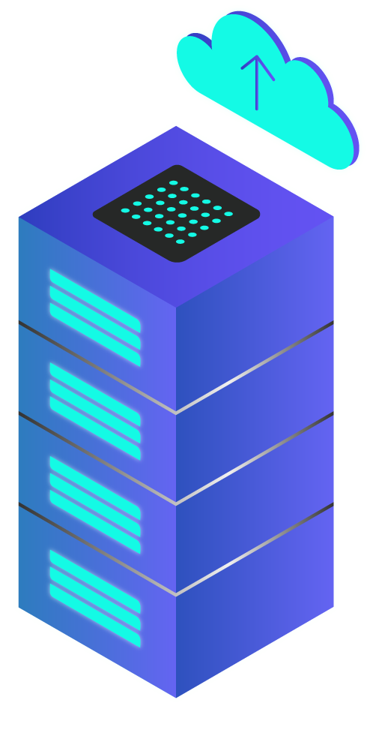
AUTONOMIC COMPUTING
Overall, autonomic computing represents a significant advance in the field of computing, as it enables the creation of more efficient, reliable, and adaptive computing systems that can meet the demands of modern computing environments.

Slide 8
TABLE OF CONTENTS
01
Introduction and Background of the topic
03
02
04
Scope of the Topic
Objectives of the Topic
Presentation of the chosen Technology

Slide 9
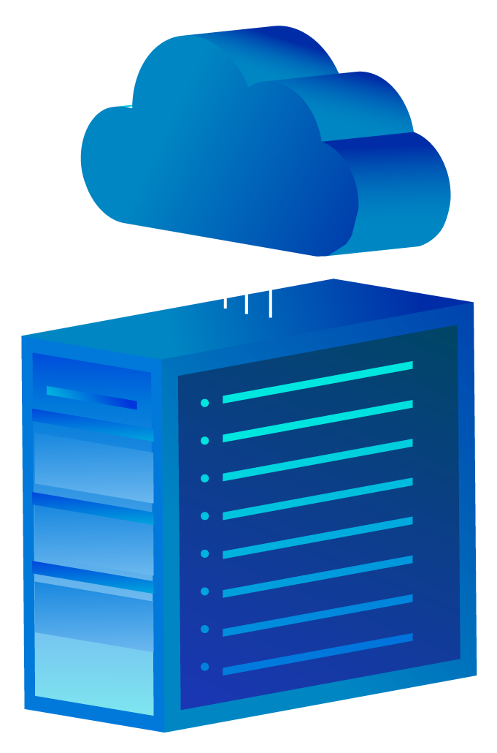
02
OBJECTIVES OF THE TOPIC

Slide 10
OBJECTIVE
1. Highlight the transformative potential of cloud computing and autonomous AI in revolutionizing industries and sectors.
2. Showcase the numerous advantages and opportunities offered by the integration of cloud computing and autonomous AI technologies.
3. Present real-world case studies and success stories that demonstrate the tangible benefits of adopting cloud computing and autonomous AI.
4. Investigate the scalability, cost-efficiency, and accessibility advantages of leveraging cloud infrastructure for AI applications.

Slide 11
TABLE OF CONTENTS
01
Introduction and Background of the topic
03
02
04
Scope of the Topic
Objectives of the Topic
Presentation of the chosen Technology

Slide 12
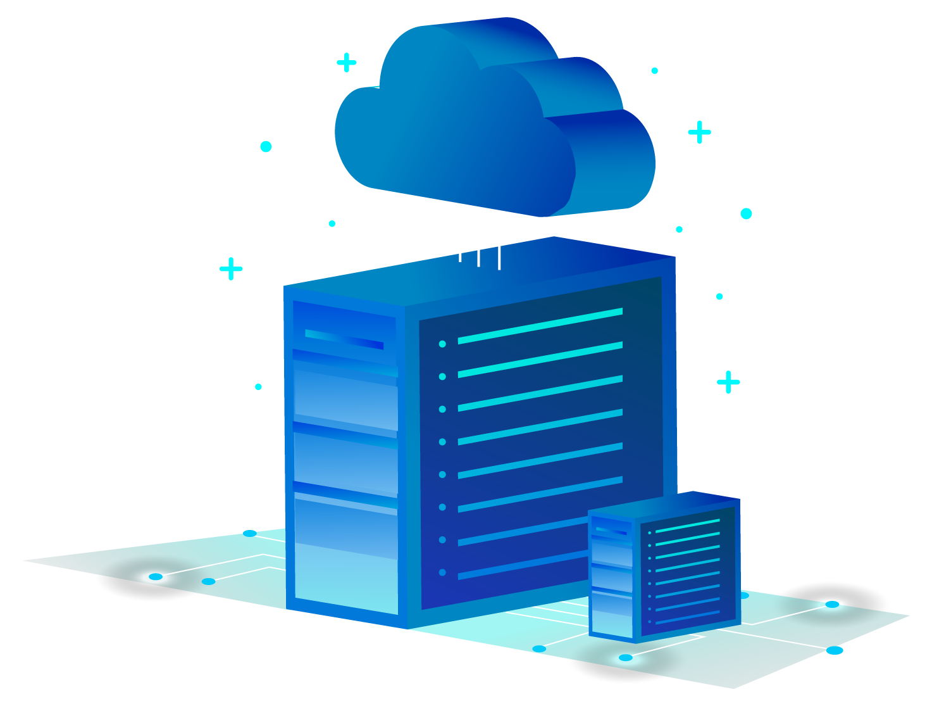
03
SCOPE OF THE TOPIC

Slide 13


SCOPE
The scope of our topic includes the interaction of cloud computing and autonomous AI, with a focus on their combined impact in driving positive transformations. We will look at the advantages, opportunities, and challenges of integrating these technologies. Examining real-world case studies and success stories that demonstrate the practical applications and tangible outcomes of cloud computing and autonomous AI across various industries and sectors is also part of the scope. We will also address concerns, misconceptions, and ethical concerns in order to provide a comprehensive understanding of the scope and implications of these technologies.

Slide 14
TABLE OF CONTENTS
01
Introduction and Background of the topic
03
02
04
Scope of the Topic
Objectives of the Topic
Presentation of the chosen Technology

Slide 15


04
PRESENTATION OF THE CHOSEN TECHNOLOGY

Slide 16

CLOUD COMPUTING
CLOUD COMPUTING

Slide 17
CLOUD COMPUTING USES AND ITS FUNCTIONS
The integration of machine learning algorithms in cloud environments enables users to have more seamless and connected experiences, as demonstrated by popular voice assistants like Alexa and Siri.
Large datasets, whether structured, unstructured, or raw, are used to train machine learning models. The processing power required to handle such large amounts of data necessitates the use of powerful CPUs and GPUs.

Slide 18
Some of the AI applications in cloud:
Natural Language Processing (NLP)
Computer Vision
Voice Recognition and Speech-to-Text
01
02
03
analyze and interpret visual data using AI algorithms. Image recognition, object detection, facial recognition, and video analysis are examples of applications such as security surveillance and autonomous vehicles.
enable voice recognition and speech-to-text capabilities, enabling applications such as voice assistants, transcription services, and voice-controlled systems.
cloud-based AI services to understand and process human language.

Slide 19
PRIVATE CLOUD
HYBRID CLOUD
PUBLIC CLOUD
THREE DIFFERENT CLOUD COMPUTING DEVELOPMENT MODELS

Slide 20
THREE DIFFERENT CLOUD COMPUTING DEVELOPMENT MODELS
PRIVATE CLOUD
is a dedicated computing environment used solely by one organization.
Example: IBM Watson provides a variety of artificial intelligence (AI) services, including Watson Assistant for creating conversational agents, Watson Studio for data exploration and model development, and Watson Visual Recognition for image analysis.

Slide 21
PRIVATE CLOUD
HYBRID CLOUD
PUBLIC CLOUD
THREE DIFFERENT CLOUD COMPUTING DEVELOPMENT MODELS

Slide 22
THREE DIFFERENT CLOUD COMPUTING DEVELOPMENT MODELS
HYBRID CLOUD
combines public and private cloud infrastructure, allowing businesses to reap the benefits of both.
Example : NVIDIA's DGX Systems combine AI-optimized hardware with hybrid cloud capabilities, enabling organizations to train and deploy AI models on-premises while leveraging cloud resources for increased compute power and scalability.

Slide 23
PRIVATE CLOUD
HYBRID CLOUD
PUBLIC CLOUD
THREE DIFFERENT CLOUD COMPUTING DEVELOPMENT MODELS

Slide 24
THREE DIFFERENT CLOUD COMPUTING DEVELOPMENT MODELS
PUBLIC CLOUD
makes available shared computing resources and services from third-party cloud service providers.
Example: AWS offers a variety of AI services, such as Amazon SageMaker for building, training, and deploying machine learning models, Amazon Rekognition for image and video analysis, and Amazon Comprehend for natural language processing tasks.

Slide 25
THREE TYPES OF CLOUD COMPUTING
Infrastructure as a Service (IaaS)
Software as a Service (SaaS)
PaaS (Platform as a Service)

Slide 26
THREE TYPES OF CLOUD COMPUTING
Infrastructure as a Service (IaaS)
a type of cloud computing that offers virtualized computing resources such as virtual machines, storage, and networks.
Example: Amazon EC2 (Elastic Compute Cloud) is a service that offers scalable virtual machine instances with adaptable computing resources.

Slide 27
THREE TYPES OF CLOUD COMPUTING
Infrastructure as a Service (IaaS)
Software as a Service (SaaS)
PaaS (Platform as a Service)

Slide 28
THREE TYPES OF CLOUD COMPUTING
PaaS (Platform as a Service)
It offers pre-configured frameworks, libraries, and tools to make AI model development, training, and deployment easier. PaaS allows developers to focus on AI algorithms and applications rather than infrastructure management.
Example: Google Cloud AI Platform streamlines AI model development, training, and deployment. It offers pre-configured frameworks, distributed training, and automated model tuning.

Slide 29
THREE TYPES OF CLOUD COMPUTING
Infrastructure as a Service (IaaS)
Software as a Service (SaaS)
PaaS (Platform as a Service)

Slide 30
THREE TYPES OF CLOUD COMPUTING
Software as a Service (SaaS)
SaaS platforms provide ready-to-use AI solutions that organizations can use without the need for extensive development. AI-powered customer service chatbots, recommendation engines, and natural language processing (NLP) tools are examples.
Example: Salesforce Einstein provides AI-powered services for customer relationship management (CRM).

Slide 31
AUTONOMIC COMPUTING
AUTONOMIC COMPUTING

Slide 32
AUTONOMIC COMPUTING USES AND ITS FUNCTIONS
Autonomic computing is used in a variety of applications, including cloud computing, data centers, and network management. It is particularly useful in large scale systems where manual management is not feasible. By automating many of the management tasks, autonomic computing can improve system performance, reduce downtime, and increase reliability.

Slide 33
AUTONOMIC COMPUTING USES AND ITS FUNCTIONS
Self-Configuration
Self-Healing
The system can be
configured based on the available workload and resources.
The system can detect and recover from failures without human intervention.
Self-Optimization
Self-Protection
(automatic resource control for optimal functioning)
The system can optimize its performance based on the workload and available resources
(identification and protection from attacks in a proactive manner) The system can protect itself from security threats and attacks.
Self-Awareness
The system can monitor and analyze its own performance and make adjustments as needed.

Slide 34
Some of the Applications in Autonomic:
Cloud Computing:
Autonomic computing can be used to manage cloud computing resources, such as virtual machines, storage, and network resources.

Slide 35
Some of the Applications in Autonomic:
Network Management:
Autonomic computing can be used to manage network resources, such as routers, switches, and firewalls.

Slide 36
Some of the Applications in Autonomic:
Security:
Autonomic computing can be used to manage security systems, such as intrusion detection and prevention systems, firewalls, and antivirus software.

Slide 37
Some of the Applications in Autonomic:
Data Center Management:
Autonomic computing can be used to manage data center resources, such as servers, storage, and network resources.

Slide 38
Some of the Applications in Autonomic:
Internet of Things (IoT):
Autonomic computing can be used to manage IoT devices, such as sensors, actuators, and controllers.

Slide 39

IMPORTANCE AND BENEFITS

Slide 40
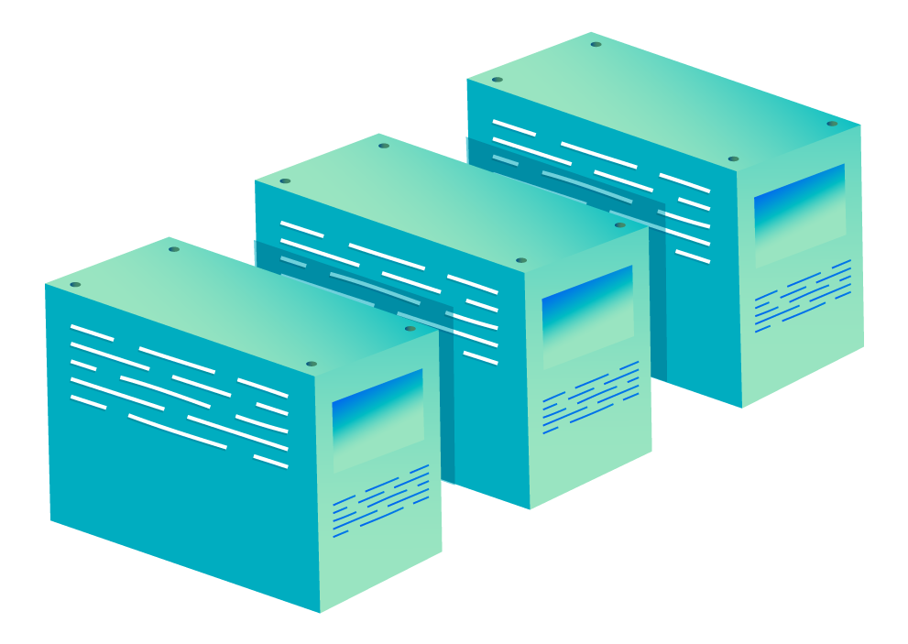
CLOUD COMPUTING
Importance and benefits
Cost savings: Cloud virtualization has reduced the cost of building and deploying AI-based models, making it accessible to small-to-medium businesses.
Productivity: Centralized cloud management eliminates the need for extensive admin time and effort, allowing IT staff to focus on non-repetitive tasks.
Analytics: AI-based models enable real-time data analysis, providing valuable insights and native analytics for various applications.
Data management: AI enhances cloud workloads in areas like customer service, marketing, ERP, and supply chain management, processing and generating data in real time.

Slide 41
CLOUD COMPUTING
Challenges:
Data privacy – AI algorithms processes and parameters can potentially expose sensitive company data to security breaches or unauthorized access.
Connectivity – Any algorithm or data processing system in the cloud depends on one thing to keep it running: a steady internet connection.

Slide 42
AUTONOMIC COMPUTING
BENEFITS:
Increased efficiency: Automation eliminates the need for humans to perform routine tasks, increasing productivity, speed, and accuracy.
Enhanced decision-making: Real-time data analysis by AI systems enables faster and more accurate decision-making.
Scalability and adaptability: AI systems can adjust resources dynamically to handle changing workloads.
Reduced errors and risks: Automation reduces human errors and biases, thereby increasing reliability.
Cost savings: Autonomous AI systems optimize resource allocation, resulting in increased operational efficiency and lower labor costs.

Slide 43
AUTONOMIC COMPUTING
CHALLENGES
Data quality and accessibility: High-quality, diverse, and accessible data, as well as addressing biases, are required for autonomous systems to be reliable.
System reliability and safety: Ensuring resilience, fault tolerance, and protection against adversarial attacks or failures are critical for autonomous AI system reliability and safety.
Privacy, security, and biases: To address concerns about privacy, security, and potential biases in decision-making, transparency, fairness, and accountability must be ensured.

Slide 44
LITERATURE REVIEWS AND SUPPORTING INFORMATION SUPPORTING THE GROUP POSITION

Slide 45

TECHNOLOGY OBSERVATION
Adoption of Cloud Computing in the Philippines:
The Philippine government has embraced cloud computing through the GovCloud initiative, which was launched by the DOST-ICT Office in 2013. GovCloud provides government agencies with cloud infrastructure access as part of the country's digital transformation efforts.

Slide 46

TECHNOLOGY OBSERVATION
Government Policies and Regarding Cloud Adoption
Cloud First Policy
Cloud computing has brought a new and more efficient means of managing government information technology resources. It is hereby declared the policy of the government to adopt a “cloud first” approach and for government departments and agencies to consider cloud computing solutions as a primary part of their infrastructure planning and procurement.

Slide 47
TECHNOLOGY OBSERVATION
Government Policies and Regarding Cloud Adoption
All government agencies shall adopt cloud computing as the preferred ICT deployment strategy for their own administrative use and delivery of government online services, except:
When it can be shown that an alternative ICT deployment strategy meets special requirements of a government agency; and
When it can be shown that an alternative ICT deployment strategy is more cost effective from a Total Cost of Ownership (TCO) perspective and demonstrates at least the same level of security assurance that a cloud computing deployment offers.

Slide 48
GLOBAL TRENDS AND ADOPTION RATES
Enterprise Adoption
- Cloud computing has been adopted by large enterprises such as Netflix, Airbnb, and Spotify to support their high-volume, scalable operations.
AI and Machine Learning (ML)
- Cloud platforms such as AWS, Azure, and GCP provide extensive AI and ML services, allowing organizations to develop and deploy sophisticated models without significant hardware investments. Amazon SageMaker, Google Cloud AI, and Microsoft Azure Machine Learning are a few examples.

Slide 49
GLOBAL TRENDS AND ADOPTION RATES
Startups and Innovation:
- By providing low-cost infrastructure and development platforms, cloud computing has fueled the rise of startups and innovation. Dropbox and GitHub began as cloud-based startups and have grown into successful enterprises.
Gaming Industry
- Cloud gaming platforms such as Google Stadia and Microsoft xCloud make use of cloud infrastructure to allow users to stream and play high-quality games without the need for dedicated gaming hardware.

Slide 50
TECHNOLOGY LITERARY REVIEWS
The Role of Cloud Computing in Artificial Intelligence
- The author's ability to highlight the advantages of using the cloud for AI applications, supported by relevant examples and case studies, was also commended. The feedback encourages the author to continue sharing valuable information on the intersection of AI and cloud computing, indicating their appreciation for the article.
Building towards more Autonomous and Proactive Cloud Technologies with Artificial Intelligence
- This article effectively bridges the gap between AI and cloud technologies, offering valuable insights for both technical experts and those new to the field. It is evident that the author possesses a deep understanding of the subject matter, and their expertise shines through in every paragraph.

Slide 51

SUMMARY

Slide 52
SUMMARY
In this comprehensive set of entries, we discover the intersection of cloud computing, autonomous AI, and their effect on distinctive industries. The article starts with an advent to cloud computing, highlighting its function in delivering on-demand computing resources and putting off the need to control agencies' personal infrastructure. Autonomous computing, with a focal point on self-handling and self-optimizing structures, changed into additionally introduced.

Slide 53
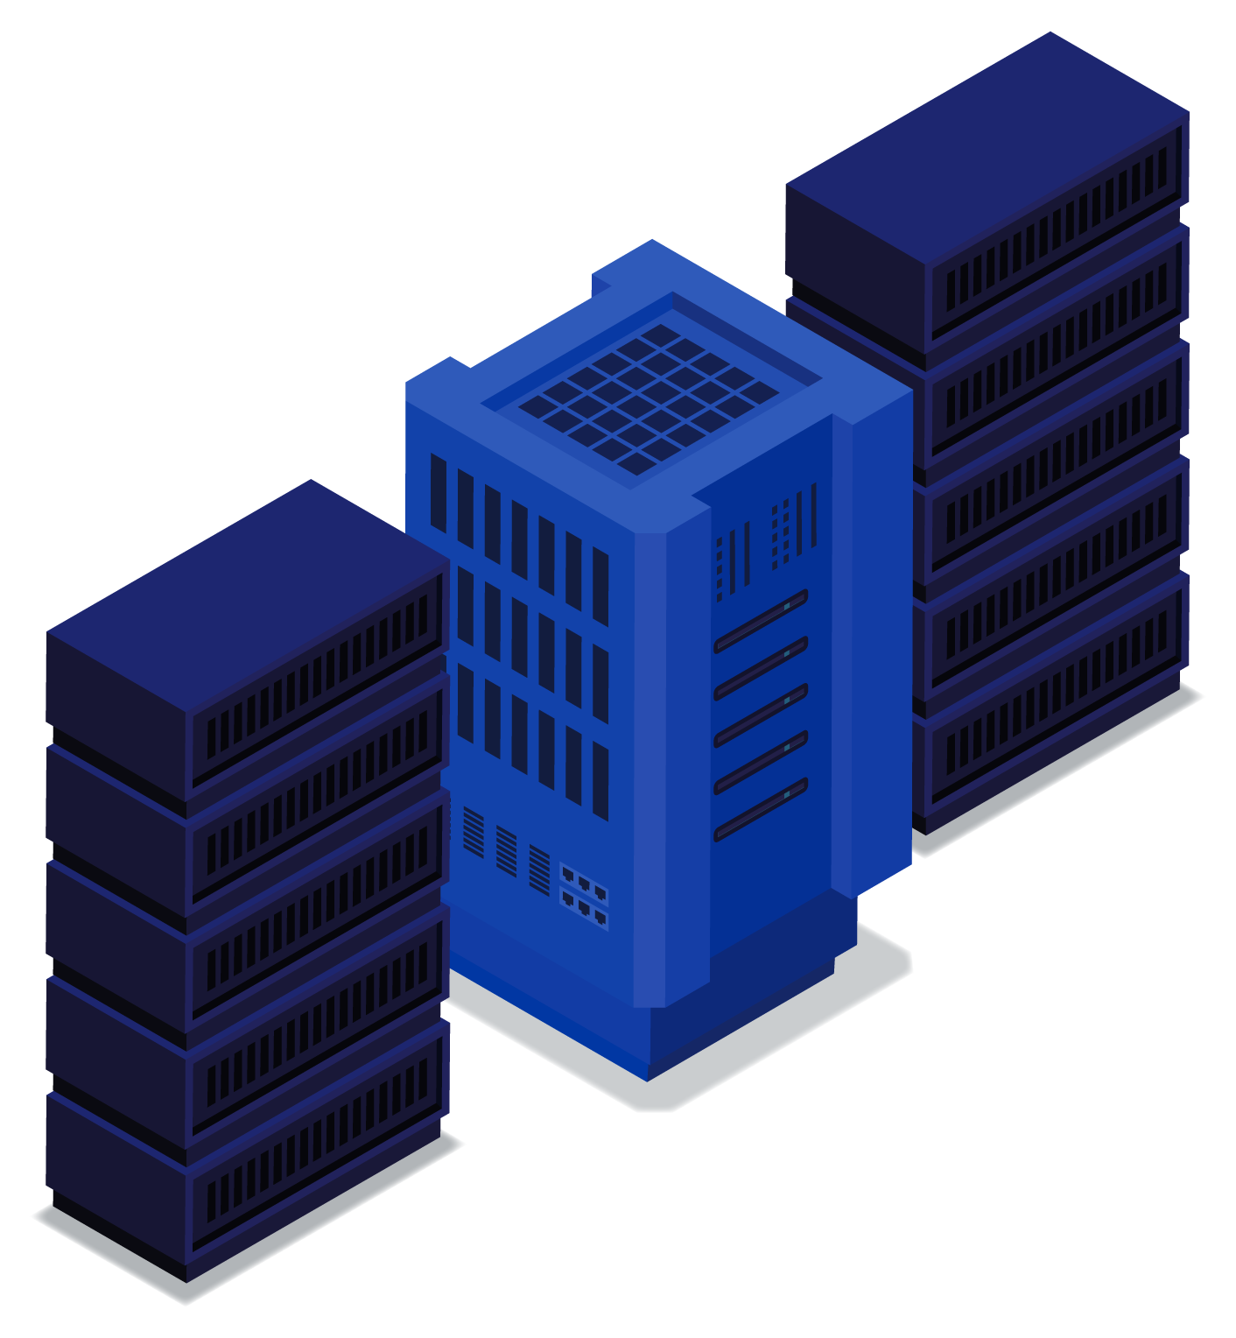
CONCLUSIONS
Cloud computing and autonomous AI technologies have the potential to revolutionize industries by enabling efficient and scalable computing resources, advanced analytics, and real-time data processing.
The integration of cloud computing and autonomous AI offers numerous benefits such as cost savings, increased productivity, enhanced decision-making, and improved system reliability.
Cloud computing provides different deployment models (public, private, hybrid) and types (IaaS, PaaS, SaaS), allowing organizations to choose the most suitable approach based on their specific requirements.
Autonomic computing enhances system performance by automating tasks such as configuration, optimization, healing, protection, and self-awareness, leading to increased efficiency and reduced errors.
Despite the advantages, challenges related to data privacy, connectivity, data quality, system reliability, safety, security, and biases must be addressed to ensure the successful implementation and adoption of these technologies.

Slide 54
RECOMMENDATIONS
Organizations should explore the potential of cloud computing and autonomous AI in their respective industries to drive innovation, improve efficiency, and gain a competitive edge.
Enterprises should carefully consider the deployment models (public, private, hybrid) and types of cloud computing (IaaS, PaaS, SaaS) to align with their business goals, security requirements, and data privacy concerns.
It is crucial to invest in robust data management practices, ensuring high-quality, diverse, and accessible data for reliable autonomous AI systems.
Collaboration between industry experts, policymakers, and researchers is necessary to establish guidelines, standards, and regulations to address concerns related to privacy, security, transparency, and biases in AI systems.
Continued research and knowledge-sharing on the intersection of cloud computing and autonomous AI will contribute to the advancement and adoption of these technologies.

Slide 55
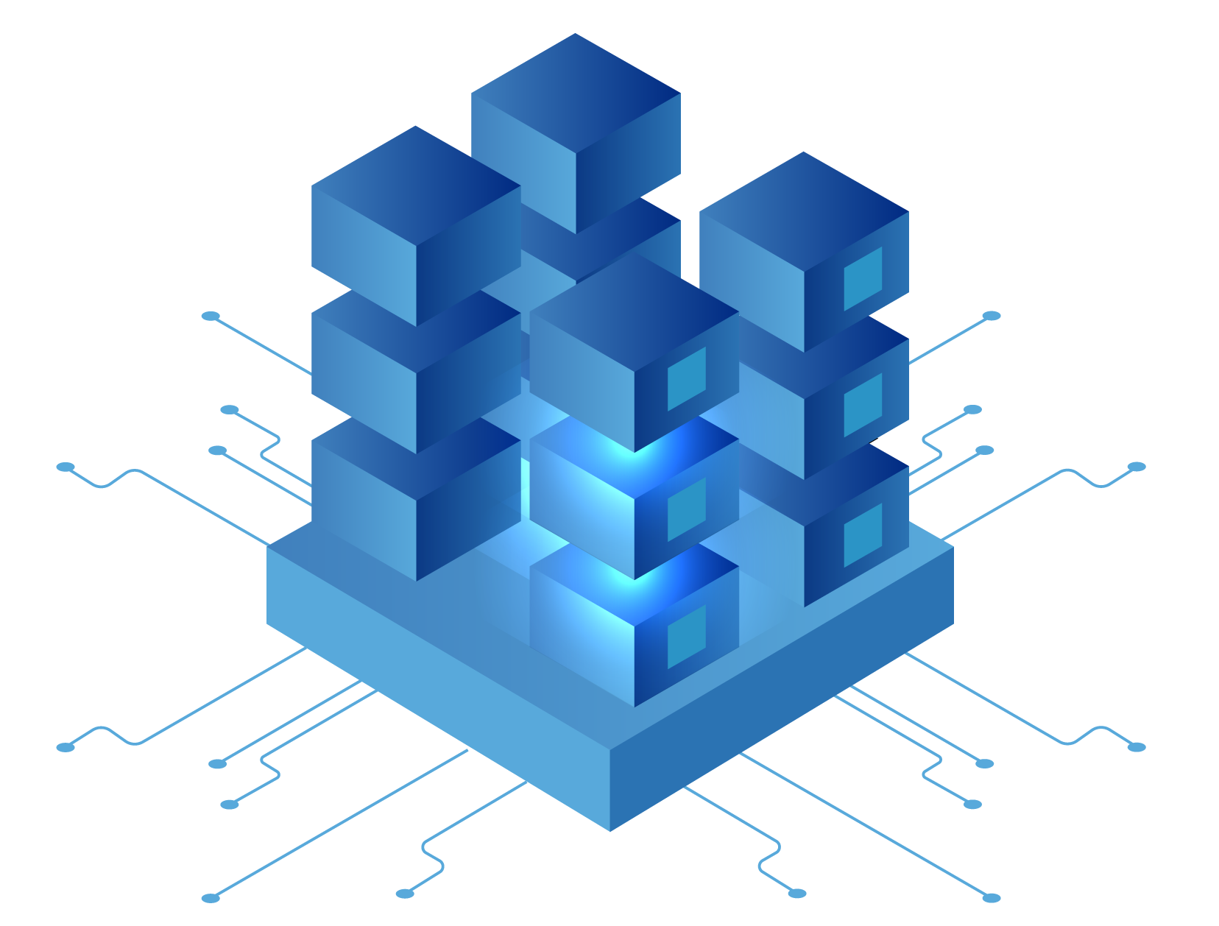
THANK YOU!
Alam, Jhonel
Fabiosa, Lenny
Marin, Manuel
Lasam, Krissa Lynne
BSCS-NS-2AB

Slide 56
REFERENCES
https://www.ibm.com/topics/cloud-computing
https://www.geeksforgeeks.org/cloud-computing/ https://cloud.google.com/learn/what-is-cloud-computing
AI in the cloud (nutanix.com)
What is autonomic computing (AC)?: AI terms explained - AI For Anyone The Role of Cloud Computing in Artificial Intelligence
Building toward more autonomous and proactive cloud technologies with AI
DICT announces cloud first approach for the Philippine government - OpenGov Asia
Government Cloud service launched in Philippines for accelerating online deployment of agencies’ services and data - OpenGov Asia

