Slide 1
WIA 1004 FUNDAMENTALS OF ARTIFICIAL INTELLIGENCE
BY: DR. ERMA RAHAYU MOHD FAIZAL

Slide 2
COURSE PRO FORMA
Please refer to the spectrum

Slide 3
COURSE STRUCTURE
Please refer to the spectrum

Slide 4
COURSE ASSESSMENT
 | CLASS ACTIVITIES | PERCENTAGE
CONTINUOUS ASSESSMENT | Selected Tutorials /Quizzes | 10%
 | Mid-Term Test | 20%
 | Assignment | 20%
FINAL EXAM | - | 50%
TOTAL |  | 100%

Slide 5
ARTIFICIAL INTELLIGENCE

Slide 6
WHAT IS AI?
Artificial Intelligence is the study of the computations that make it possible to perceive, reason and act.
Human imitations – think, act and reasoning up to the level of human thinking
https://goo.gl/sD4ZHP

Slide 7
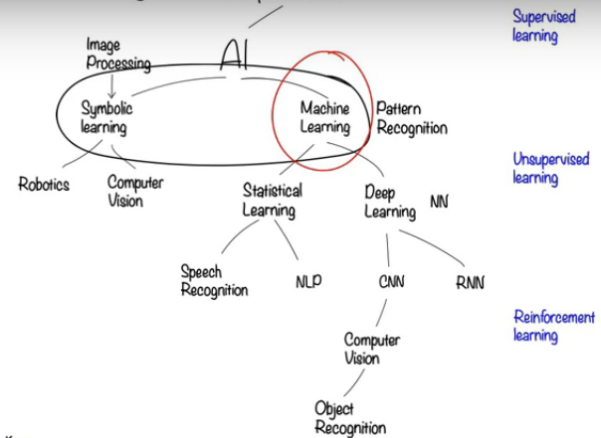
Computer Science
Credit to : Dr. Raj Ramesh (source from youtube)

Slide 8
WHEN DOES AI STARTED?
1943 McCulloch & Pitts: Boolean circuit model of brain
1950 Turing's "Computing Machinery and Intelligence"
1956 Dartmouth meeting: "Artificial Intelligence" adopted
1952—69 Look, Ma, no hands!
1950s Early AI programs, including Samuel's checkers program, Newell & Simon's Logic Theorist, Gelernter's Geometry Engine
1965 Robinson's complete algorithm for logical reasoning
1966—73 AI discovers computational complexity Neural network research almost disappears
1969—79 Early development of knowledge-based systems
1980-- AI becomes an industry
1986-- Neural networks return to popularity
1987-- AI becomes a science
1995-- The emergence of intelligent agents

Slide 9
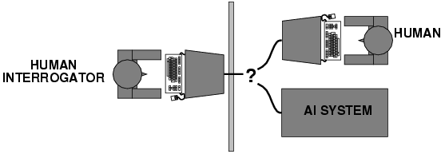
Turing Test
Turing (1950) "Computing machinery and intelligence":
"Can machines think?" → "Can machines behave intelligently?"
Operational test for intelligent behavior: the Imitation Game
Suggested major components of AI:
- knowledge representation
- reasoning,
- language/image understanding,
- learning

Slide 10
WHO STARTED AI?
Already started in 1950’s when Alan Turing invented the Turing test
Newell and Simon created Logic Theorist which consider the first AI program in 1955.
The person who coined the term “ARTIFICIAL INTELLIGENCE” is John McCarthy whom is known as the Father of AI in 1956.
1957, Newell and Simon came out with General Problem Solver as one of the research in AI.
Research in AI is evolving until now.

Slide 11
WHY DO WE NEED AI?
Taking over dangerous and repetitive job
Improvement in our daily life
Less time taken for services at any level of job
Every task is done efficiently
Reduce risk

Slide 12
WHERE DOES AI HEADING TO?

Slide 13
HOW WILL AI AFFECT OUR LIFE?
Everybody will have a virtual assistant, and they're going to be pretty smart
All your voice-based gadgets will work together
Facial recognition will be the new credit card
Everyone around you is going to start to talk about AI
Artificial intelligence will generate media specific to your personal preferences
Artificial intelligence will write news and market reports tailored specifically for you

Slide 14
AI LATEST APPLICATIONS
Transportation
Healthcare
Military
Communication
Education
Home/Service robots
https://goo.gl/2j9GzE
https://goo.gl/tiSKQw

