Slide 1
Intelligent Agents
WIA1004 FUNDAMENTALS OF ARTIFICIAL INTELLIGENCE

Slide 2
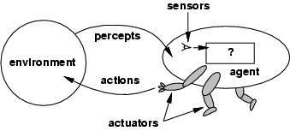
Agents and Environment

Slide 3
Agents and Environment
An agent is anything that can be viewed as perceiving its environment through sensors and acting upon that environment through actuators
Percept – perceptual inputs at any given instant.
Percept sequence – complete history of everything the agent has ever perceived.
Agent function – maps any given percept sequence to an action.

Slide 4
Examples of agent
Human agent:
eyes, ears, and other organs for sensors;
hands, legs, mouth, and other body parts for actuators
Robotic agent:
cameras and infrared range finders for sensors
various motors for actuators
Software agent (Softbot)
Function as sensors
Function as actiuators

Slide 5
agent
Fundamental faculties of intelligence
Sensing
Acting
Understanding, reasoning, learning
In order to act, one must sense.
Blind action is not a characterization of intelligence
Sensing needs understanding to be useful

Slide 6
performance
Behavior and performance of IAs in terms of agent function
Perception history (sequence) to Action Mapping
Ideal Mapping : specifies which actions an agent ought to take at any point of time
Performance measure : a subjective measure to characterize how successful an agent is (e.g. speed, power usage, accuracy, cost, etc.)

Slide 7
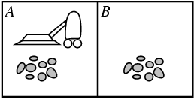
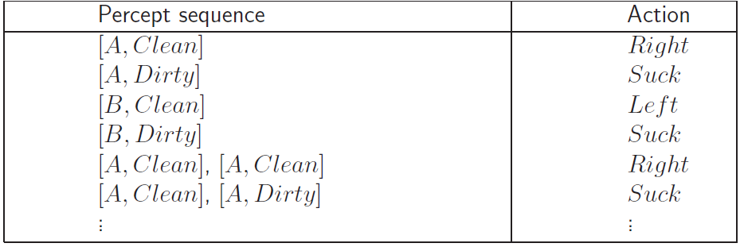
Example
Vacuum cleaner agent
Percepts: location and contents, e.g., [A,Dirty]
Actions: Left, Right, Suck, NoOp
Agent’s function → look-up table
For many agents this is a very large table

Slide 8
The Concept of Rationality
An agent should strive to "do the right thing", based on what it can perceive and the actions it can perform.
The right action is the one that will cause the agent to be most successful.
E.g. Performance measure of a vacuum cleaner agent:
Amount dirt cleaned up, amount time taken, amount of electricity consumed, amount of noise generated, etc.

Slide 9
rationality
Perfect rationality
Assumes that the rational agent knows all and will take action that maximizes the utility
Bounded rationality
Because of the limitations of the human mind, human must use approximate methods to handle many tasks

Slide 10
rationality
Rational action : The action maximizes the expected value of the performance measure given the percept sequence to date
Rational = Best?
Yes, to the best of its knowledge
Rational = optimal?
Yes, to the best of its abilities
And its constraints

Slide 11
Rational Agent
For each possible percept sequence, a rational agent should select an action that is expected to maximize its performance measure, given the evidence provided by the percept sequence and whatever built-in knowledge the agent has.
Rationality
Performance measuring success
Agents prior knowledge of environment
Actions that agent can perform
Agent’s percept sequence to date

Slide 12
rationality
Rational is different from omniscience
Percepts may not supply all relevant information
E.g., in card game, don’t know cards of others.
Rational is different from being perfect
Rationality maximizes expected outcome while perfection maximizes actual outcome.

Slide 13
Omniscience, Learning and Autonomy
Rationality distinct from omniscience (all-knowing with infinite knowledge)
Agent can perform actions in order to modify future percepts so as to obtain useful information (information gathering, exploration)
A rational agent should be autonomous (Its behavior is determined by its own experience with ability to learn and adapt)

Slide 14
PEAS
PEAS : Performance, Environment, Actuators, Sensors.
Specify the setting for intelligent agent design.
E.g. designing an automated taxi driver
Performance measure?
Environment?
Actuators?
Sensors?

Slide 15
PEAS
Agent type | Performance measure | Environment | Actuators | Sensors
Taxi driver | Safe, fast, legal, comfortable trip, maximize profits | Roads, other traffic, pedestrians, customers. | Steering, accelerator, brake, signal, horn, display.. | Cameras, sonar, speedometer, GPS, odometer, accelerometer, engine sensor, keyboard.
Medical diagnosis system | ??? | ??? | ??? | ???
Part-picking robot | ??? | ??? | ??? | ???
Interactive English tutor | ??? | ??? | ??? | ???
Notes:
Agent: Medical diagnosis system
Performance measure: Healthy patient, minimize costs, lawsuits
Environment: Patient, hospital, staff
Actuators: Screen display (questions, tests, diagnoses, treatments, referrals) Sensors: Keyboard (entry of symptoms, findings, patient's answers)
Agent: Part-picking robot
Performance measure: Percentage of parts in correct bins
Environment: Conveyor belt with parts, bins
Actuators: Jointed arm and hand
Sensors: Camera, joint angle sensors
Agent: Interactive English tutor
Performance measure: Maximize student's score on test
Environment: Set of students
Actuators: Screen display (exercises, suggestions, corrections)
Sensors: Keyboard

Slide 16
Environment types
Fully observable (vs. partially observable)
Deterministic (vs. stochastic)
Episodic (vs. sequential)
Static (vs. dynamic)
Discrete (vs. continuous)
Single agent (vs. multi agent)

Slide 17
Fully observable (vs. partially observable)
Is everything an agent requires to choose its actions available to it via its sensors? Perfect or Full information.
If so, the environment is fully accessible
If not, parts of the environment are inaccessible
Agent must make informed guesses about world.
In decision theory: perfect information vs. imperfect information.
An agent's sensors give it access to the complete state of the environment at each point in time.

Slide 18
Environment types
Fully observable (vs. partially observable)
Deterministic (vs. stochastic)
Episodic (vs. sequential)
Static (vs. dynamic)
Discrete (vs. continuous)
Single agent (vs. multi agent)

Slide 19
Deterministic(vs. Stochastic)
Does the change in world state
Depend only on current state and agent’s action?
Non-deterministic environments
Have aspects beyond the control of the agent
Utility functions have to guess at changes in world
The next state of the environment is completely determined by the current state and the action executed by the agent.

Slide 20
Environment types
Fully observable (vs. partially observable)
Deterministic (vs. stochastic)
Episodic (vs. sequential)
Static (vs. dynamic)
Discrete (vs. continuous)
Single agent (vs. multi agent)

Slide 21
Episodic (vs. sequential)
Is the choice of current action dependent on previous actions?
If not, then the environment is episodic
In non-episodic environments:
Agent has to plan ahead:
Current choice will affect future actions
The agent's experience is divided into atomic "episodes" (each episode consists of the agent perceiving and then performing a single action), and the choice of action in each episode depends ONLY on the episode itself.

Slide 22
Environment types
Fully observable (vs. partially observable)
Deterministic (vs. stochastic)
Episodic (vs. sequential)
Static (vs. dynamic)
Discrete (vs. continuous)
Single agent (vs. multi agent)

Slide 23
Static (vs. dynamic)
Static environments don’t change
While the agent is deliberating over what to do
Dynamic environments do change
So agent should/could consult the world when choosing actions
Alternatively: anticipate the change during deliberation OR make decision very fast
Semidynamic: If the environment itself does not change with the passage of time but the agent's performance score does.

Slide 24
Environment types
Fully observable (vs. partially observable)
Deterministic (vs. stochastic)
Episodic (vs. sequential)
Static (vs. dynamic)
Discrete (vs. continuous)
Single agent (vs. multi agent)

Slide 25
Discrete (vs. continuous)
If there are a limited number of distinct states, clearly defined percepts and actions, the environment is discrete
A discrete environment has fixed locations or time intervals.
A continuous environment could be measured quantitatively to any level of precision.

Slide 26
Environment types
Fully observable (vs. partially observable)
Deterministic (vs. stochastic)
Episodic (vs. sequential)
Static (vs. dynamic)
Discrete (vs. continuous)
Single agent (vs. multi agent)

Slide 27
Single agent (vs. multi agent)
An agent operating by itself in an environment or there are many agents working together

Slide 28
Environment types - summary
Task environment | Observable | Deterministic | Episodic | Static | Discrete | Agents
Crossword puzzle | Fully | Deterministic | Sequential | Static | Discrete | Single
Chess | Fully | Strategic | Sequential | Semi | Discrete | Multi
Taxi driving | Partially | Stochastic | Sequential | Dynamic | Continuous | Multi
Medical diagnosis | Partially | Stochastic | Sequential | Dynamic | Continuous | Single

Slide 29
Agent Functions and Program
An agent is completely specified by the agent function mapping percept sequences to actions.
Agent = architecture + program

Slide 30
Example
function REFLEX-VACUUM-AGENT ([location, status]) returns an action
if status=Dirty then return Suck
else if location=A then return Right
Else if location=B then return Left

Slide 31
Agent Types
Four basic kinds of agent program that embody the principles of AI:
Simple reflex agents
Model-based reflex agents
Goal-based agents
Utility-based agents

Slide 32
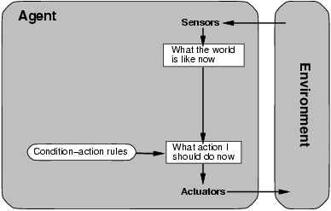
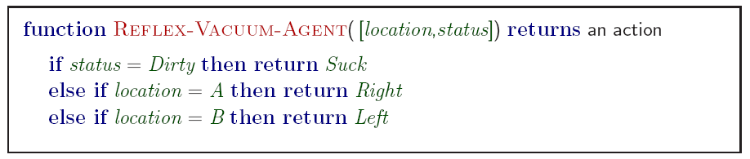
Simple Reflex Agents

Slide 33
Simple Reflex Agents
Simple but very limited intelligence.
Action does not depend on percept history, only on current percept.
Therefore no memory requirements.
Infinite loops
Suppose vacuum cleaner does not observe location. What do you do given location = clean? Left of A or right on B -> infinite loop.
Fly buzzing around window or light.
Possible Solution: Randomize action.
Thermostat.

Slide 34
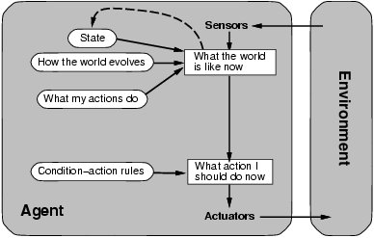
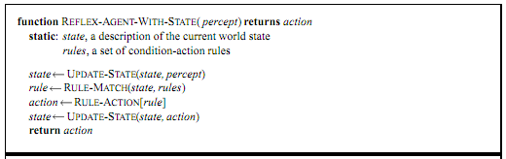
Model-based Reflex Agents

Slide 35
Model-based Reflex Agents
Keep track part that can’t be seen.
Maintain some sort of internal state that depend on the percept history
Know how world evolves
Overtaking car gets closer from behind
How agents actions affect the world
Wheel turned clockwise takes you right

Slide 36
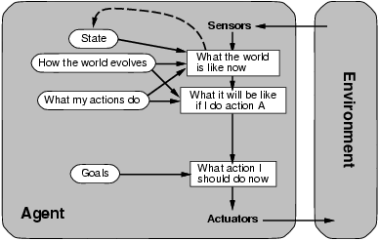
Goal-based Agents
Reflex agent breaks when it sees brake lights. Goal based agent reasons
Brake light -> car in front is stopping -> I should stop -> I should use brake

Slide 37
Goal-based Agents
Knowing state and environment? Enough?
Taxi can go left, right, straight
Have a goal
A destination to get to
Uses knowledge about a goal to guide its actions
E.g., Search, planning
Agents need some sort of goal information that describes situations that are desirable.

Slide 38
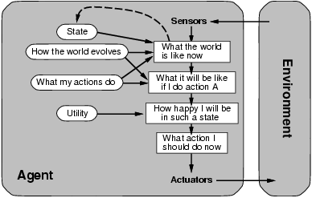
Utility-based Agents

Slide 39
Utility-based Agents
Goals alone are not enough to generate a high-quality behaviour.
A utility function maps a state (or a sequence of states) onto a real number which describes the associated degree of information - “happiness”, “goodness”, “success”.
A complete specification of the utility function allows rational decisions.

Slide 40
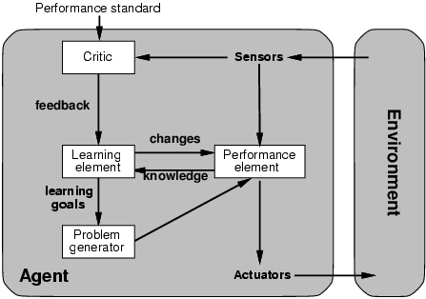
Learning Agents

Slide 41
Learning Agents
Divided into four conceptual components:
Learning element
Responsible for making improvement
Performance element
Responsible for selecting external actions
Critic
Tells the learning element how well the agent is doing with respect to a fixed performance standard
Problem generator
Responsible for suggesting actions that will lead to new and informative experiences.

Slide 42
Learning Agents – e.g. Taxi driver
Performance element
How it currently drives
Taxi driver Makes quick left turn across 3 lanes
Critics observe shocking language by passenger and other drivers and informs bad action
Learning element tries to modify performance elements for future
Problem generator suggests experiment out something called Brakes on different Road conditions
Exploration vs. Exploitation
Learning experience can be costly in the short run
shocking language from other drivers
Less tip
Fewer passengers

