Slide 1
State space search
Searching Strategy I
WIA1004/WAES1102

Slide 2
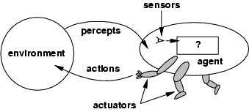
Intelligent Agent

Slide 3
Goal Directed Agent
A goal directed agent needs to achieve certain goals.
Many problems can be represented as a set of STATES and a set of rules of how one state is transformed to another.
The agent must choose a sequence of ACTIONS to achieve the desired goal.

Slide 4
Important Terms
Initial state : The description of the starting configuration of the agent
Action/Operator : Takes the agent from one state to another state.
Plan : A sequence of actions need to be taken
Goal : a description of a set of desirable states of the world. Goal states are often specified by a goal test which any goal state must satisfy.
Path cost : path -> positive number
Usually path cost=sum of step costs

Slide 5
Important Terms
Problem formulation means choosing a relevant set of states to consider, and a feasible set of operators for moving from one state to another.
Search is the process of imagining sequences of operators applied to the initial state, and checking which sequence reaches a goal state.

Slide 6
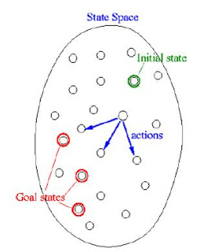
Search Problem
S : the full set of states
s_{o} : the initial state
A : S →S set of operators
G : the set of final states
Search Problem :
Find a sequence of actions which transform the agent from the initial state to a goal state

Slide 7
Search Problem
The search problem consists of finding a solution plan, which is a path from the current state to the goal state.
Representing search problem
A search problem is represented using a directed graph.
The states are represented as nodes
The allowed actions are represented as arcs

Slide 8
Searching Process
Check the current state
Execute allowable actions to move to the next state
Check if the new state is the solution state
If it is not, the new state becomes the current state and the process is repeated until the solution is found or the state space is ‘exhausted’.

Slide 9
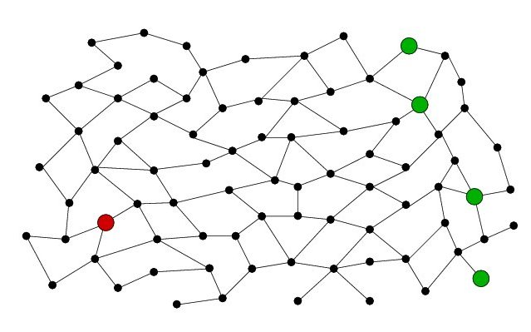
State Space
Goal States
Initial States

Slide 10
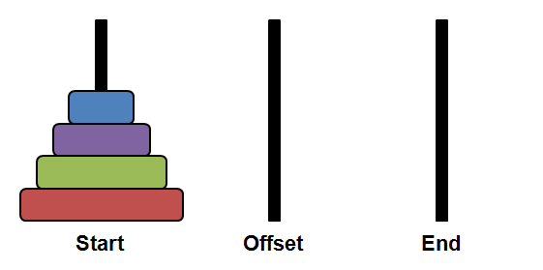
Tower of Hanoi Problem
Your task is to move the tower from the left peg to the right peg, moving only one disk at a time and never putting a larger disk on a smaller one.
Initial State

Slide 11
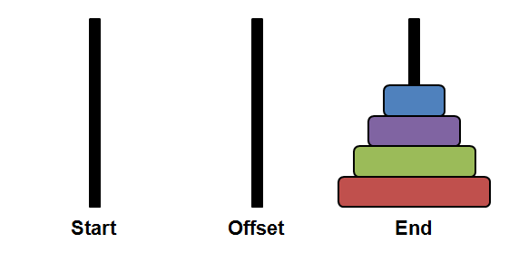
Solution?
Goal State

Slide 12
Explicit Vs. Implicit State Space
The state space may be explicitly represented.
Typically it is implicitly represented and generated when required.
The agent knows
The initial state
The operators
An operator is a function which “expands” a node
Compute the successor node(s)

Slide 13
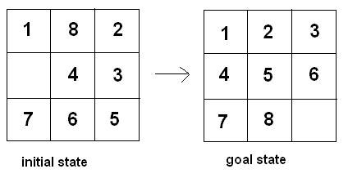
Problem Definition – Example of 8 Puzzle

Slide 14
Problem Definition
States
A description of each of the eight tiles in each location that it can occupy
Operators/Actions
The blank moves left, right, up or down
Goal Test
The current state matches a certain state
Path Cost
Each move of the blank costs 1

Slide 15
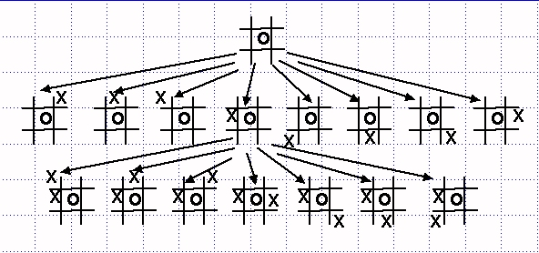
Problem Definition – Example tic-tac-toe Game

Slide 16
Search Through A State Space
Input
Set of states
Operators and costs
Start state
Goal state
Output
Path : start →a state satisfying goal test
May require shortest path

Slide 17
Basic Search Algorithm
Let L be a list containing the initial state (L= the fringe)
Loop
if L is empty return failure
Node ← select (L)
if Node is a Goal
then return Node //the path from initial state to Node
else
apply all applicable operators to Node
and
merge the newly generated state into L

Slide 18
Basic Search Algorithm : Key Issues
Search tree may be unbounded
Because of loops
Because of state space is infinite
Return a path or a node?
How are merge and select done?
Is the graph weighted or unweighted?
How much is known about the quality of intermediate states?
Is the aim to find a minimal cost path or any path as soon as possible?

Slide 19
Search Strategy
Measuring problem solving performance
COMPLETENESS – is the strategy guaranteed to find the solution if one exists?
OPTIMALITY – does the solution have low cost or the minimal cost?
What is the search cost associated with the time and memory required to find a solution?

Slide 20
Uninformed Search / Blind Search
WIA1004 / WAES1102

Slide 21
Uninformed Search Strategies
2 main techniques used:
Breadth First Search (BFS)
Depth First Search (DFS)

Slide 22
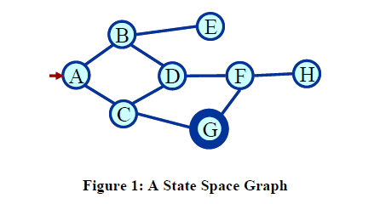
Find a path
Shortest path ?
Any path ?
Blind search
BFS
DFS

Slide 23
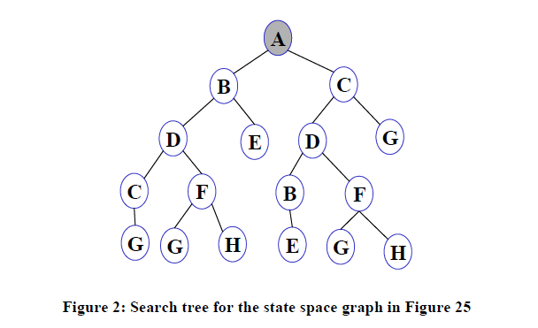
Search Tree
List all possible paths
Eliminate cycle from paths
Result: A search tree

Slide 24
Search Tree - Terminology
Root node
Leaf node
Ancestor/descendant
Branching factor
Complete path/Partial path
Expanding open nodes results in close nodes

Slide 25
Basic Search Algorithm
Let fringe be a list containing the initial state
Loop
if fringe is empty return failure
Node remove-first (fringe)
if Node is a goal
then return the path from initial state to Node
else generate all successors of Node
merge the newly generated nodes into fringe
End loop

Slide 26
Evaluating Search Strategies
Measuring problem solving performance:
Completeness – is the strategy guaranteed to find a solution if one exists?
Optimality – does the solution require low cost or the minimal cost?
Time complexity – time taken (number of nodes expanded) (worst or average case) to find a solution.
Space complexity – space used by the algorithm measured in terms of the maximum size of fringe

Slide 27
Breadth First Search
Let fringe be a list containing the initial state
Loop
if fringe is empty return failure
Node remove-first (fringe)
if Node is a goal
then return the path from initial state to Node
else generate all successors of Node
%% Expand shallowest node first
add generated nodes to the back of fringe
End loop

Slide 28
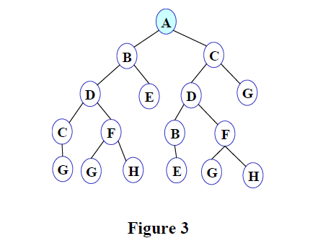
BFS Illustration
F
FRINGE: A

Slide 29
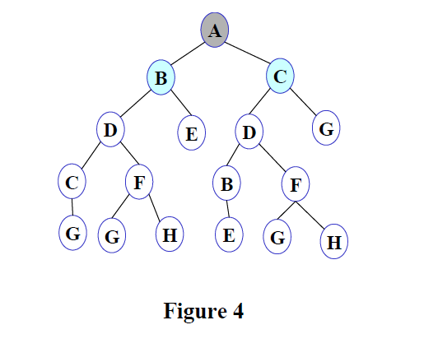
F
FRINGE: B C

Slide 30
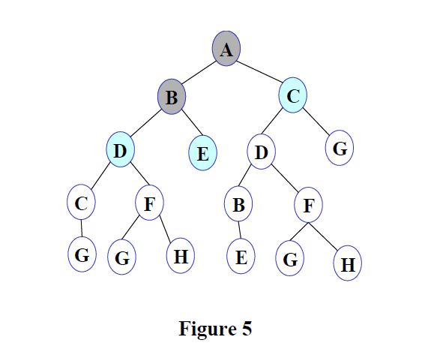
F
FRINGE: C D E

Slide 31
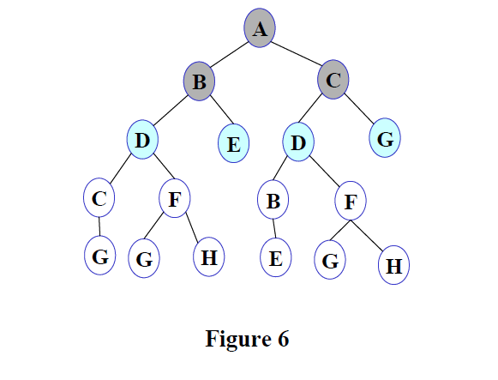
F
FRINGE: D E D G

Slide 32
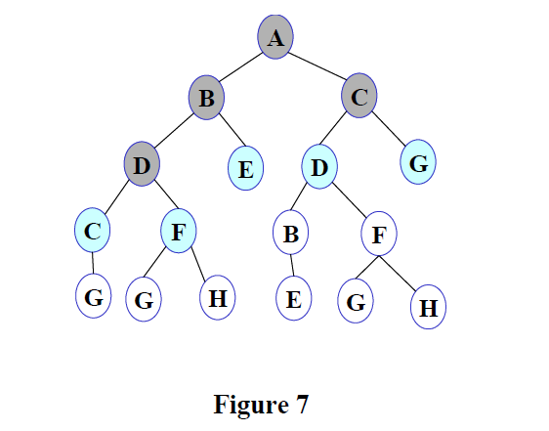
F
FRINGE: E D G C F

Slide 33
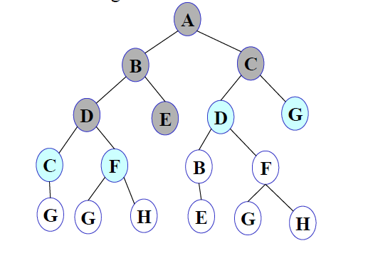
F
FRINGE: D G C F

Slide 34
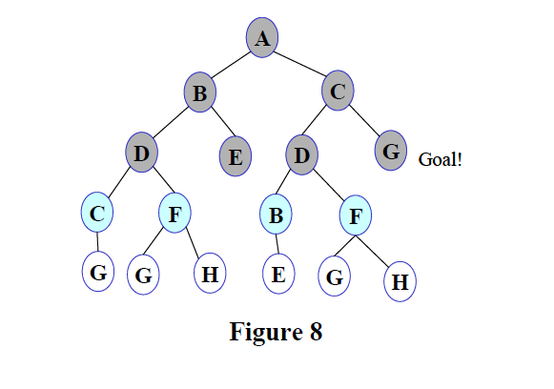
F
FRINGE: G C F B F

Slide 35
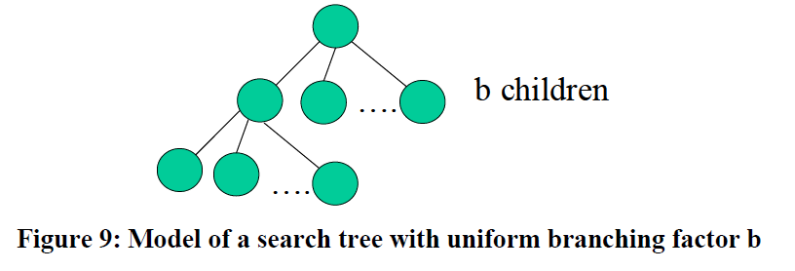
Model of Search Tree
d: depth of the shallowest goal node
m: maximum depth of the search tree

Slide 36
Breadth First
Breadth first search is:
FIFO order.
Complete.
The algorithm is optimal (i.e. admissible) if all operators have the same cost. Otherwise, finds a solution with the shortest path length.
Exponential time and space complexity, O(b^{d}), where d is the depth of the solution and b is the branching factor (i.e. number of children) at each node

Slide 37
Breadth First
A complete search tree of depth d where each non-leaf node has b children, has a total of
1+b+b²+…+b^{d} = (b^{(d+1)}-1)/(b-1) nodes
For a complete search tree of depth 12, where every node at depths 0, 1, …, 11 has 10 children and every node at depth 12 has 0 children, there are O(10¹²) nodes in the complete search tree. If BFS expands 1000 nodes/sec and each node uses 100 bytes of storage, then BFS will take 35 years to run in the worst case, and it will use 111 terabytes of memory.
Not effective unless the search space is small.

Slide 38
Breadth First
Advantage
Finds the path of minimal length to the goal.
Disadvantage
Requires the generation and storage of a tree whose size is exponential the depth of the shallowest goal node.

Slide 39
Depth First Search
Let fringe be a list containing the initial state
Loop
if fringe is empty return failure
Node remove-first (fringe)
if Node is a goal
then return the path from initial state to Node
else
generate all successors of Node, %% Expand deepest node first
add generated nodes to the front of fringe
End loop

Slide 40
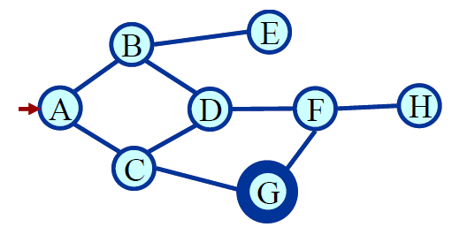
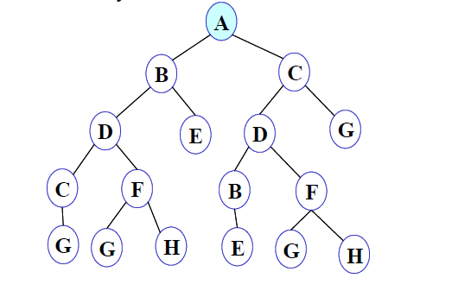
DFS Illustration
F
Figure 10
FRINGE: A

Slide 41
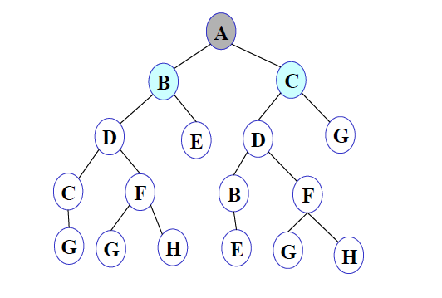
F
Figure 11
FRINGE: B C

Slide 42
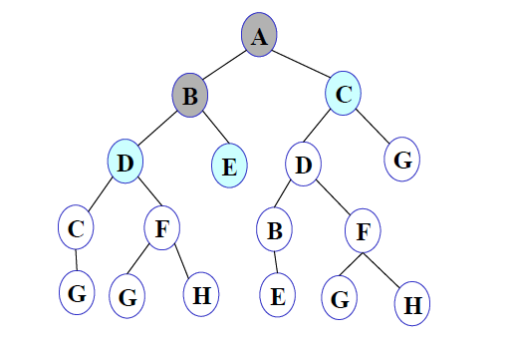
F
Figure 12
FRINGE: D E C

Slide 43
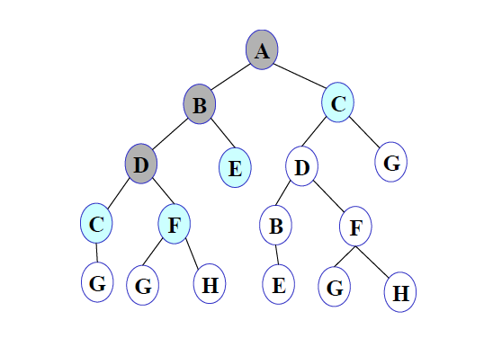
F
Figure 13
FRINGE: C F E C

Slide 44
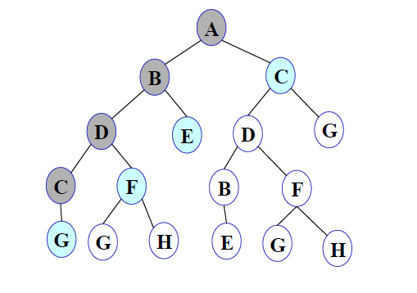
F
Figure 14
FRINGE: G F E C

Slide 45
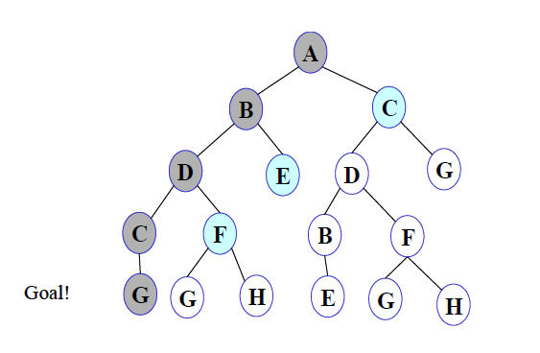
F
Figure 15
FRINGE: G F E C

Slide 46
DFS
LIFO order (use a stack).
Takes exponential time, O(b^{d}), but only linear space O(bN).
May not terminate without a “depth-bound” (depth limited search).
Not complete.

Slide 47
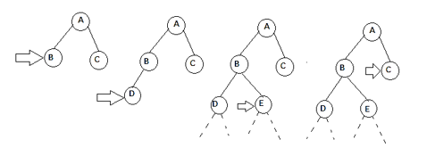
DEPTH LIMITED SEARCH (DLS)
To avoid the infinite loop condition arising in DFS
Define a predetermined depth limit (if n=2, DLS carries out depth first search till second level in the search tree)
Depth-limited search can terminate with two conditions:
If the solution is found.
If there is no solution within given depth limit.

Slide 48
DLS ALGORITHM
Determine the start node and the search depth.
Check if the current node is the goal node.
If not: Do nothing
If yes:return
Check if the current node is within the specified search depth
If not: Do nothing
If yes:Expand the node and save all of its successors in a stack.
Call DLS recursively for all nodes of the stack and go back to step 2.

Slide 49
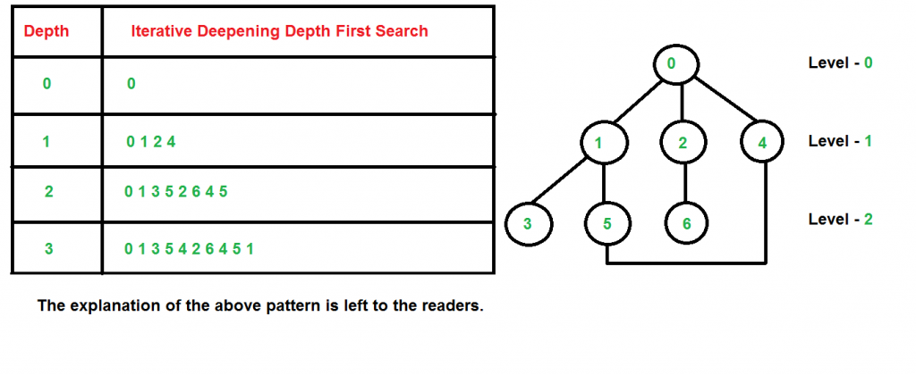
ITERATIVE DEEPENING SEARCH (ids)
Also known as Iterative Deepening Depth First Search (IDDFS)
Combines depth-first search’s space-efficiency and breadth-first search’s fast search (for nodes closer to root)
IDS calls DFS for different depths starting from an initial value. In every call, DFS is restricted from going beyond given depth. So basically we do DFS in a BFS fashion

Slide 50
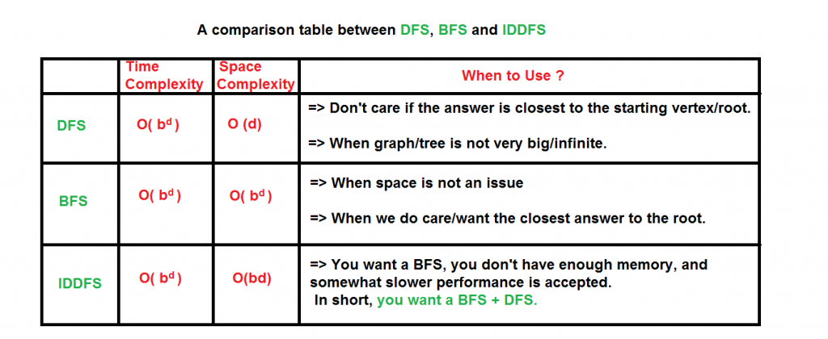
Comparison of performance

Slide 51
Formalizing search in a state space
A state space is a graph (V, E).
V is a set of nodes
E is a set or arcs
Each arc has a fixed, positive cost.
Each node is a data structure
A state description
The parent of the node
Depth of the node
The operator that generated this node
Cost of this path (sum of operator costs).

Slide 52
Some issue…
Search process constructs a search tree, where
Root is the initial state
Leaf nodes are nodes
Not yet expanded (i.e., in fringe)
Having no successors (i.e., dead ends)
Search tree may be infinite because of loops even if state space is small
Return a path or a node depending on problem

