Slide 1
Searching strategy II Informed search
WIA1004 / WAES1102

Slide 2
Outline
Heuristics function
Best-first search
Greedy best-first search
A* search
Game Search
MiniMax
Alpa-beta

Slide 3
Search algorithms
Which is the better search?
Are these search methods intelligent?
What is an intelligent search?

Slide 4
Intelligent Search
Example: I need to go to B from A and I know B is west of A
?
B
?
A
Which of the 3 paths should I take?
Travel west
?

Slide 5
Intelligent Search
But what happens when the actual scenario is:
?
B
?
A
?

Slide 6
Heuristic Search
Intelligent search uses heuristics to avoid searching everywhere
Intelligent search does not guarantee finding a solution i.e. you could get stuck
Many intelligent search (such as A*, alpha-beta pruning, etc.) have been developed by AI researchers

Slide 7
Need to improve blind search
We always use some kind of information / strategies to help in doing decision making. (we hardly do blind search)
Any kinds of “rules of thumb” that can help reach our goal = heuristic function h(n).
Aims: to avoid exponential search & loop. (i.e. to get solutions in more effective & efficient manner)

Slide 8
Choosing a Good Heuristic
For a given problem, there might be many different heuristics one can choose.
However, some heuristics are better than others.
We say the heuristic is better if it needs few nodes to examine in the search tree.
We also call this kinds of heuristics are better informed.

Slide 9
Best-first search
Remember Breadth First Search & Depth first search? Idea: Combine both advantages…
Use an evaluation function f(n) for each node
f(n) provides an estimate for the total cost.
Expand the node n with smallest f(n).
Implementation:
Order the nodes in fringe increasing order of cost.
Special cases strategy:
Greedy best-first search
A* search

Slide 10
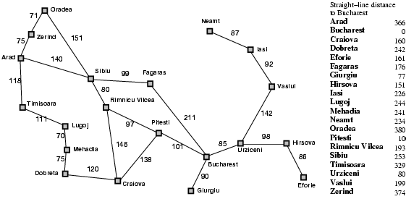
Eg: Romania with straight-line dist. (sld)

Slide 11
Greedy best-first search
f(n) = estimate of cost from n to goal
e.g., f(n) = straight-line distance from n to Bucharest
Greedy best-first search expands the node that appears to be closest to goal.
Eg., Try to find the path between Arad to Bucharest ?

Slide 12

Greedy best-first search example

Slide 13
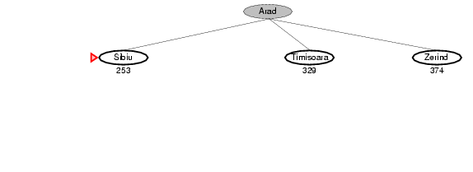
Greedy best-first search example

Slide 14
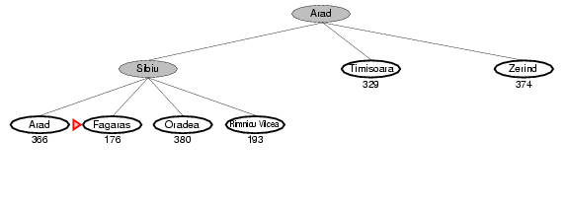
Greedy best-first search example

Slide 15
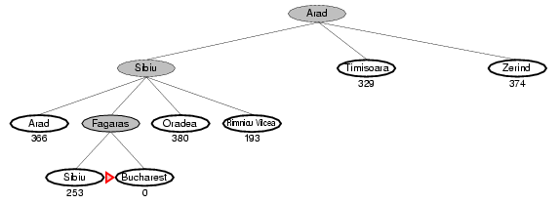
Greedy best-first search example

Slide 16
Properties of greedy best-first search
Complete? No – can get stuck in loops.
Time? O(b^{m}), but a good heuristic can give dramatic improvement
Space? O(b^{m}) - keeps all nodes in memory
Optimal? No
e.g. Arad→Sibiu→Rimnicu Virea→Pitesti→Bucharest is shorter!

Slide 17
A* search
Idea: avoid expanding paths that are already expensive
Evaluation function f(n) = g(n) + h(n)
g(n) = cost so far to reach n
h(n) = estimated cost from n to goal
f(n) = estimated total cost of path through n to goal
Best First search has f(n)=h(n)

Slide 18
Admissible heuristics
A heuristic h(n) is admissible if for every node n,
h(n) ≤ h*(n), where h*(n) is the true cost to reach the goal state from n.
An admissible heuristic never overestimates the cost to reach the goal, i.e., it is optimistic
Example: h_{SLD}(n) (never overestimates the actual road distance)
Theorem: If h(n) is admissible, A* using TREE-SEARCH is optimal

Slide 19

A* search example

Slide 20
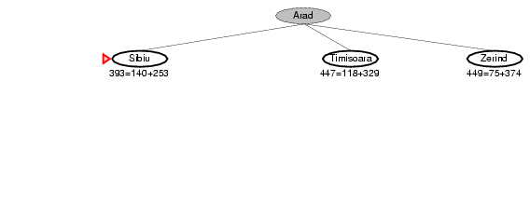
A* search example

Slide 21
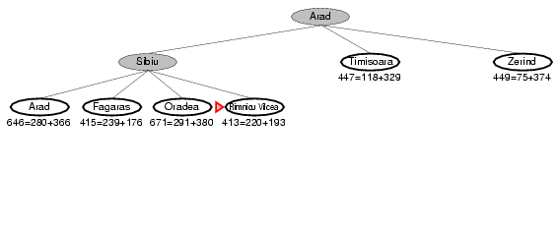
A* search example

Slide 22
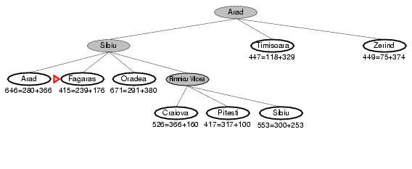
A* search example

Slide 23
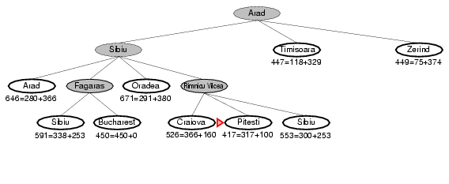
A* search example

Slide 24
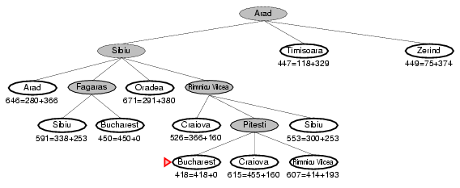
A* search example

Slide 25
Properties of A*
Complete? Yes (unless there are infinitely many nodes with f ≤ f(G) , i.e. step-cost > ε)
Time/Space? Exponential
except if:
Optimal? Yes
Optimally Efficient: Yes (no algorithm with the
same heuristic is guaranteed to expand fewer nodes)

Slide 26
Heuristic Search
Intelligent search uses heuristics to avoid searching everywhere
Intelligent search does not guarantee finding a solution i.e. you could get stuck
Many intelligent search (such as A*, alpha-beta pruning, etc.) have been developed by AI researchers

Slide 27
Heuristic Search – 2-person game
What is the difference between searching for the right move in a 2-person game and searching for an answer in a puzzle?
Original board situation
New situation caused by your action
New situation caused by your opponent action

Slide 28
Heuristic Search – 2-person game
Basic Steps: You look ahead n steps (or ply or levels), you calculate the goodness of each end step:
Which path do you go?
3
9
2
10

Slide 29
Heuristic Search – 2-person game
Basic Steps: You look ahead n steps (or ply or levels), you calculate the goodness of each end step:
No we can’t go down the rightmost path! Why?
3
9
2
10

Slide 30
Minimax algorithm
Basic Steps: You look ahead n steps (or ply or levels), you calculate the goodness of each end step as follows:
Maximum value
Minimum value
3
9
2
10

Slide 31
Minimax algorithm
What problems does one face with the minimax algorithm?
Maximum value
Minimum value
3
9
2
10

Slide 32
Minimax algorithm
Answer: You have to generate all the siblings up to the nth level before you know which is the best move!
Maximum value
Minimum value
3
9
2
10

Slide 33
Minimax algorithm
Can we have a smarter algorithm?
Maximum value
Minimum value
3
9
2
10

Slide 34
Minimax algorithm
Consider generating the first few nodes using a depth first search:
Max
Min
?
Max
3
What do I now know about this part of the search?
Min
2
3

Slide 35
Minimax algorithm
Consider generating the first few nodes using a depth first search:
Max
Min
?
Max
3
Answer: If this part is to change anything at all, it must compute a value < 3. Why?
Min
2
3

Slide 36
Minimax algorithm
Continue expanding the tree:
Max
Min
?
Reminder: If this part is to change anything at all, it must compute a value < 3.
??
Max
3
Min
2
3
5
What can we conclude now?

Slide 37
Minimax algorithm
Continue expanding the tree:
Max
Min
?
??
Max
3
Min
2
3
5
Answer: We can stop generating further along this branch!

Slide 38
Minimax algorithm
Continue expanding the tree:
Max
? <= 3
Min
?? >= 5
Max
3
Min
2
3
5
This branch is pruned

Slide 39
Minimax algorithm
Continue expanding the tree:
Max
? <= 3
Min
?? >= 5
2
What can be said here?
Max
3
2
Min
2
3
5
This branch is pruned

Slide 40
Minimax algorithm
Continue expanding the tree:
First, what constraints can we put here?
Max
? <= 3
Min
?? >= 5
What can be said here?
Max
3
2
Min
2
3
5
2
This branch is pruned

Slide 41
Minimax algorithm
Continue expanding the tree:
Max
? <= 3
? <= 2
Min
?? >= 5
2
What can be said here now?
Max
3
2
Min
2
3
5
This branch is pruned
Nothing yet!

Slide 42
Minimax algorithm
Continue expanding the tree:
Can we put some constraints here?
Max
? <= 3
? <= 2
Min
?? >= 5
2
What can be said here?
Max
3
2
Min
2
3
5
This branch is pruned

Slide 43
Minimax algorithm
Continue expanding the tree:
?? >= 3
Max
? <= 3
? <= 2
Min
?? >= 5
2
Max
3
So what can we conclude here now?
2
Min
2
3
5
This branch is pruned

Slide 44
Minimax algorithm
Continue expanding the tree:
?? >= 3
Max
? <= 3
? <= 2
Min
?? >= 5
2
Max
3
This branch can also be pruned
2
Min
2
3
5
This branch is pruned

Slide 45
α-β algorithm
Such a smart minimax algorithm is referred to as the α-β algorithm. This is because it uses the variables, α-β, to control the pruning.
α >= 3
α
β <= 3
β <= 2
β
α >= 5
2
α pruned
α
3
2
β
2
3
5
β pruned

