Slide 1
NATURAL LANGUAGE PROCESSING (NLP) WIA1004

Slide 2
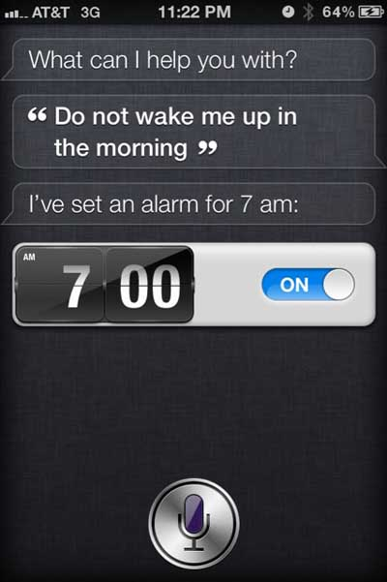
Scene 1

Slide 3
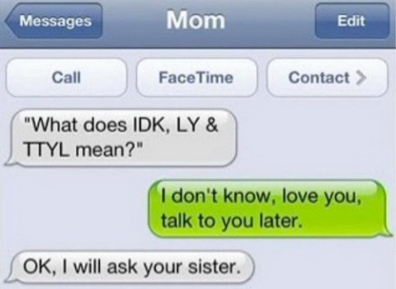
Scene 2

Slide 4
Scene 3
John saw the man on the mountain with a telescope.
Who has the telescope? John, the man on the mountain, or the mountain?

Slide 5
Perspective NLP: Areas of AI and their inter-dependencies
Knowledge Representation
Search
Logic
Machine Learning
Planning
Expert Systems
NLP
Vision
Robotics
AI is the forcing function for Computer Science

Slide 6
WHAT IS NLP?
Branch of AI
2 Goals
Science Goal: Understand the way language operates
Engineering Goal: Build systems that analyse and generate language; reduce the man machine gap

Slide 7
WHERE DOES IT FIT IN THE CS TAXONOMY?
Computers
Databases
Artificial Intelligence
Algorithms
Networking
Robotics
Natural Language Processing
Search
Information
Retrieval
Machine
Translation
Language
Analysis
Semantics
Parsing

Slide 8
THE FAMOUS TURING TEST: LANGUAGE BASED INTERACTION
Test conductor
Machine
Human
Can the test conductor find out which is machine and which is human

Slide 9
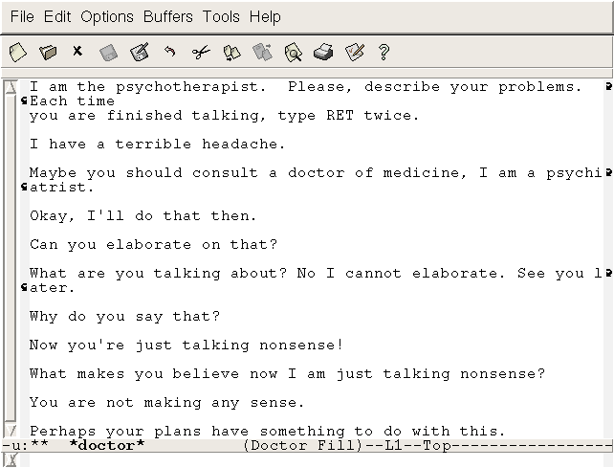
INSPIRED ELIZA (another sample interaction)

Slide 10
Early days..
How to measure Intelligence of a Machine?
Turing test – Alan Turing (1950)
A machine can be accepted to be intelligent if it can fool a judge that its human over a tele-typing exercise.
ELIZA by Weizenbaum (1966)
Pretends to be a psychiatrist and converses with a user on his problems.
Uses Keyword pattern matching
Many users thought the machine really understood their problem.
Many such systems exist now. E.g. Alan, Alice, David
Can such tests be taken as a measure for Intelligence ? Debate goes on..

Slide 11
Levels of NLP
Levels of NLP
Phonology
Lexical Analysis
Syntax
Semantic
Discourse
Pragmatic
Morphology
Pronunciation of words
Formation of words
Formation of words
Structure of sentences
Meaning of sentences
Interpretation of
sentences
Interpretation of
the whole text

Slide 12
PHONETICS / PHONOLOGY
Speech processing
Humans process speech remarkably well.
Speech interface can replace keyboards and monitors.
Convert Acoustic signals to Text.
Phonemes are the smallest recognizable speech unit in a language.
Graphemes are the textual representation.
Phonemes can be identified using their phonetic & spectral features.

Slide 13
Speech – So is it difficult ?
“It's very hard to wreck a nice beach ”
Pronunciation of different speakers
Pace of speech
Speech ambiguity – Homonyms
I ate eight cakes
That band is banned
I went to the mall near by to buy some food
The Finnish were the first ones to finish
I know no James Bond.

Slide 14
MORPHOLOGY
Word formation rules from root words
Nouns: Plural (boy-boys); Gender marking (czar-czarina)
Verbs: Tense (stretch-stretched); Aspect (e.g. perfective sit-had sat); Modality (e.g. request khaanaa→ khaaiie)
First crucial first step in NLP
Languages rich in morphology: e.g., Dravidian, Hungarian, Turkish
Languages poor in morphology: Chinese, English
Languages with rich morphology have the advantage of easier processing at higher stages of processing
A task of interest to computer science: Finite State Machines for Word Morphology

Slide 15
LEXICAL ANALYSIS
Essentially refers to dictionary access and obtaining the properties of the word
e.g. dog
noun (lexical property)
take-’s’-in-plural (morph property)
animate (semantic property)
4-legged (-do-)
carnivore (-do)
Challenge: Lexical or word sense disambiguation

Slide 16
LEXICAL DISAMBIGUATION
First step: part of Speech Disambiguation
Dog as a noun (animal)
Dog as a verb (to pursue)
Sense Disambiguation
Dog (as animal)
Dog (as a very detestable person)
Needs word relationships in a context
The chair emphasised the need for adult education
Very common in day to day communications
Satellite Channel Ad: Watch what you want, when you want (two senses of watch)
e.g., Ground breaking ceremony/research

Slide 17
NEW TERMS, ADDITIONAL MEANINGS/NUANCES FOR EXISTING TERMS
Justify as in justify the right margin (word processing context)
Xeroxed: a new verb
Digital Trace: a new expression
Communifaking: pretending to talk on mobile when you are actually not
Discomgooglation: anxiety/discomfort at not being able to access internet
Helicopter Parenting: over parenting

Slide 18
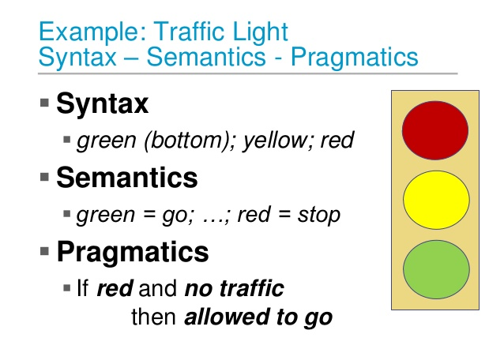
SYNTAX VS SEMANTICS VS PRAGMATICS

Slide 19
Syntax
Words convey meaning. But when they are put together they convey more.
Syntax is the grammatical structure of the sentence. Just like the syntax in programming languages.
structures and patterns in phrases
how phrases are formed by smaller phrases and words
Identifying the structure is the first step towards understanding the meaning of the sentence.
Syntactic Analysis (Parsing) = Process of assigning a parse tree to a sentence.

Slide 20
SYNTAX PROCESSING STAGE
Structure Detection
S
VP
NP
V
NP
I
like
mangoes

Slide 21
CHALLENGES IN SYNTACTIC PROCESSING: STRUCTURAL AMBIGUITY
Scope
1.The old men and women were taken to safe locations
(old men and women) vs. ((old men) and women)
2. No smoking areas will allow Hookas inside
Preposition Phrase Attachment
I saw the boy with a telescope
(who has the telescope?)
I saw the mountain with a telescope
(world knowledge: mountain cannot be an instrument of seeing)

Slide 22
HIGHER LEVEL KNOWLEDGE NEEDED FOR DISAMBIGUATION
Semantics
I saw the boy with a pony tail (pony tail cannot be an instrument of seeing)
Pragmatics
((old men) and women) as opposed to (old men and women) in “Old men and women were taken to safe location”, since women- both and young and old- were very likely taken to safe locations
Discourse:
No smoking areas allow hookas inside, except the one in Hotel Grand.
No smoking areas allow hookas inside, but not cigars.

Slide 23
SEMANTİCS
What do you mean..?
Words – Lexical Semantics
Sentences – Compositional Semantics
Converting the syntactic structures to semantic format – meaning representation.
Semantics: the meaning of a word or phrase within a sentence.

Slide 24
SEMANTIC ANALYSIS
Representation in terms of
Predicate calculus/Semantic Nets/Frames/Conceptual Dependencies and Scripts
John gave a book to Mary
Action: Give
Agent: John,
Object: Book,
Recipient: Mary

Slide 25
PRAGMATİCS
Pragmatics: structures and patterns in discourses.
Sentence standing alone may not mean so much. It may be ambiguous.
What information is contained in the contextual sentences that is not conveyed in the actual sentence?
Discourse / Context makes utterances more complicated.
Implicatures:
How many times do you go skating each week?
Speech acts:
Do you know the time?
Anaphora – Resolving the pronoun’s reference. Co-reference resolution
“I read the book by Dr. Kalam. It was great”
“We gave the monkeys the bananas because they were hungry”
Jane races Mary on weekends. She often beats her.

Slide 26
DISCOURSE
Processing of sequence of sentences
Mother to John:
John go to school. It is open today. Should you bunk? Father will be very angry.
Ambiguity of open
bunk what?
Why will the father be angry?
Complex chain of reasoning and application of world knowledge
Ambiguity of father
father as parent
or
father as headmaster

Slide 27
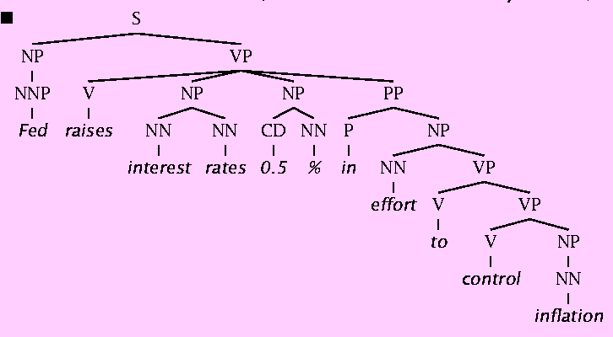
Why is Natural Language Understanding difficult?
The hidden structure of language is highly ambiguous
Structures for: Fed raises interest rates 0.5% in effort to control inflation (NYT headline 5/17/00)

Slide 28
Challenges in NLP: Ambiguity
Words or phrases can often be understood in multiple ways.
Teacher Strikes Idle Kids
Killer Sentenced to Die for Second Time in 10 Years
They denied the petition for his release that was signed by over 10,000 people.
child abuse expert/child computer expert

Slide 29
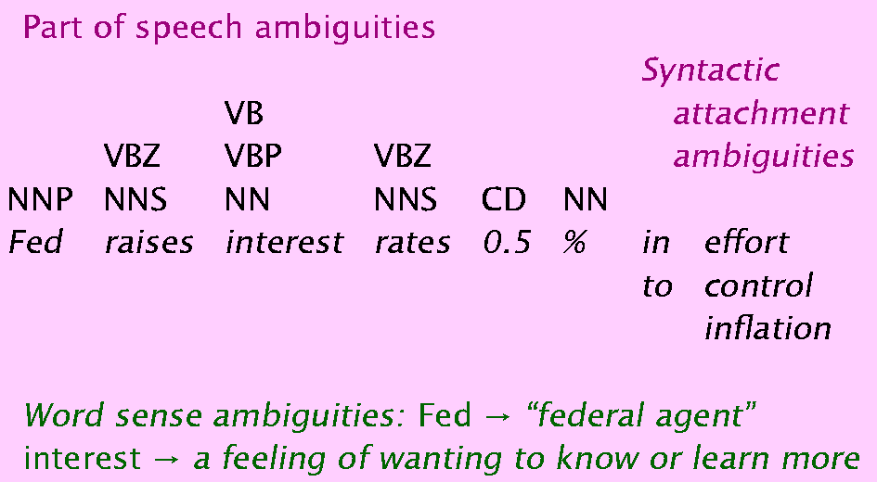
Where are the ambiguities?

Slide 30
Probabilistic/Statistical Resolution of Ambiguities
When there are ambiguities, choose the interpretation with the highest probability.
Example: how many times peoples say
“Mary loves …”
“the Mary love”
Which interpretation has the highest probability?

Slide 31
Parsing
Analyze the structure of a sentence
S
NP
VP
PP
NP
NP
D
N
V
D
N
P
D
N
The student put the book on the table

Slide 32
S
S
VP
VP
NP
NP
NP
NP
N
N
V
N
N
V
A
N
Teacher strikes idle kids
Teacher strikes idle kids

Slide 33
Enabling Technologies
Stemming
Reduce detects, detected, detecting, detect, to the same form.
POS Tagging
Determine for each word whether it is a noun, adjective, verb, …..
Parsing
sentence ⇒ parse tree
Word Sense Disambiguation
orange juice vs. orange coat
Learning from text

Slide 34
NLP Applications
Question answering
Who is the first Taiwanese president?
Text Categorization/Routing
e.g., customer e-mails.
Text Mining
e.g., find everything that interacts with X subject.
Machine (Assisted) Translation
Spelling correction
Is that just dictionary lookup?

Slide 35
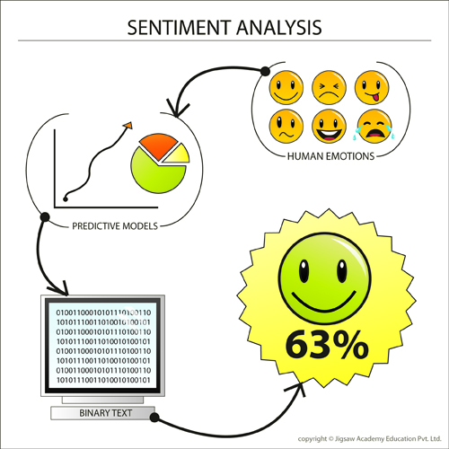
Sentiment Analysis
Sentiment is the attitude, opinion or feeling toward something, such as a person, organization, product or location.
Sentiment analysis provides easy-to-use mechanisms to identify the positive or negative sentiment within any document or webpage.
Demo: Sentiment140

Slide 36
Application areas
Text-to-Speech & Speech recognition
Information Retrieval
Information Extraction
Document Classification
Document Image Analysis
Automatic Summarization
Text Proofreading – Spelling & Grammar
Story understanding systems
Plagiarism detection
Can u think of anything else ??

Slide 37
Conclusion
Complete human-level natural language understanding is still a distant goal
But there are now practical and usable partial NLU systems applicable to many problems
An important design decision is in finding an appropriate match between (parts of) the application domain and the available methods
But, used with care, statistical NLP methods have opened up new possibilities for high performance text understanding systems.

