Slide 1

Serverless – The End
Function-as-a-Service
If Amazon says it safe to use serverless, it is safe to use serverless!

Slide 2


Synchroon (API Gateway)
/helloworld
Amazon API Gateway
AWS Lambda

Slide 3

Asynchroon (event)
Event Payload
Amazon Simple Storage Service
AWS Lambda

Slide 4

Stream-Based (DynamoDB)
(Batched) changes
Amazon Simple Storage Service
AWS Lambda

Slide 5
Lambda Event Sources
Amazon S3
Amazon DynamoDB
Amazon Kinesis Data Streams
Amazon Simple Notification Service
Amazon Simple Email Service
Amazon Simple Queue Service
Amazon Cognito
AWS CloudFormation
Amazon CloudWatch Logs
Amazon CloudWatch Events
AWS CodeCommit
Scheduled Events (powered by Amazon CloudWatch Events)
AWS Config
Amazon Alexa
Amazon Lex
Amazon API Gateway
AWS IoT Button
Amazon CloudFront
Amazon Kinesis Data Firehose
Other Event Sources: Invoking a Lambda Function On Demand
Sample Events Published by Event Sources
https://docs.aws.amazon.com/lambda/latest/dg/invoking-lambda-function.html

Slide 6
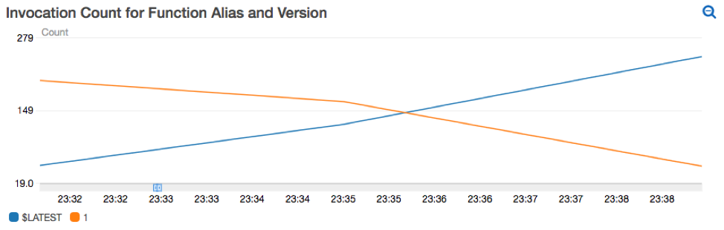
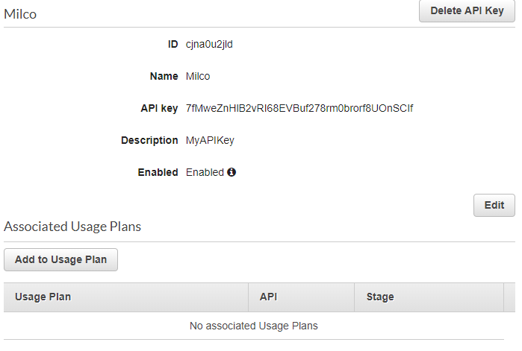
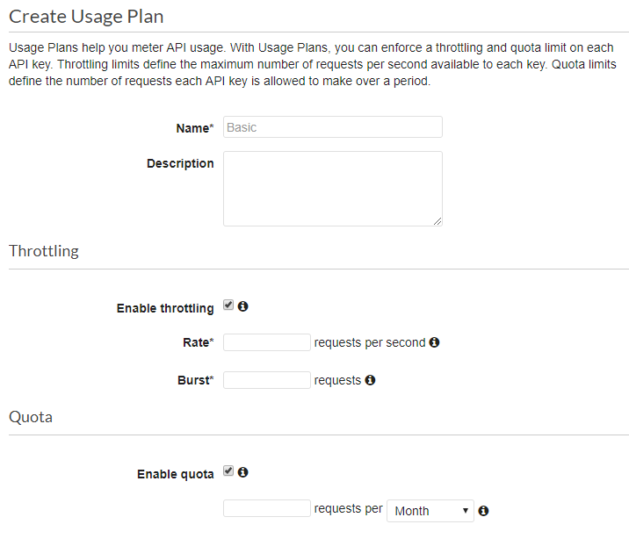
Canary Deployments/
Linear Traffic Shifting
API Keys
Throttling

Slide 7
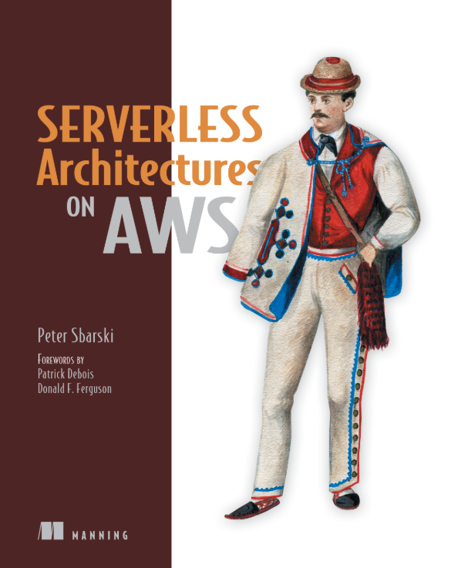
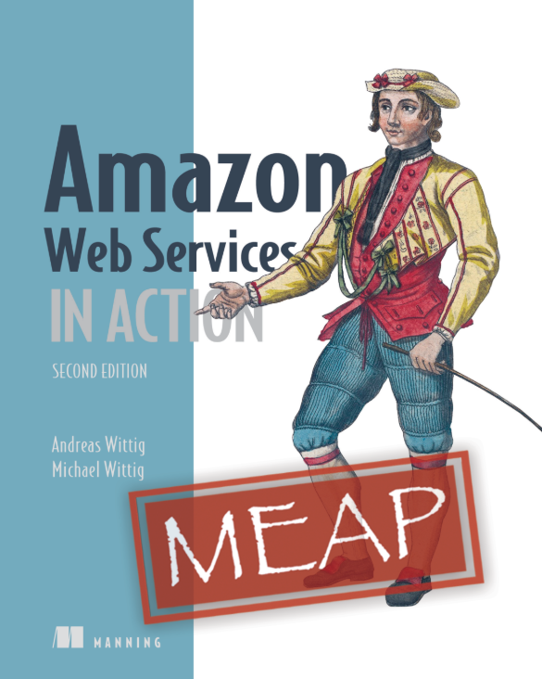
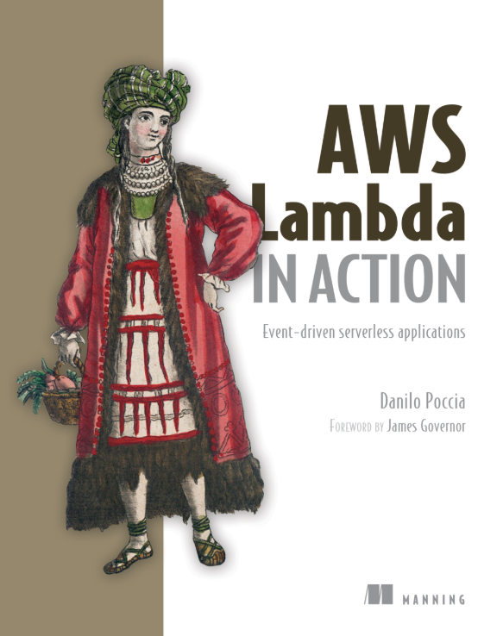
Bronnen

Slide 8
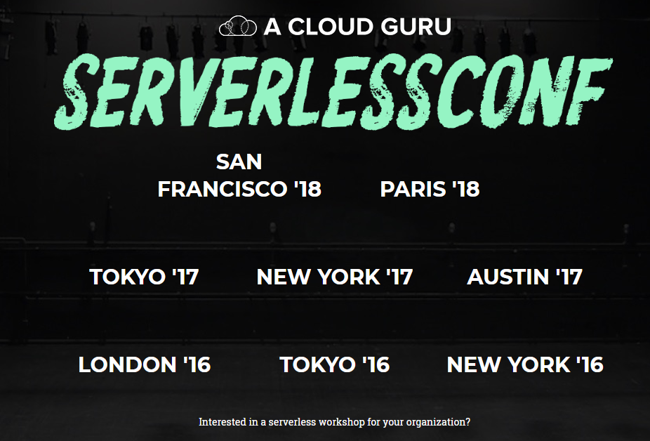
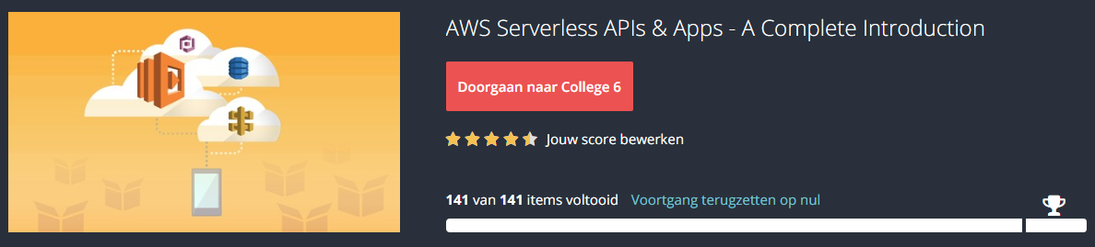
Bronnen
(A Cloud Guru) https://github.com/mnuman/serverless-workshop
(AWS) https://github.com/mnuman/aws-serverless-workshops

Slide 9
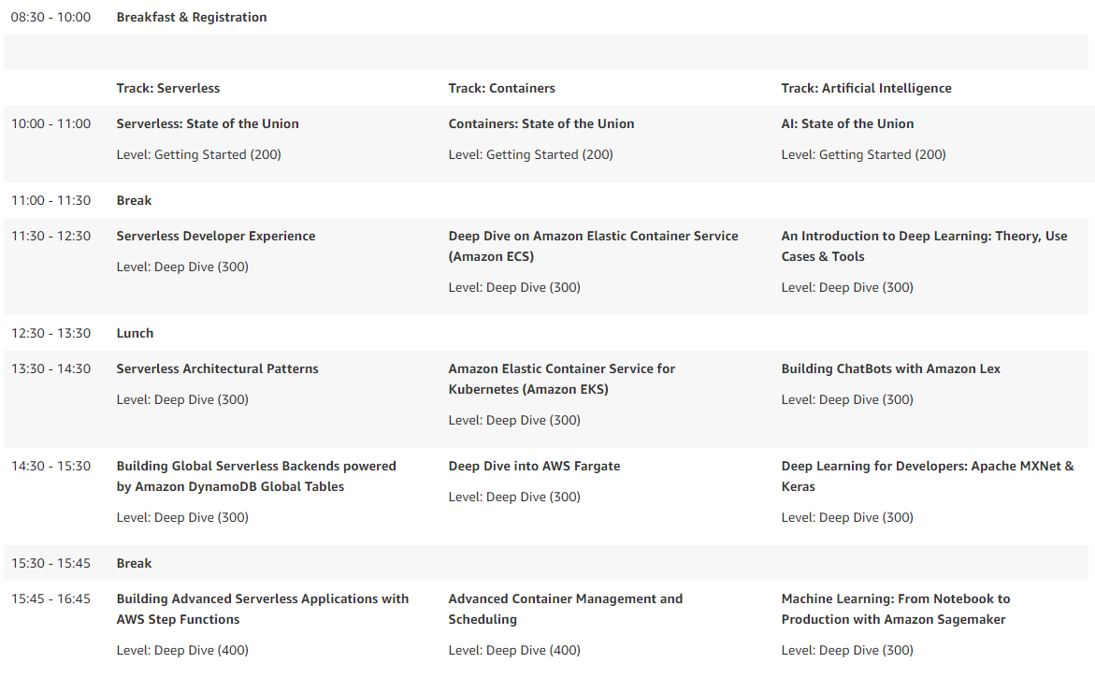

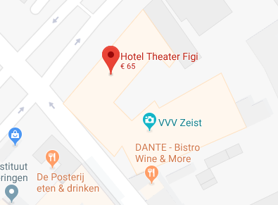
AWS Developer Days Utrecht
https://goo.gl/Vje8MJ

Slide 10

Eindhoven
De Zaale 11
5612 AJ Eindhoven
Netherlands
Utrecht
Blok D, Graadt van Roggenweg 328-334
3531 AH Utrecht
Netherlands
Sofia Bulgaria
Nikolay Haytov 12
1113 Sofia
Bulgaria
info@syntouch.nl
www.syntouch.nl

