Slide 1
Evolutionary HyperNet-InfoGAN Baselines for Controllable Synthetic Image Generation
Mark Nuppnau, Khalid Kattan, R.G. Reynolds
Wayne State University | University of Michigan - Dearborn
AAAI 2026

Slide 2
Motivation
Medical synthetic data must be controllable and auditable
InfoGAN encourages disentangled, interpretable latent structure without supervision
Prior work: PGPE evolved generator directly over >500k parameters
- Duplicate modes formed early and persisted permanently
- Partial mode coverage (typically missing 1+ digit classes)
Key question: Can a smaller, structured search space fix these failure modes?

Slide 3
Architecture: HyperNet-InfoGAN
PGPE evolves a compact HyperNetwork (~32k params)
HyperNetwork generates full Generator weights (~225k params)
Generator produces images conditioned on structured latent codes
z = [noise(62), discrete(8 or 10), continuous(2)]
Discriminator/Q-network trained with backpropagation
Shared-z protocol: same noise, varying discrete code
→ Differences isolate code-dependent structure
Key Insight
Direct encoding: PGPE over 500k+ params
→ Duplicate modes become permanent
Indirect encoding: PGPE over ~32k params
→ Duplicate modes resolve during training
7x reduction in search dimensionality
enables coordinated parameter changes

Slide 4
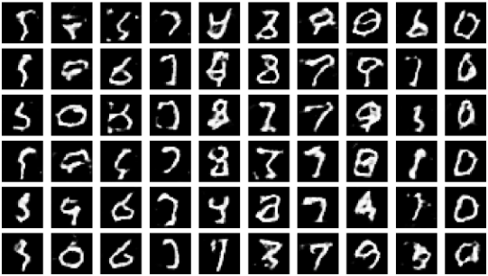
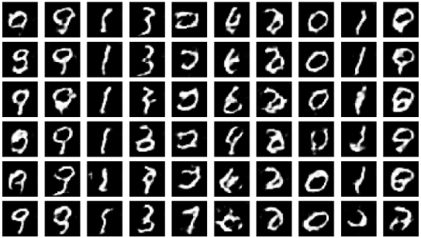
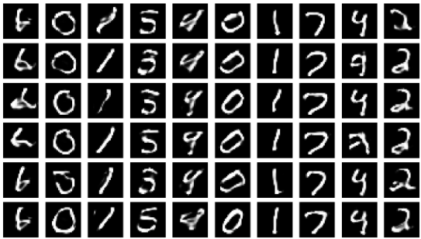
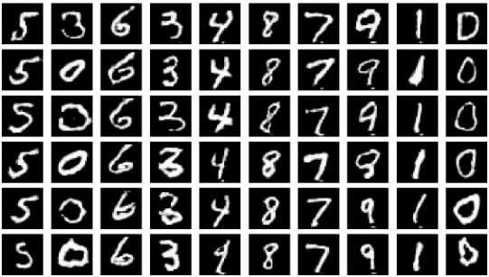
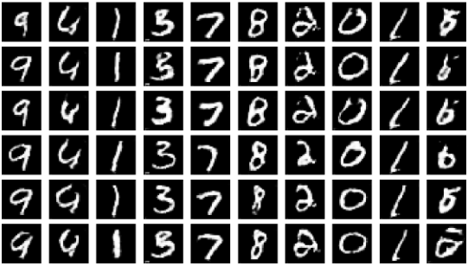
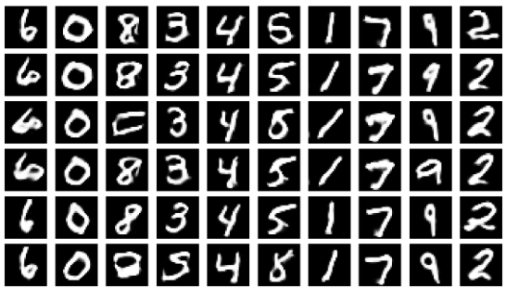
MNIST: Duplicate Modes Resolve with Indirect Encoding
Direct: Duplicate '0'
Direct: Duplicate '1'
Indirect (HyperNet)
21k iterations
21k iterations
21k iterations
198k iterations
198k iterations
198k iterations
HyperNet resolves all 10 digits ✓

Slide 5
MNIST: Quantitative Progression
Iteration | Covered | Dups | mi_avg | mi_max | r_sense | r_intra | Spread | RFL
21k | 7/10 | 3 | 0.034 | 0.065 | 0.170 | 0.913 | 0.032 | 0.606
198k | 10/10 | 0 | 0.091 | 0.094 | 0.138 | 0.892 | 0.029 | 0.581
Early training: 7/10 coverage, 3 duplicate assignments, high raw separation (0.170)
Late training: 10/10 coverage, 0 duplicates, MI more than doubles (0.034 → 0.091)
r_sense decreases moderately — cleaner allocation over raw separation magnitude
Adversarial balance remains stable throughout (RFL ≈ 0.58)

Slide 6
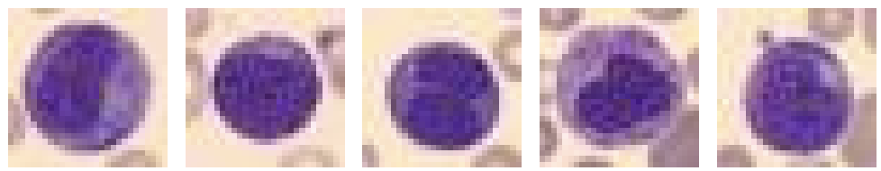
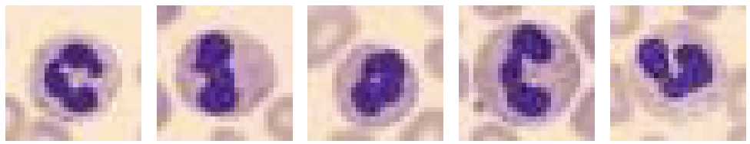
BloodMNIST: A Harder Challenge
8 cell types with shared visual factors and class-varying nucleus morphology
8 classes: Basophil, Eosinophil, Erythroblast, Imm. Granulocytes,
Lymphocyte, Monocyte, Neutrophil, Platelet
Shared factors: surrounding red blood cells, circular cell boundary
Varying factors: nucleus size, shape, lobulation, cytoplasm thickness
Discriminative signal concentrated in nucleus morphology
Same architecture and fitness schedule as MNIST — no dataset-specific tuning
Immature Granulocytes
Neutrophils

Slide 7
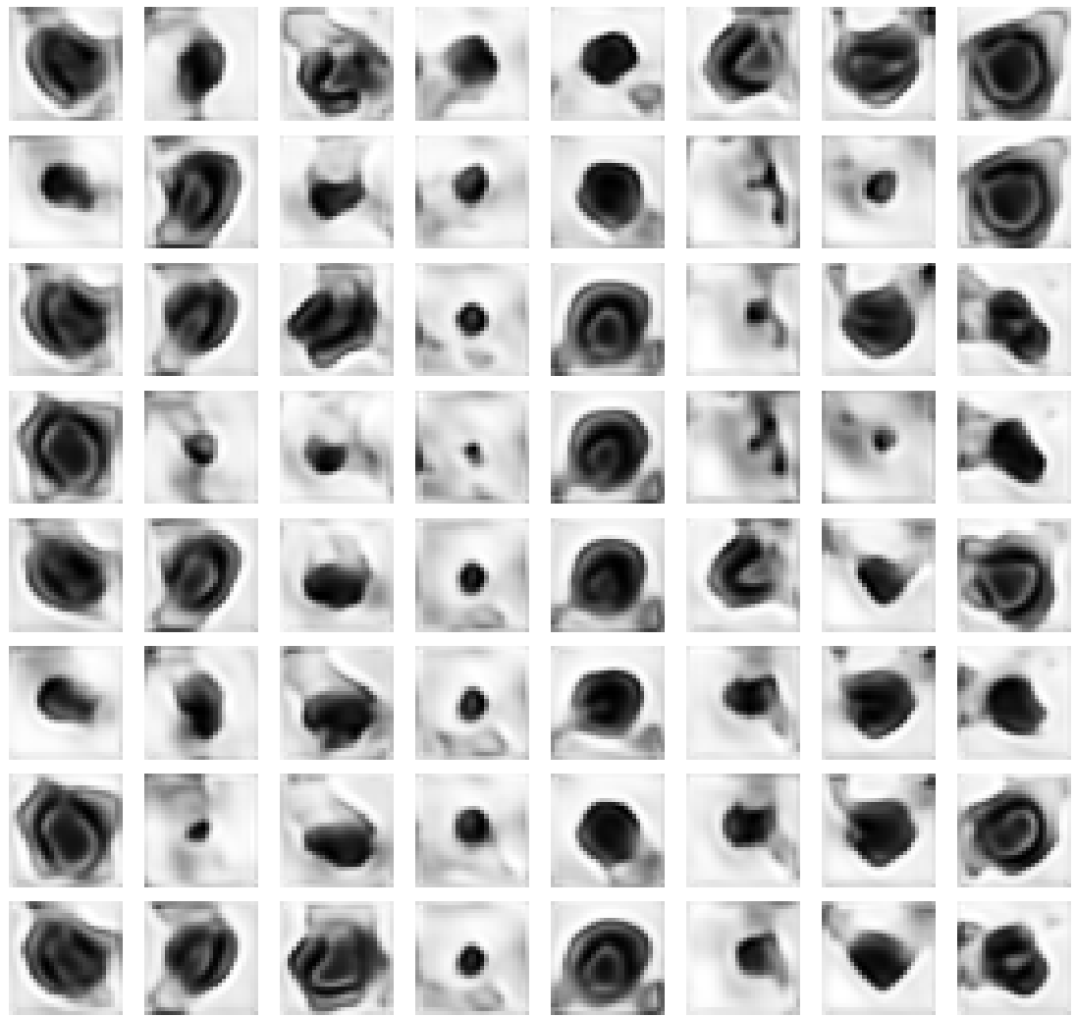
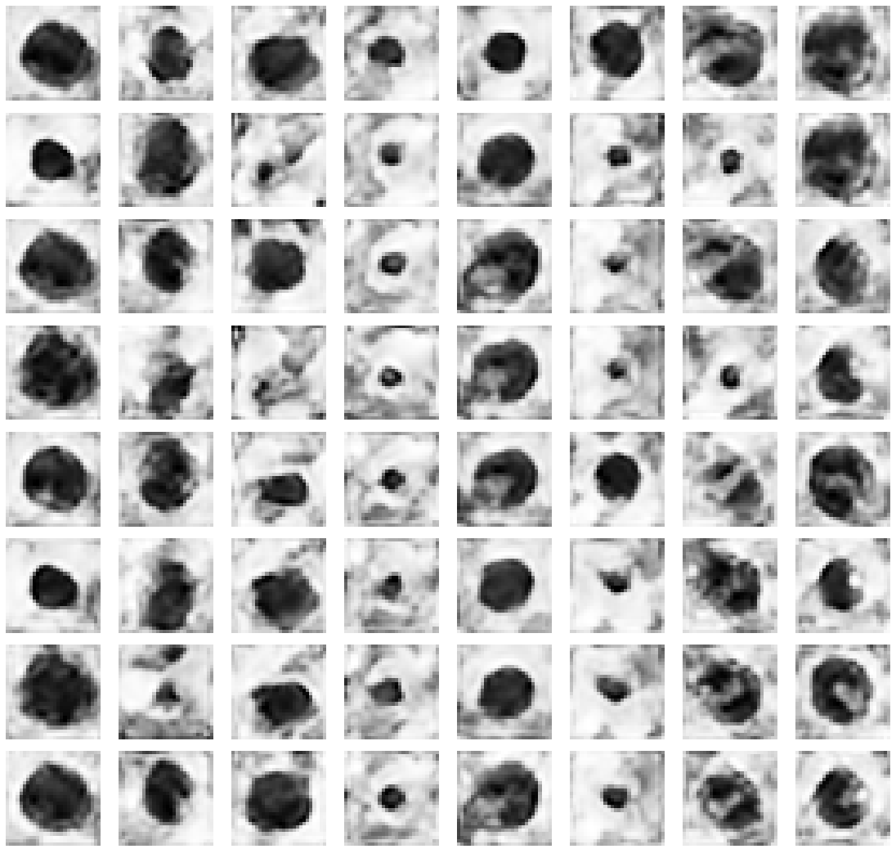
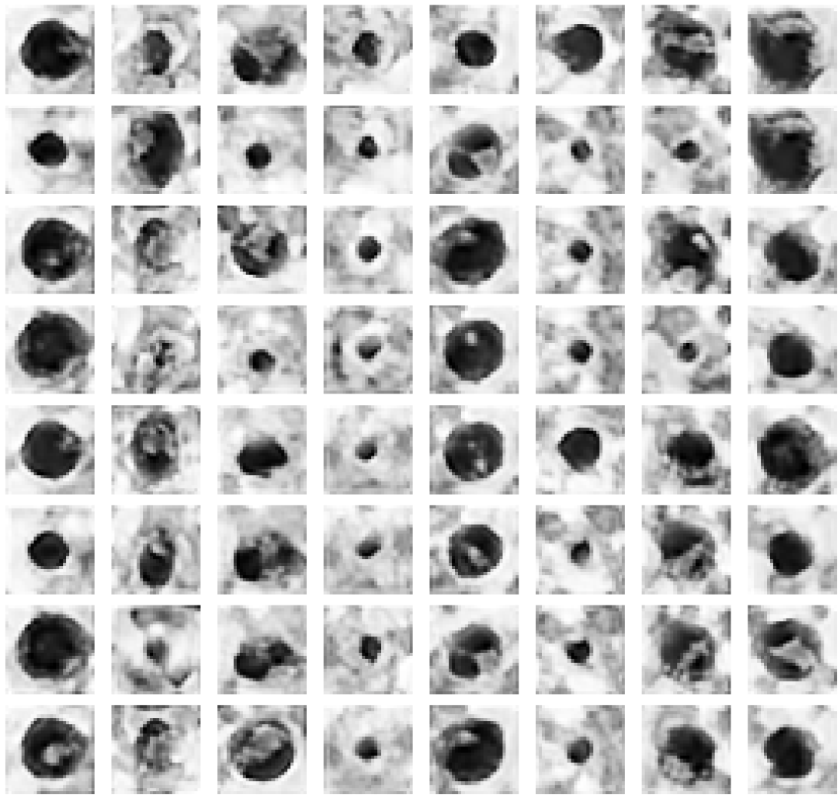
BloodMNIST: Visual Progression
Iteration 34k
Iteration 115k
Iteration 289k
Generic cell template, irregular boundaries
Rounder cells, nuclei begin differentiating
Richer texture, smoother, but shared template persists

Slide 8
BloodMNIST: Quantitative Progression
Iteration | mi_avg | r_sense | r_intra | ProtoCorr | RFL
34k | 0.077 | 0.170 | 0.560 | 0.681 | 0.523
115k | 0.086 | 0.161 | 0.647 | 0.633 | 0.561
289k | 0.092 | 0.155 | 0.910 | 0.701 | 0.584
MI steadily improves (0.077 → 0.092) — codes carry increasing information
r_intra rises strongly (0.56 → 0.91) — within-code consistency improves
ProtoCorr increases late — template similarity returns as codes refine shared features
RFL stable throughout (0.52–0.58) — no mode collapse or divergence
Partial disentanglement: biological plausibility improves, but codes don't fully
separate into distinct hematologic morphologies

Slide 9
Trust Relevance and Limitations
What Works
Remaining Gap
Stable adversarial training on both datasets
Full MNIST digit coverage (10/10)
Duplicate modes resolve (not permanent)
BloodMNIST: realistic cell morphology
Latent control is auditable and inspectable
BloodMNIST codes don't map to 8 distinct cell types
Disentanglement via low-cost geometric proxies:
cell size, nucleus position, orientation
Mathematical code separation ≠ biological separation
Static fitness weights vulnerable to shortcuts

Slide 10
Conclusion and Future Work
Indirect encoding via HyperNetwork fundamentally changes trainability
• 7x parameter reduction enables PGPE to resolve duplicate modes
• Same architecture transfers from MNIST to BloodMNIST without modification
BloodMNIST reveals the gap: MI-driven disentanglement ≠ biological separation
• Static fitness functions are vulnerable to geometric shortcuts
Next step: Cultural Algorithms (CA) as meta-level controller
• Adaptive fitness weighting during training
• Morphology-aware priors to align codes with clinical structure
• Semantic trap detection to prevent shortcut exploitation

Slide 11
Thank You
Questions?
Mark Nuppnau • robert.reynolds@wayne.edu • Wayne State University

