Slide 1
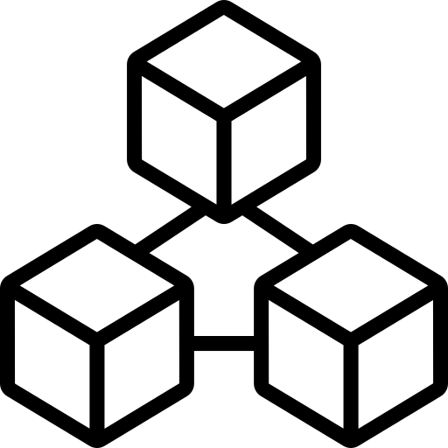
blockchain
LearnWithNura • AI | Web3 | Blockchain | Technology

Slide 2
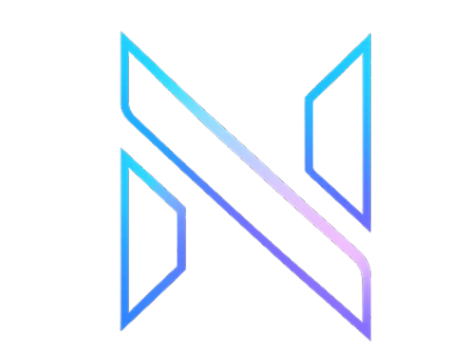
What Is Blockchain?
Blockchain is a decentralized digital ledger that records transactions securely.
LearnWithNura | Slide 1

Slide 3
Why Does Blockchain Matter?
It enables trust and transparency without relying on a central authority.
LearnWithNura | Slide 2

Slide 4
KEY TAKEAWAY
Common Applications
Cryptocurrency, supply chains, digital identity, and smart contracts.
LearnWithNura | Slide 3

Slide 5
Benefits
Option A
Option B
Security, transparency, immut
ability, and decentralization.
LearnWithNura | Slide 4

Slide 6
SAVE THIS FOR LATER
Learn AI, Web3 & Technology visually.
Follow @LearnWithNura for more.
LearnWithNura | Slide 5

