Slide 1
Obstacle Avoidance
and
Object Recognition
for the
Visually Impaired
Presented by:
Katta Priyatham (14115059)
MNV Sai Krishna (14115064)
Maharnab Mitra (14115065)

Slide 2
Objective
The mission of this project is to develop a visual system with 'human-like' capabilities for blind and visually impaired persons, via the use of computer vision and deep learning techniques.
Navigation : Helping the user to move on busy streets and trying to avoid collisions with other people and objects (vehicles in particular)
Search Assistance : Generation of 3d sound plays a major role in this mode. The developed model is expected to help the user to find an item, for example, finding a chair, water bottle, fridge etc. 3d sound as explained before helps the user to find out where an object is spatially located indoors.

Slide 3
Object Detection Algorithm
YOLO (You Only Look Once) based on RCNN (Region-based Convolutional Neural Networks)
Currently our model is capable of detecting 20 classes of objects which are mentioned in our report.

Slide 4
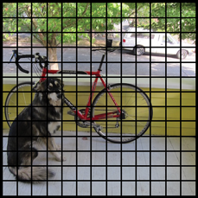
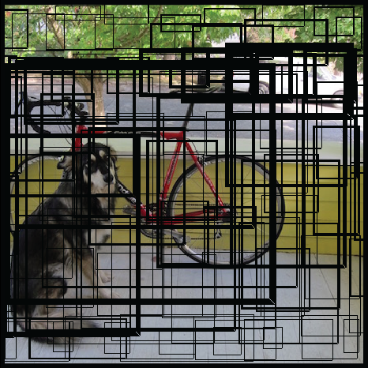
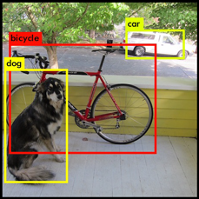
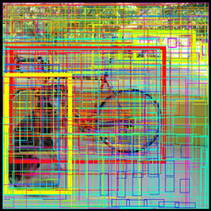
Working of YOLO

Slide 5
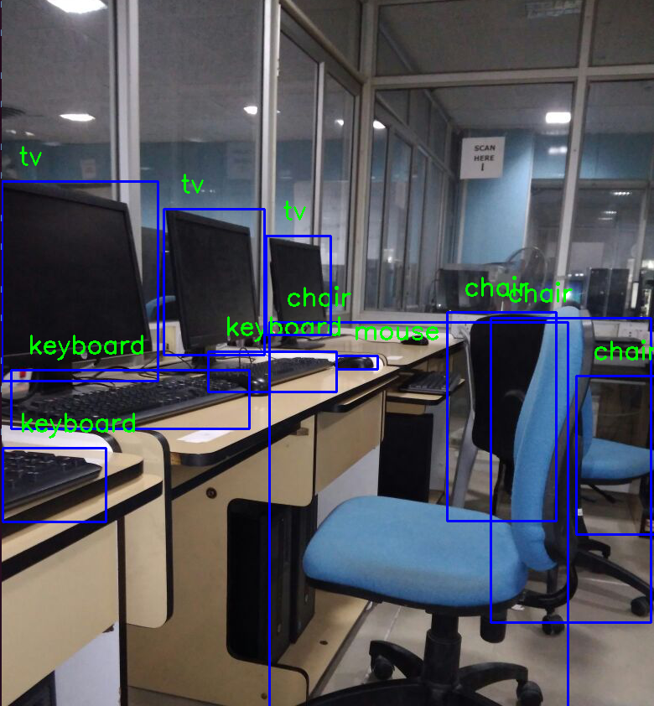
Pre mid term progress
Detection of objects
A decent running time
successfully detects objects provided they fall in the classes used to train it
Algorithm was slow in terms of processing speed
Required high memory to evaluate a single image

Slide 6
Single Shot Detection (SSD)
It discretizes the output space of bounding boxes into a set of default boxes over different aspect ratios and scales per feature map location.
This is a variation of our previous model. We removed some of the last layers in the neural network and traded accuracy for speed.
The previous model did not work so well when a video was feeded as input. The rate at which the previous model processed a video file was about 0.1 frames/second.
The current model processes the given input video stream at 1 frame/second.
The output obtained is as follows:

Slide 7
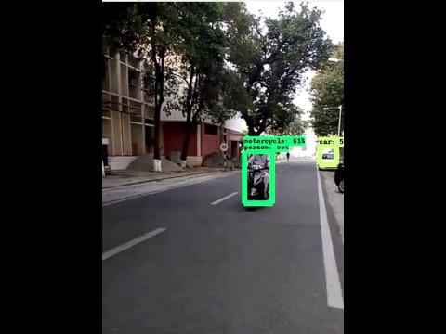
Output video

Slide 8
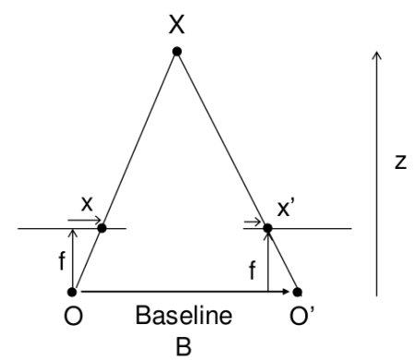
Depth Estimation
As demonstrated in the output video. We measure the size of objects which cover majority of the image and warn the user accordingly.
By using two separate cameras and calculating disparity.This method is discussed
Disparity = x−x′ = Bf / Z
We can determine which objects are nearest to the stereo webcams by calculating the shift between the object from ‘left eye’ and ‘right eye’ perspective – the bigger the shift, the nearer the object. The result obtained when we ran this algorithm on a single image is as follows.

Slide 9
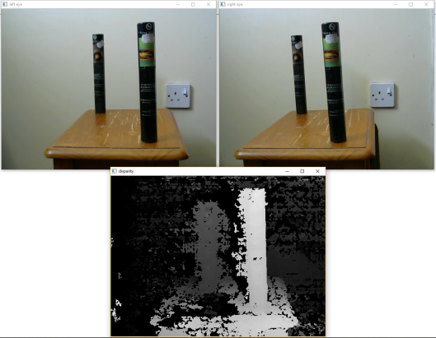
Estimating depth and generation of grayscale image
The nearer the object, The brighter is the pixel value.
By calculating the position of the brightest pixel, we warn the user to move in different (safe) direction.

Slide 10
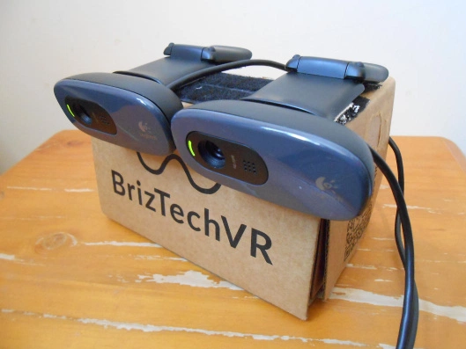
Future Work
Building a proof of concept of our model.
The arrangement of the cameras is as follows:
Integrating the developed algorithm in a mobile application.
Integrating our models with a portable processor and establish a
fast communication between the cameras and the processor.
Interpreting the text outputs in the form of audio signals.

