Slide 1
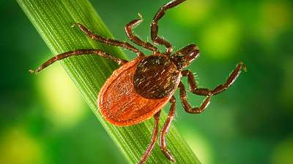
Characteristics of Lyme Disease in New York State
Screencast

Slide 2
Research Questions
Data
Exploratory Analysis
Regression Analysis
Discussion

Slide 3
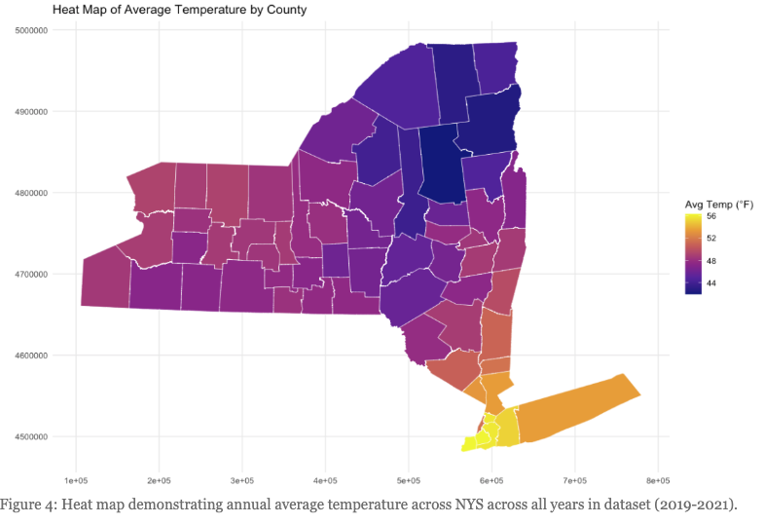
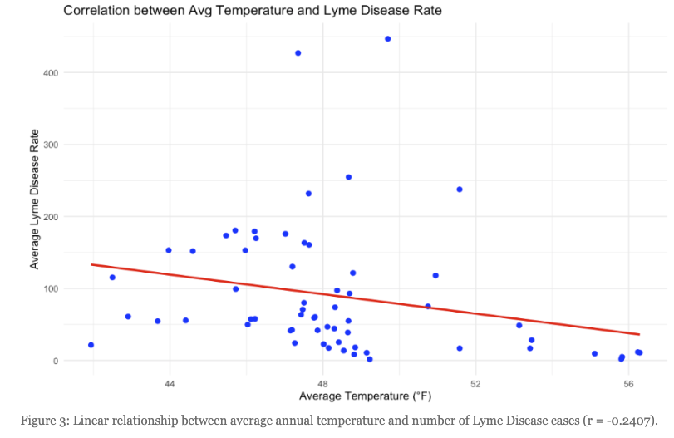

Slide 4
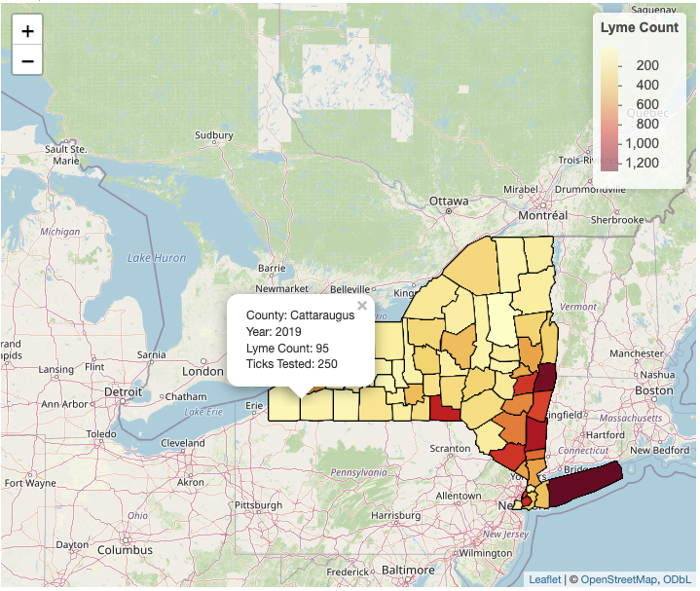

Slide 5
