Slide 1
Inverting Amplifier
By Matthew Winter

Slide 2
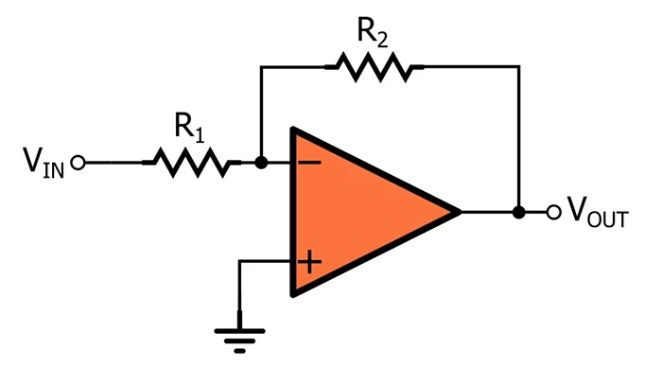
What Is A Inverting Amplifier
Inverting Amplifiers: A type of operational amplifier (op-amp) configuration.
Key Component: Operational Amplifier (Op-Amp)
Function: Inverts the input signal and amplifies it.
Commonly used for: Signal processing, audio applications, instrumentation, and more.

Slide 3
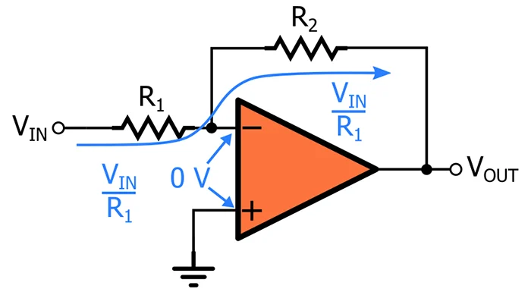
Basic Theory of Operations
An inverting amplifier is a type of operational amplifier (op-amp) configuration that takes an input signal, inverts its polarity, and amplifies it by a gain determined by the ratio of feedback and input resistors. The inverting terminal of the op-amp is connected to the input signal source, while the non-inverting terminal is grounded. This configuration results in an output signal that is an inverted and amplified version of the input.

Slide 4
Where is the Circuit Used?
Audio Amplification: Used in audio equipment for amplifying audio signals.
Signal Processing: Used in filter circuits and waveform shaping.
Instrumentation: Precise measurements and signal conditioning in sensors.
Feedback Systems: Used in control systems and feedback loops.

Slide 5
Advantages Vs. Disadvantages
Advantages: High input impedance, stable gain, versatility in adjusting gain with resistor values, easy to design and implement, widely used in various applications.
Disadvantages: Signal inversion might not be desirable in all cases and requires careful consideration of op-amp specifications and component values for optimal performance.

Slide 6
Variations Of the Circuit
Dual Power Supply Configuration: Allows amplification of both positive and negative input signals.
Virtual Ground Creation: Useful when a ground reference is needed in single-supply applications.
Variable Gain: Achieved by using a potentiometer in place of R2.

Slide 7
References
Poole, I. (2009, April 7). Op Amp Inverting Amplifier: Circuit; Design; Equations, Basics, Tutorial . . Electronics-Notes.com; Electronics Notes. https://www.electronics-notes.com/articles/analogue_circuits/operational-amplifier-op-amp/inverting-amplifier.php
‌
Basic Amplifier Configurations: the Inverting Amplifier - Video Tutorial. (n.d.). Www.allaboutcircuits.com. https://www.allaboutcircuits.com/video-tutorials/the-basic-op-amp-inverting-amplifier/
Electronics Tutorials. (2018, February 24). Inverting Operational Amplifier - The Inverting Op-amp. Basic Electronics Tutorials. https://www.electronics-tutorials.ws/opamp/opamp_2.html
Op amp circuits - Example 2 Inverting op amp amplifier. (n.d.). Www.youtube.com. Retrieved August 21, 2023, from https://www.youtube.com/watch?v=ZUKqbbbdLjI
‌
‌
‌

