Slide 1
Intro to CS461/ECE422

Slide 2
What we cover in discussion sections?
We will go over MPs’ materials.
Worth about 50% of your final grade, and you should work in a team of two.
You will have 5 MPs:
Crypto Project
Systems Project
Network Project
Web Project
Mystery MP (To be announced later in the course)
Every MP has two checkpoints
Checkpoint 1 covers the basics to get you started.
Checkpoint 2 goes over more advanced applications.

Slide 3
Prerequisite (CS241/ECE391)
Topics you should know, or you can learn on your own.
Random Functions, Prime Factorization, Modular Arithmetic, Greatest Common Divisor, Bin/Hex/Dec Conversions, etc.
Memory Layouts, Stack Frame, File system, VMs
Network 101: Packets, Common Protocols, Routing/Forwarding
https://github.com/angrave/SystemProgramming/wiki/Networking%2C-Part-1%3A-Introduction
https://hpbn.co/
How Web Browser works, HTTP protocol, JavaScript/HTML/SQL
Languages: Assembly Instructions, Python
Shellcoders Handbook (if ambitious)
We will cover basic concepts you need for each project in coming weeks.

Slide 4
Basic Review
Virtual machines
Unix file system permissions
Binary/Hexadecimal/Decimal Conversions
XOR

Slide 5
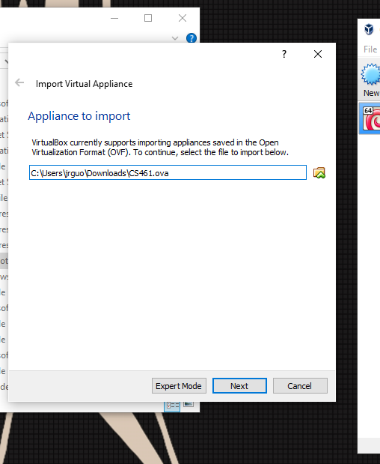
Virtual Machines
We will provide an Ubuntu image for the projects
Can be found on the course website
In short, virtual machine runs an OS inside an OS.
Install VirtualBox
Import Virtual Appliance
VM image is available on the course website

Slide 6
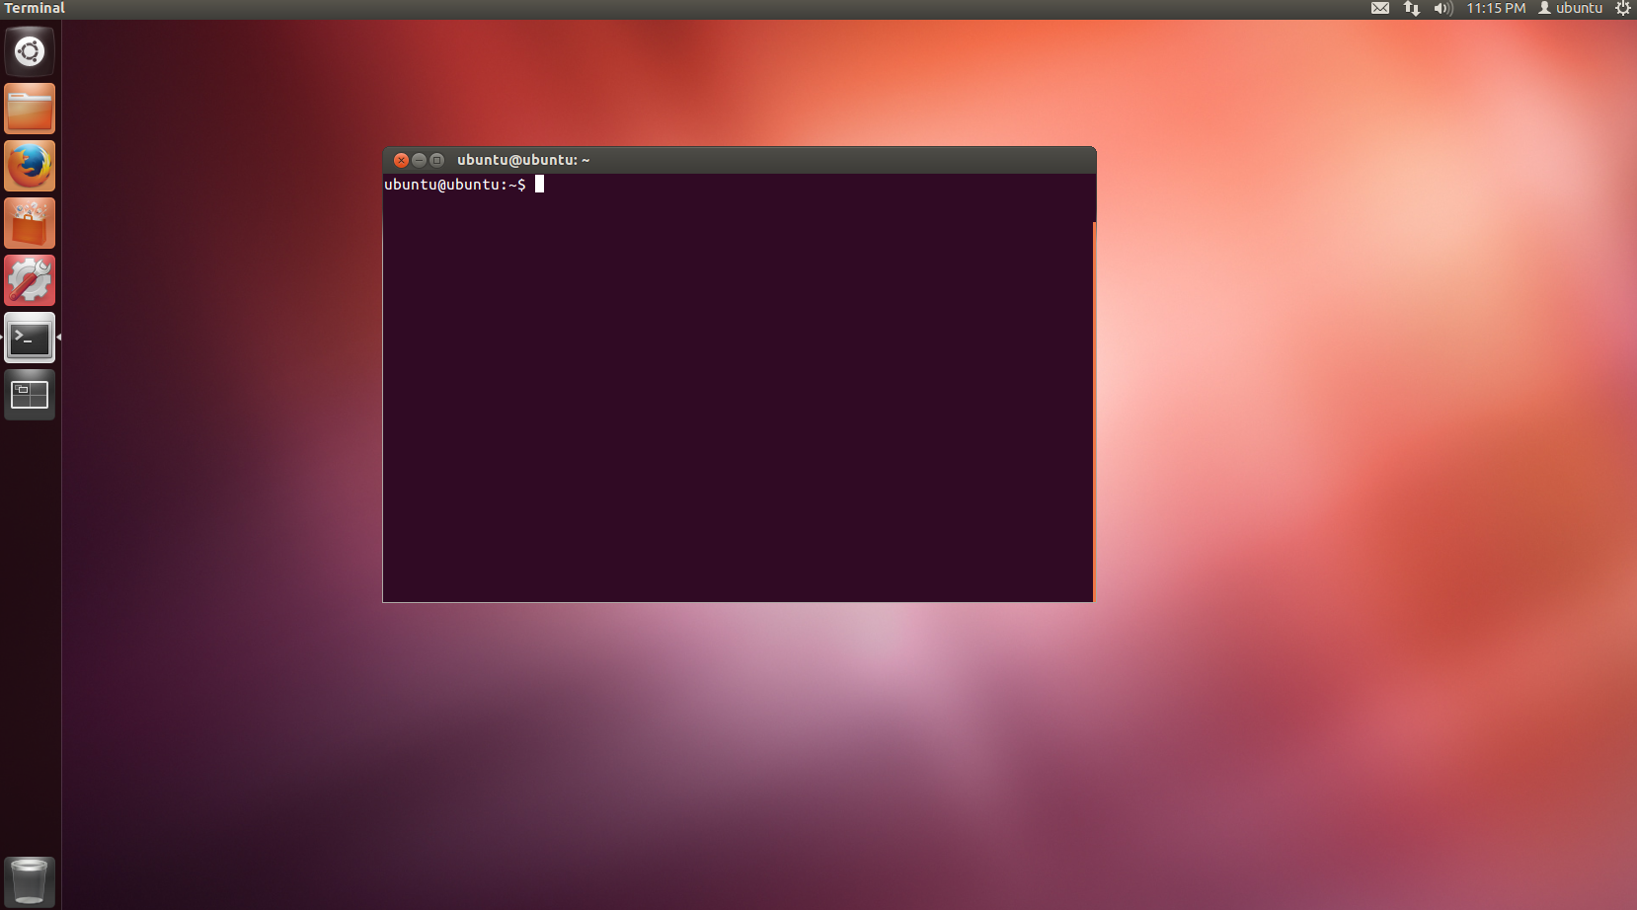
Virtual Machines (cont.)
OVA size: 1.3 GB
Default Password: ubuntu
Grading is done on the VM

Slide 7
Unix File System Permissions
For every file, we have read/write/execute access modes.
Every file in unix has the following attributes: Owner permissions, Group permissions, and Other permissions.
For example, when you run: ls -l filename, You may see -rwxr-xr--:
The owner has read(r), write(w) and execute(x) permission.
The group members have read(r) and execute(x) permission, but no write permission.
All others have read(r) only permission.
Chmod is the command used to change file permissions. For example, chmod 755 means:
Read/Write/Execute for owner.
Read/Execute for all others.

Slide 8
Bin/Hex/Dec Conversions
Binary to Decimal: 111001 = 1*2^5 + 1*2^4 + 1*2^3 + 0*2^2 + 0*2^1 + 1*2^0 = 57
Decimal to Binary, Example: http://www.rapidtables.com/convert/number/how-decimal-to-binary.htm
Binary to Hex/Hex to Binary, know 16 mappings: http://www.rapidtables.com/convert/number/how-binary-to-hex.htm
Hex/Decimal is similar to Binary/Decimal:
Hex to Decimal: 0x1128 = 1*16^3 + 1*16^2 + 2*16^1 + 8 *16^0 = 4392
Decimal to Hex: http://www.permadi.com/tutorial/numDecToHex/
Please use tools to convert values, it’s less error prone.
Demo
Notes:
Python 2.7.3
bin(DECIMAL_NUM) -> binx ary string of integer given
int(BINARY_STR, 2) -> decimal representation of binary str
int(HEX_STR, 16) -> decimal representation of hex str
hex(DECIMAL) -> hex representation of decimal

Slide 9
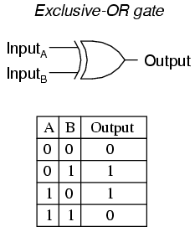
Properties of XOR
Commutative: A ⊕ B = B ⊕ A
Associative: A ⊕ ( B ⊕ C) = (A ⊕ B) ⊕ C
Identity element: A ⊕ 0 = A
Self-inverse: A ⊕ A = 0
Example: B ⊕ (A ⊕ B)
B ⊕ (B ⊕ A)
(B ⊕ B) ⊕ A
0 ⊕ A
A
Demo
Notes:
Python 2.7.3
A ^ B

Slide 10
Cryptography Math 101
Modular Arithmetic
Prime numbers
Relatively prime
Greatest Common Divisor
Euclidean Algorithm
Extended Euclidean Algorithm
Multiplicative inverse
Totient function

Slide 11
Modular Arithmetic
Division: n = q(a) + r, q is quotient, r is remainder.
Example: 11 = 2(4) + 3, n = 11, a = 4, q = 2, and r = 3.
a divides n if n = ma for some integer m.
n ≅ r mod a: We say n is congruent to r modulo a
Example: a divides n means n ≅0 mod a

Slide 12
Prime numbers & Relatively Prime
An integer p is prime if and only if its only divisors are 1 and p.
Example: 13 is prime, 4 is not prime
Two numbers a and b are relatively prime if: gcd(a, b) = 1
Example: 64 and 15 are relatively prime, 64 and 32 are not relatively prime.

Slide 13
Greatest Common Divisor
GCD (Greatest Common Divisor): The largest number that divides both a and b; Often written as gcd(a, b) = c.
Example: gcd(60, 24) = 12
Notes:
Prime factorization is hard!

Slide 14
Euclidean Algorithm
Euclidean Algorithm is used to find GCD of two numbers based on the fact: gcd(a, b) = gcd(b, a mod b)
Set c = max(a, b) and d = min(a, b)
Use division (c / d) to find c = q(d) + r
If r = 0, return gcd(a, b) = d
Set c = d and d = r, goto step 2
Example: gcd(55, 22) = gcd(22, 55 mod 22) = gcd(22, 11) = 11

Slide 15
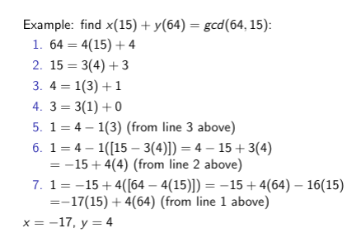
Extended Euclidean Algorithm
Extended Euclidean Algorithm: also finds integer coefficients x and y such that ax + by = gcd(a, b)
You run Euclidean first, then substitute remainders backward.

Slide 16
Multiplicative Inverse
If gcd(m, b) = 1, then b has a multiplicative inverse b^(-1) mod m
bb^(-1) ≅1 mod n
Example: 5 * 3 ≅1 mod 7: so 5 and 3 are multiplicative inverses modulo 7.
Finding Multiplicative Inverse using Extended Euclidean Algorithm
We know gcd(64, 15) = 1, so they are relatively prime.
Furthermore, we know 1 = -17(15) + 4(64)
1 mod 15 = -17(15) + 4(64) mod 15 = 4(64) mod 15
4 x 64 ≅1 mod 15

Slide 17
Euler’s totient function φ(n)
It counts the positive integers less than a given integer n that are relatively prime to n.
If n = pq for prime numbers p and q
φ(n) = φ(pq) = φ(p) x φ(q) = (p - 1) ( q - 1)
φ(21) = φ(3) x φ(7) = (3 - 1) x (7 - 1) = 12

