Slide 1
What’s in MP1 Checkpoint 2?
Checkpoint 2 is worth ⅚ of your total MP1 grade.
Problems:
Length extension (15 points)
MD5 collisions (15 points)
Padding Oracles (25 points)
Mining your Ps and Qs (25 points)
Colliding certificates (20 points)

Slide 2
MD5 - Introduction
Processes messages in 512 bit blocks
Internal state is of size 128 bits, which are initialized to constants
Compression function
Takes 2 inputs: Internal state or IV for first block + 512 bit message block
Output is 128 bit value, which is used as internal state for the next block
If no next block, 128 bit output is the hash

Slide 3
Merkle-Damgard Construction
Video (0:55 - 2:20): https://www.youtube.com/watch?v=VCOinPlsThw&t=54s
Take away: it suffers length-extension attack.
Any questions on MD Construction?

Slide 4
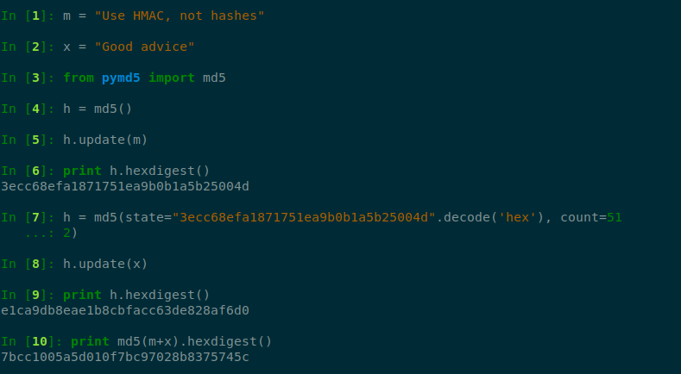
Length extension (1)
Is this correct way to do it?

Slide 5
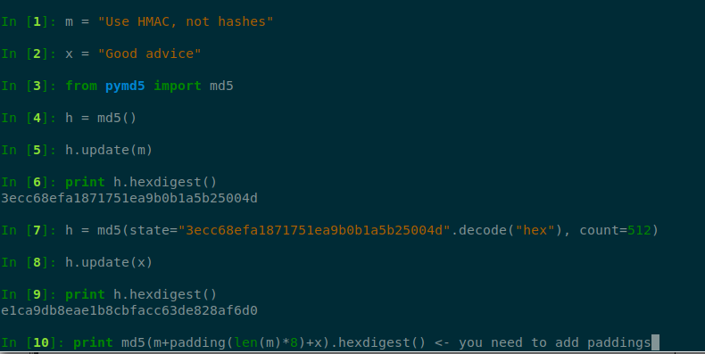
Length extension (2)

Slide 6
MD5 Collisions
Two messages with the same hash value
Attacker creates two different documents A and B, that have an identical hash value.
Fastcoll: MD5 collision generator
Use this tool to generate two strings that hash to the same hash.
Then you can use these two strings as prefix to files “sol_1.2.2_good.py” and “sol_1.2.2_evil.py”
Please do not use file names to solve this problem...

Slide 7
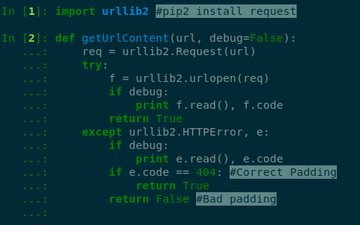
Exploiting a Padding Oracle
5 minute video tutorial (5:40 - 10:30 ), algorithm on high level: https://youtu.be/evrgQkULQ5U?t=345
This is all you need to understand to implement padding oracle.
You can refer to the paper for more details.
Tips:
Start early on this problem, the server hosting the script is not very fast.
Be careful with conversions between hex and binary.
hexData = strHex.decode('hex'); bytearray(hexData);
binascii.hexlify
HTTP request template to get you started:

Slide 8
Mining your Ps and Qs (1)
Public-key Cryptography: Encryption key != Decryption key
Computationally infeasible to compute the private key given a public key
In short, impossible to recover message given public key and encrypted message
RSA re-introduction:
Components of RSA
n - the modulus of the keys, created as a product of two large prime numbers (p, q)
e - the public key, d - the private key
Key generation
Pick two large random primes p, q and compute n = pq
Pick e = 1 mod (p-1) * (q-1)
Compute d such that 1 = ed mod (p-1)*(q-1)
Encryption with public key: encrypted_text = plaintext^e mod n
Decryption with private key: plaintext = encrypted_text^d mod n

Slide 9
Mining your Ps and Qs (2)
Is RSA secure?
Yes, if you know what you are doing. (The best known way to compute d from e, n is to factor n into p and q.)
No, when used with malfunctioning random number generators.
We give you a list of moduli that use these “malfunctioning random number”
Some of the modulus in moduli.txt are malformed: they share one prime factor with another.
Approximate 100 out of 10100, brute force them only if you think you are a vvvvvery lucky person.
We made it easier for your computer to compute, it was originally out of 50000.

Slide 10
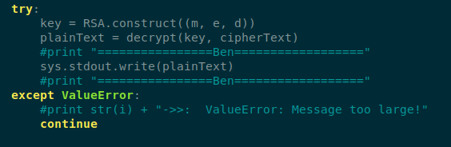
Mining your Ps and Qs (3)
Figure out how RSA works, then focus on section 3.3 on the paper.
You need to compute all-pairs GCDs using the algorithm outlined in section 3.3
The final output of the algorithm is the GCD of each modulus with the product of all the other moduli
Tutorial on how to compute product tree and remainder tree: https://facthacks.cr.yp.to/
Tips:
Don’t forget to get rid of GCD = 1
If you don’t want to implement multiplicative inverse: look up gmpy.invert function
Put assert functions where you think some math equations should hold
Once you have GCDs of each modulus, you are ready for RSA part!
For each candidate, compute RSA using m, e, d:

Slide 11
Creating Colliding Certificates (1)
Digital Certificate is document used to prove the ownership of a key. If you get a certificate, it means that the public key on the cert belongs to the owner of the cert.
Certificate is signed by a CA, who is trusted by everyone.

Slide 12
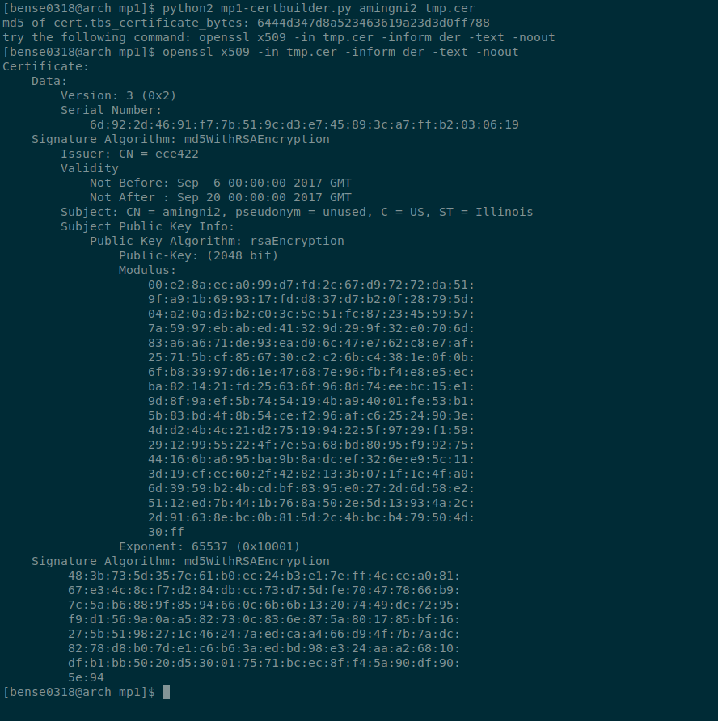
Creating Colliding Certificates (2)

Slide 13
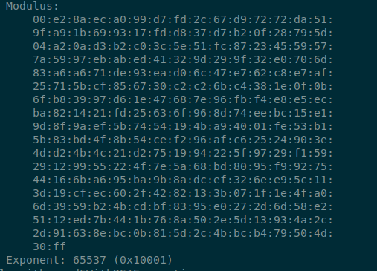
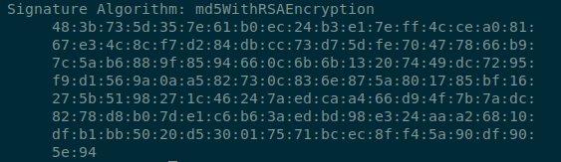
Creating Colliding Certificates (3)
What you need to do is to find two moduli that hashes to the same Signature
One is given by running mp1-certbuilder.py, the other is your task.
Your task

Slide 14
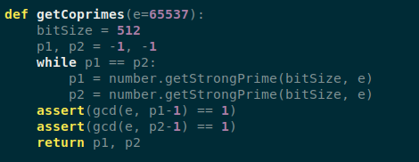
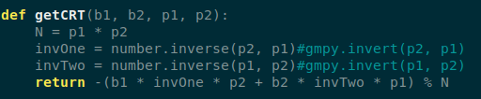
Creating Colliding Certificates (4)
The paper has very detailed step by step construction details, so we won’t duplicate them here.
Tips:
Please put assertion functions where you see fit, it will save you a lot of time on details.
If you failed to generate the solution using 1024 bit size, generate a 1023 bit pair using fastcoll.
This will help when searching using coprimes since it will generally make search b = b0 + k * p1 * p2 faster.
Some pseudo code: Chinese Remainder Theorem, Get Coprimes,

Slide 15
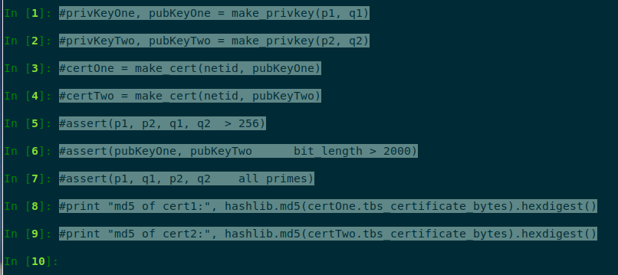
Creating Colliding Certificates (5)
Make sure to verify your solution

Slide 16


