Slide 1
Intro to Systems

Slide 2
Learning Objectives
Know what each of the most common x86 registers is used for
Gain familiarity with the most common x86 instructions
Be able to read disassembled x86 programs
Be able to write small x86 programs
Understand what the stack is and why it’s useful
Understand how the stack frame is laid out in memory
Used AT&T Syntax

Slide 3
Commonly Used x86 Registers
EAX - Return value
EBX
ECX - Loop counter
EDX
EDI - Repeated operation destination
ESI - Repeated operation source
EBP - Stack base pointer
ESP - Stack pointer
EIP - Program counter
EFLAGS - Status of previous operations (used in conditionals)

Slide 4
Assembly Syntax
Two types of syntax: Intel and GAS/AT&T
We use GAS/AT&T in CS/ECE 461
Intel:
add eax, [ebx+4]
Mnemonic, then operands
Destination operand first, then source
Brackets indicate memory access
GAS/AT&T:
add 4(%ebx), %eax
Mnemonic, then operands
Source operand first, then destination
Parentheses indicate memory access

Slide 5
GAS/AT&T Syntax
Prefix registers with %
Prefix constants with $ (except memory offsets)
Memory syntax:
displacement(base_reg, offset_reg, scalar_multiplier)
base_reg + displacement + offset_reg * scalar_multiplier
Not all fields are required - usually just (%eax) or 4(%eax)
An example will come later
See https://en.wikibooks.org/wiki/X86_Assembly/GAS_Syntax

Slide 6
Common Instructions (1)
Arithmetic Operations
add, sub - add/subtract data in first operand to/from second
inc, dec - increment/decrement operand
neg - change sign of operand
Logical Operations
and, or, xor - bitwise and/or/xor
not - flip all of the bit values
shl, shr - shift bits left/right

Slide 7
Common Instructions (2)
Transfer Instructions
mov - copy data from first operand to second
lea - compute address and store it in second operand (does NOT access memory)
push - Push the operand onto the stack (see later slides)
pop - Pop a value off the top of the stack into the operand
Jump Instructions
jmp - jump to address in operand
Reference: https://en.wikibooks.org/wiki/X86_Assembly/16_32_and_64_Bits
Notes:
Fun fact: Just the different MOV instructions in x86 are Turing-complete!

Slide 8
Common Instructions - Example
xor %eax, %eax
add $3, %eax
dec %eax
shl $3, %eax
lea 4(, %eax, 4), %eax
eax = eax ^ eax
eax = eax + 3
eax = eax - 1
eax = eax << 3
eax = 4 * eax + 4
Notes:
What’s in EAX?
68

Slide 9
Common Instructions (3)
EFLAGS register set by CMP and TEST (and all other arithmetic instructions)
Conditional Instructions - jump to a label/address
je - jump if equal
jne - jump if not equal
jz - jump if zero
jg - jump if greater than
jl - jump if less than
jle/jge - jump if equal or less than/greater than

Slide 10
GAS/AT&T Memory Syntax Example
mov my_foos, %ebx
mov $5, %ecx
mov $461, 8(%ebx, %ecx, 16)
Notes:
What does this code do?
Next slide has solution

Slide 11
GAS/AT&T Memory Syntax Example
mov my_foos, %ebx
mov $5, %ecx
mov $461, 8(%ebx, %ecx, 16)
EBX points to an array of foo_t’s
ECX is index into array
typedef struct {
int a, b, c, d;
} foo_t;
foo_t my_foos[10];
my_foos[5].c = 461;

Slide 12
The Stack
The stack stores working data
Last in first out (LIFO) data structure
Stack grows downwards in memory
ESP - Stack pointer - points to the top of the stack
push instruction decrements ESP (subtracts 4), then writes data to top of stack
pop instruction reads the value on top of stack, then increments ESP (adds 4)

Slide 13
Stack Frame (1)
Each function has its own stack frame
Used to save/restore state for function calls
Used to store local variables
EBP - Base pointer - points to the bottom of the stack frame
C calling convention:
Push args onto the stack from right to left in C declaration order
Caller-saved: EAX, ECX, EDX
Callee-saved: EBP, ESP, EBX, ESI, EDI
http://www.delorie.com/djgpp/doc/ug/asm/calling.html

Slide 14
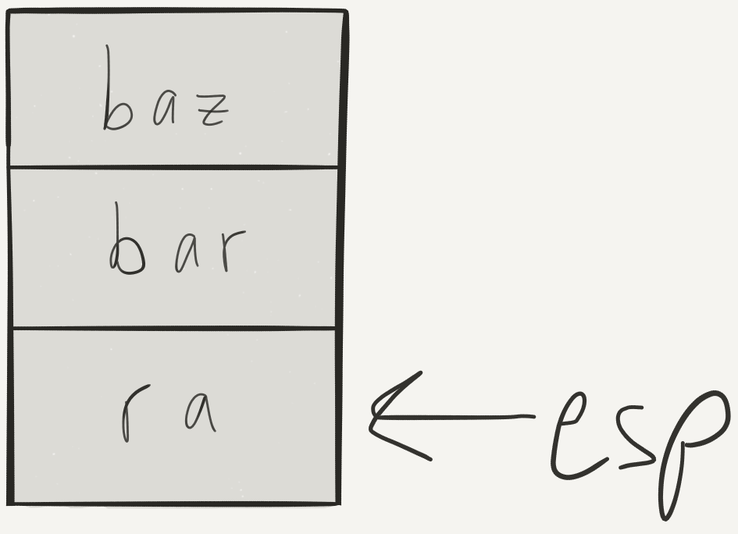
Stack Frame (2)
// int foo(int bar, char *baz);
another_function:
push %eax // baz
push %ebx // bar
call foo
add $8, %esp
/* call foo pushes old EIP (return address) onto the stack, sets EIP to point to entry point of foo */
Notes:
This is right after we call foo in another function, but before we execute any of foo.
Push args from right to left.

Slide 15
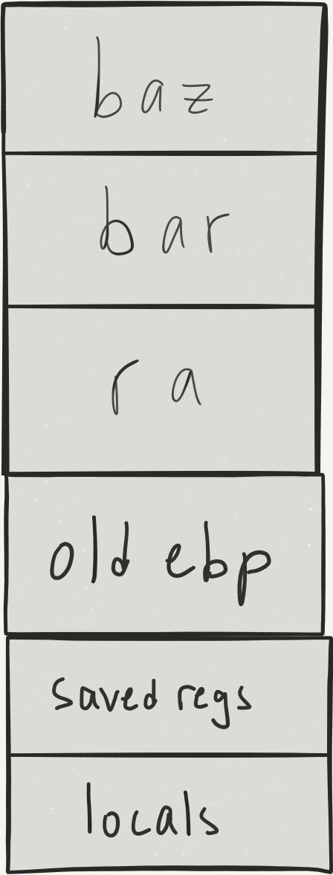
Stack Frame (3)
// int foo(int bar, char *baz);
foo:
push %ebp // Prologue
mov %esp, %ebp
sub $12, %esp // allocate local
// Do work… // vars
mov %ebp, %esp // Epilogue
pop %ebp
ret
Notes:
Now we’re in foo, just after setup.

Slide 16
Stack Frame (4)
// int foo(int bar, char *baz);
foo:
push %ebp // Prologue
mov %esp, %ebp
sub $12, %esp // allocate local
// Do work… // vars
leave // Epilogue
ret
Notes:
leave instruction does cleanup for you

Slide 17
GDB Crash Course
bt - Print a backtrace and show the call stack history
b *addr_or_function - Set a breakpoint at the given address or function
r - Run the program
c - Continue to the next breakpoint
s - Step to the next line or instruction
p variable_or_$register - Print a variable or register’s value
x addr - eXamine the contents of memory
disas function - Display a disassembled function
info reg - Print the contents of all registers

Slide 18
Demo

Slide 19
Want to Learn More?
Get some practice by writing C code, compiling it, then disassembling it in GDB

