Slide 1
x86 Exploits

Slide 2
Translate x86 to C
xor %ebx,%ebx
add $99,%ebx
sub $4,%esp
loop:
mov %ebx,(%esp)
call sing_it
dec %ebx
jnz loop
add $4,%esp

Slide 3
Translate x86 to C
xor %ebx,%ebx
add $99,%ebx
sub $4,%esp
loop:
mov %ebx,(%esp)
call sing_it
dec %ebx
jnz loop
add $4,%esp
int bottles_left = 99;
do {
sing_it(bottles_left);
bottles_left--;
} while (bottles_left > 0);

Slide 4
x86 ISA
8 bits = 1 byte
char -> 1 byte
int -> 4 bytes
word -> 2 bytes* (4 bytes in GDB)
long -> 4 bytes
Memory address -> 4 bytes
Pointer -> ?
Registers -> 4 bytes
Each memory location -> 1 byte
… | …
0xDEADBEEC | 0x0D
0xDEADBEED | 0xF0
0xDEADBEEE | 0xAD
0xDEADBEEF | 0x8B
… | …
Notes:
Instruction set architecture

Slide 5
Registers (4 Bytes)
EAX
 |  | AH | AL
AX

Slide 6
GDB Tutorial/Demo

Slide 7
GDB Command References
https://courses.engr.illinois.edu/ece391/notes/student-notes.pdf
(Notes Set 0 and 1)
https://courses.engr.illinois.edu/ece391/references/doc-x86-asm.pdf
(x86 Reference Sheet)
_shared/mp2/GDB tutorial.pdf

Slide 8
x86 Assembly Resources
http://www.ibiblio.org/gferg/ldp/GCC-Inline-Assembly-HOWTO.html#s3
https://en.wikibooks.org/wiki/X86_Assembly/GAS_Syntax

Slide 9
Buffer Overflow - Demo

Slide 10
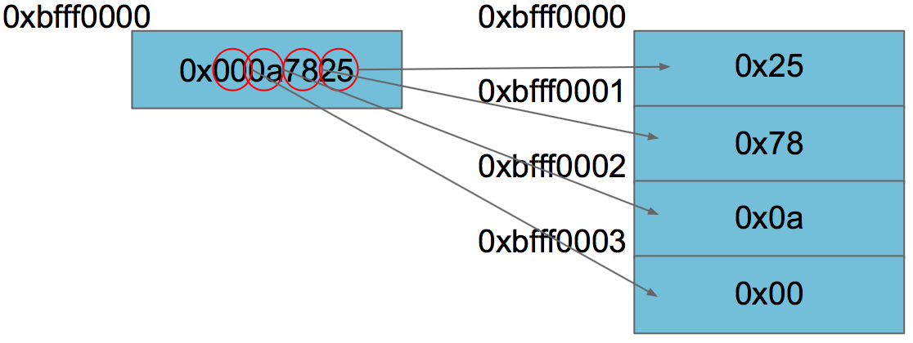
Endianness
Byte order on x86 is little endian
Read from top of stack to bottom
(low to high addresses)
First thing that gets read is little -> small -> least significant byte
push $0x2be15 = push $0x0002be15

Slide 11
Unsafe Functions
Unsafe:
strcpy and friends (str*)
sprintf
gets
Use Instead:
strncpy and friends (strn*)
snprintf
fgets

Slide 12
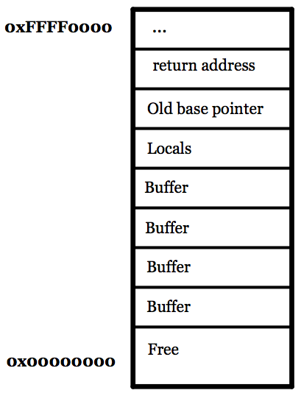
Shellcode
Buffer overflows are pretty simple…

Slide 13
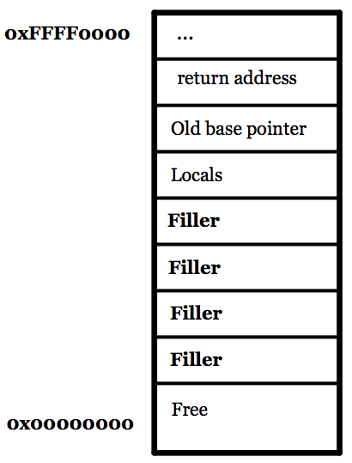
Shellcode
Buffer overflows are pretty simple…
Start writing on the stack…

Slide 14
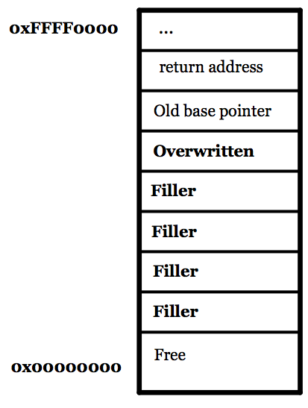
Shellcode
Buffer overflows are pretty simple…
Start writing on the stack…
And just keep going until you overwrite an important variable

Slide 15
Shellcode
Buffer overflows are pretty simple…
Start writing on the stack…
And just keep going until you overwrite an important variable
Hooray, an exploit!

Slide 16
Shellcode
Buffer overflows are pretty simple…
Start writing on the stack…
And just keep going until you overwrite an important variable
What if we keep going?

Slide 17
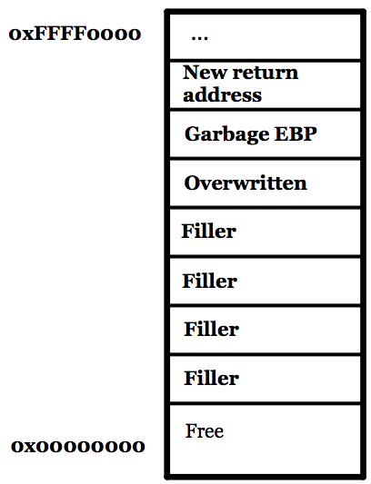
Shellcode
Buffer overflows are pretty simple…
Start writing on the stack…
And just keep going until you overwrite an important variable…
And overwrite the return address

Slide 18
Shellcode
Buffer overflows are pretty simple…
Start writing on the stack…
And just keep going until you overwrite an important variable…
And overwrite the return address
We can jump to almost any location we want! If only we had some conveniently located malicious instructions somewhere nearby…

Slide 19
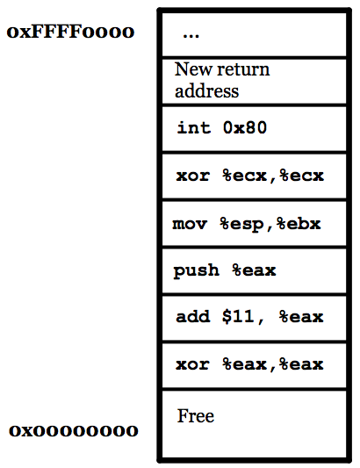
Shellcode
Buffer overflows are pretty simple…
Start writing on the stack…
And just keep going until you overwrite an important variable…
And overwrite the return address
We can jump to code we’ve placed on the stack

Slide 20
Shellcode
Buffer overflows are pretty simple…
Start writing on the stack…
And just keep going until you overwrite an important variable…
And overwrite the return address
We can jump to code we’ve placed on the stack
More on this next week

