Slide 1
Crypto MP1/CK1

Slide 2
What’s in MP1 Checkpoint 1?
1.1.1: Hex/Decimal/Binary Conversions (2 points)
1.1.2: Encryption/Decryption
Substitution Cipher (3 points)
Decrypting AES (3 points)
Breaking a Weak AES Key (3 points)
Decrypting a Ciphertext with RSA (3 points)
1.1.3: Hashing
Avalanche Effect (3 points)
Weak Hashing Algorithm (3 points)
Due on 9-13-2017, we will run the autograder on Saturday, Tuesday to give you some feedback for checkpoint 1.
Start early and take advantage of this.

Slide 3
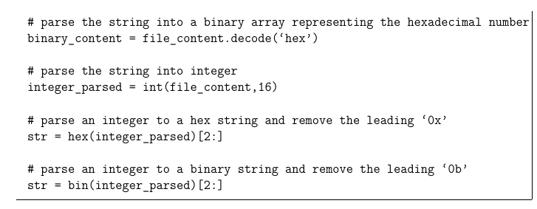
Hex/Decimal/Binary Conversion
Convert a hex string to decimal number.
Convert the same hex string to binary number.
Section 1.1.1.1 has all the functions you need to complete this part.

Slide 4
Substitution Cipher
Retrieve the original text given a substitution key and a ciphertext.
Every character in an alphabet is replaced by a corresponding character from the key
Two alphabet example:
Replace letter A with letter Z in the original text
Replace letter B with letter F in the original text
The substitution will contain “ZF”
If plain text is ABA, the ciphertext will be ZFZ
Approach: decryption is done by a reverse-lookup of the key.
dict[keyfile[index]] = chr(index + ord(‘A’))

Slide 5
Decrypting AES
Intro to AES
Symmetric cipher - same key is used to encrypt and decrypt
Block Cipher: operate on fixed-size chunks
You need IV to initialize the first block, and key to encrypt.
Decrypt a ciphertext using IV and Key.
We recommend PyCrypto library for this part.
Approach: simply use the library to solve.

Slide 6
Breaking a Weak AES Key
Unlike the previous problem, you don’t have the AES Key for this problem.
However, the search space is reduced from 2^256 to 2^6.
Approach: bruteforce

Slide 7
Decrypting a Ciphertext with RSA
Quick Intro to how RSA works
Public key encryption:
Key pair: public and private key
Public key: public knowledge
Private key: confidential
Messages encrypted with one key can only be decrypted by the other key
Encryption: c ≅ m^e (mod n), where m is the message, e is the encryption key, n is the module
Decryption: c^d ≅ (m^e)^d ≅ m mod n
c, d, n are given to you. You need to compute m.
Don’t overthink this problem.
Decrypting a ciphertext given private key, and module.
You cannot use third party library to use this part.
You can only use pow function from python math library

Slide 8
Avalanche Effect
Demonstrate the avalanche effect on the SHA-256 function.
Compute hamming distance between two SHA-256 hashes.
Hamming distance example:
Two numbers 3 and 5, their binary representations are 0011 and 0101.
Do an XOR operation: 3 ^ 5 = 0110, just count how many ones you have.
Hamming distance between 3 and 5 is 2.

Slide 9
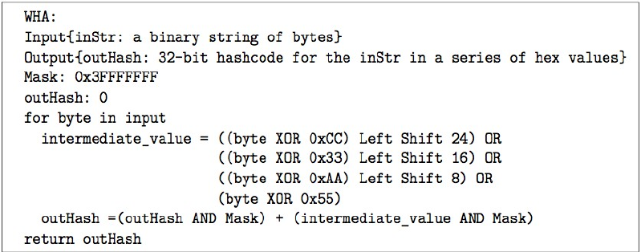
Weak Hashing Algorithm
Given a weak hashing algorithm, we ask you to find a string that produces the same hash as the string in your 1.1.3.2_input_string.txt
Approach: Know the properties of XOR
If you figure out how WHA works, it would be very straight forward to come up with a string that maps to the same hash string as in the text file 1.1.3.2_input_string.txt

Slide 10
What’s in MP1 Checkpoint 2?
Checkpoint 2 is worth ⅚ of your total mp1 grade.
Problems:
Length extension attack
MD5 collisions
Padding Oracles
Mining your P’s and Q’s
Colliding certificates

