Slide 1
Development of a Single-Carrier SM-MIMO Transceiver
System Concept
Literature Research

Slide 2
Large-Scale MIMO

Slide 3
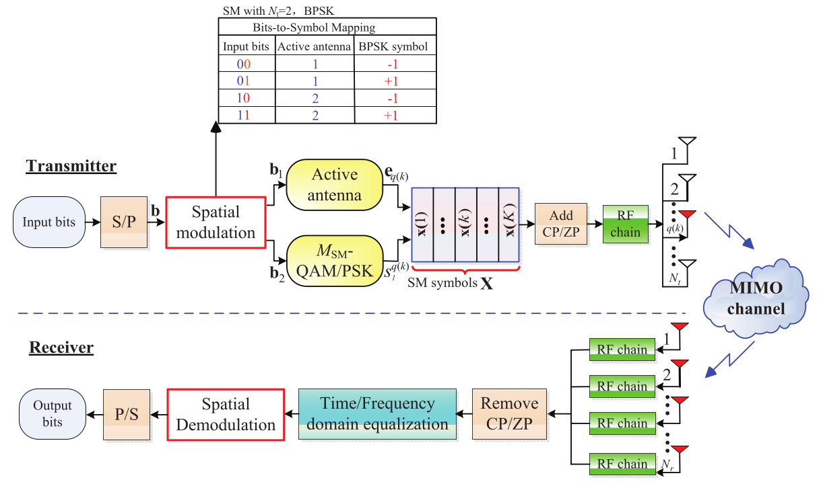
System Model SC-SM

Slide 4
Spatial Modulation System Design

Slide 5
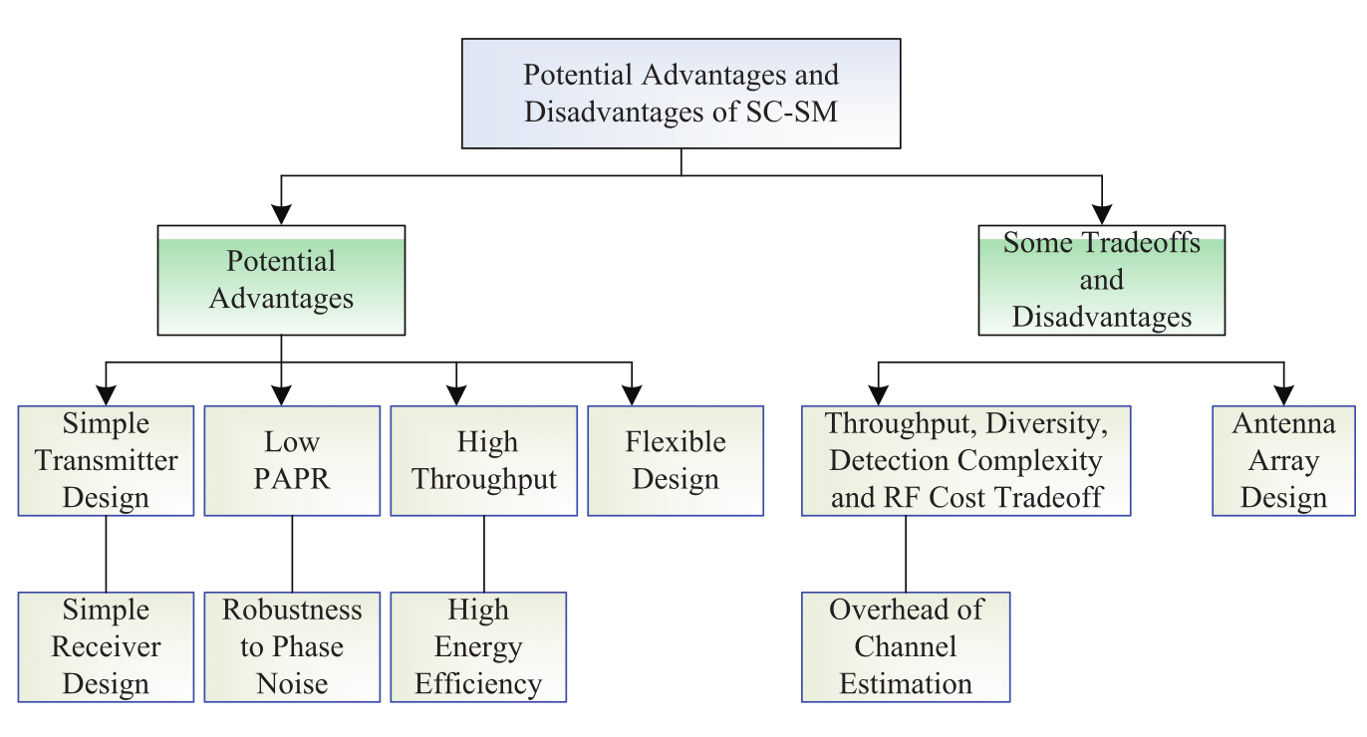
Advantages & Disadvantages

Slide 6
Detector Design
Conventional SM detectors focus on TA index, ignore ISI
Conventional MIMO detectors assume N_r > N_t
BER performance of GSM dominated by the detectors
Receiver architectures:
  Frequency-Domain Equalization
  Time-Domain Equalization
  Turbo Equalizer
TDE Detection schemes:
  ML-based
  PIC-R-SIC
  LSS

Slide 7
Low-Complexity Detection Scheme for GSM-SC
Based on M-algorithm
Fully ranked QR-Matrix not needed

Slide 8
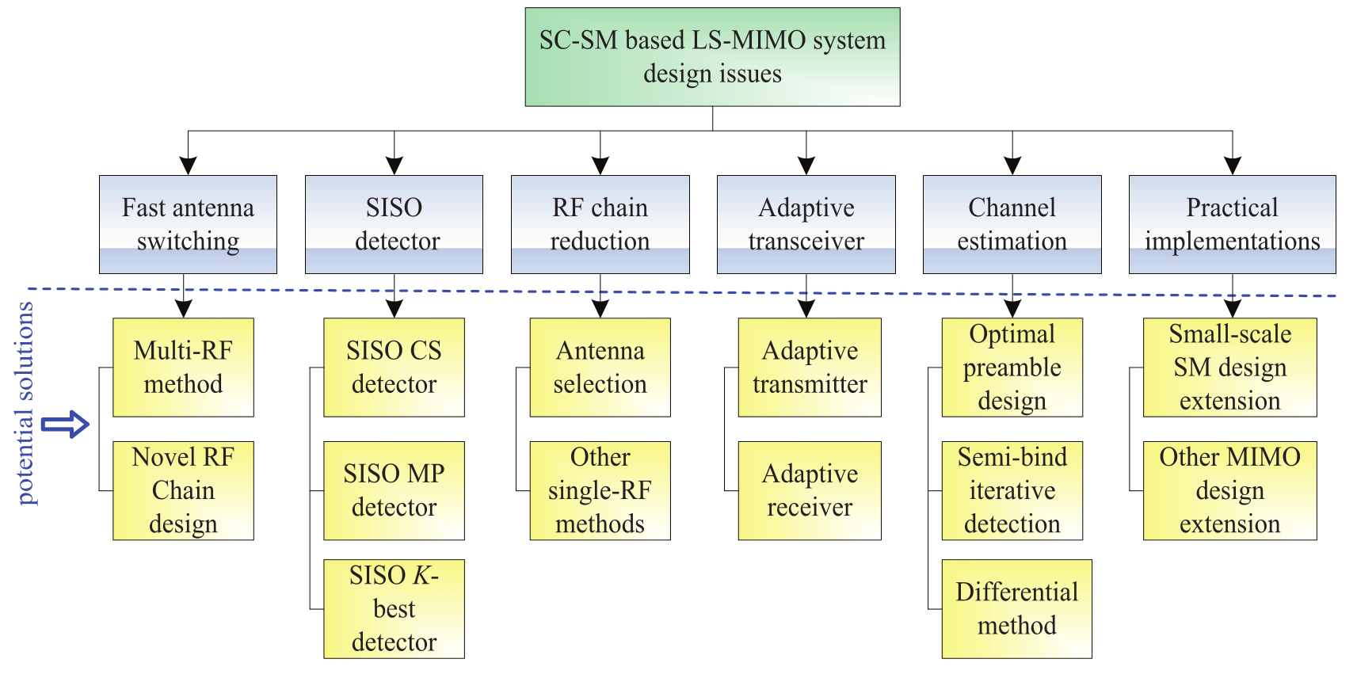
Potential Design Issues

Slide 9
Any questions?
Sources
  P. Yang, Y. Xiao, Y. L. Guan, K. V. S. Hari, A. Chockalingam, S. Sugiura, H. Haas, M. Di Renzo, C. Masouros, Z. Liu, L. Xiao, S. Li and L. Hanzo, “Single-Carrier SM-MIMO: A Promising Design for Broadband Large-Scale Antenna Systems,” IEEE Commun. Surveys & Tutorials, vol. 18, no. 3, pp. 1687-1716, August 2016
  L. Xiao, D. Lilin, Y. Zhang, Y. Xiao, P. Yang and S. Li, “A low-complexity detection scheme for generalized spatial modulation aided single carrier systems,” IEEE Commun. Lett., vol. 19, no. 6, pp. 1069-1072, Jun. 2015
  Z. Tian, Z. Li, M. Zhou and X. Yang, “M-Algorithm-Based Optimal Detectors for Spatial Modulation,“ Journal of Commun., vol. 10, no. 4, April 2015

