Slide 1
Development of a Single-Carrier SM-MIMO Transceiver
Detector Implementation
Channel Estimation & Synchronization

Slide 2
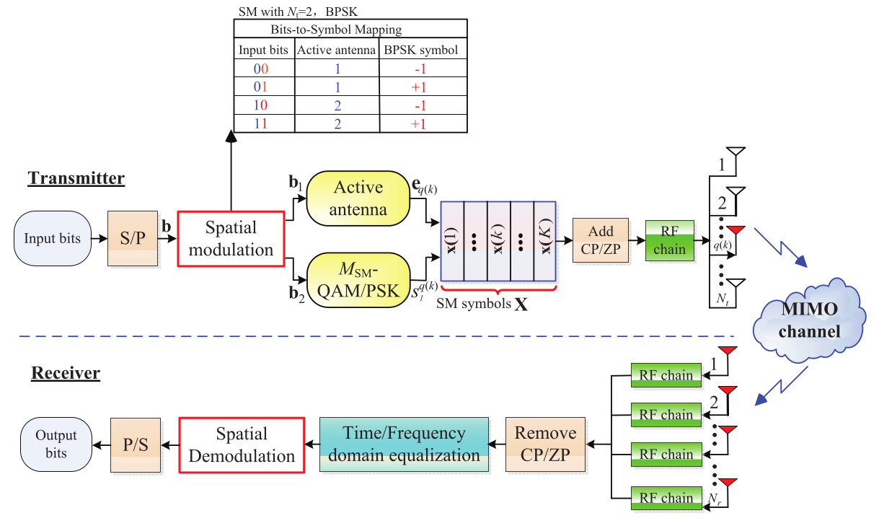
System Model SC-SM
  Figure 1: General transceiver structure of SC-SM systems [1]

Slide 3
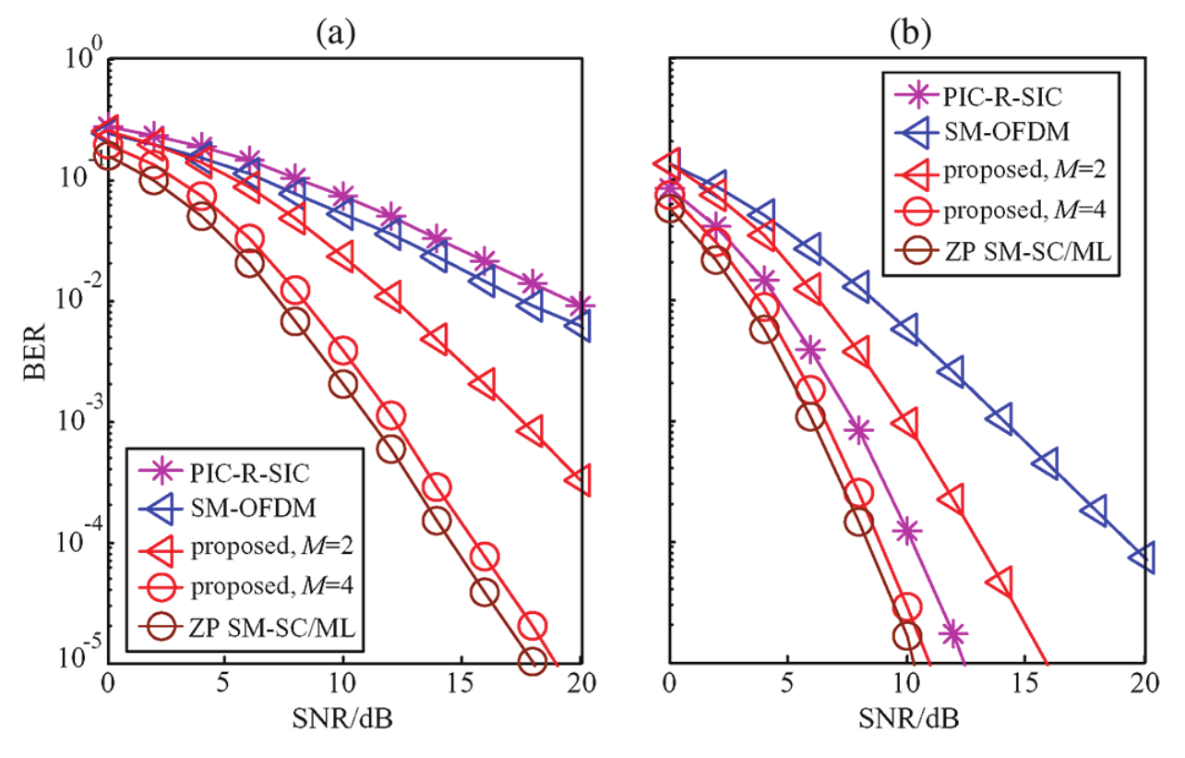
Low-Complexity Single-Stream ML Scheme
Based on M-algorithm.
Single stream ML detection.
Avoids QR-decomposition.
Balanced trade-off:
performance/complexity.
Scheme approaches ML
detector with increasing M.
Efficient operation even in
rank-deficient channel
scenarios.
Figure 2: BER of ZP-aided SM-SC and SM-OFDM with
different receiver antennas: (a) N_r = 1; (b) N_r = 2 [1]

Slide 4
Detector Implementation – Practical Solutions
Module & class-based approach:
  sc_sm_transceiver.py – transceiver, LSS-detector classes.
  channel.py – uniform frequency-selective rayleigh fading channel class.
  modulation.py – linear modulation classes.
Spatial modulation symbol creation, e.g. [0, -1].
Debug:
  Correctly store metrics & estimated symbols.
  Correct norms and variances.
  Add true final detection over M candidates.
Look into / validate Zero-Prefix.
Improve scripts for testing & plotting.

Slide 5
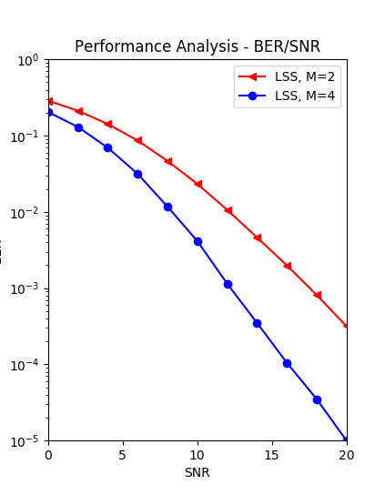
Detector Implementation – Simulation Results
Figure 4: BER of ZP-aided SM-SC and SM-OFDM with
different receiver antennas: (a) N_r = 1; (b) N_r = 2 [1]
Figure 3: BER of ZP-aided SM-SC with
receiver antenna: N_r = 1

Slide 6
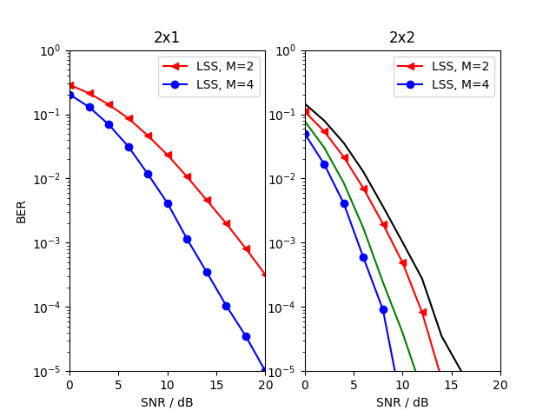
Detector Implementation – Simulation Results
Figure 5: BER of ZP-aided SM-SC with
different receiver antennas: N_r =1; N_r = 2

Slide 7
Channel Estimation & Preamble Design
Common approach: Use pilot signals (or preambles) and correlate.
Conventional preamble sequences may hurt advantages of SC-SM:
  Sparse structure of SC-SM symbols not taken into account.
  Prone to estimation errors – small-scale SM more robust than V-BLAST.
  Not investigated in large-scale SC scenarios.
Special training sequences using cyclic right-shifting method:
  May not be suitable for high rates: Power efficiency loss, pilot overhead
Ternary-like pseudo-random sequences promising candidates.
Reducing pilot overhead:
  Semi-blind iterative detection techniques.
  Advanced training optimization techniques.
  Differentially encoded designs.

Slide 8
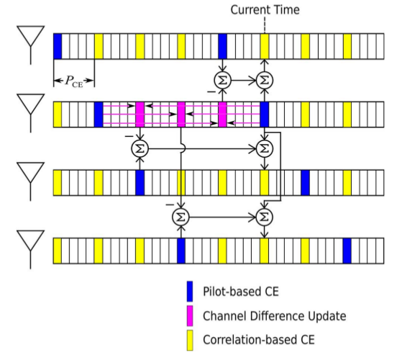
Practical Channel Estimation - TCCE/CCE
Implement small-scale
approach: Hybrid between
conventional channel
estimation and transmission
cross channel estimation.
Estimate whole MIMO
channel by sending
pilots through 1 TA.
High channel correlation:
Gain of 7.5 dB.
Figure 4: Block diagram of TCCE for SM with N_t = 4. [2]

Slide 9
Practical Channel Estimation – Other schemes
Semi-blind joint channel estimation and data detection for STSK:
  Uses initial least square channel estimate.
  Then low-complexity single-stream ML.
  Few iterations sufficient to approach ML with perfect CSI.
  Lower bound: number_of_training_blocks > N_t / number_of_time_slots.
Reduced-complexity joint channel estimation and data detection:
  Based on the above-mentioned scheme.
  Channel coefficients estimated according to MMSE criterion.
  Achievable BER performance improves at the expense of an increased
  decoding complexity (increases linearly with number of iterations).
Reduced-complexity ML detection and capacity-optimized training:
  Optimal power allocation between data & training blocks (capacity bound).
  Same SER performance as iterative data-detection/channel-estimation algorithm.

Slide 10
Prospects
Solve 1 dB offset for 2x2 scenario.
Implement different channels (COST, LTE).
Implement and analyze channel estimation scheme(s).
Implement synchronization.
Proof of concept with GNU Radio

Slide 11
Any questions?
Sources
  [1] L. Xiao, D. Lilin, Y. Zhang, Y. Xiao, P. Yang and S. Li, “A low-complexity detection scheme for generalized spatial modulation aided single carrier systems,” IEEE Commun. Lett., vol. 19, no. 6, pp. 1069-1072, Jun. 2015
  [2] X. Wu, H. Claussen, M. Di Renzo and H. Haas, “Channel estimation for spatial modulation,” IEEE Trans. Commun., vol. 62, no. 12, pp. 4362-4372, Dec. 2014

