Slide 1
Development of a Single-Carrier SM-MIMO Transceiver
Detector Design
MIMO Implementation

Slide 2
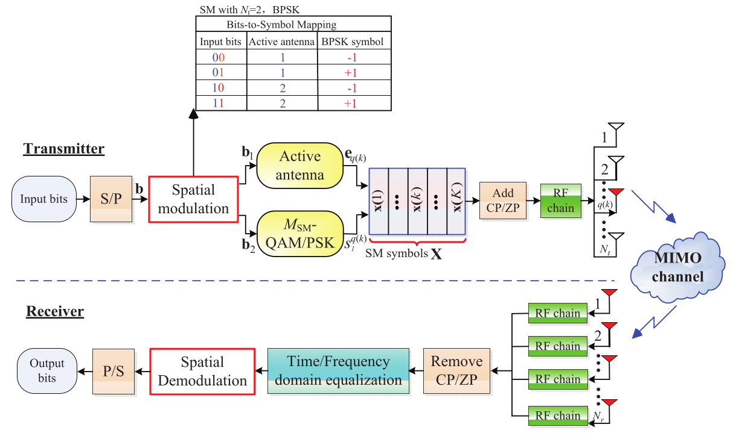
System Model SC-SM
  Figure 1: General transceiver structure of SC-SM systems [1]

Slide 3
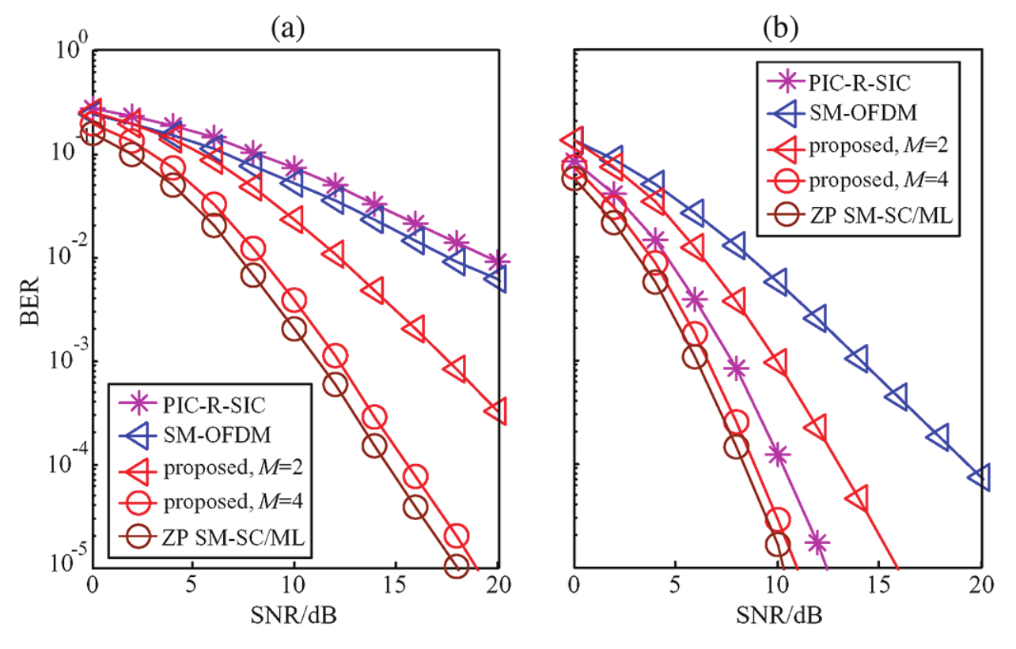
Low-Complexity Detection Scheme for GSM-SC
Based on M-algorithm
Single stream ML detection
Avoids QR-decomposition
Balanced trade-off:
performance & complexity
Scheme approaches ML
detector with increasing M
Efficient operation even in
rank-deficient channel
scenarios
Figure 4: BER of ZP-aided SM-SC and SM-OFDM with
different receiver antennas: (a) N_r = 1; (b) N_r = 2 [1]

Slide 4
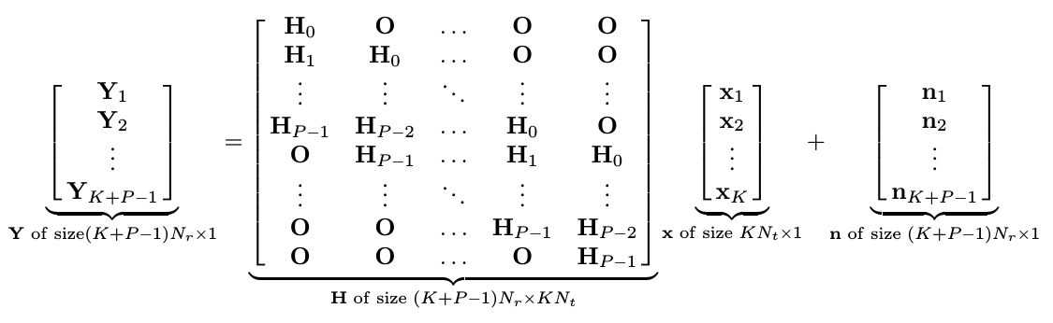
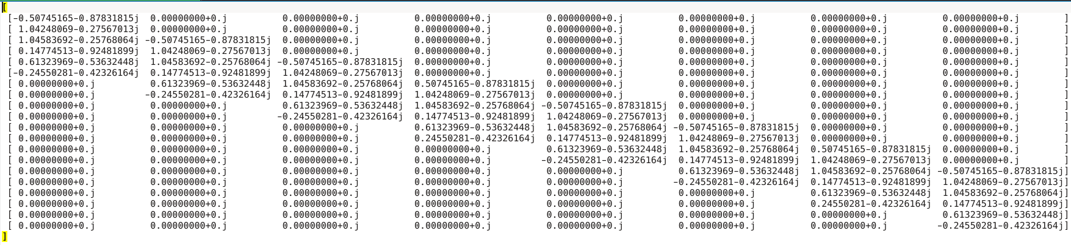
Current Detector Design
Transmission system fully implemented:
Channel Matrix scales according to N_t, N_r:

Slide 5
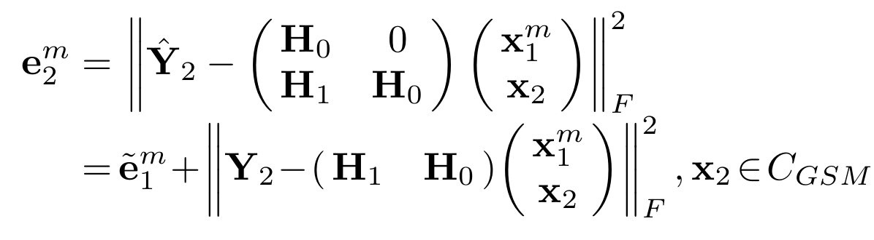
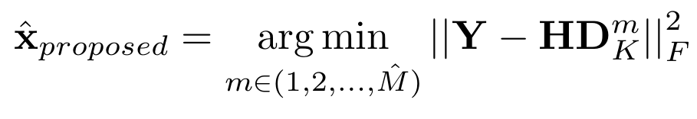
Current Detector Design
Working MIMO implementation (N_t x N_r):
  1 x 2
  2 x 2
M smallest metrics are chosen by M-algorithm:
  M = 1
  No final detection yet:
Script to test the detector:
  If every sent symbol is correctly detected: True
  ~45% of the time this is the case (SNR = 10 dB)

Slide 6
Prospects
Adjust sent symbols
Generalize for number of multi-path links (P)
Generalize for M (starting with M = 2)
Compare BER performance with results in paper
MIMO schemes to implement:
  2 x 1
  N_t x N_r
Fuse scripts: class based SISO transmission and MIMO detector scheme
Addition of spatial modulation / spatial modulation symbols
Proof of concept with GNU Radio

Slide 7
Any questions?
Sources
  [1] L. Xiao, D. Lilin, Y. Zhang, Y. Xiao, P. Yang and S. Li, “A low-complexity detection scheme for generalized spatial modulation aided single carrier systems,” IEEE Commun. Lett., vol. 19, no. 6, pp. 1069-1072, Jun. 2015
  >>> import this
  >>> import antigravity

