Slide 1
Development of a Single-Carrier SM-MIMO Transceiver for Broadband Large-Scale Antenna Systems
System Model & Analysis
Channel Estimation & Synchronization

Slide 2
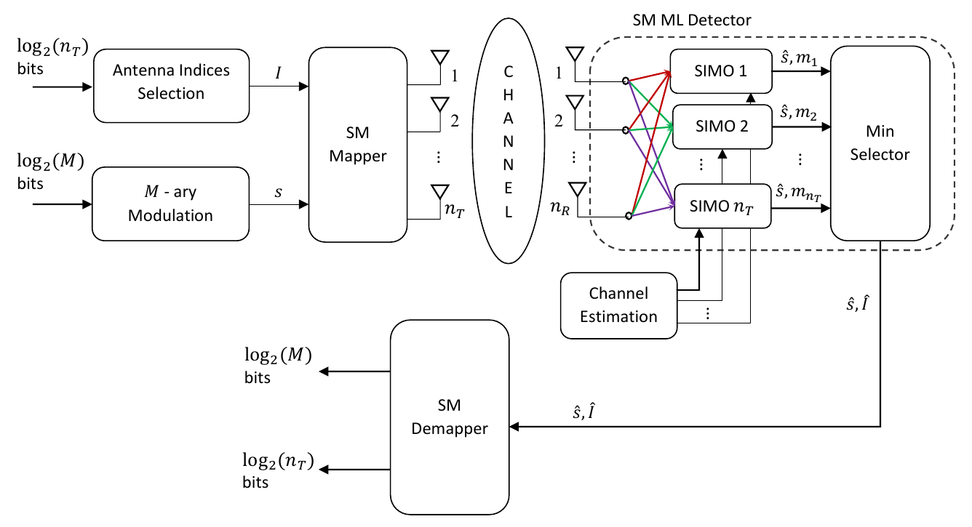
System Model: Spatial Modulation
Use antenna index information as additional modulation dimension.
Apply information in specific SM-symbol modulation algorithm.
  Figure 1: General structure of Spatial Modulation systems [0].

Slide 3
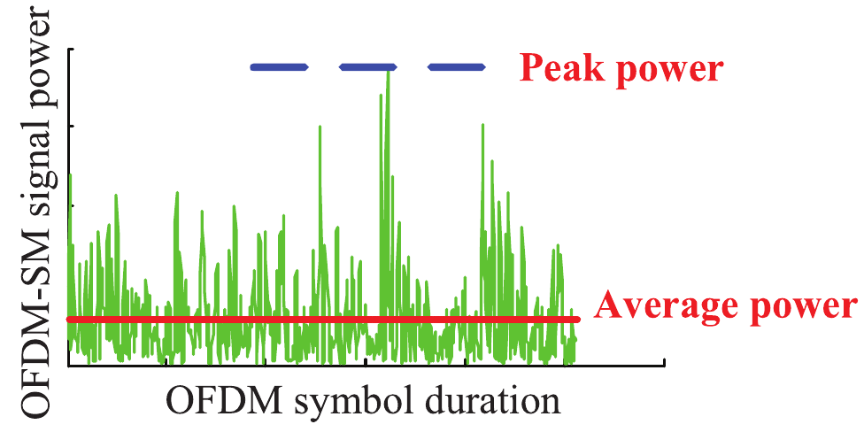
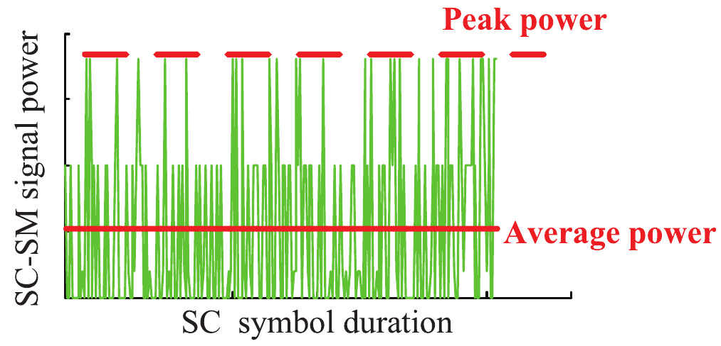
System Model: Large-Scale Single-Carrier
Spatial Modulation predominantly investigated in flat fading channels.
In frequency-selective channels: OFDM is assumed.
Disadvantages of OFDM-SM:
  Usage of various transmit antennas in one frame jeopardizes single-RF benefits of SM-MIMO.
  Low power amplifier efficiency due to PAPR.
  Computational burden of DFTs increases with number of transmit antennas
Frequency-selective channel may be converted into frequency flat fading channels by carefully designed receive filters.
  Figure 2: Comparison of PAPR of OFDM-SM and SC-SM [1].

Slide 4
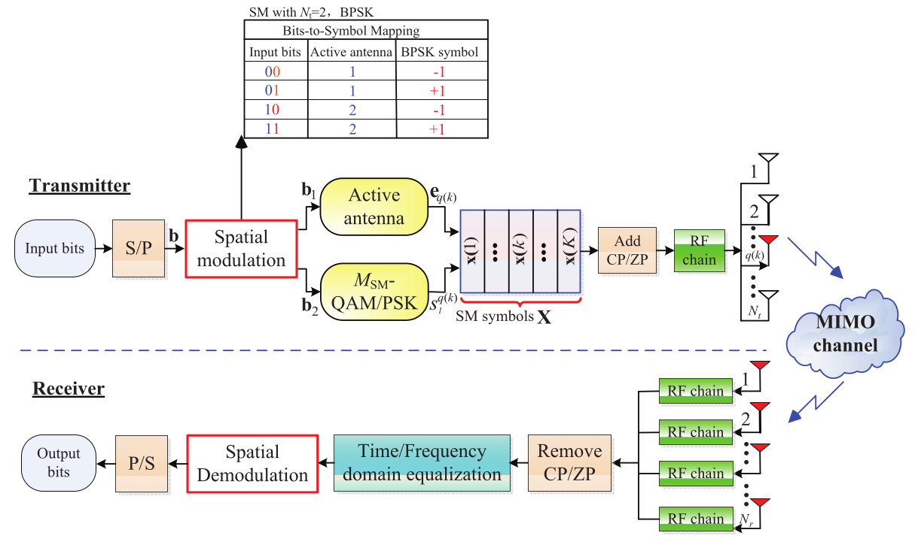
Single-Carrier Spatial Modulation (1)
  Figure 3: General transceiver structure of SC-SM systems [1].

Slide 5
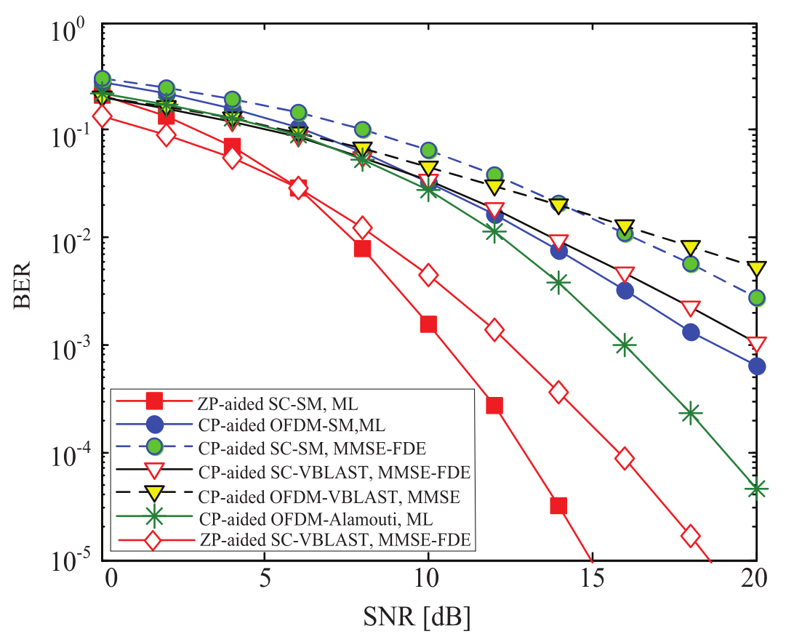
Single-Carrier Spatial Modulation (2)
Use ZP-aided SC-SM:
  Promising BER
  performance.
  Only one RF-chain
  at transmission.
Channel matrix might
be rank deficient.
Attractive trade-off
amongst detection
complexity, BER,
achievable transmission
rate and power efficiency.
Figure 4: BER comparison of the ZP-aided SC-SM scheme over its CP-aided counterpart and various CP-aided classic MIMO transmission schemes [1].

Slide 6
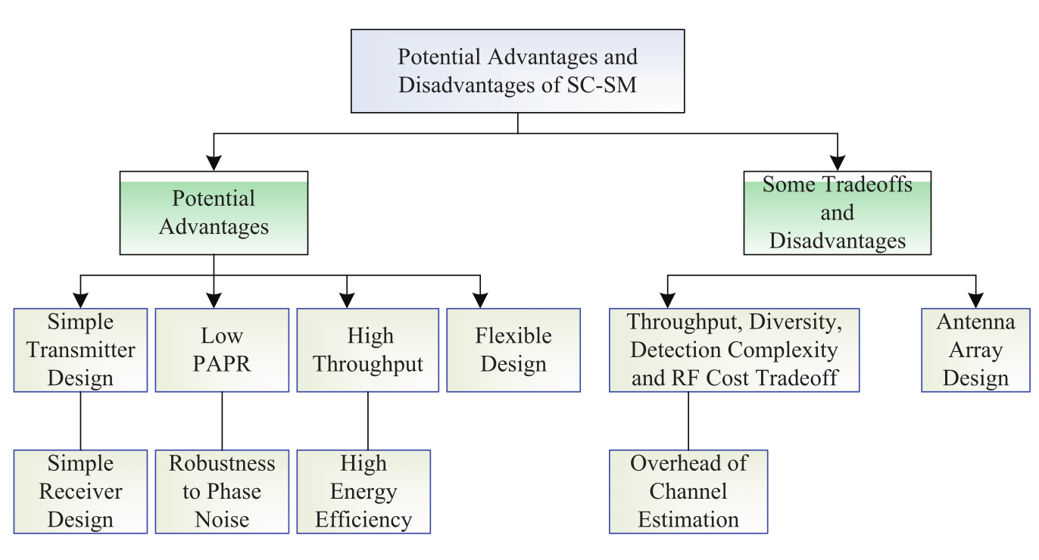
Advantages & Disadvantages
Figure 5: A summary of main advantages and disadvantages of the SC-SM scheme [1].

Slide 7
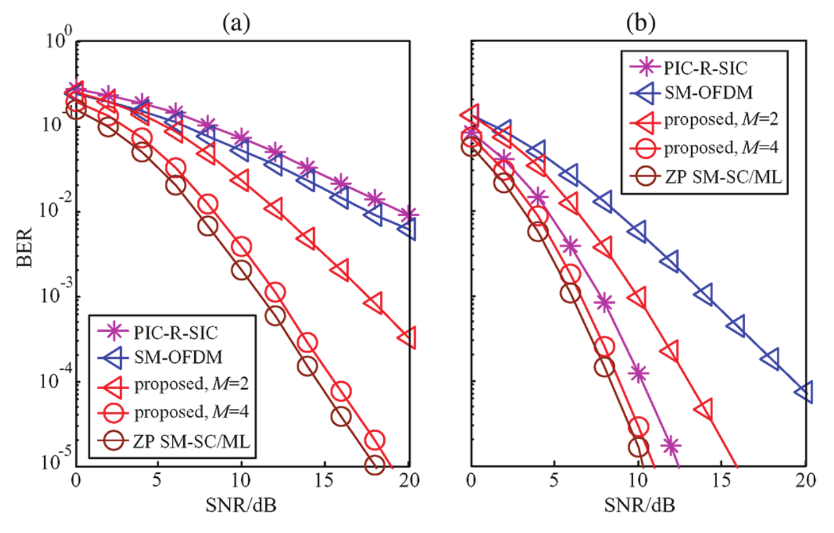
Low-Complexity Detection Scheme for GSM-SC
Based on M-algorithm
Single stream ML detection
Avoids QR-decomposition
Balanced trade-off:
performance & complexity
Scheme approaches ML
detector with increasing M
Efficient operation even in
rank-deficient channel
scenarios
Figure 6: BER of ZP-aided SM-SC and SM-OFDM with
different receiver antennas: (a) N_r = 1; (b) N_r = 2 [2].

Slide 8
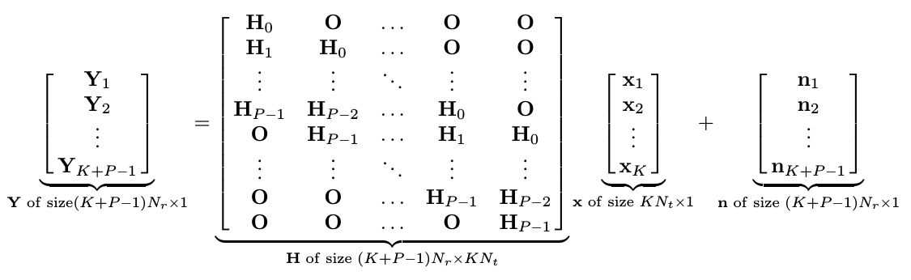

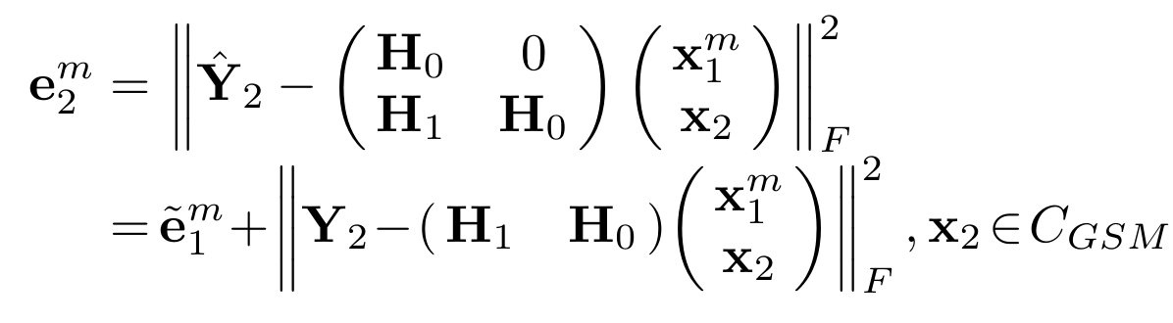
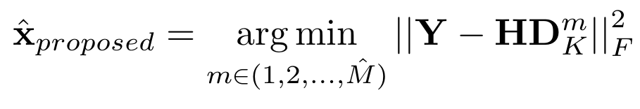
Specific Detector Design
Transmission system model:
For each step: compute and choose M best metrics.
Final detection after K steps:

Slide 9
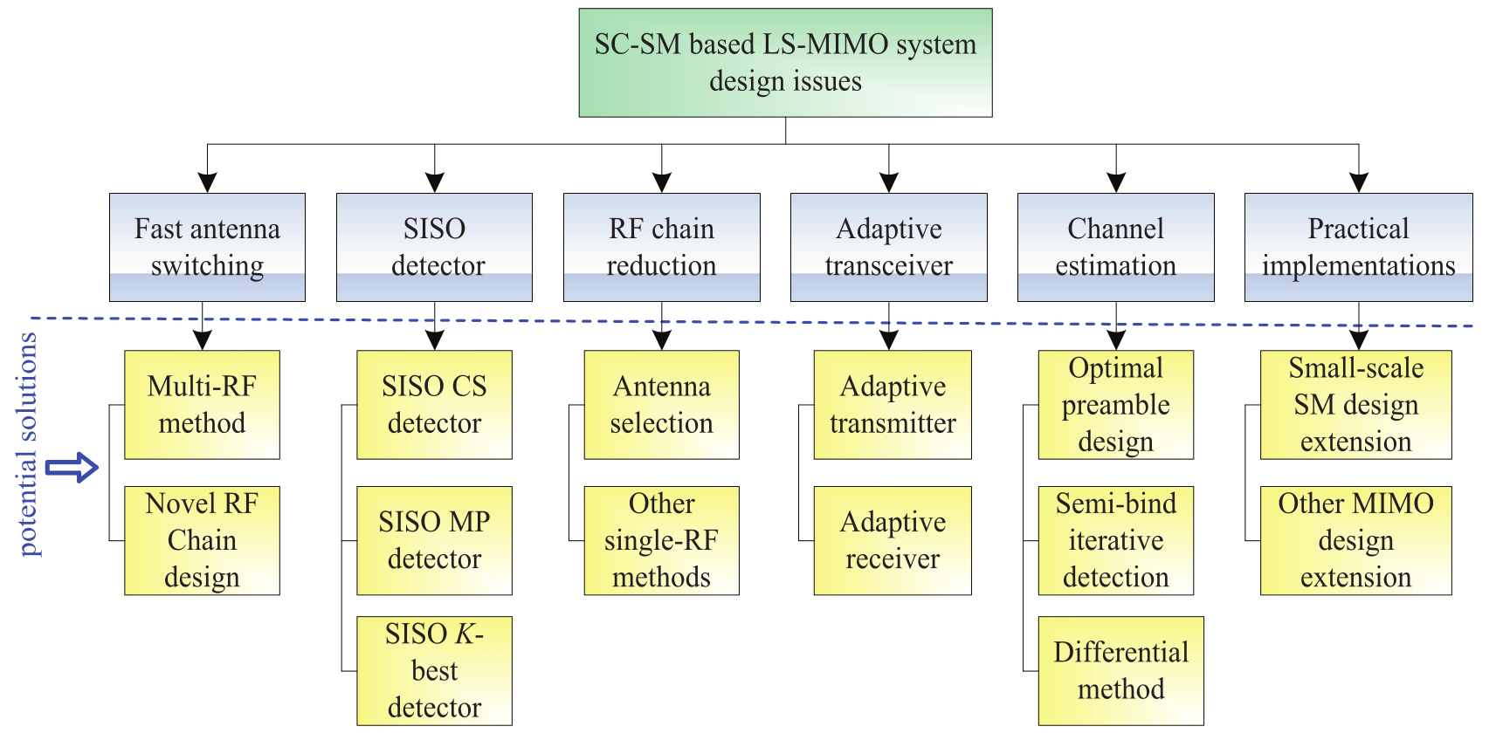
Potential Design Issues
Figure 7: Potential future design issues and potential solutions [1].

Slide 10
Classic Channel Estimation scheme
For each transmission antenna: send training sequence.
Using Gold Sequences: no multi-path effects for different antennas.
  A frame can contain multiple antenna sequences.
Correlate with the corresponding sequence at the receiver.
  Channel Impulse Response for each transmit antenna.
Reconstruct channel matrix with impulse responses.
Performance trade-offs:
  Longer sequences → lower threshold for reconstruction & more overhead.
  More N_t → more index information & more overhead.
  More N_r → lower channel estimation SNR needed.

Slide 11
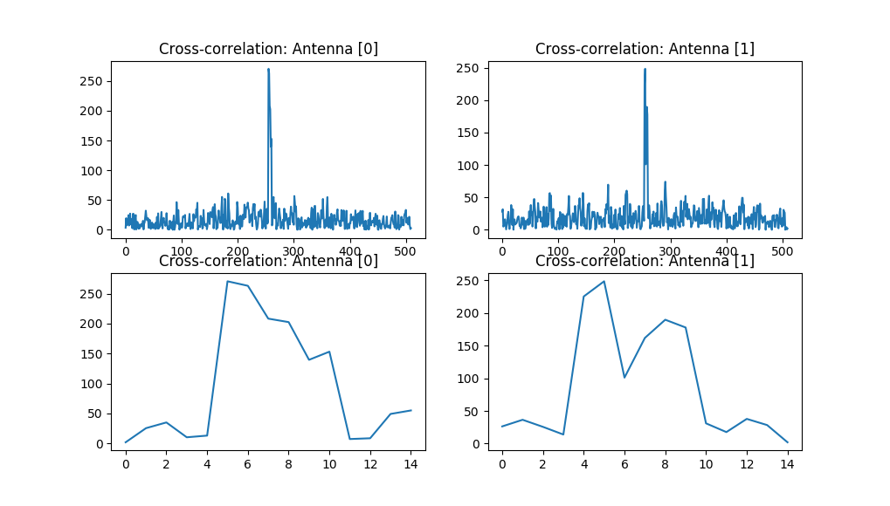
Simulation Results: Classic Approach (1)
Figure 8: Results of correlation: Channel Impulse Response for different sending antennas [N_r =2; N_r = 2; hard coded].

Slide 12
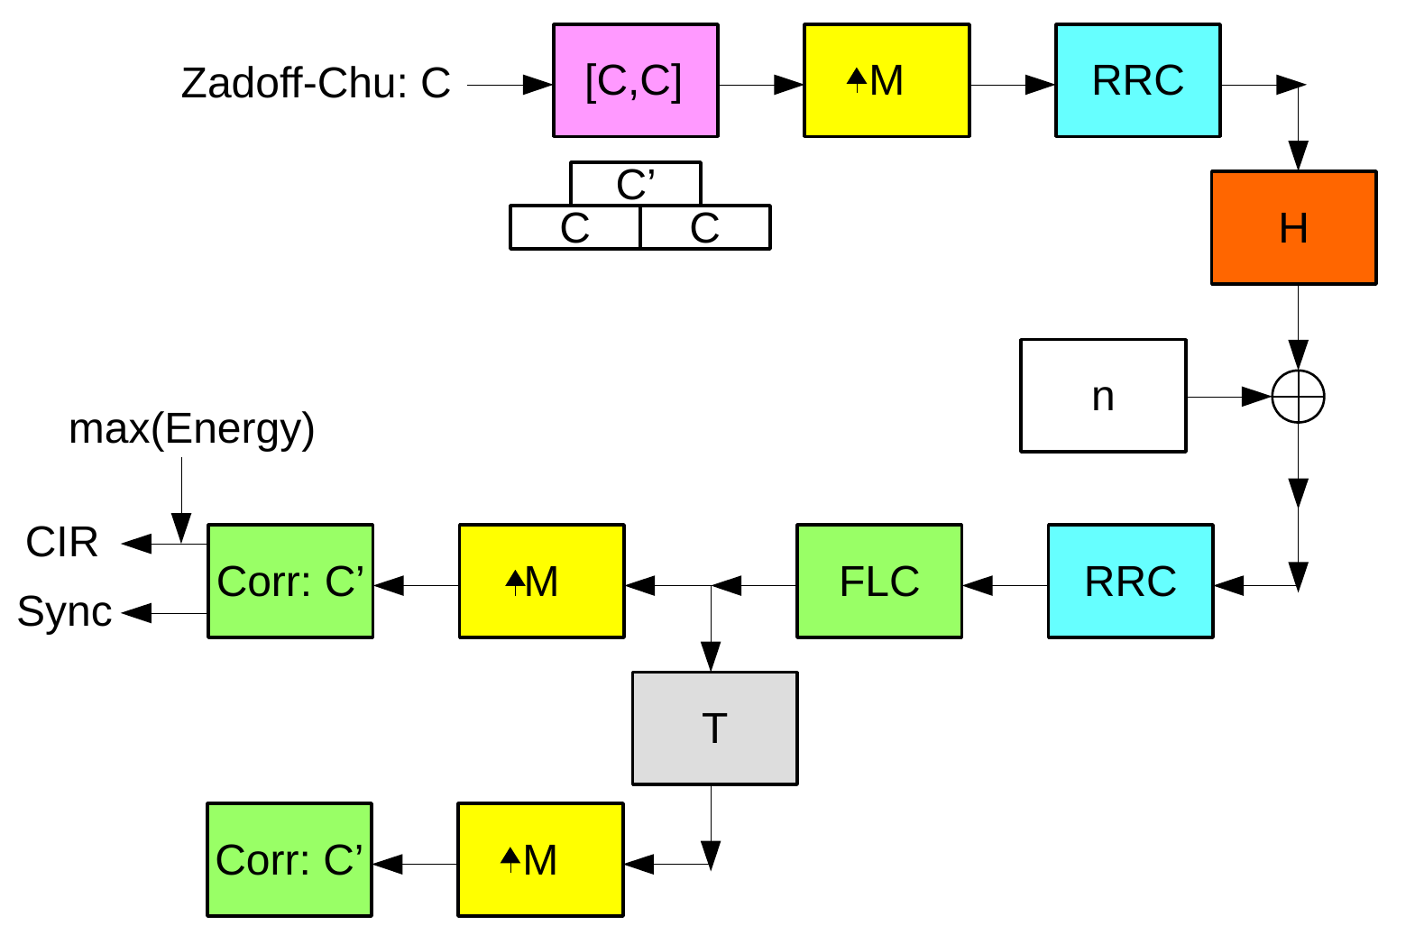
Simultaneous Frame Synchronization and Channel Estimation scheme
  Figure 9: Proposed Synchronization & Channel Estimation scheme.

Slide 13
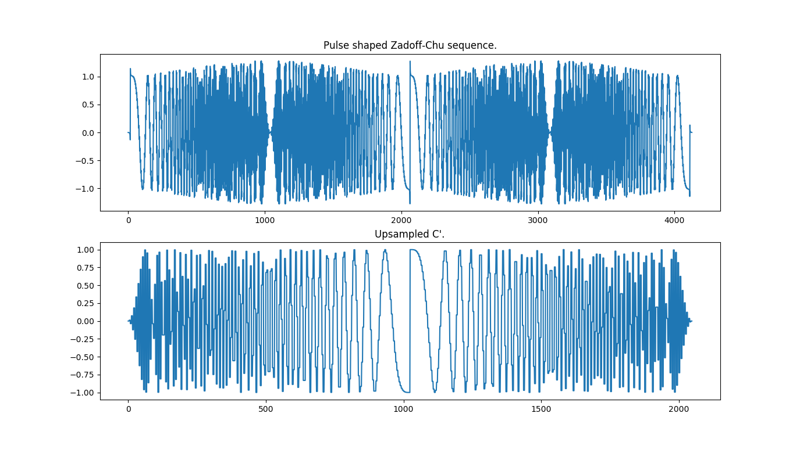
Simulation Results: Pulse shaped chirp
Figure 10: Upsampled frames: C and C’.

Slide 14
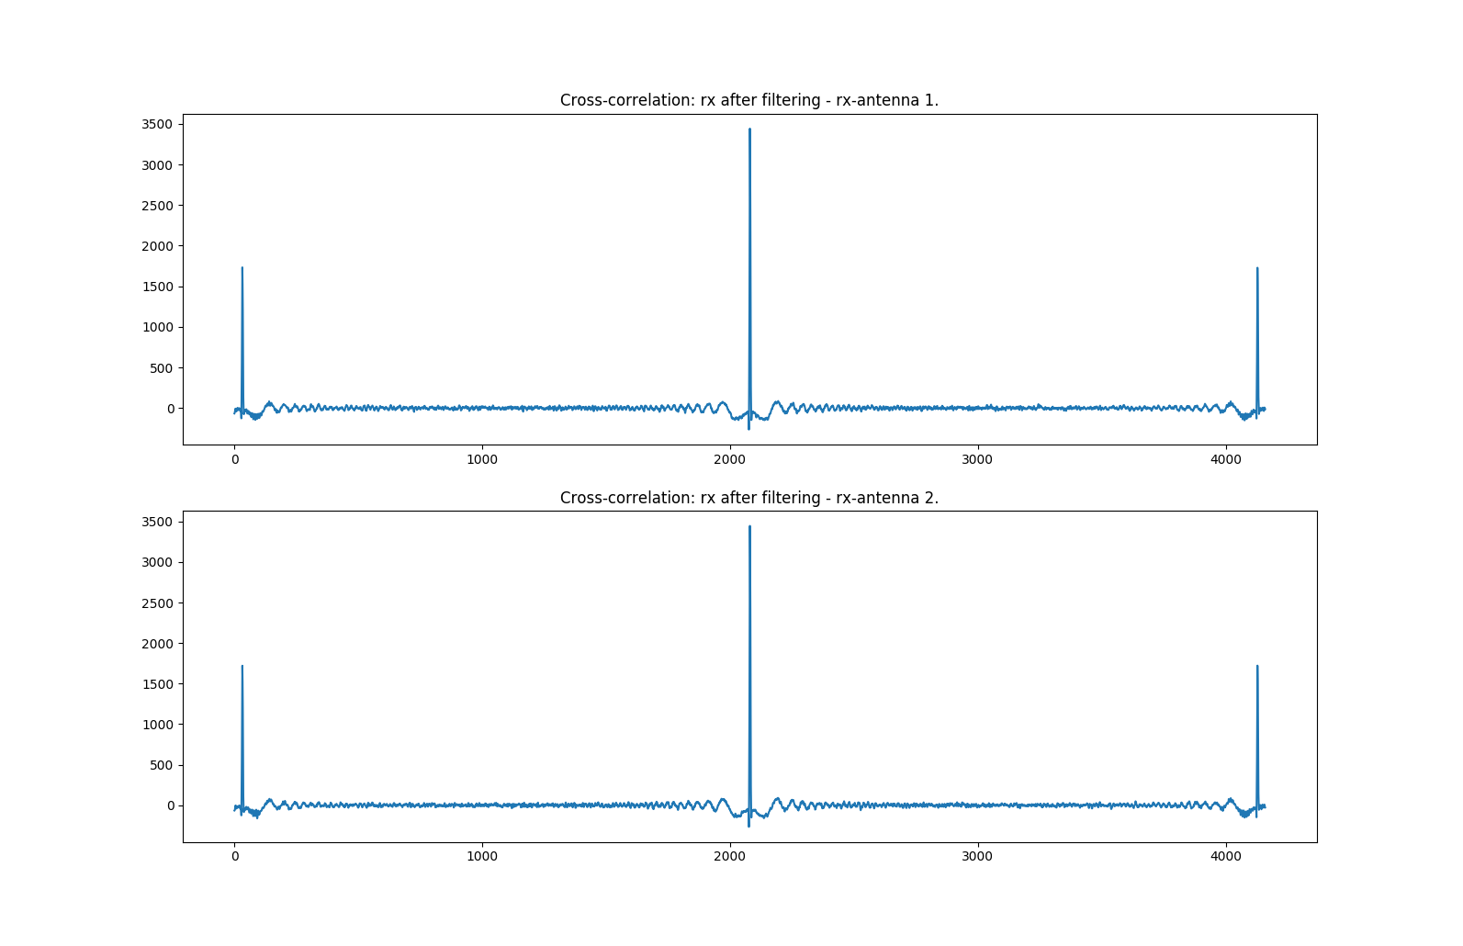
Simulation Results: SIMO / Split (1)
Figure 11: Cross-correlation of the received frame with C’ - split reception antennas.

Slide 15
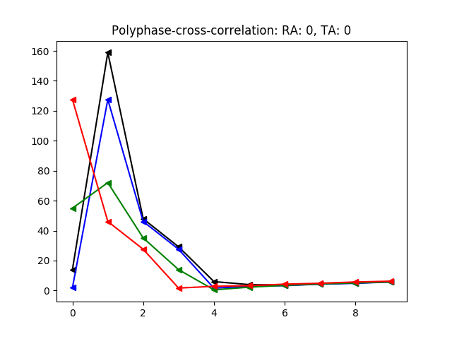
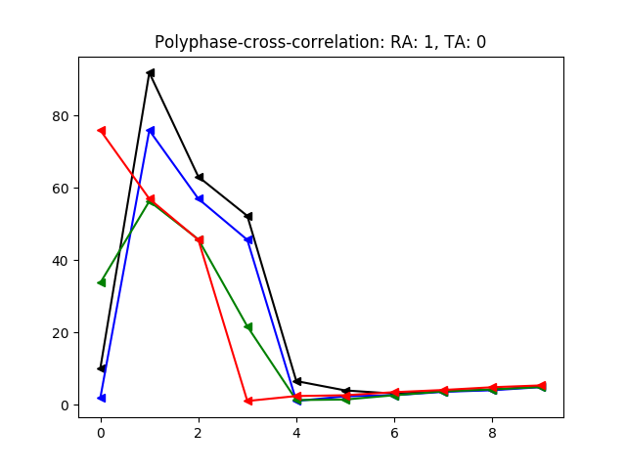
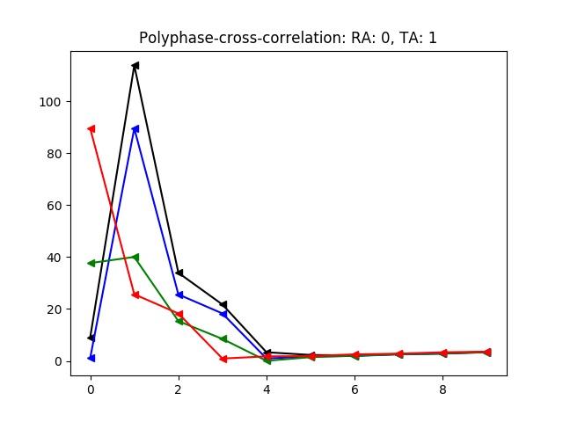
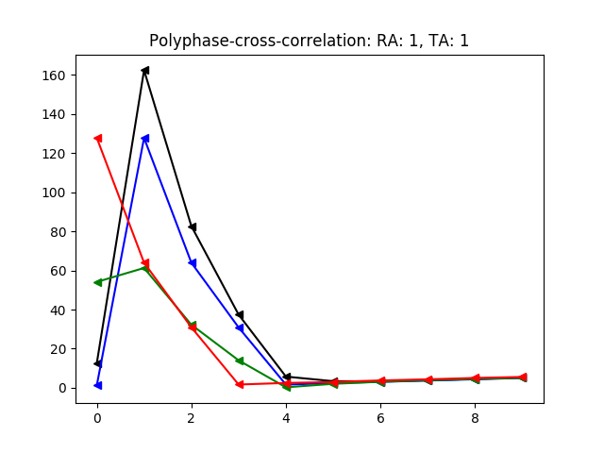
Simulation Results: SIMO / Split (2)
Figure 12: Polyphase-cross-correlation of the received frame with C’ -
split reception antennas – split transmit antennas.

Slide 16
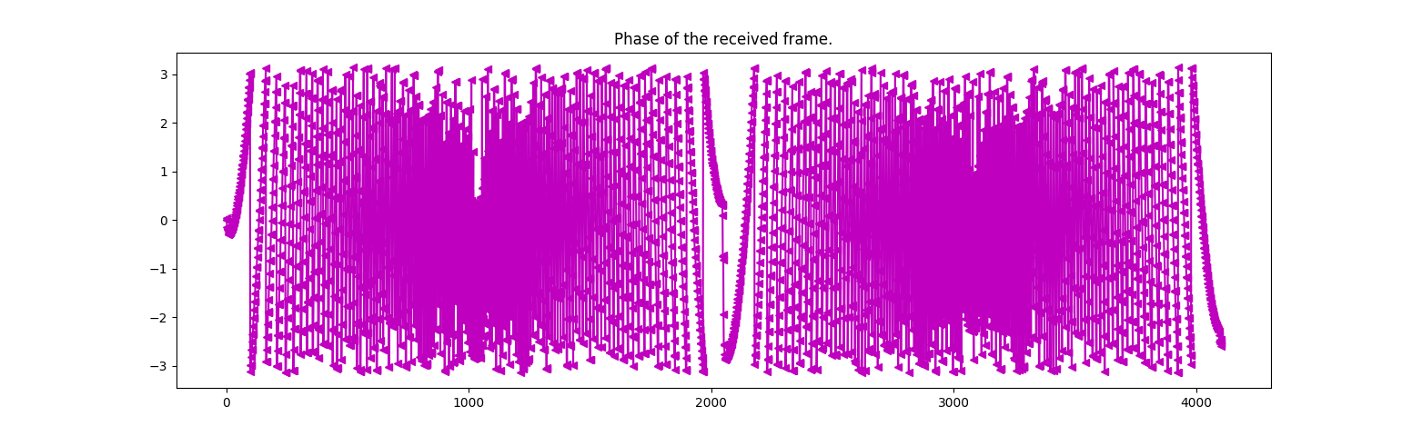
Frequency & Phase Synchronization
Estimate frequency-offset by multiplying the identical values of the training frame halves:
  Resulting phase-offset over time between points is frequency offset.
Frame offset is estimated by energy of channel impulse response.
Phase-offset is phase of frame begin of correlation.
Figure 13: Phase of the received frame.

Slide 17
Results
Single-carrier SM and detector scheme:
  System scales well.
  Relatively low complexity.
  Robust even in demanding scenarios.
  Promising candidate for large-scale MIMO aided multiuser uplink and downlink design.
Channel estimation and synchronization scheme:
  Works well in most scenarios.
  Overhead trade-off: frame length and coherence time.
  Scheme might be published in a paper.

Slide 18
Prospects
Current work:
  Exhaustive tests and comparisons.
  Test different channel models (COST, LTE).
  Compare to other Spatial Modulation approaches.
  Generalize, optimize and improve code base.
In future works:
  Proof of concept with GNU Radio.
  Tests on hardware.

Slide 19
Any questions?
Sources
  [0] E. Basar, M. Wen, R. Mesleh, M. Di Renzo, Y. Xiao, H. Haas, “Index Modulation Techniques for Next-Generation Wireless Networks,” IEEE Access, vol. 5, August 2017
  [1] P. Yang, Y. Xiao, Y. L. Guan, K. V. S. Hari, A. Chockalingam, S. Sugiura, H. Haas, M. Di Renzo, C. Masouros, Z. Liu, L. Xiao, S. Li and L. Hanzo, “Single-Carrier SM-MIMO: A Promising Design for Broadband Large-Scale Antenna Systems,” IEEE Commun. Surveys & Tutorials, vol. 18, no. 3, pp. 1687-1716, August 2016
  [2] L. Xiao, D. Lilin, Y. Zhang, Y. Xiao, P. Yang and S. Li, “A low-complexity detection scheme for generalized spatial modulation aided single carrier systems,” IEEE Commun. Lett., vol. 19, no. 6, pp. 1069-1072, Jun. 2015

