Slide 1
Development of a Single-Carrier SM-MIMO Transceiver
Channel Estimation & Synchronization
Complete System Analysis

Slide 2
Classic Channel Estimation scheme
For each transmission antenna: send training sequence.
Using Gold Sequences: no multi-path effects for different antennas.
  A frame can contain multiple antenna sequences.
Correlate with the corresponding sequence at the receiver.
  Channel Impulse Response for each transmit antenna.
Reconstruct channel matrix with impulse responses.
Performance trade-offs:
  Longer sequences → lower threshold for reconstruction & more overhead.
  More N_t → more index information & more overhead.
  More N_r → lower channel estimation SNR needed.

Slide 3
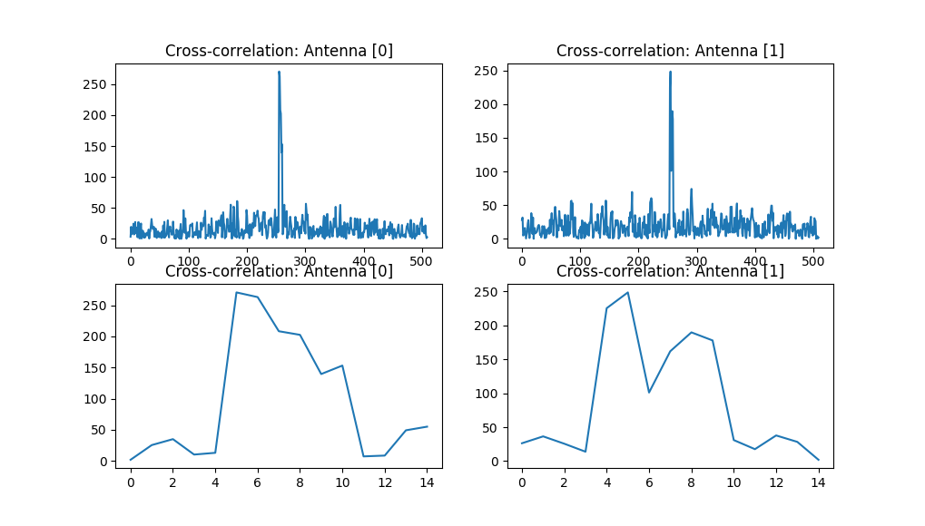
Simulation Results: Classic Approach (1)
Figure 1: Results of correlation: Channel Impulse Response for different sending antennas [N_r =2; N_r = 2; hard coded].

Slide 4
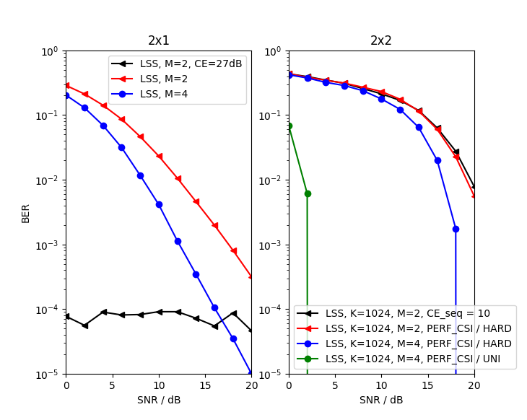
Simulation Results: Classic Approach (2)
  Figure 2: Classic SC-SM Channel Estimation scheme.

Slide 5
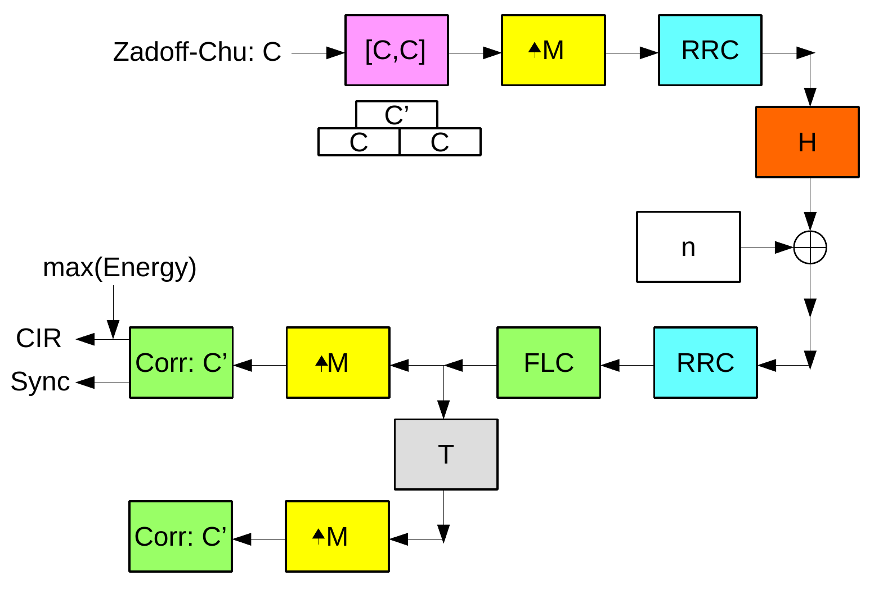
Simultaneous Frame Synchronization and Channel Estimation scheme
  Figure 3: Proposed Synchronization & Channel Estimation scheme.

Slide 6
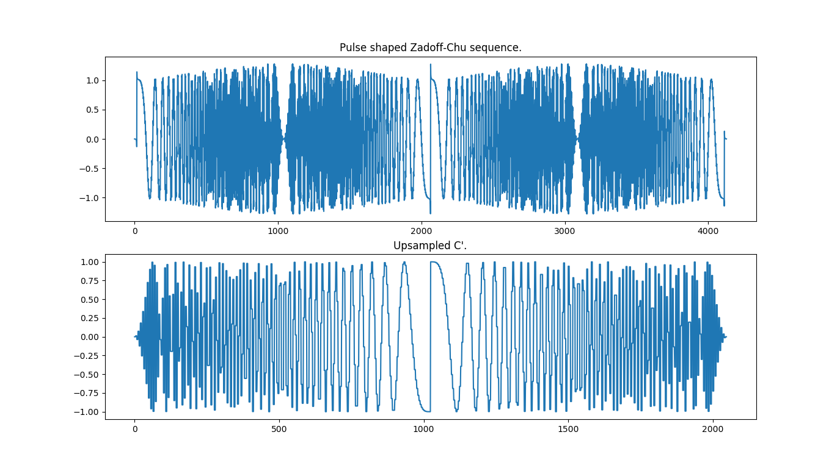
Simulation Results: SISO (1)
Figure 4: Upsampled frames: C and C’.

Slide 7
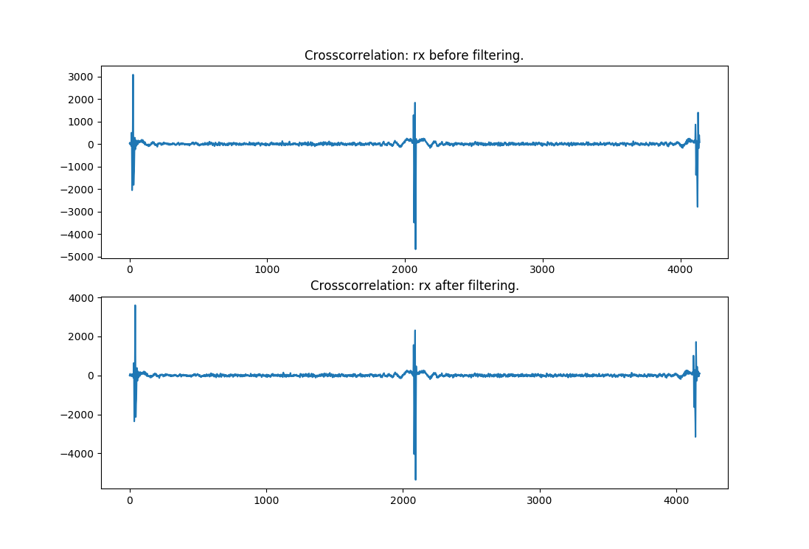
Simulation Results: SISO (2)
Figure 5: Cross-correlation of the received frame with C’.

Slide 8
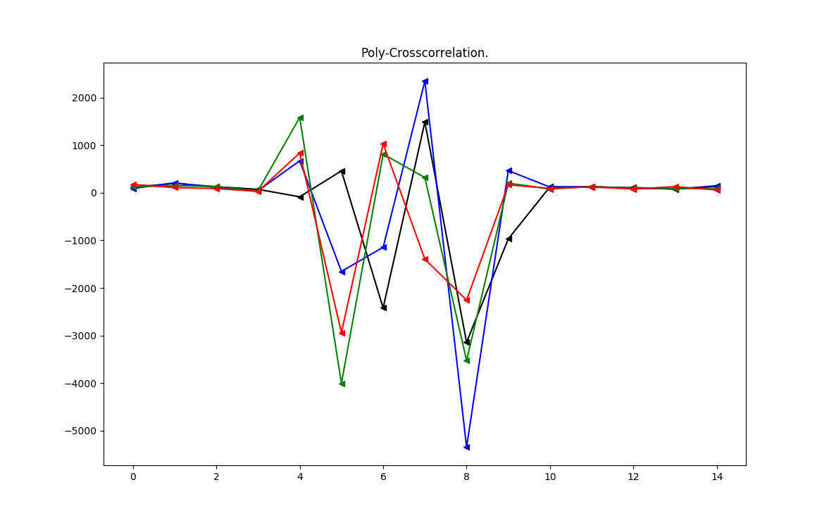
Simulation Results: SISO (2)
Figure 6: Polyphase-cross-correlation of the received frame with C’.

Slide 9
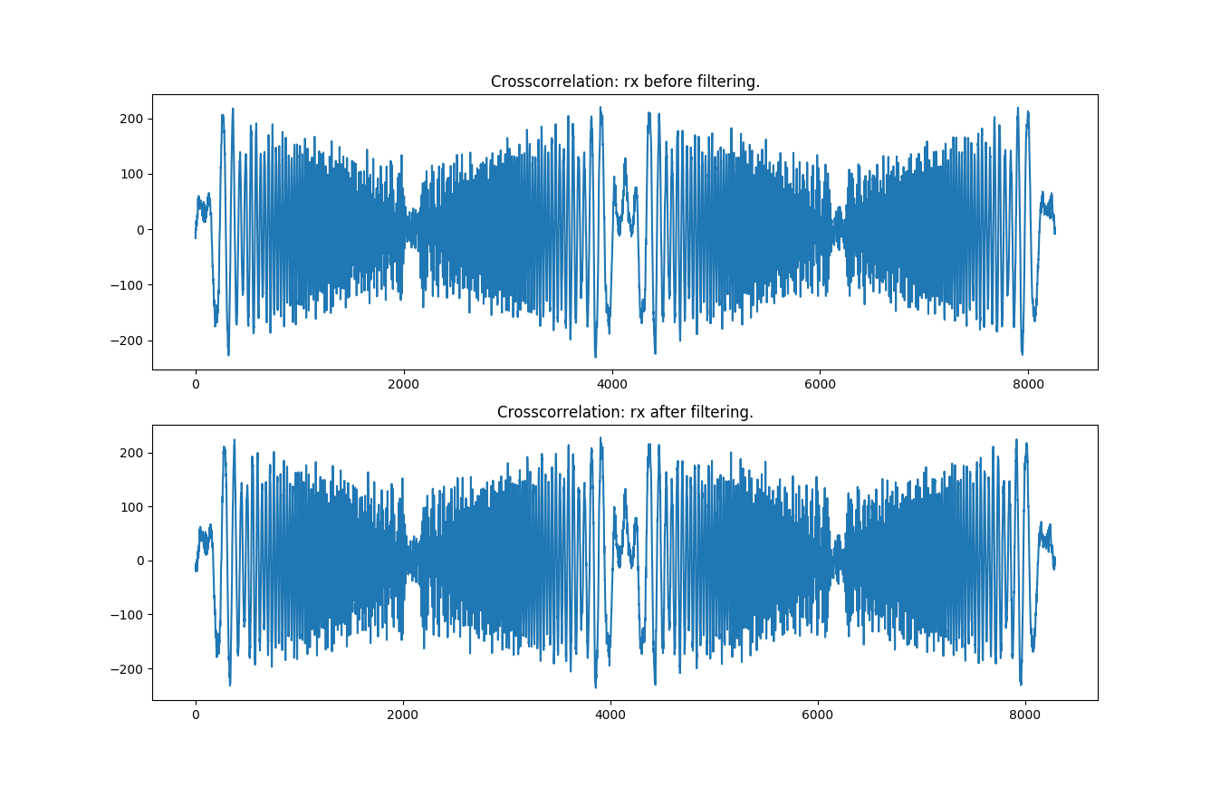
Simulation Results: SIMO (1)
Figure 7: Cross-correlation of the received frame with C’.

Slide 10
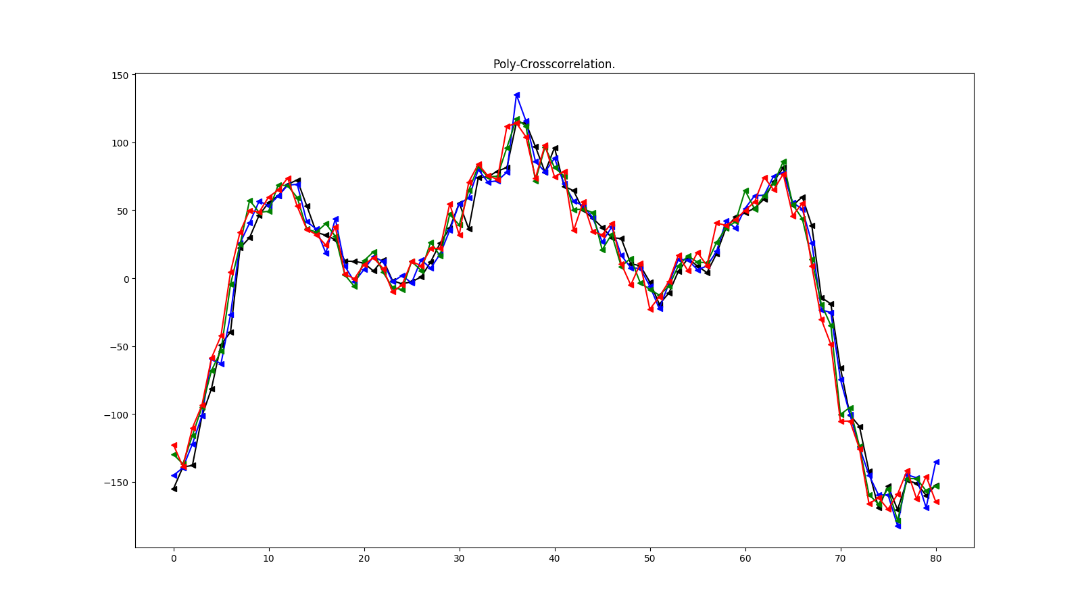
Simulation Results: SIMO (2)
Figure 8: Polyphase-cross-correlation of the received frame with C’.

Slide 11
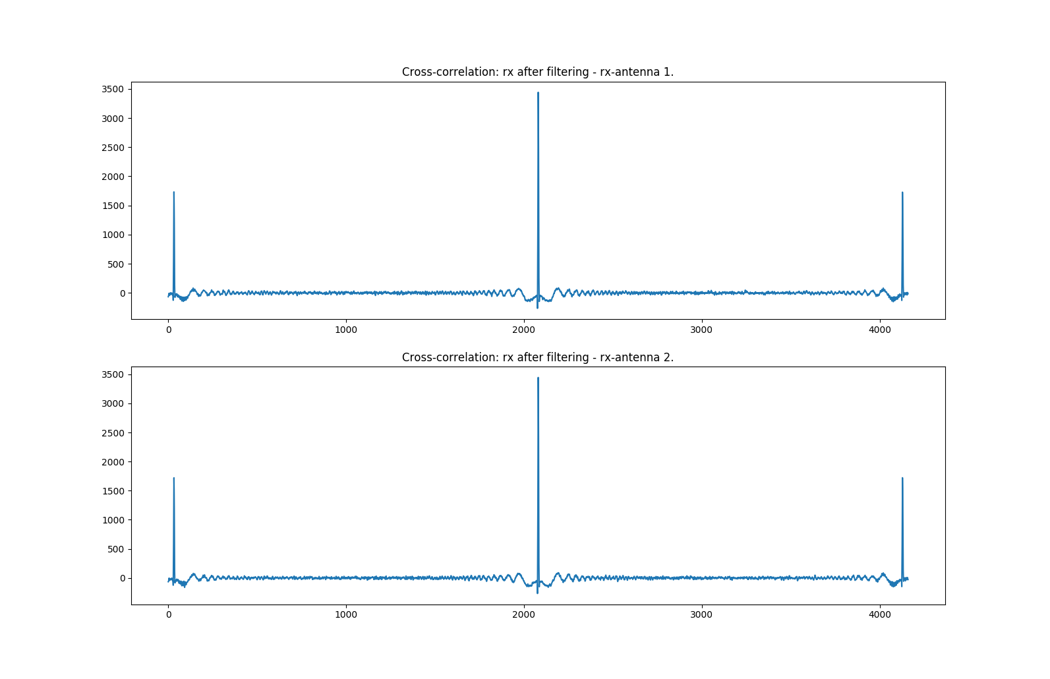
Simulation Results: SIMO/Split (1)
Figure 9: Cross-correlation of the received frame with C’ - split reception antennas.

Slide 12
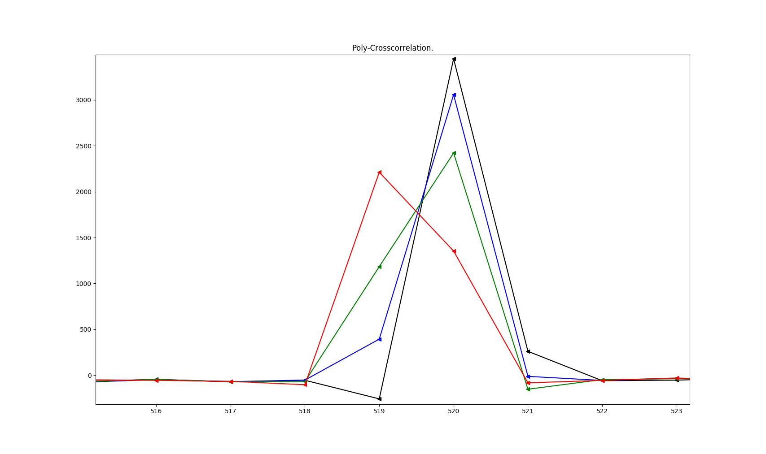
Simulation Results: SIMO/Split (2)
Figure 10: Polyphase-cross-correlation of the received frame with C’ -
split reception antennas – antenna 1.

Slide 13
Concrete Issues
Fix / adapt SIMO-simulation.
Specify special channel simulations.
Generalize current training setup.
  Slice given Block-Toeplitz into transmit antenna Vector-Toeplitz matrices.
  Find relevant correlation points and extract channel.

Slide 14
Prospects
New:
  Implement frequency and phase synchronization.
  Exhaustive tests and comparisons
Persisting issues:
  Solve 1 dB offset for 2x2 scenario.
  Implement different channels (COST, LTE).
Near future:
  Proof of concept with GNU Radio
  Start writing

Slide 15
Any questions?
Sources
  Roth M. et al., 2017

