Slide 1
MINEARENA 1.0 · CODE COMMIT · BIET DAVANGERE
DIstoHelp
Personalized Post-Discharge
Deterioration Monitor
Wearable vitals → personalized NEWS2 → artifact-suppressed, explained alerts.
FHIR R4, end-to-end.
PS-03 · HEALTH-TECH & DIGITAL HEALTH
HAPI FHIR R4 · Synthea · FastAPI · React · PhysioNet BIDMC · NEWS2
Track: PS-03 — Personalized Post-Discharge Deterioration Monitor · Demo build (synthetic + PhysioNet data)
DIstoHelp · MineArena 1.0 · PS-03

Slide 2
THE PROBLEM
2 / 14
Patients don't deteriorate in hospital.
They deteriorate on day 3 at home — unwatched.
Sepsis, heart failure and COPD exacerbations announce themselves
4–8 hours before the crash
— but nobody is watching the vitals.
LATE DETECTION
ALERT FATIGUE
ONE-SIZE-FITS-ALL SCORING
Average post-discharge death or ICU readmission signs surface hours after they become measurable.
Naive threshold monitors fire 28–29 alerts/patient/day — clinicians learn to ignore them.
Standard NEWS2 ignores who the patient is — a COPD patient at SpO₂ 90 is fine, not critical.
~50%
28–29
0 context
“The challenge is not simply collecting patient vitals —
it's intelligently identifying when a reading requires clinical attention.” — PS-03
Clinical decision support only — not a medical diagnosis system.
DIstoHelp · MineArena 1.0 · PS-03

Slide 3
THE SOLUTION
3 / 14
One engine. Three superpowers.
01
02
03
Personalize
Filter noise
Explain every alert
Every score knows who the patient is — their conditions, meds and rolling baseline.
Sensor garbage never becomes a clinical alert — it becomes a device event, visibly separate.
Each alert names the triggering reading, the rule applied, and the profile fact that fired it.
COPD → SpO₂ Scale 2 (88–92%)
Beta-blockers → blunted HR thresholds
Rolling 60-reading z-scores
Probe removal (SpO₂ 0 + flat HR)
Flatlines · motion noise · implausible values
2,934 artifacts suppressed (vs 236 naive)
Reading · rule · profile fact · explanation
Watch → Review → Urgent
Ack / resolve lifecycle + FHIR escalation
Clinical decision support only — not a medical diagnosis system.
DIstoHelp · MineArena 1.0 · PS-03

Slide 4
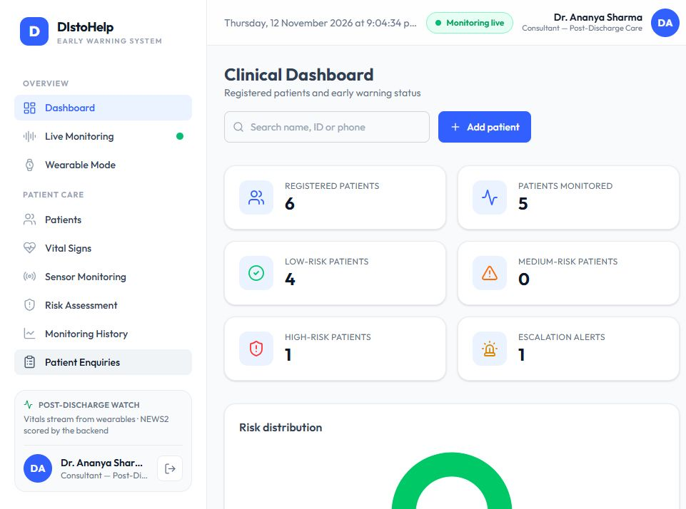
THE PRODUCT
4 / 14
Two apps. One monitoring engine.
STAFF WORKSPACE
Clinical Dashboard
Live Monitoring
Vital Signs
Risk Assessment
Patient Enquiries
Clinical Dashboard
risk-sorted cohort, one tap into any patient
Live Monitoring
always-on telemetry wall — charts stream over WebSocket
Vital Signs
manual + simulator + BIDMC replay + ESP32 input
Risk Assessment
NEWS2 with per-patient personalization breakdown
Patient Enquiries
breathlessness · fever · dizziness intake
PATIENT VIEW (/me)
Mobile-number login → own vitals, score, alerts — nothing else.
Print-friendly.
Clinical decision support only — not a medical diagnosis system.
DIstoHelp · MineArena 1.0 · PS-03

Slide 5
HOW IT WORKS
5 / 14
From heartbeat to hospital action — in one pipeline
1
2
3
4
5
SENSE
VALIDATE
FILTER
SCORE
ALERT
Phone camera (PPG) · BLE band · ESP32 · simulator · BIDMC replay
LOINC-coded FHIR R4 validation on ingest
Artifacts suppressed: probe removal, flatline, motion, implausible
NEWS2 + personalization (Scale 2 · meds · baseline drift · check-ins)
Watch · Review · Urgent — fully explained, ack/resolve lifecycle
Every step is
hot-swappable at the edges
— camera, band, or clinical replay — and every rule leaves an audit trail in FHIR and SQLite.
FHIR Observation → HAPI R4 store → local read-model → WebSocket → dashboard & wrist
Clinical decision support only — not a medical diagnosis system.
DIstoHelp · MineArena 1.0 · PS-03

Slide 6
PERSONALIZATION
6 / 14
The same number means different things to different patients
VITAL
RULE
WITHOUT IT
WITH IT
SpO₂ 90% · COPD + hypercapnia
SpO₂ Scale 2
Critical alert (Scale 1, flunks 3x)
At target — no alert
HR 98 bpm · on metoprolol
Beta-blocker blunting
Warning at 91+ bpm
Normal
RR 19 vs patient's 14 baseline
Rolling baseline (z-score)
Ignored — below threshold
Gradual deterioration flagged
Breathlessness today
Symptom check-in +2
Invisible to monitor
Score rises — clinician sees it
Both Scale-2 and beta-blocker blunting fire on
Beryl, patient p01
— the PS-03 “two personalization rules” bar, exceeded.
Clinical decision support only — not a medical diagnosis system.
DIstoHelp · MineArena 1.0 · PS-03

Slide 7
ARTIFACT SUPPRESSION
7 / 14
The monitor that cries wolf gets unplugged
PROBE REMOVAL
SpO₂ 0 + flat heart-rate — classic fingertip-off-sensor signature
Suppressed
FLATLINE SIGNAL
Identical readings N times — sensor stuck, not a pulse
Suppressed
MOTION NOISE
|ΔSpO₂| > 8 or |ΔHR| > 40 in one tick — movement artifact
Suppressed
IMPLAUSIBLE VALUE
HR 18 · SpO₂ 140 · Temp 44 — physically impossible
Suppressed
SINGLE-READING BLIP
One off-chart reading, everything else normal
Ignored
MISSING DATA
Device silent >10 min — connectivity alert, NOT clinical
Escalates
They never become alerts.
They become
device events
— visible, separate, and excluded from the score.
Clinical decision support only — not a medical diagnosis system.
DIstoHelp · MineArena 1.0 · PS-03

Slide 8
THE EVIDENCE
8 / 14
Earlier detection. Fewer false alarms.
516 min
2,934
0
mean earlier detection on slow deterioration vs naive fixed thresholds (p02–p05)
artifact readings suppressed across the replay corpus — zero reached a clinician
false alerts in stable-recovery and artifact scenarios — naive raised 28–29 per patient/day
Our engine — first alert (slow_deterioration)
Naive — sensor-artifact scenario
≈ 7–9 h earlier
28 / day
Naive fixed thresholds — first alert
Ours — same scenario
baseline
≈ 0 / day
Method:
deterministic replay of 24 h, 1-min ticks, seed 42, over 5 Synthea patients × 4 scenarios —
naive = fixed HR > 120 · SpO₂ < 92 · RR > 24 · Temp > 38.3.
Report: POST /api/scenarios/evaluate · stored in DB · reproducible on demand
Clinical decision support only — not a medical diagnosis system.
DIstoHelp · MineArena 1.0 · PS-03

Slide 9
FHIR R4 — COMPLIANT, NOT CLAIMED
9 / 14
Real interoperability, verified, stored in HAPI
R4 Vital Signs Observations
WHAT'S STORED
LOINC 8867-4 · 2708-6 · 9279-1 · 8310-5 — validated with fhir.resources before storage
8867-4
Heart rate
Observation · beats/min
HAPI FHIR R4 server
Live now (public sandbox hapi.fhir.org/baseR4) · Docker deploy included for local/private
2708-6
SpO₂
Observation · % (Scale 1/2)
Escalation as FHIR resources
Flag + CommunicationRequest created on HAPI for every escalation — Kannada & Hindi text included
9279-1
Respiratory rate
Observation · breaths/min
5 Synthea cohorts
8310-5
Body temperature
250-patient population generated with real Synthea → 5 clinically-diverse discharges picked
Observation · °C (synthesized)
FHIR R4 compliance verified: Observations accepted and stored by HAPI; Flag / CommunicationRequest round-trips confirmed
DIstoHelp · MineArena 1.0 · PS-03

Slide 10
PS-03 — EVERY REQUIREMENT, MAPPED
10 / 14
Mandatory walkthrough, line by line
3.1
FHIR R4 ingestion · LOINC vitals · HAPI R4 store
DONE
3.2
Virtual wearable simulator + BIDMC replay
DONE
3.3
≥5 Synthea discharge profiles driving personalized scoring
DONE
3.4
NEWS2 + ≥2 personalization rules (we have 4)
DONE
3.5
Artifact detection & false-alert suppression
DONE
3.6
Clinician dashboard: vitals, trends, scores, explained Watch/Review/Urgent
DONE
3.7
Scenario replay + performance report vs naive thresholds
DONE
H1
Patient-facing symptom check-in (breathlessness · fever · dizziness) → score
DONE
H2
Escalation to team — FHIR Flag/CommunicationRequest · Hindi/Kannada
DONE
H3
Missing-data (device silence) alerts — separate from clinical
DONE
All mandatory requirements satisfied · 3 hint features complete · Judges' criteria: detection lead time · alert efficiency · false-alert suppression · FHIR compliance · explainability
DIstoHelp · MineArena 1.0 · PS-03

Slide 11
DEPLOYED TODAY, VERIFIED LIVE
11 / 14
Not a mock. Serving real traffic, now.
RENDER (CLOUD)
CLOUDFLARE TUNNEL
FastAPI backend + static frontend, always-on
Public kiosk URL, phone-as-wearable wired to it
https://distohelp-ps03-api.onrender.com
https://……trycloudflare.com
ALWAYS-ON STREAMS
BIDMC REPLAY
All 5 patients streaming from boot (autostream)
PhysioNet ICU recordings — real human deterioration
verified live in browser
/api/bidmc/replay · 53 records
Verified:
HTTPS 200 · HAPI sandbox live · WebSocket frames flowing · patient portal signs in on phone · QR codes printed
Clinical decision support only — not a medical diagnosis system.
DIstoHelp · MineArena 1.0 · PS-03

Slide 12
ARCHITECTURE
12 / 14
Deliberately boring. Dependable under pressure.
WEARABLE
INGEST API
ARTIFACT FILTER
NEWS2 ENGINE
Phone camera · BLE band · ESP32 + MAX30102 · simulator · BIDMC replay
FHIR R4 validation
LOINC-coded Observations
Probe removal · flatline
motion · implausible · missing
Scale 1 / 2 · meds blunting
rolling baselines · check-ins
HAPI FHIR R4
READ MODEL
DASHBOARD + PATIENT APP
System of record · Observations · Flag / CommunicationRequest
SQLite · decisions, alerts, baselines, check-ins — sub-50 ms reads
Live Monitoring · risk queue · explained alerts · wrist kiosk
Async HAPI worker flushes transaction bundles off the hot path — monitoring never blocks on FHIR server latency.
Clinical decision support only — not a medical diagnosis system.
DIstoHelp · MineArena 1.0 · PS-03

Slide 13
THE 90-SECOND DEMO
13 / 14
Scripted for the room, not for the slides
0:00
Sign in — staff the hospital, patient the ward
0:10
Open /live — all five Synthea patients streaming, p02 flagged HIGH RISK
0:25
Tap Live waveforms — real-time HR · SpO₂ · RR · NEWS2 trend, SMA-5 smoothed
0:40
Finger on phone camera — real pulse enters the same pipeline; artifacts suppressed
0:55
Start slow_deterioration on p02 — watch review → urgent with full explanation on screen
1:10
Tap Acknowledge → escalate — FHIR Flag lands on HAPI; Kannada SMS on the wire
1:25
POST /api/scenarios/evaluate — 516-minute lead-time report, printed live
Clinical decision support only — not a medical diagnosis system.
DIstoHelp · MineArena 1.0 · PS-03

Slide 14
WHY THIS WINS
The only entrant that ships
compliance, evidence and a working product —
in one demo.
FHIR R4 is proven, not promised
Real HAPI store, validated on ingest, FHIR-native escalations
False-alert suppression is measured
2,934 artifacts caught vs 236 noisy naive alerts
Explainability built in
Every alert: reading · rule · profile fact — no black box
It runs right now
Render URL, Cloudflare kiosk, phone-as-wearable, BIDMC replay — all live
Monitor continuously. Detect deterioration early. Reduce false alerts. Prioritize patient safety.
Synthea-generated synthetic cohort · PhysioNet BIDMC (open access) · No real patient data · Clinical decision support only
DIstoHelp · MineArena 1.0 · PS-03

