Slide 1
IaaS

Slide 2
Definition (NIST)
“The capability provided to the consumer is provision processing, storage, networks, as well as other fundamental computing resources where the consumer is able to deploy & run arbitrary software, which can include operating systems and applications. The consumer does not manage or control the underlying cloud infrastructure but has control over operating systems, storage, & deployed applications; and possibly limited control of select networking components (e.g., host firewalls).”

Slide 3
Definition (google cloud)
Infrastructure as a service (IaaS) is the on-demand availability of highly scalable computing resources as services over the internet. It eliminates the need for enterprises to procure, configure, or manage infrastructure themselves, and they only pay for what they use.
Notes:
https://cloud.google.com/learn/what-is-iaas?hl=en

Slide 4
Definition (AWS)
Infrastructure as a Service (IaaS) is a business model that delivers IT infrastructure like compute, storage, and network resources on a pay-as-you-go basis over the internet.
Notes:
https://aws.amazon.com/what-is/iaas/

Slide 5
Definition (Azure)
Infrastructure as a service (IaaS) is a type of cloud computing service that offers essential compute, storage, and networking resources on demand, on a pay-as-you-go basis.
Notes:
https://azure.microsoft.com/en-us/resources/cloud-computing-dictionary/what-is-iaas/

Slide 6
IaaS delivers a cloud computing infrastructure – servers, storage, network services and virtual machines – as services.
Rather than purchasing these infrastructure components, clients instead purchase access to these components as services

Slide 7
Types of IaaS resources
Compute
CPU
GPU
RAM
Storage
Block storage (SSD/HDD)
File storage (NAS)
Object storage
Network
Routing/switching
Load balancer

Slide 8
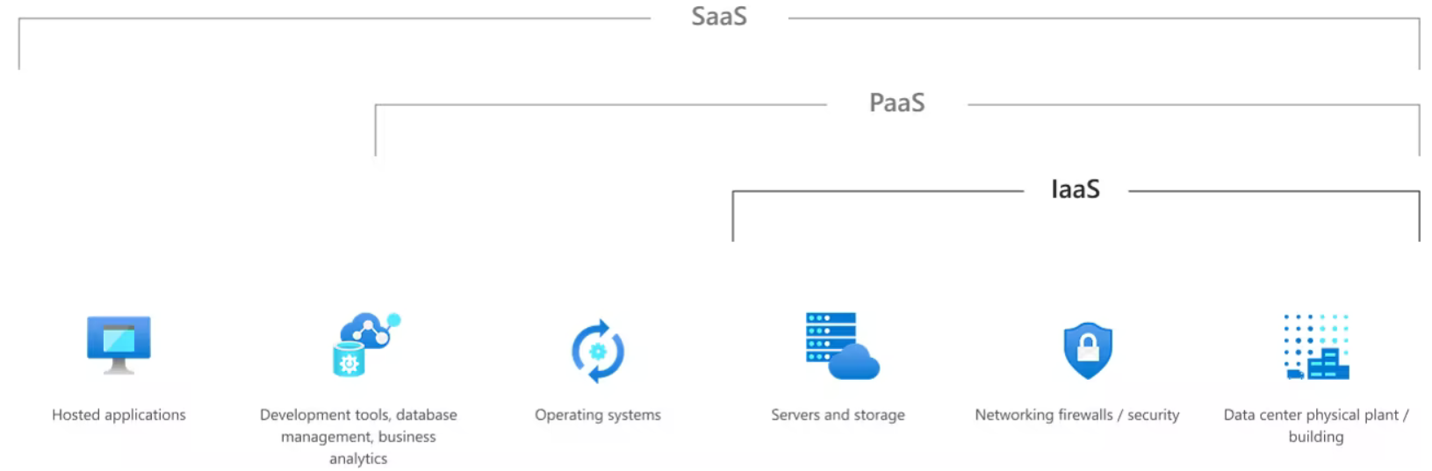

Slide 9
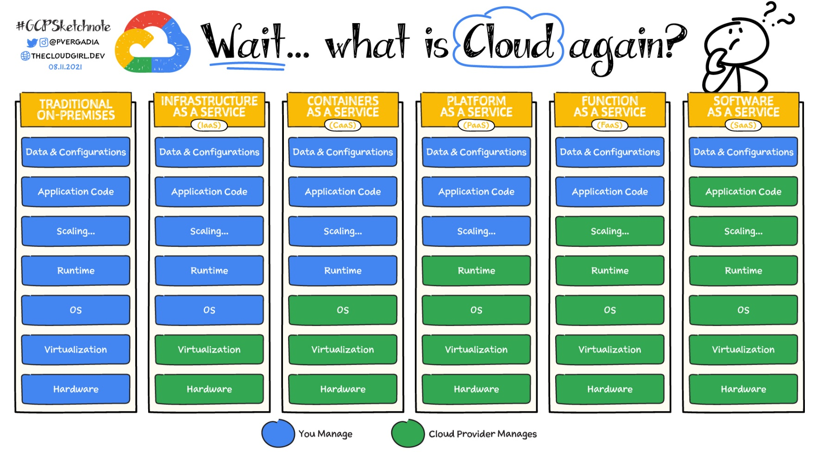

Slide 10
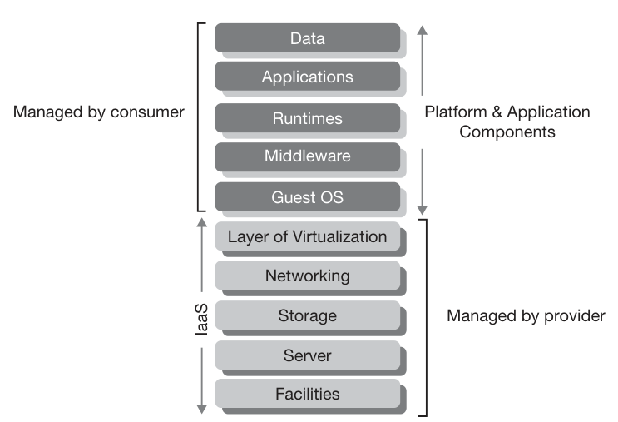
IaaS Component Stack

Slide 11
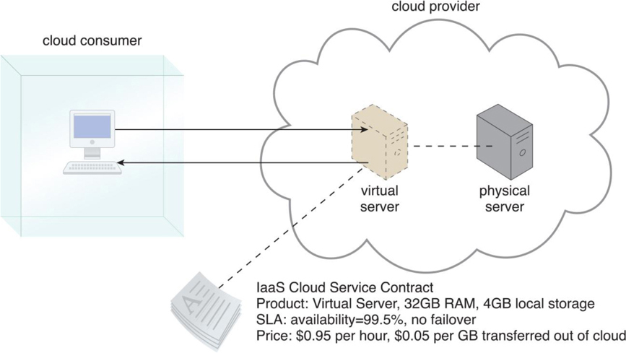

Slide 12
Examples Public IaaS
AWS: Amazon Elastic Compute Cloud (EC2), Amazon S3
Microsoft Azure
Google Cloud: Google Compute Engine, Cloud Storage

Slide 13
Example Private IaaS
OpenStack
OpenNebula
Eucalyptus
Apache CloudStack
Microsoft’s Azure Stack

Slide 14
IaaS is particularly suitable for situations:
New organisations without the capital to invest in hardware
Organisations that are growing rapidly but purchasing additional hardware would be prohibitive
Speculative development of new lines of business without the need to invest in infrastructure components.

Slide 15
A good candidate for IaaS
High business growth that outpaces infrastructure capabilities
Unpredictable spikes in demand for infrastructure services
Low utilization of existing infrastructure resources
Large volumes of data that overwhelm on-premises data stores
Slow response times with on-premises applications
Application performance limitations due to capacity constraints
Slow hardware refresh cycles

Slide 16
Use Cases
Run testing and development
Perform big data analysis
Handle spikes in traffic
Provision resources quickly
Improve disaster recovery preparation

Slide 17
IaaS pros
Highest level of control over infrastructure
On-demand scalability
No single point of failure for higher reliability
Reduced upfront capital expenditures (for example, pay-as-you-go pricing)
Fewer provisioning delays and wasted resources
Accelerated development and time to market
Notes:
https://cloud.google.com/learn/paas-vs-iaas-vs-saas?hl=en

Slide 18
IaaS cons
Responsible for your own data security and recovery
Requires hands-on configuration and maintenance
Difficulties securing legacy applications on cloud-based infrastructure

