Slide 1
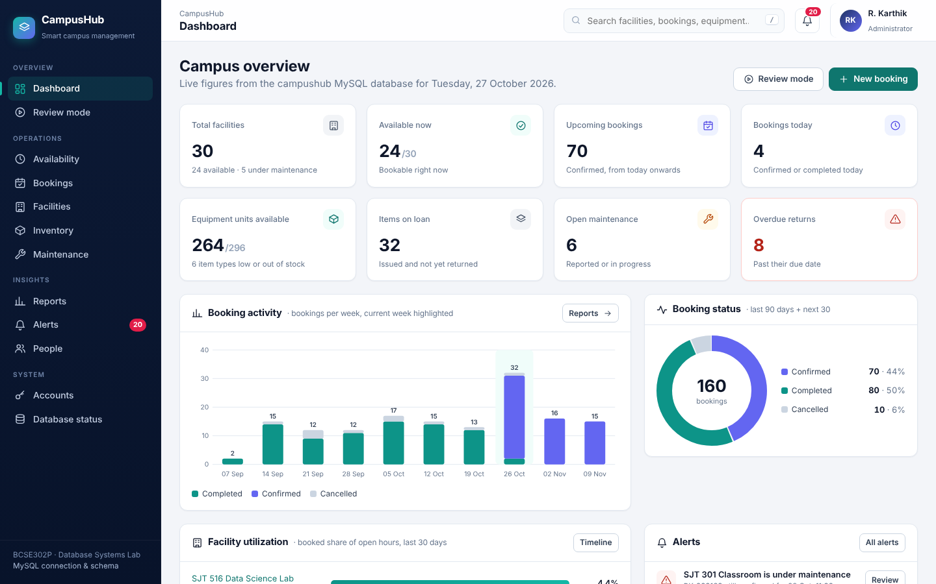
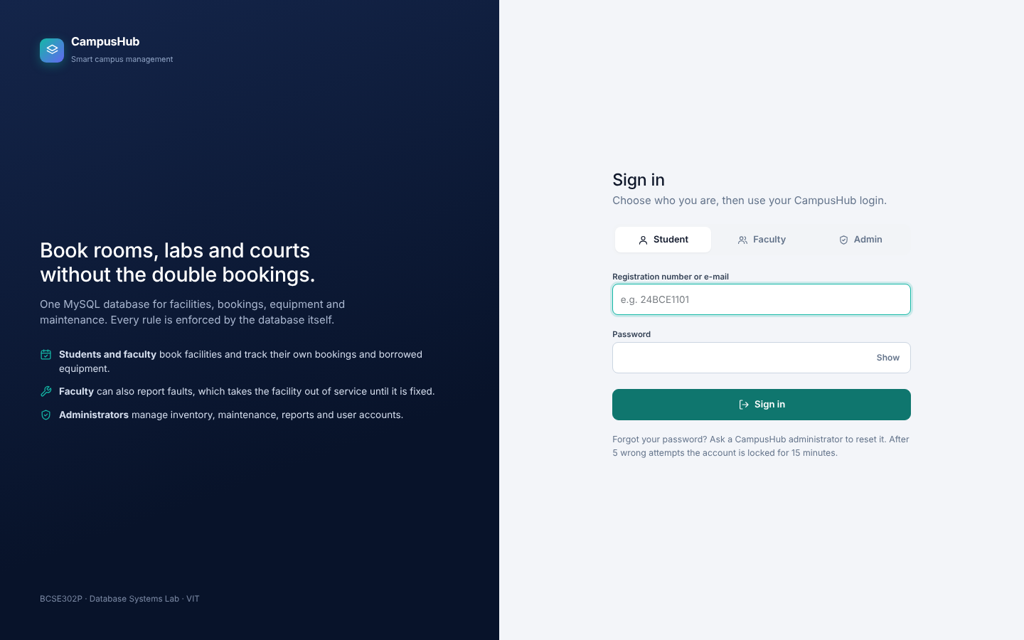
BCSE302P DATABASE SYSTEMS LAB · VIT VELLORE · PROJECT REVIEW
CampusHub
Smart campus facility, booking and inventory management system on MySQL
MA
Mohammed Affan 24BAI0014
Database design, triggers, procedures
HG
Hardik Gupta 24BCI0017
Flask backend, queries, reports, sign-in
AS
Arham Sadiq K 24BAI0335
Interface, sample data, testing
Live demo: website + MySQL Workbench side by side
Notes:
Affan opens. Introduce the team and the three parts: Affan - database design and the rules inside MySQL; Hardik - Flask backend, queries, reports and sign-in; Arham - interface, sample data and testing. Tell ma'am that every feature will be shown on the website and immediately proved in MySQL Workbench with a query from sql/review_demo_queries.sql.

Slide 2




The problem we are solving
Presented by Affan
Campus rooms, labs, halls and courts are booked on paper, e-mail or WhatsApp
Double bookings
No live availability
Lost equipment
Broken rooms booked
Two groups arrive for the same room at the same time: nothing checks for overlapping slots.
Nobody can see which rooms are free right now or later today without asking around.
Projectors, kits and laptops are lent out with no record of who has them or when they are due.
Maintenance is not linked to booking, and admins have no usage data for planning.
Goal One MySQL database that holds facilities, bookings, equipment and maintenance together, and refuses bad data itself: no double booking, no issuing missing stock, no booking a broken room.
Notes:
Explain the four problems in plain words. Then the goal: one database where the rules are enforced by MySQL itself, so even a mistake in the app or a direct insert can't break them.

Slide 3



Our approach: the rules live inside MySQL
Presented by Affan
A thin Flask website on top of a MySQL database that enforces every business rule
Browser
Flask app
MySQL 8
Student, faculty and admin sign in and use their own pages
Reads the form, calls ONE parameterized query or stored procedure, shows the result
Constraints, triggers, procedures, transactions and views decide what is allowed
Constraints
PK, FK, UNIQUE, CHECK, ENUM, NOT NULL
5 triggers
overlap, stock, maintenance
4 procedures
transaction + row lock
4 views
reports and dashboards
Why this matters: even a direct INSERT typed into Workbench obeys the same rules. When MySQL refuses something, the website shows the exact trigger or constraint that refused it.
Notes:
Walk left to right: browser, Flask, MySQL. Stress that Flask has no business rules - it only calls the database. Every rule is in MySQL. Key line: even a direct INSERT in Workbench obeys the same rules.

Slide 4
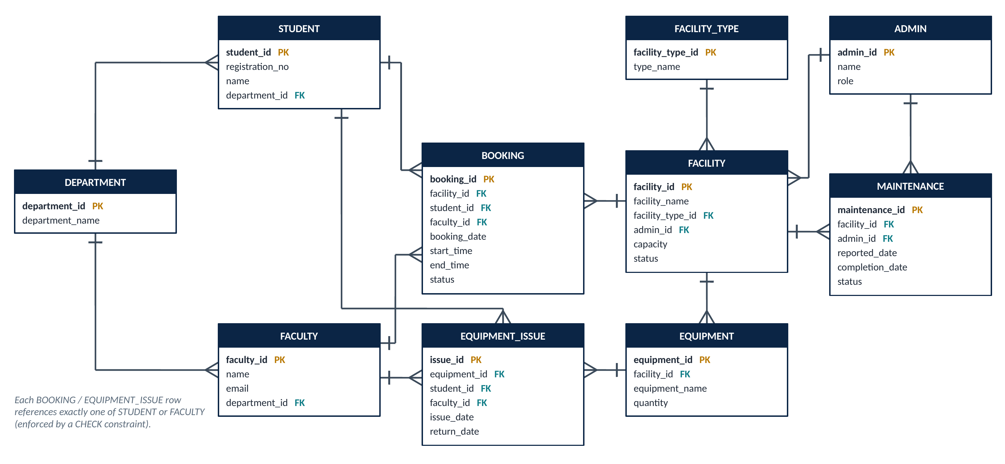
Database design: 11 tables in 3NF
Presented by Affan
ER model → relational schema · primary and foreign keys · CHECK · UNIQUE · indexes
VERIFY IN WORKBENCH · SLIDE 4
SHOW TABLES;
-- 11 tables (10 core + user_account)
-- plus the 4 views
SHOW CREATE TABLE booking;
-- PRIMARY KEY (booking_id)
-- FOREIGN KEY -> facility, student, faculty
-- CHECK chk_booking_time (end > start)
-- CHECK chk_booking_person (exactly one booker)
-- INDEX idx_booking_slot
-- (facility_id, booking_date, start_time)
ON THE SCREEN
Workbench Schemas panel: expand campushub → Tables, Views, Stored Procedures
Expand booking → Columns, Indexes, Foreign Keys, Triggers
10 core tables + user_account (added later for sign-in, as a separate migration)
Proves: the design in the report is really implemented, with keys and constraints in MySQL.
Notes:
Show the ER diagram, then switch to Workbench. Expand campushub in the Schemas panel. Run SHOW TABLES and SHOW CREATE TABLE booking. Point at the primary key, the three foreign keys, the two CHECK constraints and idx_booking_slot. Mention 3NF: department and facility type names are stored once in their own tables.

Slide 5
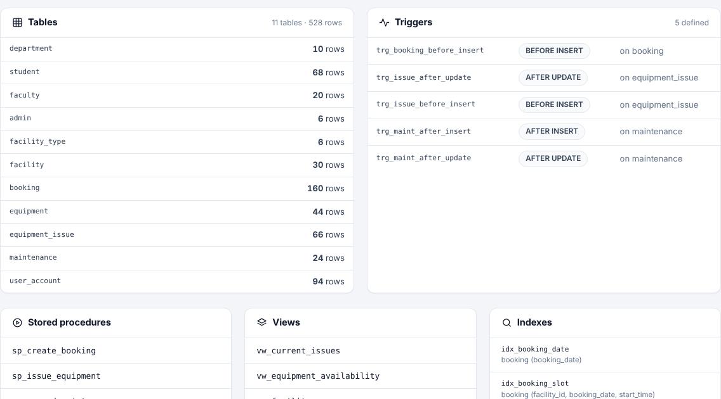
The rules inside MySQL
Presented by Affan
5 triggers · 4 stored procedures · 4 views, listed live from information_schema
VERIFY IN WORKBENCH · SLIDE 5
SELECT TRIGGER_NAME, ACTION_TIMING,
EVENT_MANIPULATION, EVENT_OBJECT_TABLE
FROM information_schema.TRIGGERS
WHERE TRIGGER_SCHEMA = 'campushub';
SELECT ROUTINE_NAME
FROM information_schema.ROUTINES
WHERE ROUTINE_SCHEMA = 'campushub'
AND ROUTINE_TYPE = 'PROCEDURE';
SELECT TABLE_NAME
FROM information_schema.VIEWS
WHERE TABLE_SCHEMA = 'campushub';
ON THE WEBSITE
Admin menu → Database status
Point at the Triggers, Stored procedures and Views lists
These lists are read live from information_schema
Proves: the database itself holds the logic: 5 triggers, 4 procedures and 4 views.
Notes:
Open the Database status page as admin. Then run the three information_schema queries in Workbench. Name each trigger: T1 trg_booking_before_insert (overlap + status), T2 trg_issue_before_insert (stock check and minus one), T3 trg_issue_after_update (stock plus one on return), T4 trg_maint_after_insert (facility closed), T5 trg_maint_after_update (facility reopened).

Slide 6
Sign-in with three roles
Presented by Hardik
user_account table · salted password hashes · lockout after 5 wrong tries
VERIFY IN WORKBENCH · SLIDE 6
SELECT role, COUNT(*) AS accounts
FROM user_account GROUP BY role;
SELECT ua.role,
COALESCE(s.name, f.name, a.name) AS person,
LEFT(ua.password_hash, 30) AS stored_hash,
ua.failed_attempts, ua.last_login_at
FROM user_account ua
LEFT JOIN student s ON s.student_id = ua.student_id
LEFT JOIN faculty f ON f.faculty_id = ua.faculty_id
LEFT JOIN admin a ON a.admin_id = ua.admin_id
ORDER BY ua.last_login_at DESC LIMIT 5;
ON THE WEBSITE
Private window → choose Student → 24BCE1101 / Campus@2026
Show a wrong password first: generic error message
Run the second query: last_login_at just changed
Proves: only a hash is stored, never the password; each login belongs to one person.
Notes:
Hardik. Sign in as the student in a private window (Ctrl+Shift+N). Optionally type a wrong password first to show the generic message and that failed_attempts goes up. Then run both queries: the stored_hash column is unreadable scrambled text, not Campus@2026, and last_login_at shows the sign-in just happened. Say: passwords are hashed with scrypt and a salt; after 5 wrong attempts the account locks for 15 minutes.

Slide 7
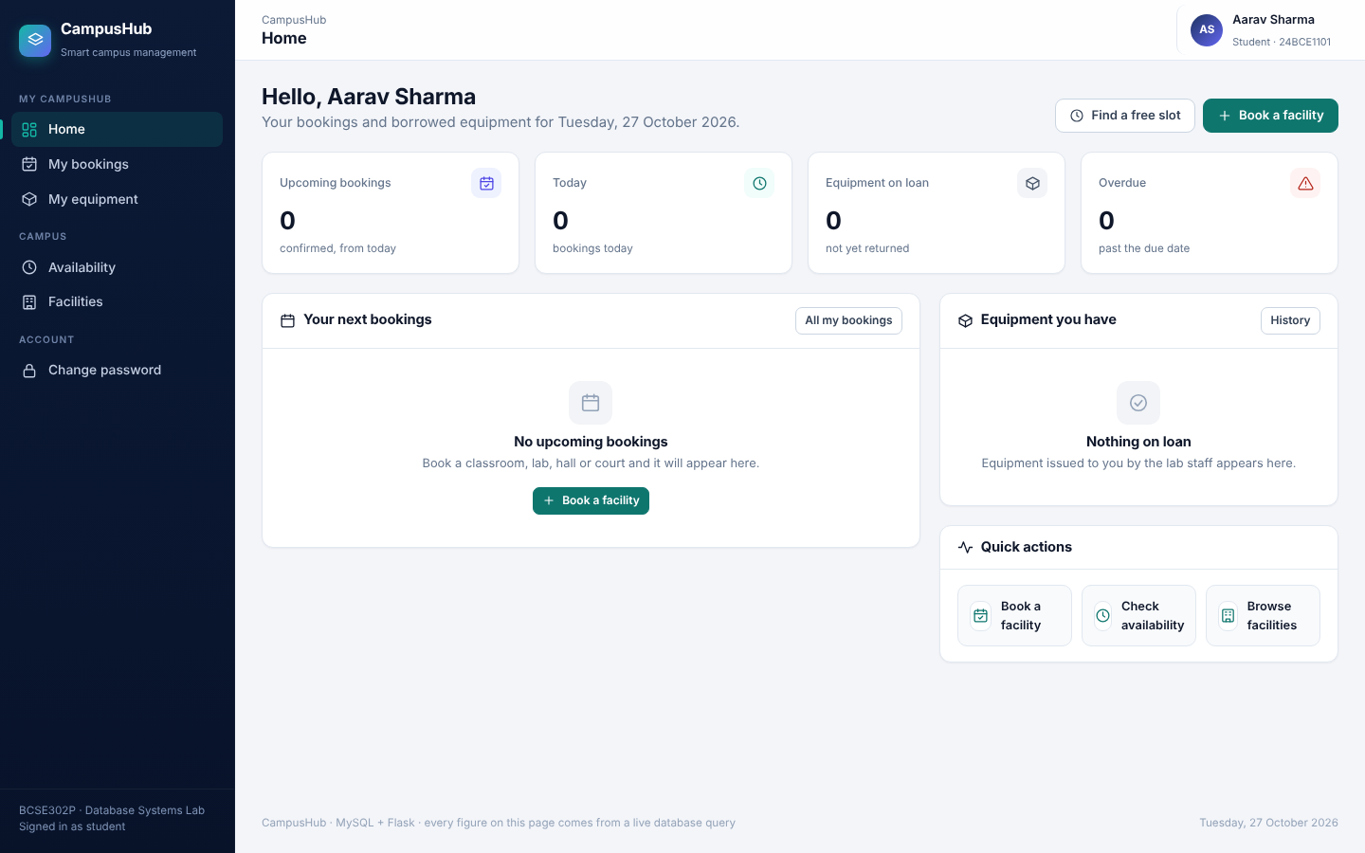
A student sees only their own data
Presented by Hardik
Row-level filtering: WHERE student_id = the signed-in student · admin pages return 403
VERIFY IN WORKBENCH · SLIDE 7
SELECT b.booking_id, f.facility_name,
b.booking_date, b.start_time, b.end_time
FROM booking b
JOIN facility f ON f.facility_id = b.facility_id
JOIN student s ON s.student_id = b.student_id
WHERE s.registration_no = '24BCE1101'
AND b.status = 'CONFIRMED'
AND b.booking_date >= CURDATE()
ORDER BY b.booking_date, b.start_time;
-- number of rows = the "Upcoming bookings"
-- card on the student's home page
ON THE WEBSITE
Student home: upcoming, today, on loan, overdue cards
Short menu: no admin pages; type /reports → Access denied
Availability: other people's bookings show only as Booked
Proves: the card is a live query filtered to this one student.
Notes:
Hardik. Point at the four cards. Count the rows of the query and compare with the Upcoming bookings card. Type http://127.0.0.1:5000/reports in the address bar to show Access denied. Open Availability: other bookings show as Booked, no names - privacy.

Slide 8
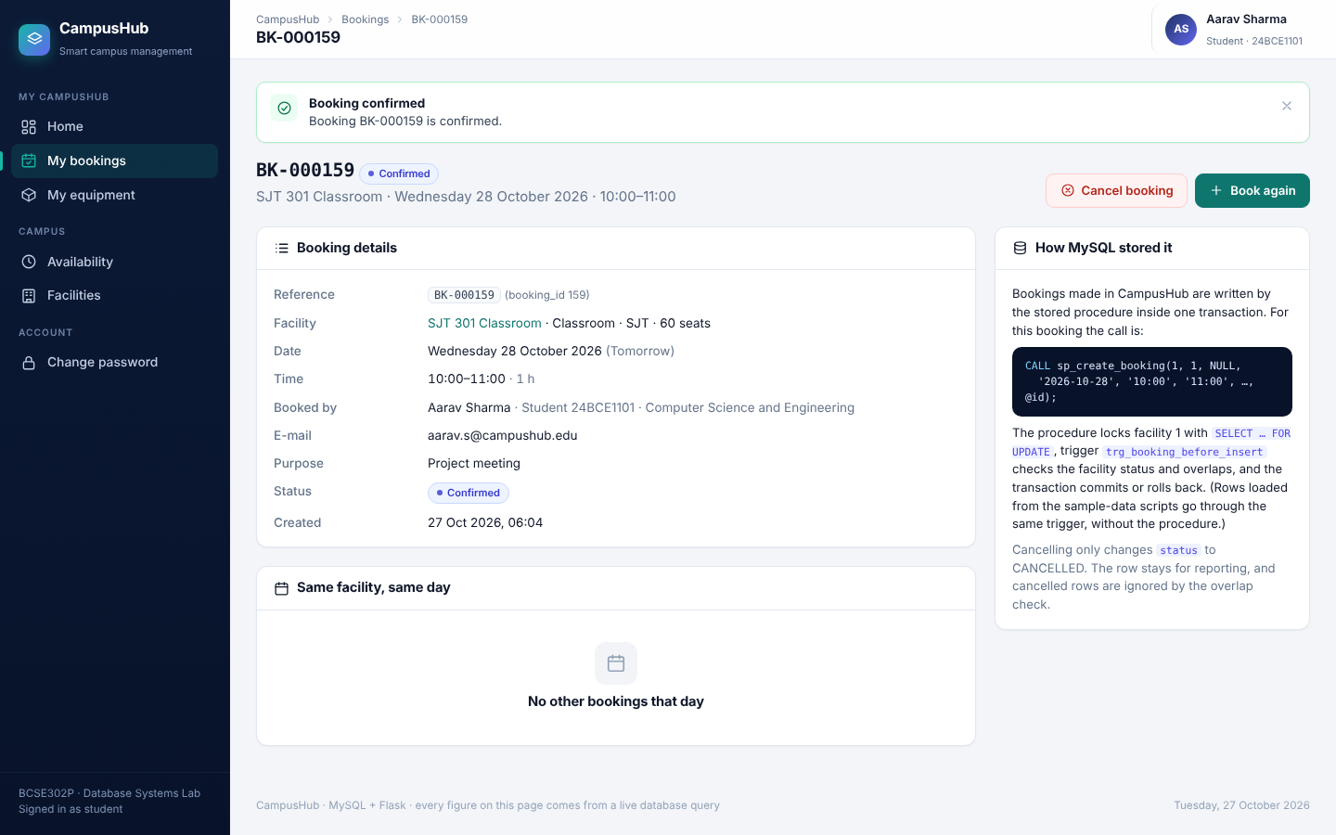
Booking through a stored procedure
Presented by Hardik
sp_create_booking: START TRANSACTION · SELECT … FOR UPDATE · INSERT · COMMIT
VERIFY IN WORKBENCH · SLIDES 8–9
SELECT b.booking_id, f.facility_name,
COALESCE(s.name, fa.name) AS booked_by,
b.booking_date, b.start_time, b.end_time,
b.status
FROM booking b
JOIN facility f ON f.facility_id = b.facility_id
LEFT JOIN student s ON s.student_id = b.student_id
LEFT JOIN faculty fa ON fa.faculty_id = b.faculty_id
ORDER BY b.booking_id DESC LIMIT 3;
-- new row: booked_by = Aarav Sharma, CONFIRMED
ON THE WEBSITE
Book a facility → tomorrow 10:00–11:00 → Confirm
No 'booked by' box: a student books only in their own name
Booking page shows the exact CALL that MySQL ran
Proves: the booking was written by the procedure, in the signed-in student's name.
Notes:
Hardik. Pick any facility that is not under maintenance, tomorrow, 10:00 to 11:00, purpose Project meeting. While choosing, point at the schedule box on the right. After Confirm, show the BK reference and the How MySQL stored it box. Run the query: the new row is on top with Aarav Sharma. Explain: the procedure locks the facility row, inserts, the trigger checks, then COMMIT.

Slide 9
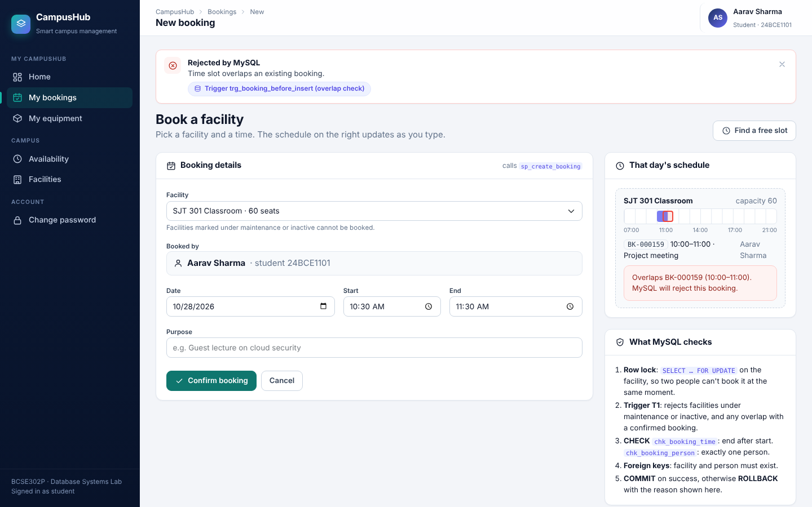
Double booking is refused by trigger T1
Presented by Affan
BEFORE INSERT trigger · overlap rule · SIGNAL SQLSTATE '45000' · ROLLBACK
VERIFY IN WORKBENCH · SLIDE 9
SHOW CREATE TRIGGER trg_booking_before_insert;
-- the part that refused the booking:
-- IF NEW.status = 'CONFIRMED' AND EXISTS (
-- SELECT 1 FROM booking b
-- WHERE b.facility_id = NEW.facility_id
-- AND b.booking_date = NEW.booking_date
-- AND b.status = 'CONFIRMED'
-- AND b.start_time < NEW.end_time
-- AND b.end_time > NEW.start_time)
-- THEN SIGNAL SQLSTATE '45000' SET MESSAGE_TEXT
-- = 'Time slot overlaps an existing booking';
ON THE WEBSITE
Same room, same date, 10:30–11:30 → Confirm
Red box: Rejected by MySQL, trg_booking_before_insert
Re-run the latest-bookings query: no new row
Proves: MySQL, not the website, rejected the clash, and nothing was saved.
Notes:
Affan. This is the key moment. Try 10:30-11:30 on the same room and date. The red message names the trigger. Re-run the slide 8 query: no new row, the transaction rolled back. Then show SHOW CREATE TRIGGER and read the overlap condition: existing start < new end AND existing end > new start.

Slide 10
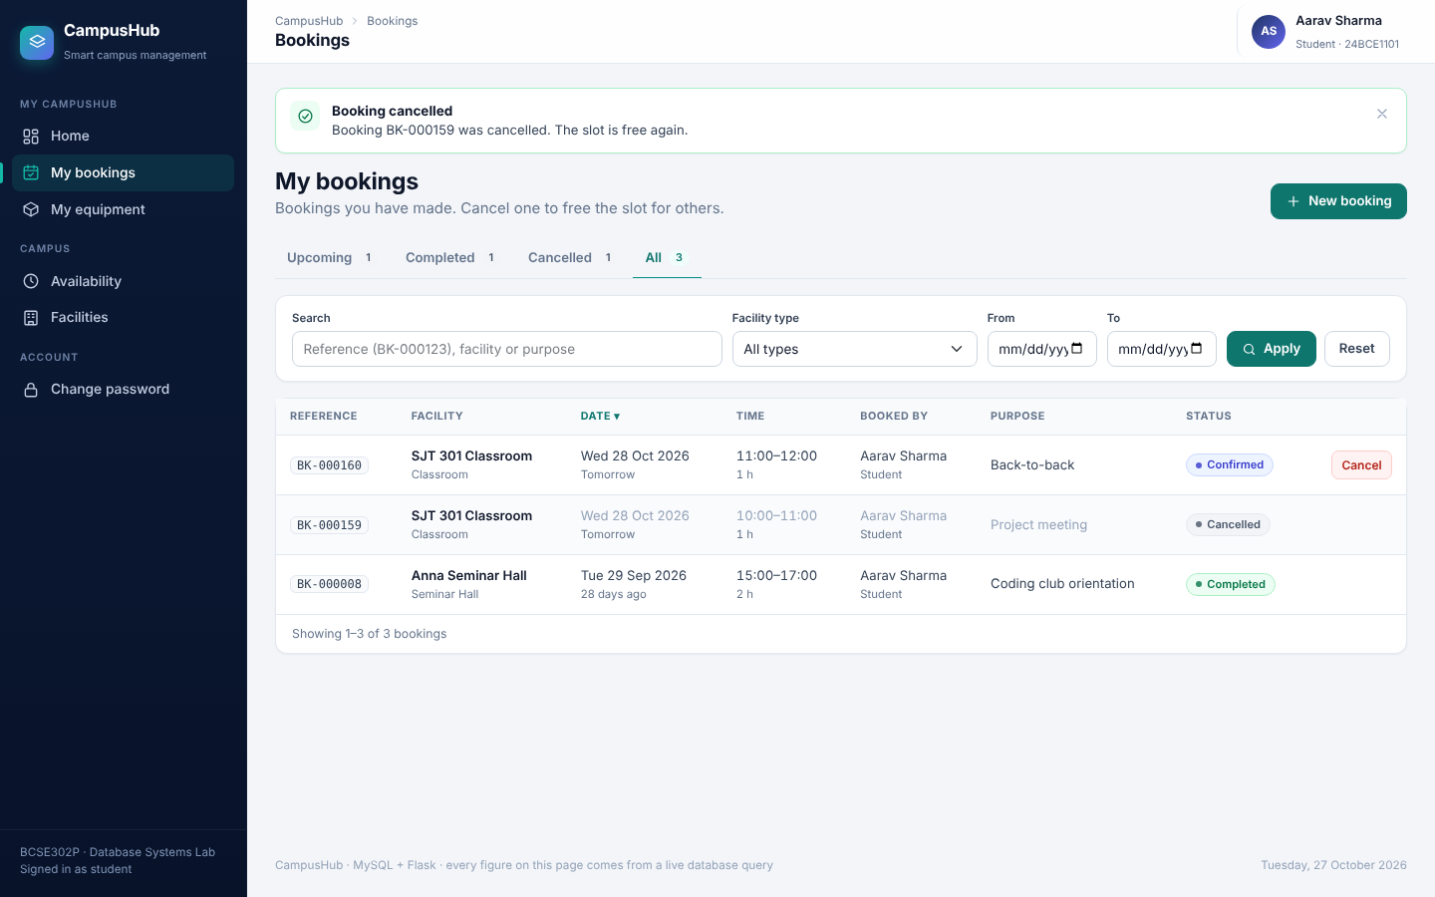
Back-to-back is allowed, cancelling keeps history
Presented by Affan
Strict < and > in the overlap rule · cancel = status change, not DELETE
VERIFY IN WORKBENCH · SLIDE 10
SELECT x.booking_id, x.start_time,
x.end_time, x.status
FROM booking x
JOIN (SELECT facility_id, booking_date
FROM booking
ORDER BY booking_id DESC LIMIT 1) last
ON last.facility_id = x.facility_id
AND last.booking_date = x.booking_date
ORDER BY x.start_time;
-- 10:00-11:00 and 11:00-12:00 side by side
-- the cancelled booking stays as history
ON THE WEBSITE
Same room, 11:00–12:00 → accepted (touches 11:00 only)
My bookings → Cancel one → confirm in the pop-up
Re-run the query: row still there, status CANCELLED
Proves: 11:00 < 11:00 is false, so touching slots don't clash; history is kept for reports.
Notes:
Affan. Book 11:00-12:00 on the same room: accepted, because 11:00 > 11:00 is false. Then cancel one booking from My bookings. The query shows the whole day of that room. Cancelled bookings are ignored by T1, so the slot is free again. Sign the student out from the name menu at the top right.

Slide 11
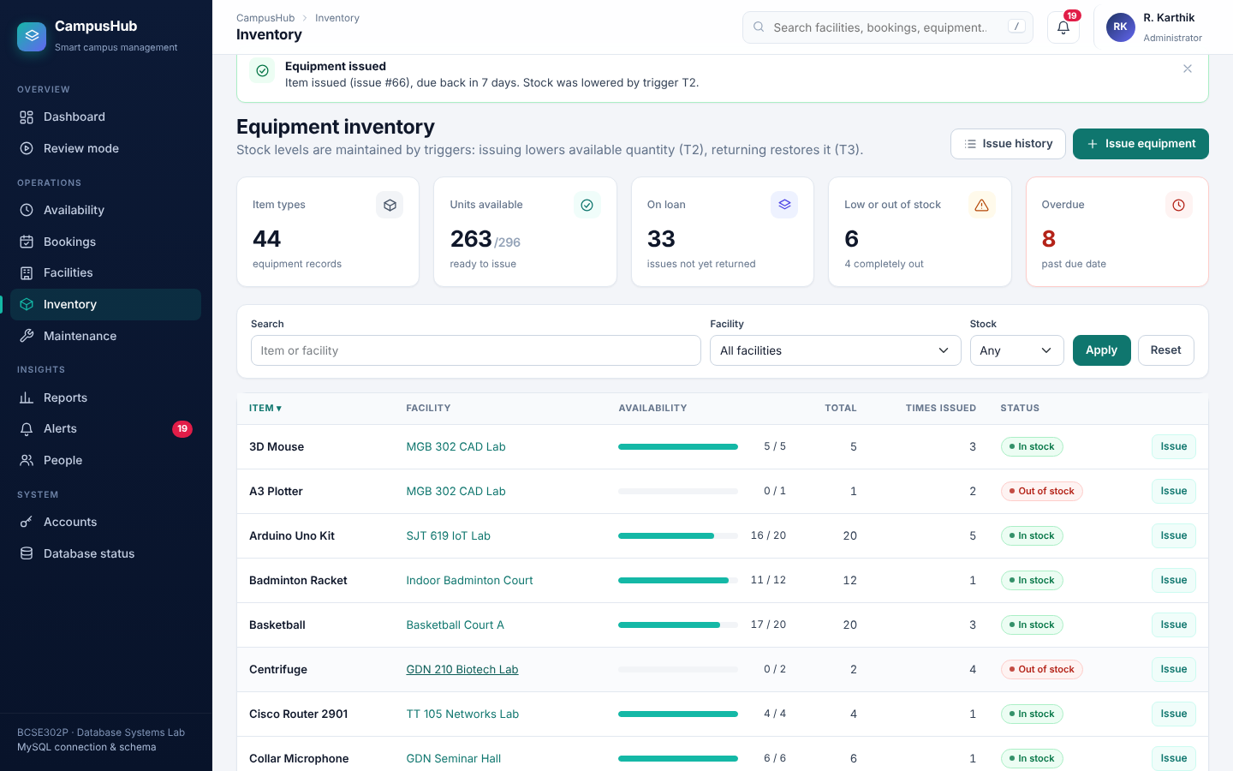
Equipment issue and return: T2 and T3
Presented by Hardik
sp_issue_equipment + BEFORE INSERT trigger (stock − 1) · AFTER UPDATE trigger (stock + 1)
VERIFY IN WORKBENCH · SLIDE 11
SELECT ei.issue_id, e.equipment_name,
e.quantity, e.available_qty,
COALESCE(s.name, fa.name) AS issued_to,
ei.due_date, ei.status
FROM equipment_issue ei
JOIN equipment e ON e.equipment_id = ei.equipment_id
LEFT JOIN student s ON s.student_id = ei.student_id
LEFT JOIN faculty fa ON fa.faculty_id = ei.faculty_id
ORDER BY ei.issue_id DESC LIMIT 3;
-- issue: available_qty - 1 (trigger T2)
-- return: available_qty + 1 (trigger T3)
ON THE WEBSITE
Sign in as admin → Inventory → Issue on an item → Issue item
Run the query: available_qty dropped by 1
Issue history → Return → run again: back up by 1
Proves: stock is maintained by triggers; the app never changes it directly.
Notes:
Hardik. Admin window: karthik.admin@campushub.edu / Campus@2026. Inventory, click Issue on any in-stock item, choose a student, Issue item. Run the query: available_qty is one less. Then Issue history, Return on that row, run again: one more. Returning the same item twice is rejected by sp_return_equipment.

Slide 12
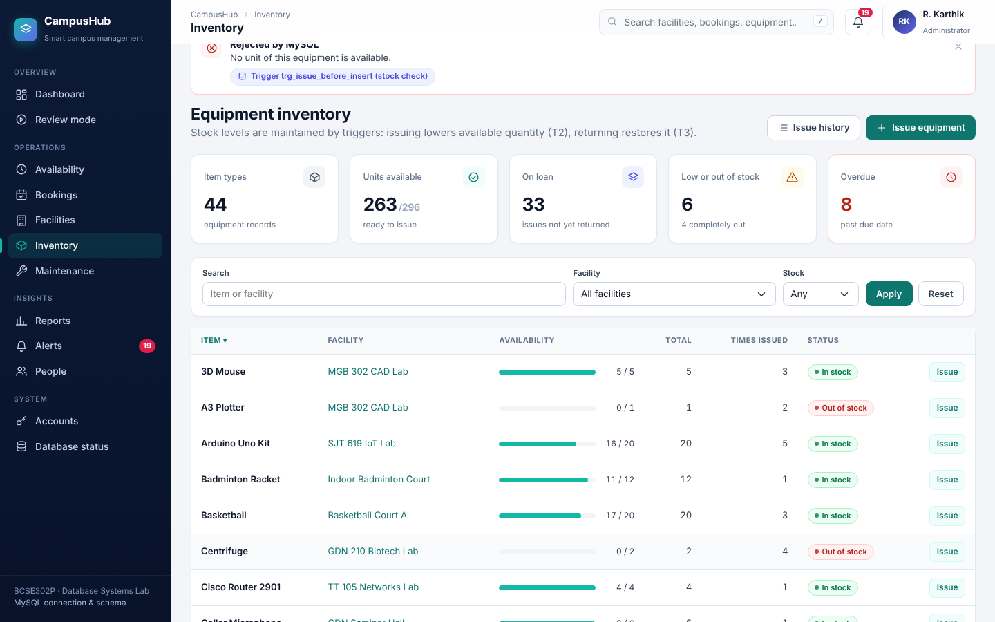
Issuing an item with no stock is refused
Presented by Hardik
Trigger T2 checks stock inside the same statement · CHECK keeps 0 ≤ available ≤ total
VERIFY IN WORKBENCH · SLIDE 12
SELECT equipment_name, quantity,
available_qty, availability_status
FROM equipment
WHERE available_qty = 0;
-- inside trigger T2:
-- IF (SELECT available_qty FROM equipment
-- WHERE equipment_id = NEW.equipment_id) < 1
-- THEN SIGNAL SQLSTATE '45000' SET MESSAGE_TEXT
-- = 'No unit of this equipment is available';
-- ELSE UPDATE equipment
-- SET available_qty = available_qty - 1 ...
ON THE WEBSITE
Inventory → Issue on an item marked Out of stock
Red box: Rejected by MySQL, trg_issue_before_insert
Re-run the slide 11 query: no new issue, stock unchanged
Proves: the database protects the stock count even if the website tried to over-issue.
Notes:
Hardik. Pick an item shown as Out of stock (for example Document Camera or A3 Plotter). The red message names the trigger. Run the query to show the out-of-stock items, then the slide 11 query again: no new row.

Slide 13
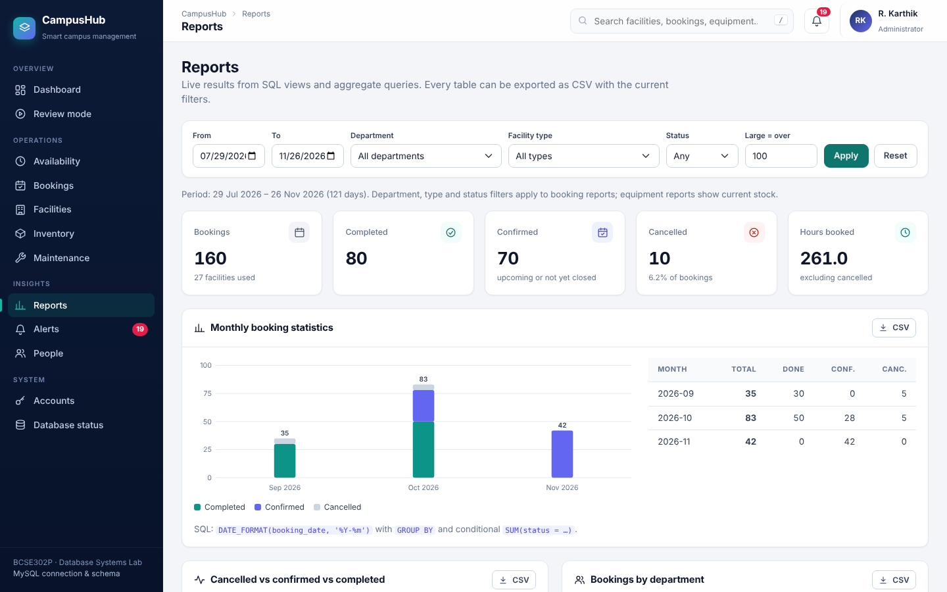
Reports from views and GROUP BY queries
Presented by Hardik
Views · LEFT JOIN · GROUP BY · HAVING · COALESCE · CSV export
VERIFY IN WORKBENCH · SLIDE 13
SELECT facility_name, total_bookings, hours_booked
FROM vw_facility_usage
ORDER BY total_bookings DESC LIMIT 5;
SELECT d.department_name, COUNT(*) AS bookings
FROM booking b
LEFT JOIN student s ON s.student_id = b.student_id
LEFT JOIN faculty fa ON fa.faculty_id = b.faculty_id
JOIN department d ON d.department_id =
COALESCE(s.department_id, fa.department_id)
WHERE b.status <> 'CANCELLED'
GROUP BY d.department_name ORDER BY bookings DESC;
SELECT f.facility_name, COUNT(*) AS requests
FROM maintenance m JOIN facility f
ON f.facility_id = m.facility_id
GROUP BY f.facility_name HAVING COUNT(*) > 1;
ON THE WEBSITE
Admin → Reports: change the date range or department → Apply
Download one block as CSV (opens in Excel)
Run the matching query: the same numbers
Proves: every chart and table is a real SQL result, and the filters are parameterized.
Notes:
Hardik. Show the Reports page and one CSV download. Run the view query (most-booked facilities), the department query (COALESCE picks the student's or faculty member's department) and the HAVING query (facilities with repeated faults). Explain WHERE filters rows before grouping, HAVING filters groups after.

Slide 14
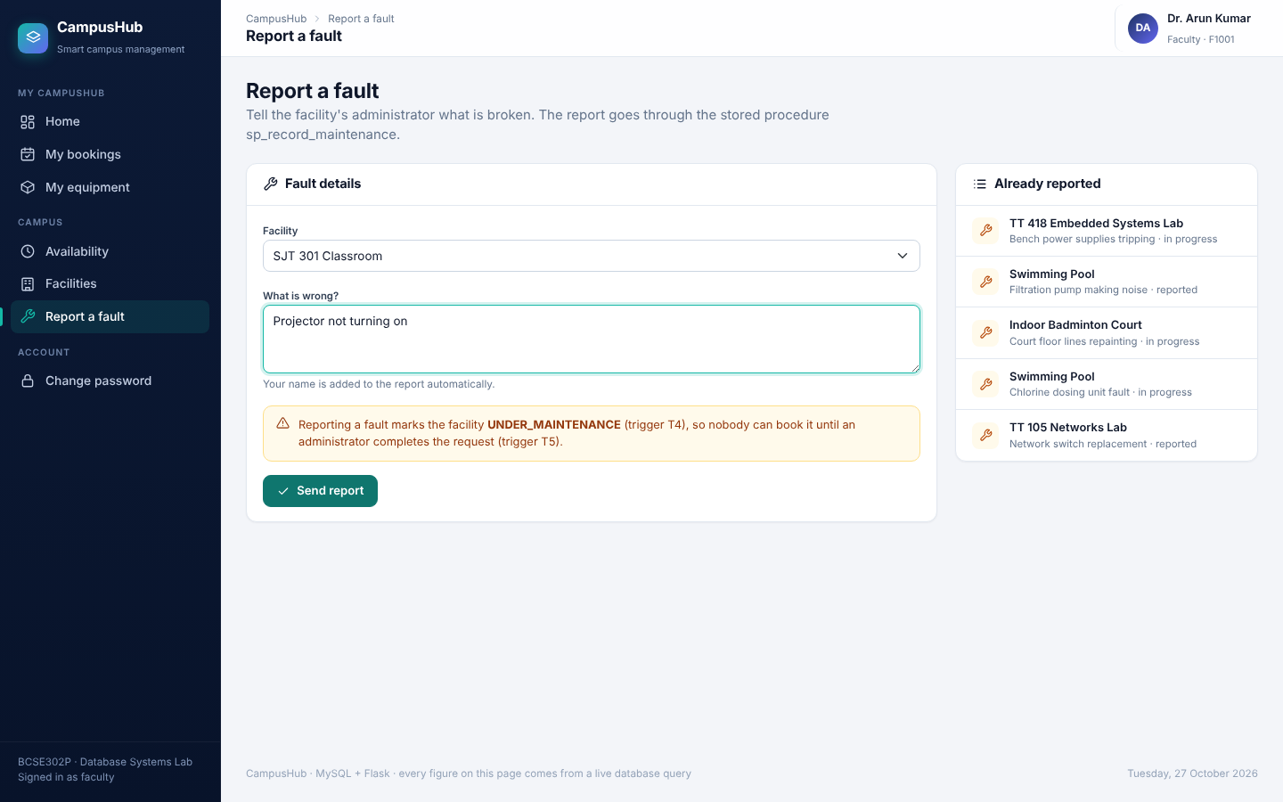
Faculty reports a fault: trigger T4
Presented by Arham
sp_record_maintenance + AFTER INSERT trigger → facility UNDER_MAINTENANCE
VERIFY IN WORKBENCH · SLIDES 14–15
SELECT m.maintenance_id, f.facility_name,
f.status AS facility_status,
m.issue_description,
m.status AS request_status
FROM maintenance m
JOIN facility f ON f.facility_id = m.facility_id
ORDER BY m.maintenance_id DESC LIMIT 3;
-- after the report:
-- request_status = REPORTED
-- facility_status = UNDER_MAINTENANCE (T4)
ON THE WEBSITE
Private window: Faculty → F1001 / Campus@2026
Report a fault → choose a room → describe → Send report
Try booking that room: refused (T1 status check)
Proves: one INSERT into maintenance automatically closed the facility.
Notes:
Arham. Sign in as faculty F1001 in the private window. Report a fault on a room, for example 'Projector not turning on'. The report is sent to that room's administrator and the faculty name is added. Run the query: facility_status is UNDER_MAINTENANCE. Optionally try to book that room: rejected by T1.

Slide 15
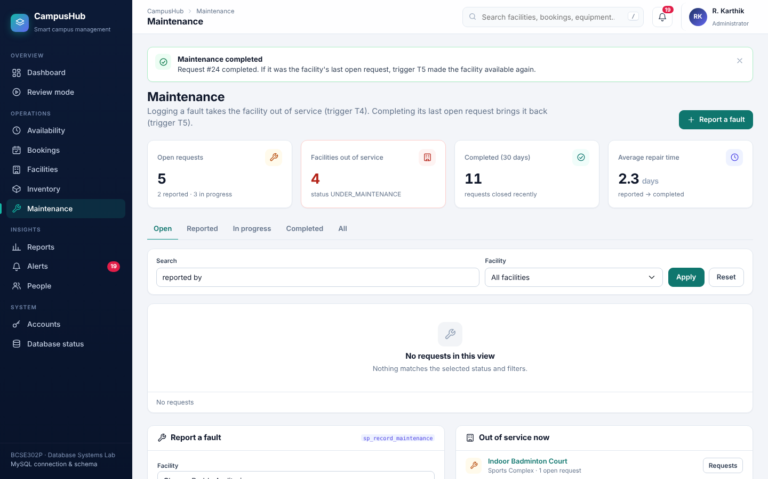
Admin completes the repair: trigger T5
Presented by Arham
AFTER UPDATE trigger with NOT EXISTS → room reopens only after its LAST open request
VERIFY IN WORKBENCH · SLIDE 15
-- run the slide 14 query again:
-- request_status = COMPLETED
-- facility_status = AVAILABLE (T5)
-- inside trigger T5:
-- IF NEW.status = 'COMPLETED'
-- AND OLD.status <> 'COMPLETED'
-- AND NOT EXISTS (SELECT 1 FROM maintenance
-- WHERE facility_id = NEW.facility_id
-- AND status <> 'COMPLETED')
-- THEN UPDATE facility SET status = 'AVAILABLE'
-- WHERE facility_id = NEW.facility_id;
ON THE WEBSITE
Admin → Maintenance → find the new request
Start work, then Complete → confirm
Run the slide 14 query again: AVAILABLE
Proves: a room with two open faults stays closed until both are fixed.
Notes:
Arham. Admin window, Maintenance page. Click Start work, then Complete on the faculty's request. Run the slide 14 query again: COMPLETED and AVAILABLE. Explain the NOT EXISTS: if another request is still open for the same room, it stays closed.

Slide 16
Admin dashboard: every number is live SQL
Presented by Arham
8 KPIs from COUNT / SUM subqueries · charts drawn from GROUP BY results
VERIFY IN WORKBENCH · SLIDE 16
SELECT
(SELECT COUNT(*) FROM facility) AS facilities,
(SELECT COUNT(*) FROM facility
WHERE status = 'AVAILABLE') AS available,
(SELECT COUNT(*) FROM booking
WHERE status = 'CONFIRMED'
AND booking_date >= CURDATE()) AS upcoming,
(SELECT COUNT(*) FROM equipment_issue
WHERE status = 'ISSUED') AS on_loan,
(SELECT COUNT(*) FROM maintenance
WHERE status <> 'COMPLETED') AS open_maint,
(SELECT COUNT(*) FROM equipment_issue
WHERE status = 'ISSUED'
AND due_date < CURDATE()) AS overdue;
-- all 8 cards: sql/review_demo_queries.sql
ON THE WEBSITE
Admin → Dashboard: read out the eight cards
Run the query: the same numbers
Click a card (Overdue returns) to drill down
Proves: the dashboard is not hard-coded; it reads the database on every load.
Notes:
Arham. Read out the cards, run the query, compare. The full 8-column version is in review_demo_queries.sql under slide 16. Click Overdue returns to show the drill-down list.

Slide 17
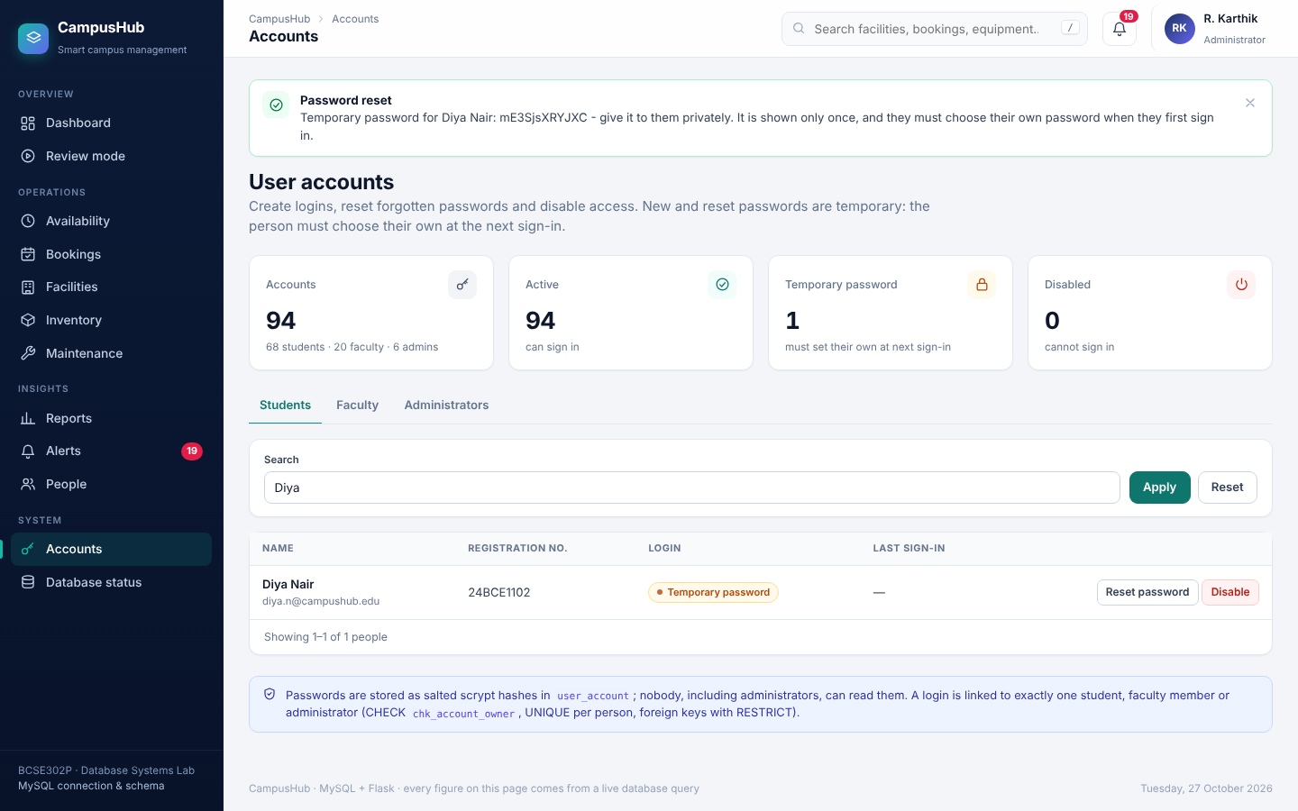
Accounts and security
Presented by Arham
Admin resets a password → temporary, must be changed · CSRF tokens · deny-by-default access
VERIFY IN WORKBENCH · SLIDE 17
SELECT s.name, ua.must_change_password,
ua.is_active, ua.failed_attempts,
ua.password_changed_at
FROM user_account ua
JOIN student s ON s.student_id = ua.student_id
WHERE s.registration_no = '24BCE1102';
-- after Reset: must_change_password = 1
SELECT CONSTRAINT_NAME, CHECK_CLAUSE
FROM information_schema.CHECK_CONSTRAINTS
WHERE CONSTRAINT_NAME = 'chk_account_owner';
ON THE WEBSITE
Admin → Accounts → search Diya → Reset password
Temporary password is shown once; she must change it
Search box: ' OR '1'='1 finds nothing (parameterized SQL)
Proves: account changes are stored in MySQL, and a CHECK ties each login to exactly one person.
Notes:
Arham. Reset Diya Nair (24BCE1102), not the demo student, so the student login keeps working. Run the query: must_change_password is 1. Show the CHECK constraint. Then type ' OR '1'='1 in the admin search box: no results, because every value is passed as a parameter. Mention: every form carries a CSRF token, and students get 403 on admin pages.

Slide 18
How we tested it
Presented by Arham
Positive and negative tests for every rule: valid data must pass, invalid data must be refused
RUN IN WORKBENCH · SLIDE 18
20
76
33
-- File > Open SQL Script >
-- sql/tests/verify_rules.sql
-- click the lightning bolt (run all)
-- result tab 1: one row per test
-- # test result
-- 1 Valid booking PASS
-- 2 Overlap rejected (T1) PASS
-- ...
-- 20 Booking slot index PASS
-- result tab 2: passed 20 · failed 0
-- uses a throw-away "ZZ SelfTest Room",
-- dates 400 days ahead, cleans up after itself
rule checks run inside MySQL
automated end-to-end app tests
of them on sign-in and security
sql/tests/verify_rules.sql prints PASS / FAIL for each
every page, every role, rejections, CSV, injection attempts
lockout, CSRF, 403 / 404, password reset, privacy
WHAT THE 20 RULE CHECKS COVER
Valid booking · overlap · rollback · back-to-back · end < start · two bookers · bad foreign key · cancel and rebook · T4 · booking a closed room · T5 · issue (T2) · out of stock · return (T3) · double return · duplicate UNIQUE · capacity CHECK · RESTRICT delete · object counts · index
Proves: every trigger, procedure and constraint was tested on the real MySQL server.
Notes:
Arham. Run verify_rules.sql live, or show its result tab if it was run just before. 20 PASS, 0 FAIL. The 76 automated app tests drive the website end to end with a test client (all pages for all roles, every rejection, CSV exports, SQL-injection strings, the database-down page); they were run on a test copy of the schema, and verify_rules.sql is the check on the real MySQL.

Slide 19
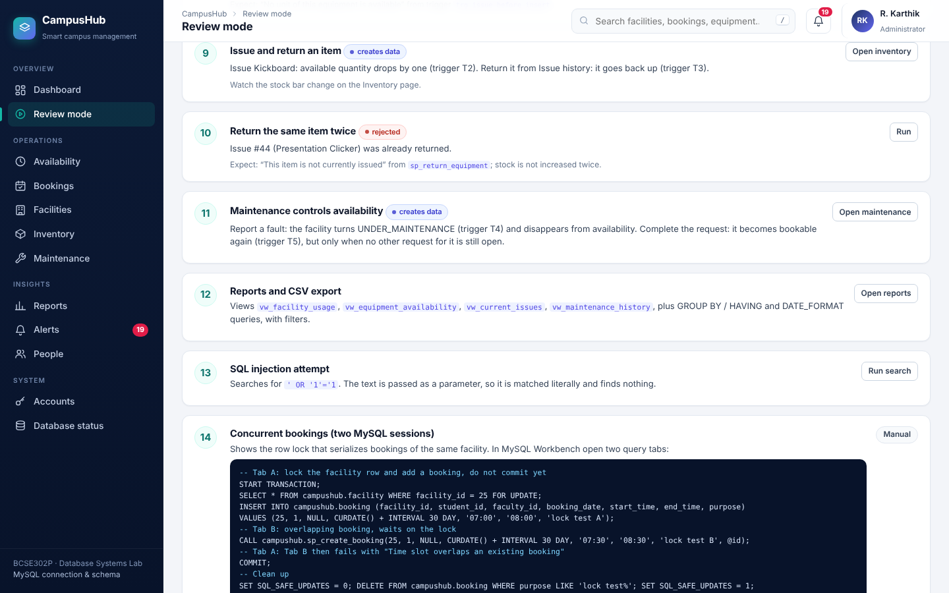
Two people, same slot, same moment
Presented by Affan
Transaction isolation: the row lock makes the second booking wait, then T1 refuses it
WORKBENCH · TWO TABS · SLIDE 19
-- TAB A
START TRANSACTION;
SELECT * FROM facility
WHERE facility_id = 1 FOR UPDATE;
INSERT INTO booking (facility_id, student_id,
faculty_id, booking_date, start_time,
end_time, purpose)
VALUES (1, 1, NULL, CURDATE() + INTERVAL 30 DAY,
'07:00', '08:00', 'lock test A');
-- TAB B (waits for Tab A's lock)
CALL sp_create_booking(1, 2, NULL,
CURDATE() + INTERVAL 30 DAY,
'07:30', '08:30', 'lock test B', @id);
-- TAB A
COMMIT; -- Tab B: Time slot overlaps ...
ON THE WEBSITE
Workbench: open two query tabs, A and B
Run Tab A's lines, then Tab B: B keeps spinning
COMMIT in A: B finishes with 'overlaps' (then clean up)
Proves: without the lock both could pass the check at once; with it they are serialised.
Notes:
Affan. Uses facility 1; if facility 1 is under maintenance in your data, change the 1 in all three places to an AVAILABLE facility id. Run Tab A's three statements but not COMMIT. Run Tab B: it waits. Go back to Tab A and COMMIT: Tab B finishes with the overlap error. Clean up with the three lines at the end of review_demo_queries.sql (SET SQL_SAFE_UPDATES = 0; DELETE ... 'lock test%'; SET SQL_SAFE_UPDATES = 1).

Slide 20




WHAT WE BUILT
A campus database that refuses bad data by itself
No double bookings
trigger T1 + transaction with row lock
Stock and rooms kept correct
triggers T2–T5, no manual updates
Three roles, secure sign-in
hashed passwords, lockout, CSRF, own data only
Live dashboards and reports
views, GROUP BY, HAVING, CSV export
NEXT STEPS
Password reset by e-mail and two-step sign-in · recurring bookings and approvals · nightly MySQL EVENT to close past bookings · e-mail reminders for overdue equipment
Thank you
Questions?
Notes:
Affan closes: four things we built, then next steps. Invite questions; whoever owns the topic answers first.

