Slide 1
COMPUTER NETWORKS LAB | BCSE308P | PROJECT REVIEW 1
NetMind
AI-Powered Network Intelligence and LLM Network Copilot
Mohammed Affan 24BAI0014
Hardik 24BCI0017
Notes:
Hardik, 15 seconds.
"Good morning sir. I am Hardik and this is Mohammed Affan. Our project is NetMind, a network monitoring system with an AI layer that explains what is happening in the network."

Slide 2
Abstract
Networks generate huge amounts of traffic and performance data, but monitoring tools only show raw numbers and leave the interpretation to the user.
NetMind captures and analyses network traffic, identifies protocols (TCP, UDP, ICMP, DNS, HTTP) and calculates latency, throughput, packet loss and jitter. Traffic comes from live capture and from NS2 simulation.
An ML model detects unusual traffic, and an LLM Copilot uses RAG to explain problems in plain English. The Copilot only advises; it never controls the network.
KEYWORDS
Packet Analysis
TCP/IP
NS2 Simulation
Anomaly Detection
RAG
LLM Copilot
Notes:
Hardik, 30 seconds.
"In short, sir: networks generate a lot of traffic and performance data, but monitoring tools only show raw numbers."
"NetMind captures and analyses network traffic, both live and from an NS2 simulation. It identifies protocols and calculates latency, throughput, packet loss and jitter."
"On top of this, a machine learning model detects unusual traffic, and an LLM Copilot explains the problem in simple language. The Copilot only advises and never controls the network."

Slide 3
Problem statement
Monitoring tools give data, not understanding. Tools like Wireshark capture and display everything, but the user still has to work out what it means.
WHAT THE TOOL SHOWS
WHAT THE USER NEEDS TO KNOW
Latency: 185 ms
Packet loss: 7.4%
TCP retransmissions: high
Connections: rising
Is this bad?
What caused it?
Which protocol or link?
What should I check?
Notes:
Hardik, 35 seconds.
"Sir, modern networks generate a lot of data: packets, connections, latency and throughput. Tools like Wireshark can capture and display all of it. But they only show raw numbers."
"If a user sees high latency or a sudden rise in connections, he still has to work out what it means, what caused it and what to do. That needs expertise. So the problem is that monitoring tools give data, but not understanding."

Slide 4
Objective: measure, detect, explain
1
2
3
Measure
Detect
Explain
Capture packets and calculate latency, throughput, loss and jitter
A machine learning model flags traffic that looks different from normal
An AI Copilot explains the likely cause in plain English and suggests what to check
Live capture (Scapy) + NS2 simulation
Isolation Forest
RAG + LLM
Real network data is the foundation. The AI only explains it and never controls the network.
Notes:
Hardik, 40 seconds.
"Our objective is to build NetMind, which works in three steps."
"First, measure. We get network data from live packet capture and from an NS2 simulation, and calculate latency, throughput, packet loss and jitter."
"Second, detect. A machine learning model checks whether the traffic is unusual."
"Third, explain. An AI Copilot uses these measurements and a networking knowledge base to explain the problem in simple language and suggest what to check."
"The important point is that real network data is the foundation. The AI only explains it and does not control the network. Affan will now explain the architecture."

Slide 5
Proposed system architecture
Performance
latency, loss, jitter
Live Capture
Scapy
RAG Engine
networking notes
Traffic Analyzer
TCP UDP ICMP DNS HTTP
Topology + Routing
graph, Dijkstra
State Database
SQLite
Dashboard
Streamlit
NEW
NS2 Simulation
trace file
LLM Copilot
explanation
ML Anomaly
Isolation Forest
Networking core
AI layer
Storage
Presentation
Notes:
Affan, 75 seconds. Point at each box as you name it.
"Sir, this is our architecture. It is a pipeline from left to right."
"Data comes in from two sources. Live packets are captured using Scapy, and simulated traffic comes from NS2 as a trace file. The Traffic Analyzer then identifies the protocol: TCP, UDP, ICMP, DNS or HTTP."
"Three modules work on this traffic. The Performance Analyzer calculates latency, throughput and packet loss. The Topology module builds a graph of the nodes and finds shortest paths using Dijkstra's algorithm. The ML module uses Isolation Forest to detect anomalies."
"All results are stored in a database. When the user asks a question, the RAG engine finds the relevant networking knowledge, and the LLM Copilot combines it with the current network state to give an explanation."
"Finally, everything is shown on the dashboard. Each module can be developed and tested separately. I will now explain the NS2 module."

Slide 6
Methodology: NS2 simulation
0.5 s
TCP file transfer starts
5-NODE NS2 NETWORK
n0
3.0 s
UDP burst joins: queue fills, packets dropped (congestion)
TCP source
router
sink
1 Mb bottleneck, queue 10
6.0 s
UDP stops: network recovers
n2
n3
7.0 s
Main link fails: Distance Vector reroutes via n4
n1
n4
8.5 s
Link comes back
UDP source
backup
netmind_scenario.tcl
NS2 runs
netmind.tr trace file
parse_trace.py
throughput, loss, delay, jitter
Notes:
Affan, 55 seconds.
"Sir, as per your suggestion, we have added an NS2 Simulation Module."
"In NS2 we build a five-node network. A TCP file transfer runs from n0 to n3. At 3 seconds, a heavy UDP stream joins on the same 1 megabit link. The router queue fills up, delay increases and packets get dropped. This is congestion."
"At 7 seconds we make the main link fail. Since we use Distance Vector routing, traffic is rerouted through the backup node n4, and the delay goes up."
"NS2 writes every packet event into a trace file. Our Python parser reads it and calculates throughput, packet loss, delay and jitter for every second. Because we know exactly when we created each problem, we can check whether NetMind detects and explains it correctly."

Slide 7
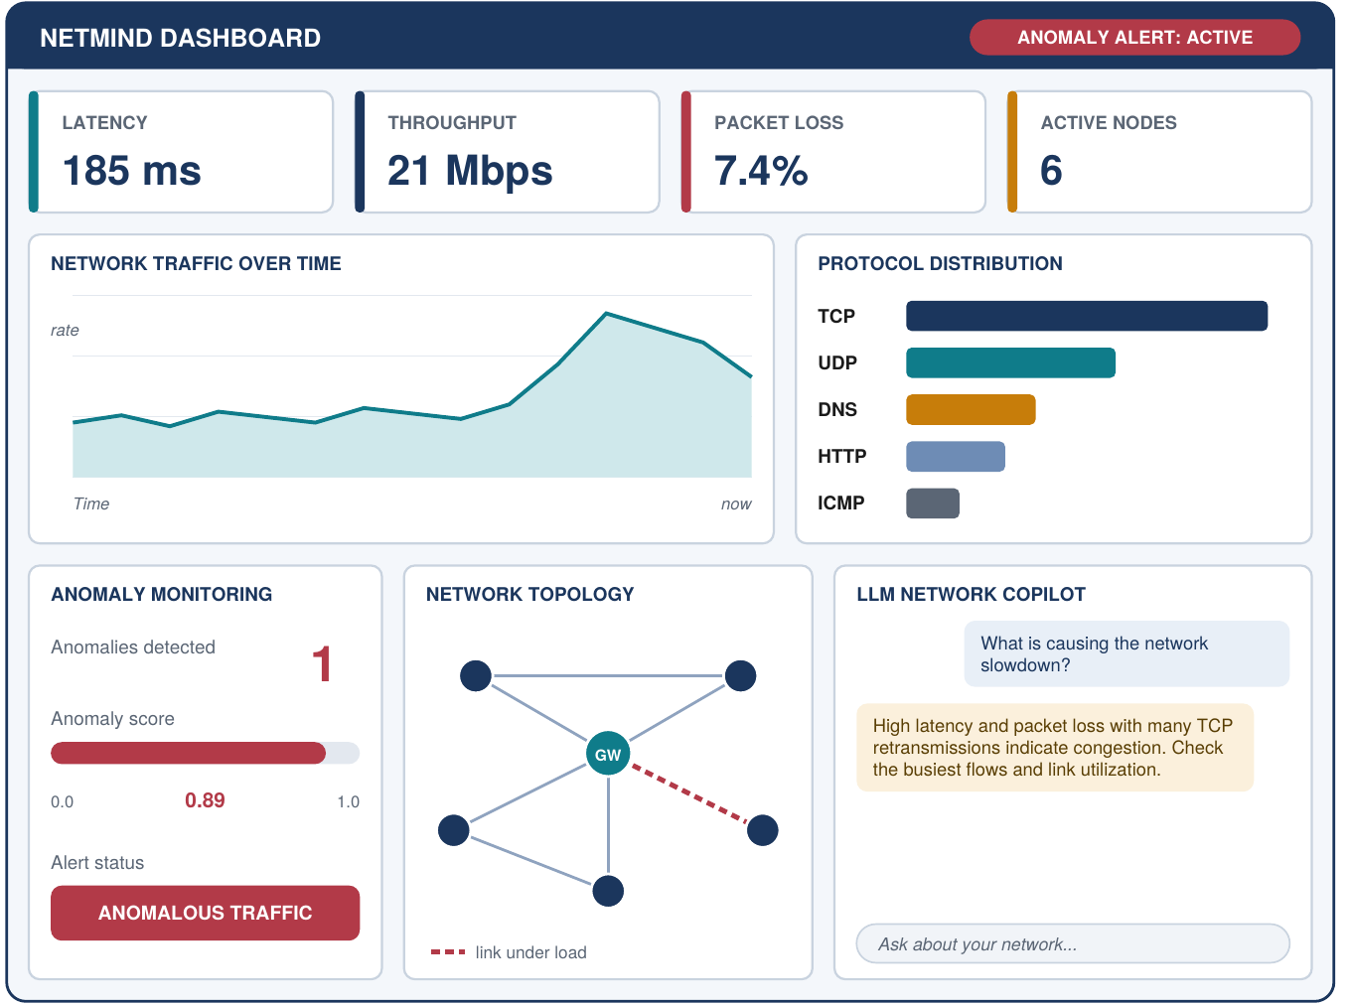
Example: "Why is the network slow?"
1
Measure
Latency 185 ms, packet loss 7.4%, many TCP retransmissions
2
Detect
ML model flags the traffic as anomalous (score 0.89)
3
Ask
User asks the Copilot what is causing the slowdown
4
Explain
Likely congestion. Check the busiest flows and link utilization
Illustrative values, not measured results. We will recreate this scenario in NS2.
Notes:
Hardik, 40 seconds.
"Here is an example of how it works. These are illustrative values, not measured results."
"Suppose the network becomes slow. NetMind measures a latency of 185 milliseconds, packet loss of 7.4 percent and a high number of TCP retransmissions. The ML module flags this traffic as anomalous."
"The user asks the Copilot: what is causing the slowdown? The Copilot explains that the likely cause is congestion, and suggests checking the busiest flows and the link utilization."
"We will recreate this same scenario in NS2 to test it. All of this appears on one dashboard, as in this mockup."

Slide 8
Expected result
Networking
NS2 simulation
Intelligence
Live traffic captured and classified by protocol
Latency, throughput, loss and jitter measured
Topology graph with shortest paths
Congestion and link failure created on purpose
Distance Vector rerouting shown in NAM
Metrics calculated from trace files
Unusual traffic flagged by the ML model
Plain-English explanation of the cause
Troubleshooting suggestions for the user
Final result: one dashboard showing live or simulated network state, alerts and AI explanations
Notes:
Affan, 40 seconds.
"Sir, at the end of the project we expect three kinds of results."
"On the networking side, NetMind will capture live traffic, classify it by protocol, measure latency, throughput, loss and jitter, and show the topology with shortest paths."
"With NS2, we will create congestion and a link failure on purpose, show Distance Vector rerouting in NAM, and calculate the same metrics from the trace files."
"On the intelligence side, the ML model will flag unusual traffic and the Copilot will explain the cause and suggest what to check."
"The final result is one dashboard that shows all of this together."

Slide 9
Plan and work split
24
syllabus topics mapped
Hardik
Mohammed Affan
Packet Capture
Traffic Analyzer
Topology and Routing
Network State Database
Dashboard (lead)
NS2 Simulation
Performance Analyzer
ML Anomaly Detection
RAG Engine
LLM Copilot
8
development phases, networking first
2
data sources: live capture and NS2
Thank you. Questions?
Together: integration, testing, documentation
Notes:
Affan first, then Hardik, then Affan closes. 50 seconds.
Affan: "Sir, the project maps to 24 topics of our Computer Networks syllabus, such as TCP, UDP, DNS, IPv4 addressing, routing and performance analysis."
"We will build it in eight phases. We start with the networking modules, and add the AI modules after that foundation works."
"NS2 also lets us show congestion control and Distance Vector routing from the syllabus in action."
"For the work split, I will handle the NS2 simulation, the Performance Analyzer, anomaly detection, the RAG engine and the Copilot."
Hardik: "I will handle packet capture, the Traffic Analyzer, topology and routing, and the database, and I will lead the dashboard. Integration and testing we will do together."
Affan: "Thank you sir. We are happy to take questions."

