Slide 1
C++
Embedded Linux Program

Slide 2
General tips for learning
Always learn by doing
Test yourself
Always ask questions if you don’t understand
DON’T use AI for writing code when learning

Slide 3
Section’s Goals
Get comfortable developing in C++
Learn Object Oriented Design methodology
Common software design patterns
Learn systems programming concepts
Build graphical user interfaces
Concurrency and multi-threaded development
Some basic network programming (extra)

Slide 4
Today’s Goals
Intro to C++
Setting up a simple development environment
Review basic C++ features
Some more C++ features

Slide 5
What is C++?
C++ is a system programming language.
C++ is standardized by the International Organization for Standardization (ISO)
Compilers vendors supply compilers that adhere to the ISO standard (gcc/g++, MSVC)
Modern C++ refers to the programming style that uses features that make coding safer and cleaner (subjective) since C++11

Slide 6
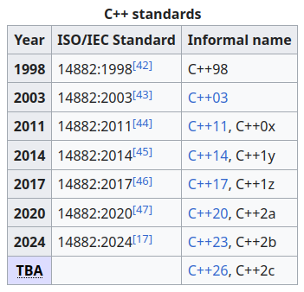
C++ standards

Slide 7
What is systems programming?
Systems programming refers to developing software that may:
  Interact directly with computer hardware
  Have many constraints on resource management
  Require high performance and efficiency
Examples:
  Operating systems
  Database engines
  Browser engines
  Game engines (and graphics applications)
  Mathematical and simulation libraries
  Embedded systems
  And many more ...

Slide 8
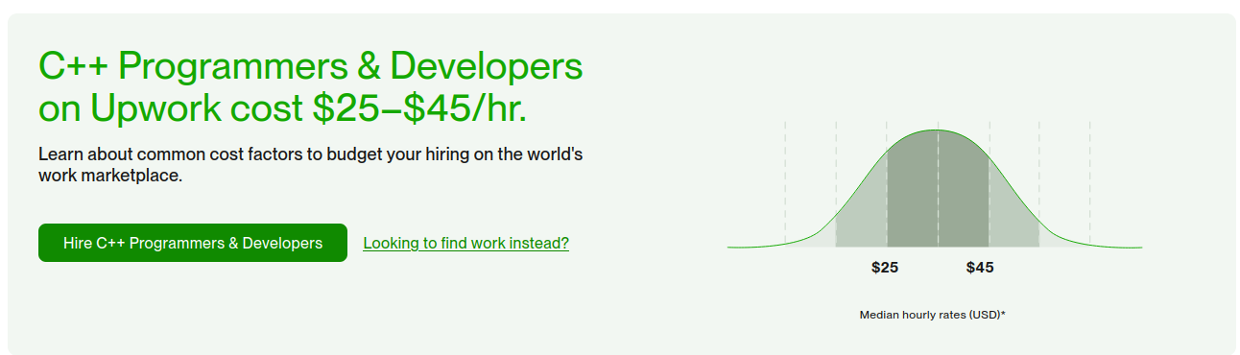

Slide 9
Development
Let’s setup our development environment for gcc

Slide 10
Code Editor vs IDE
Text editing tools
Has a code editor
Autocomplete
Build tools
Formatting and syntax highlighting
Debugging tools

Slide 11
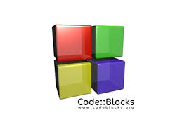






Editor vs IDE

Slide 12
Let’s write some code

Slide 13
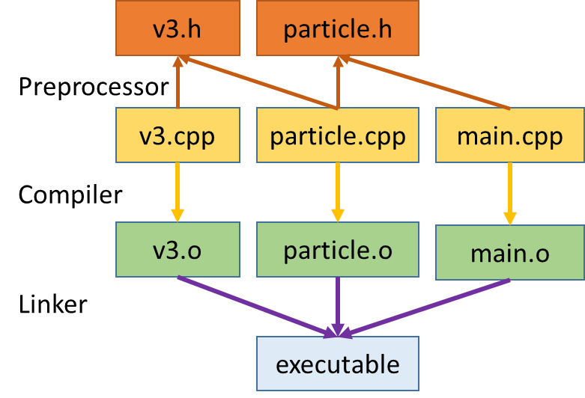
C++/C build process

Slide 14
C++ review

Slide 15
Resources and references
https://makefiletutorial.com/
Professional C++ (6th Edition) Marc Gregoire
https://godbolt.org/

