Slide 1
Today’s Goals
Expanding our wallet application
Applying object oriented design
Learn about SOLID
Composition vs inheritance

Slide 2
Object Oriented Design
In Object Oriented Design, we think of our application domain in terms of objects and classes
Classes define the blueprint state (class members), behavior (class methods), and the relationship to other classes (inheritance, composition ...etc)
Objects are actual instances of these classes. Each object stores in memory the data defined by its class.
The key to Object Oriented Design is to think about the following:
      What data should objects of this class hold?
      What relationships to other objects should objects of this class have?
      What is the lifetime of objects of this class?
Objects can represent actual tangible items (eg. dog, car, plane … etc) or they can represent just a collection of related data and behavior (eg. LoginSession, FileWriter … etc)

Slide 3
The 4 Pillars of OOP
Encapsulation
Abstraction
Inheritance
Polymorphism

Slide 4
Our smart wallet app
Currently we don’t have any functionality (only UI)
Let’s start designing a more useful app
We will use diagrams similar to UML (Unified Modeling Lanugage) to design our system
https://www.visual-paradigm.com/guide/uml-unified-modeling-language/uml-class-diagram-tutorial/

Slide 5
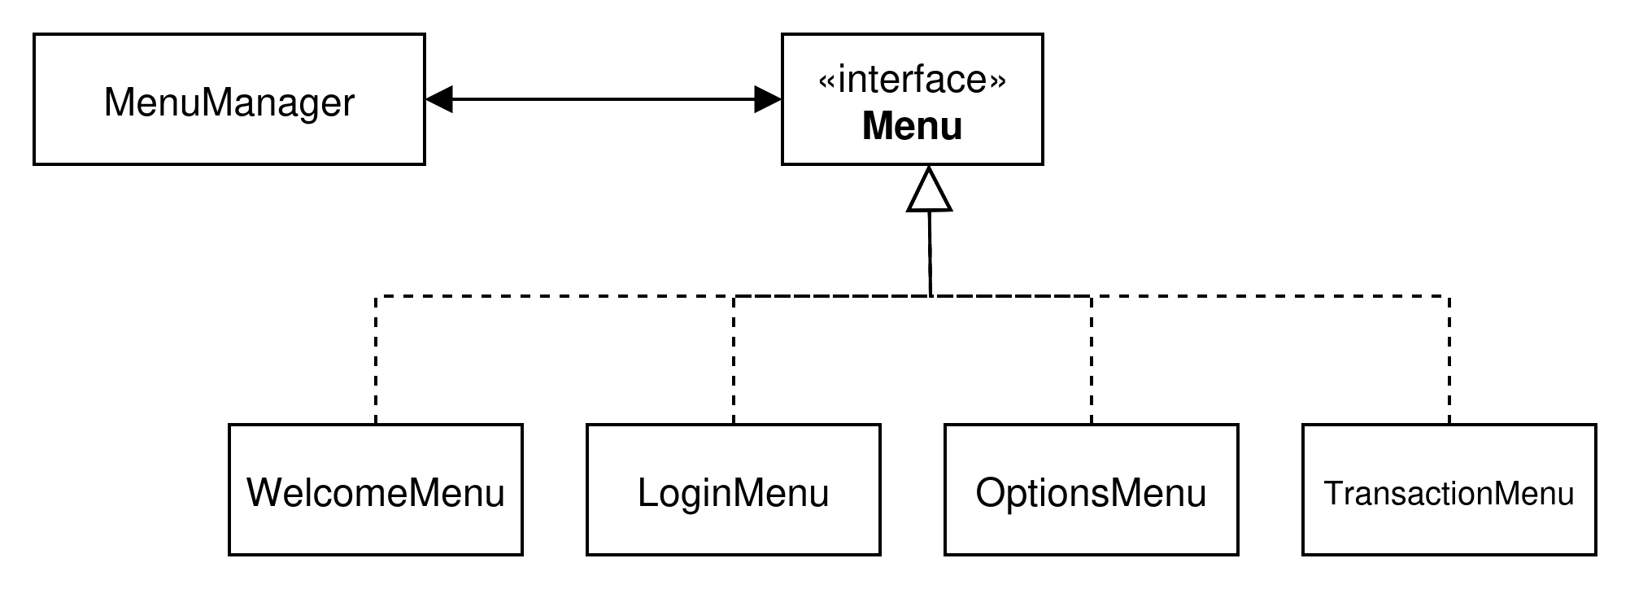
Current state

Slide 6
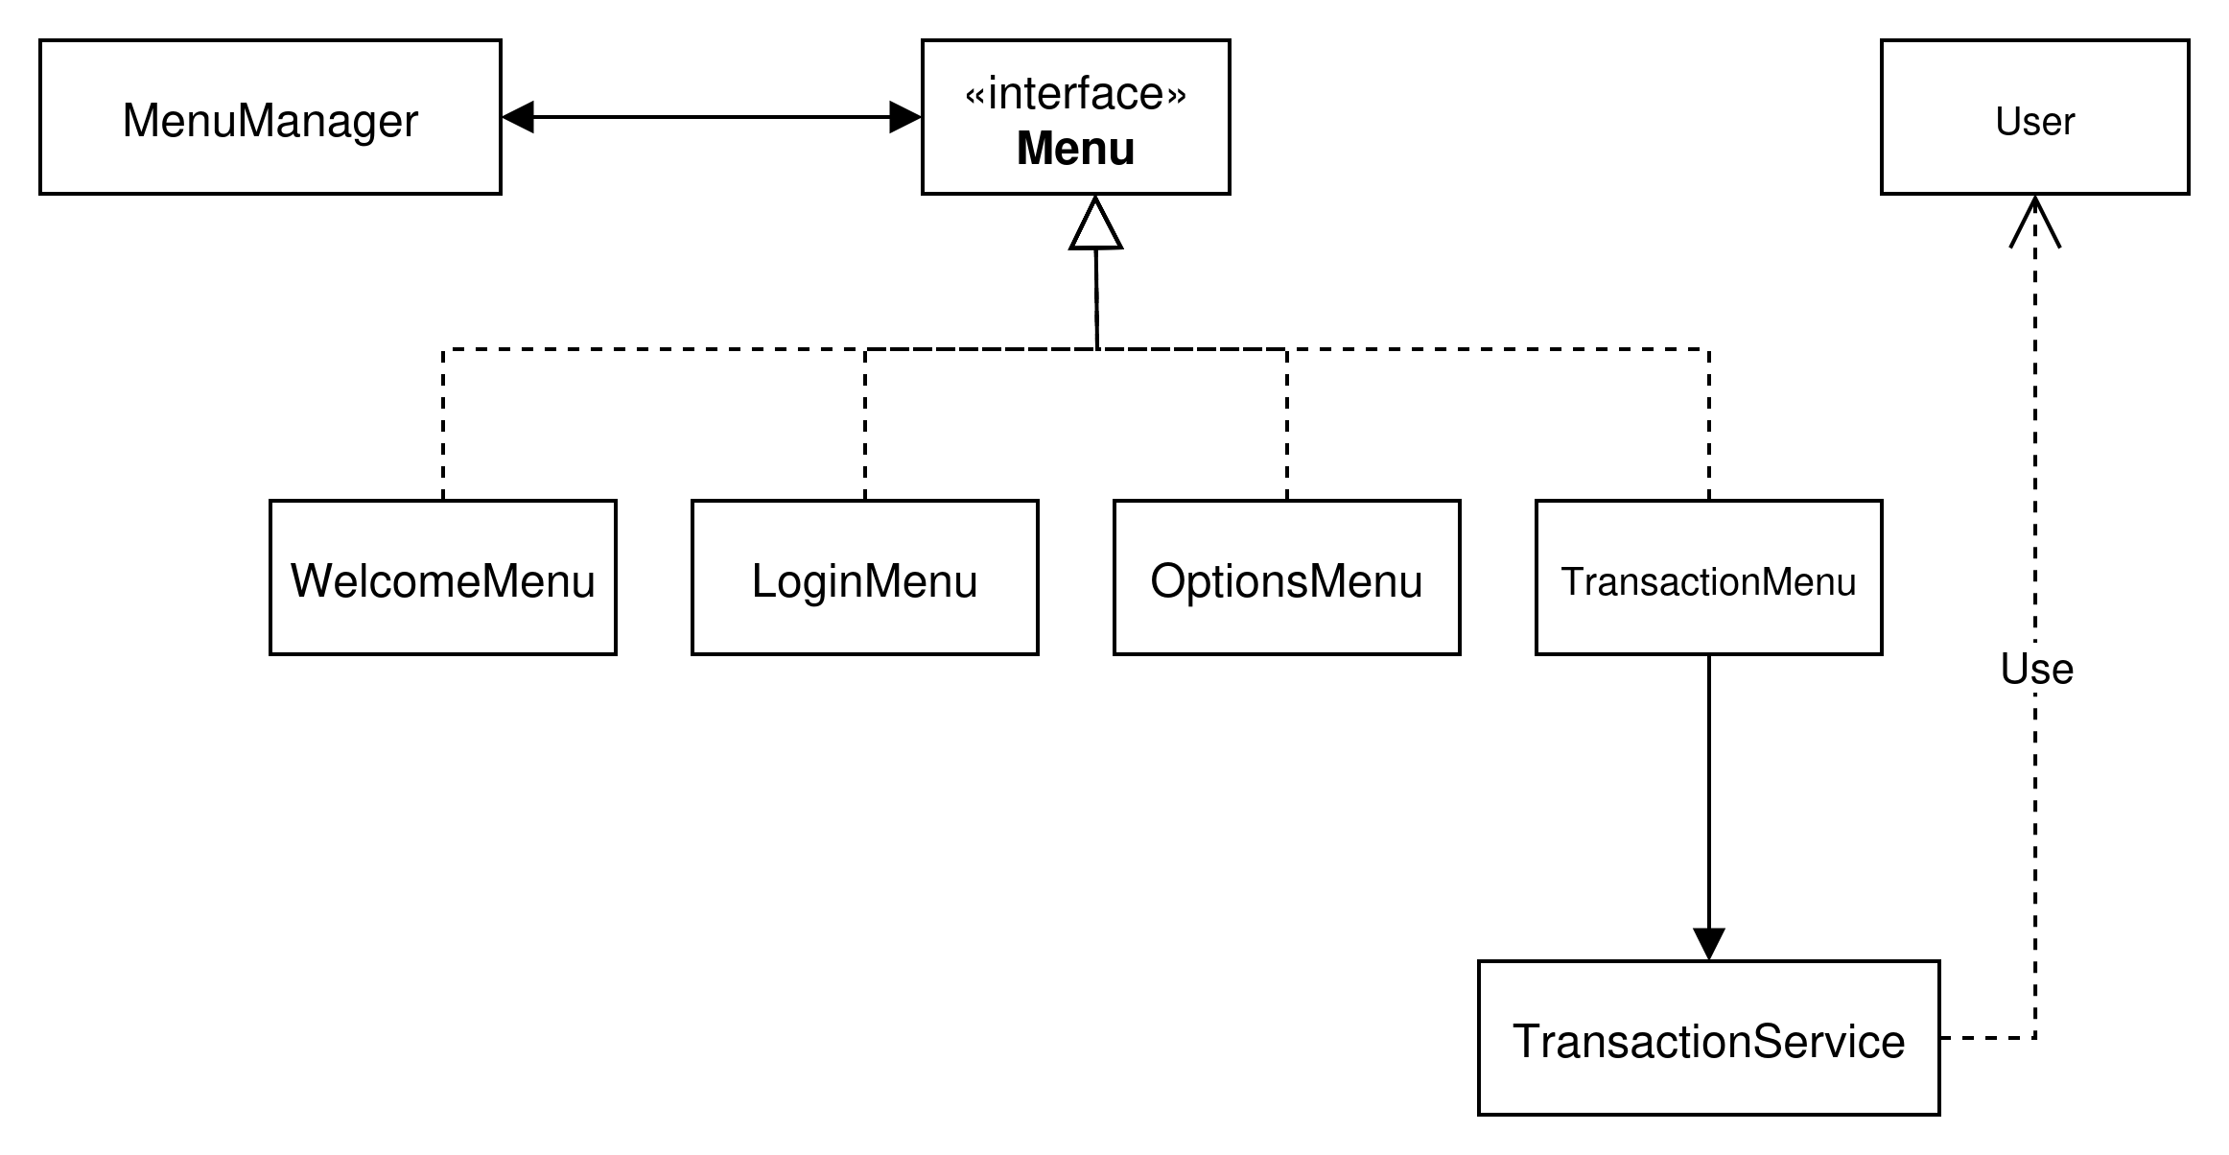

Slide 7
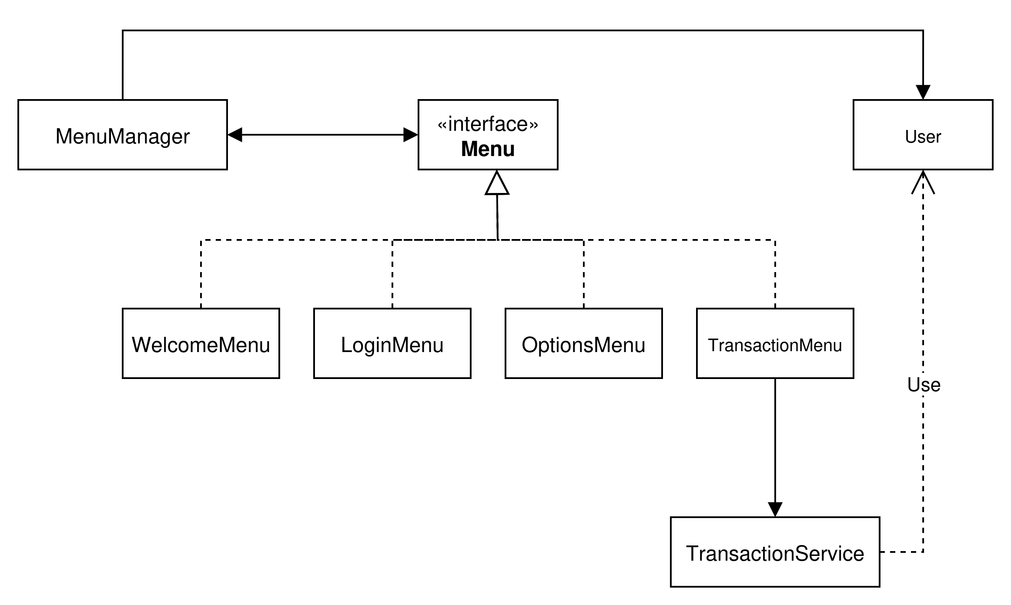

Slide 8
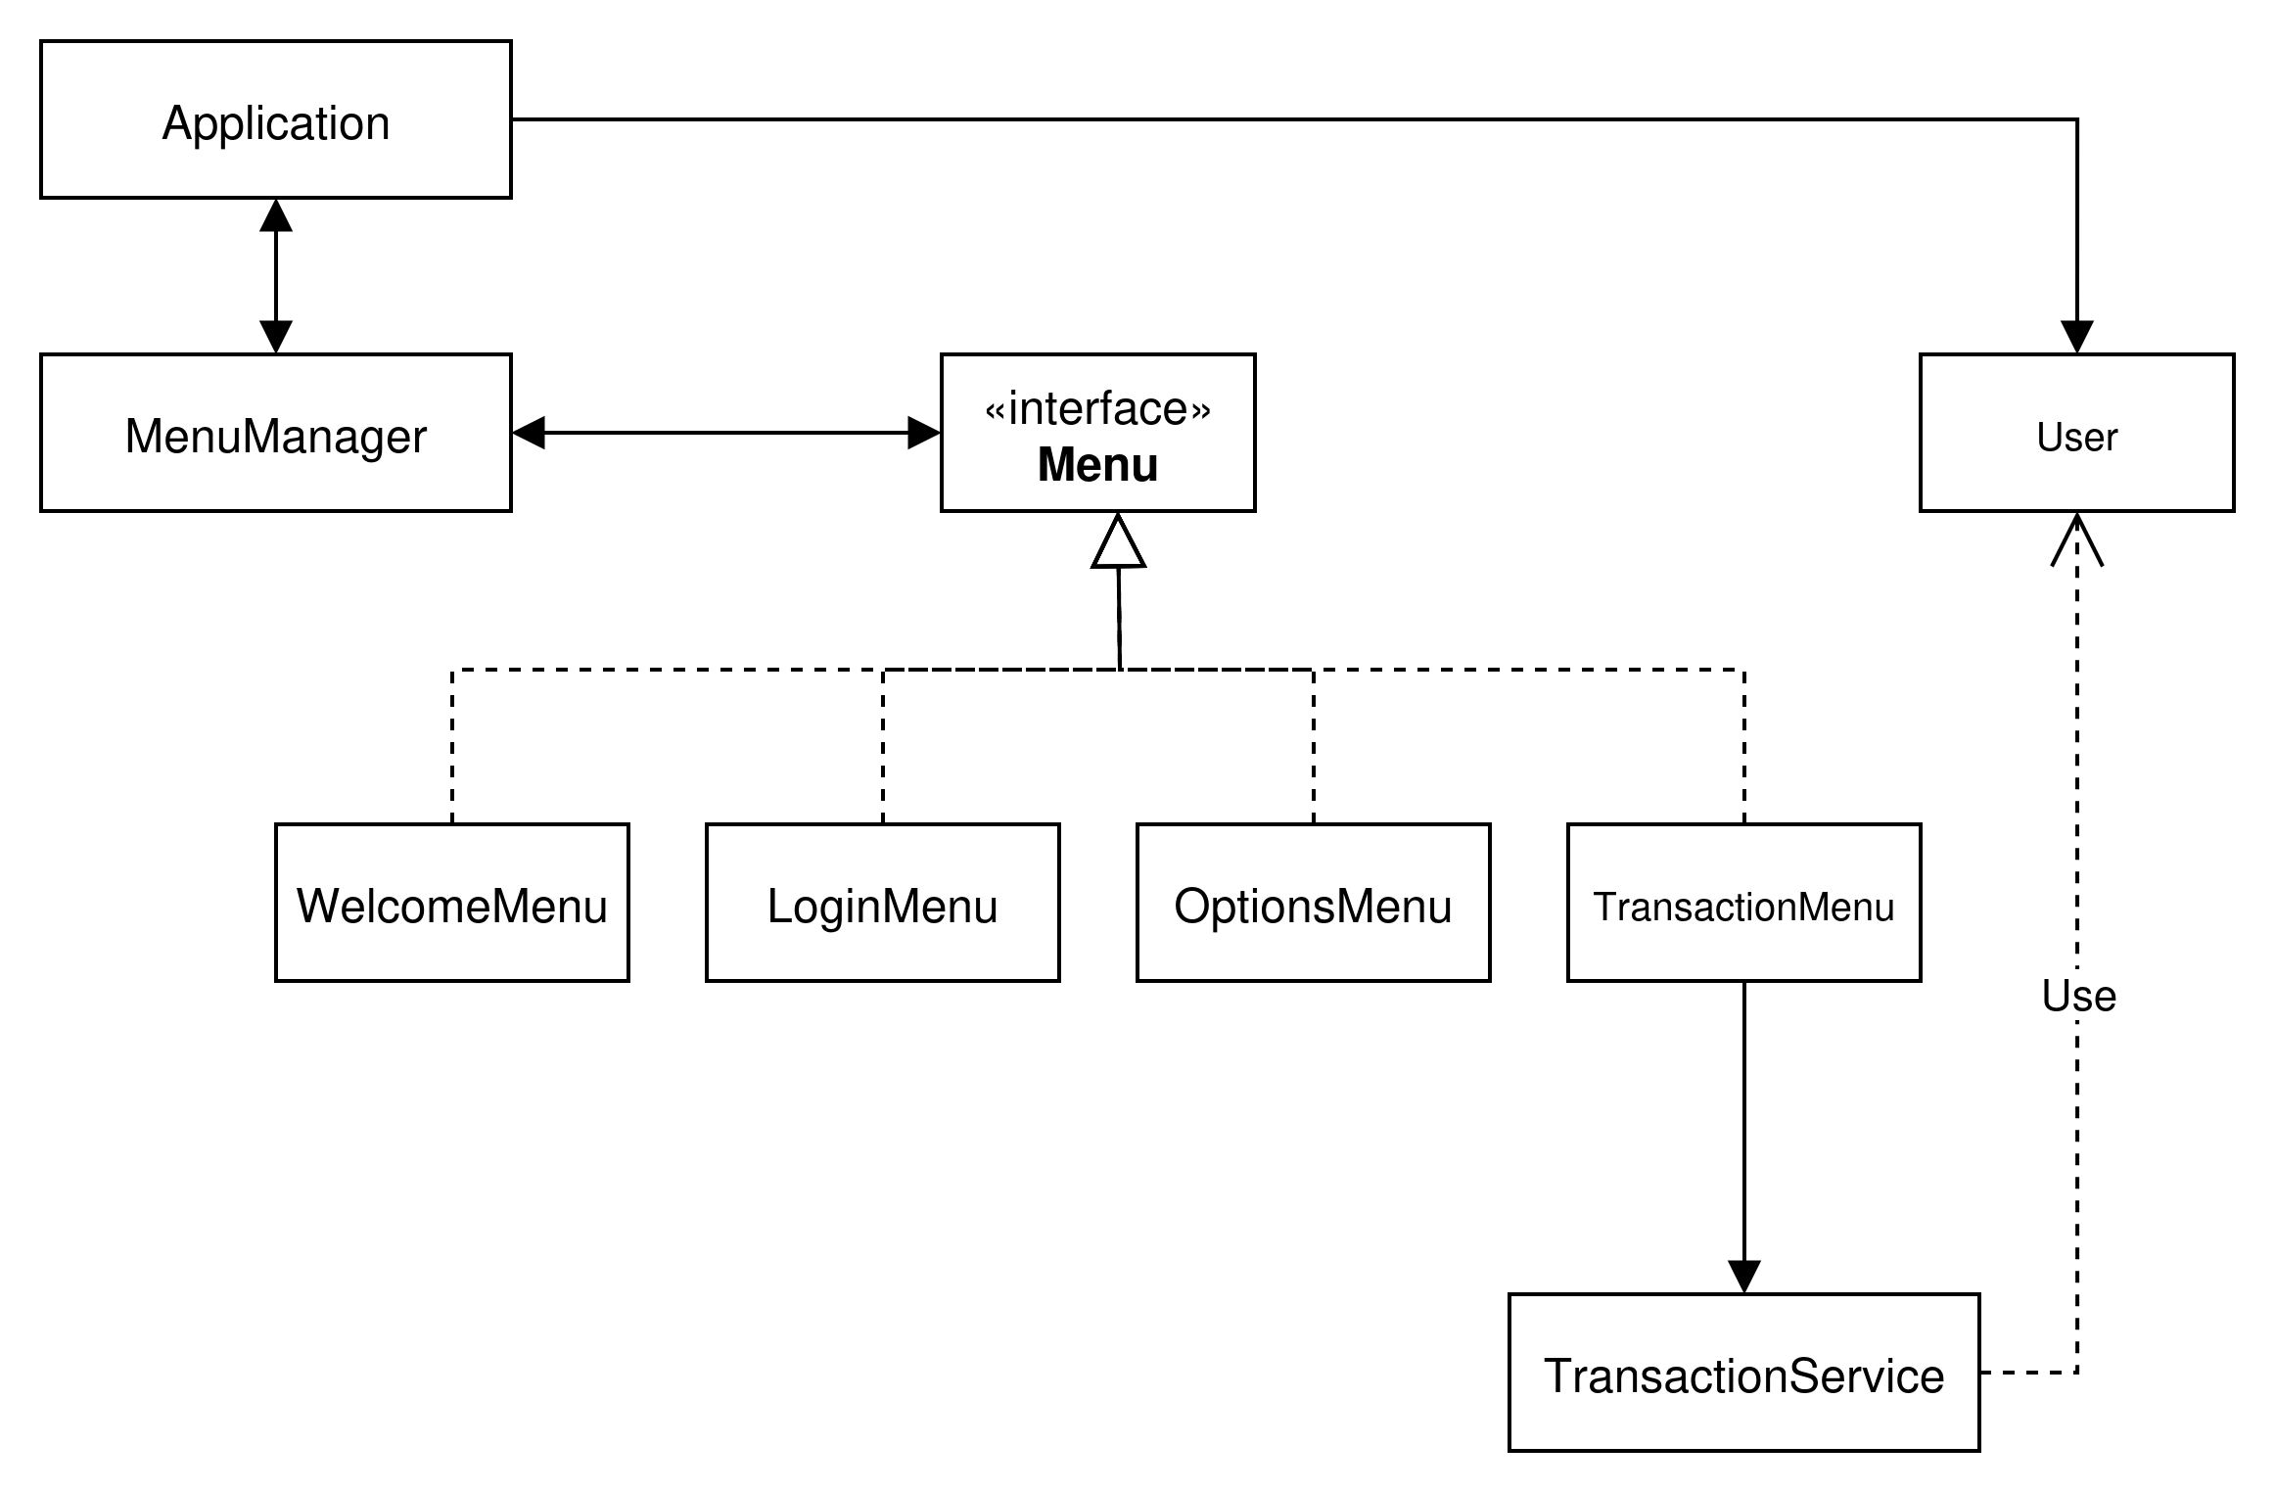

Slide 9
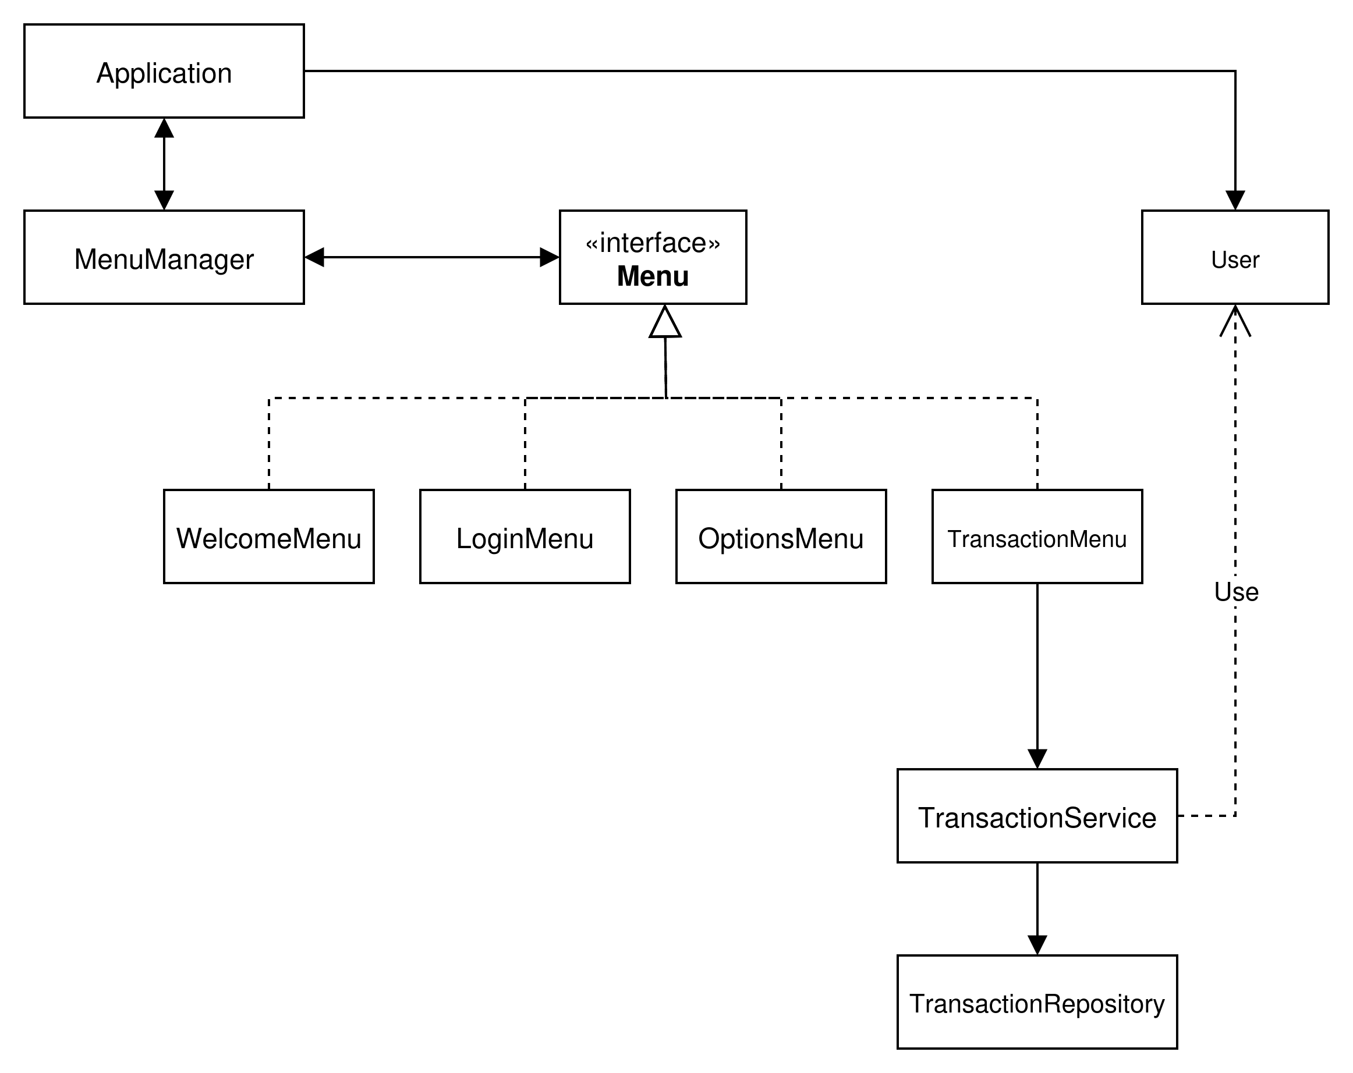

Slide 10
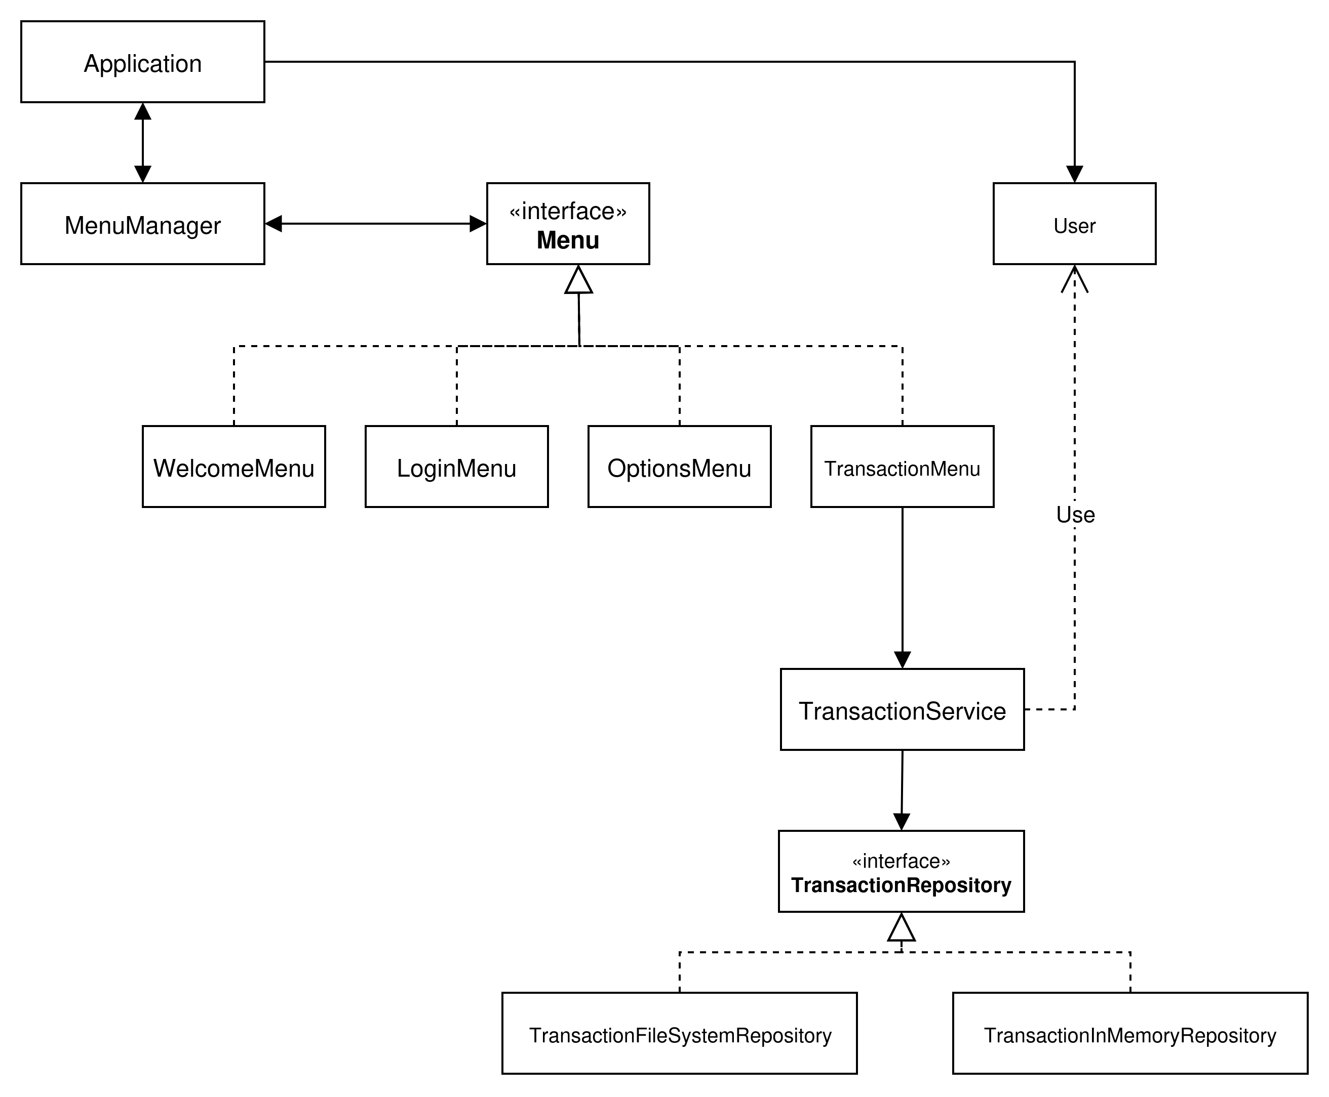

Slide 11
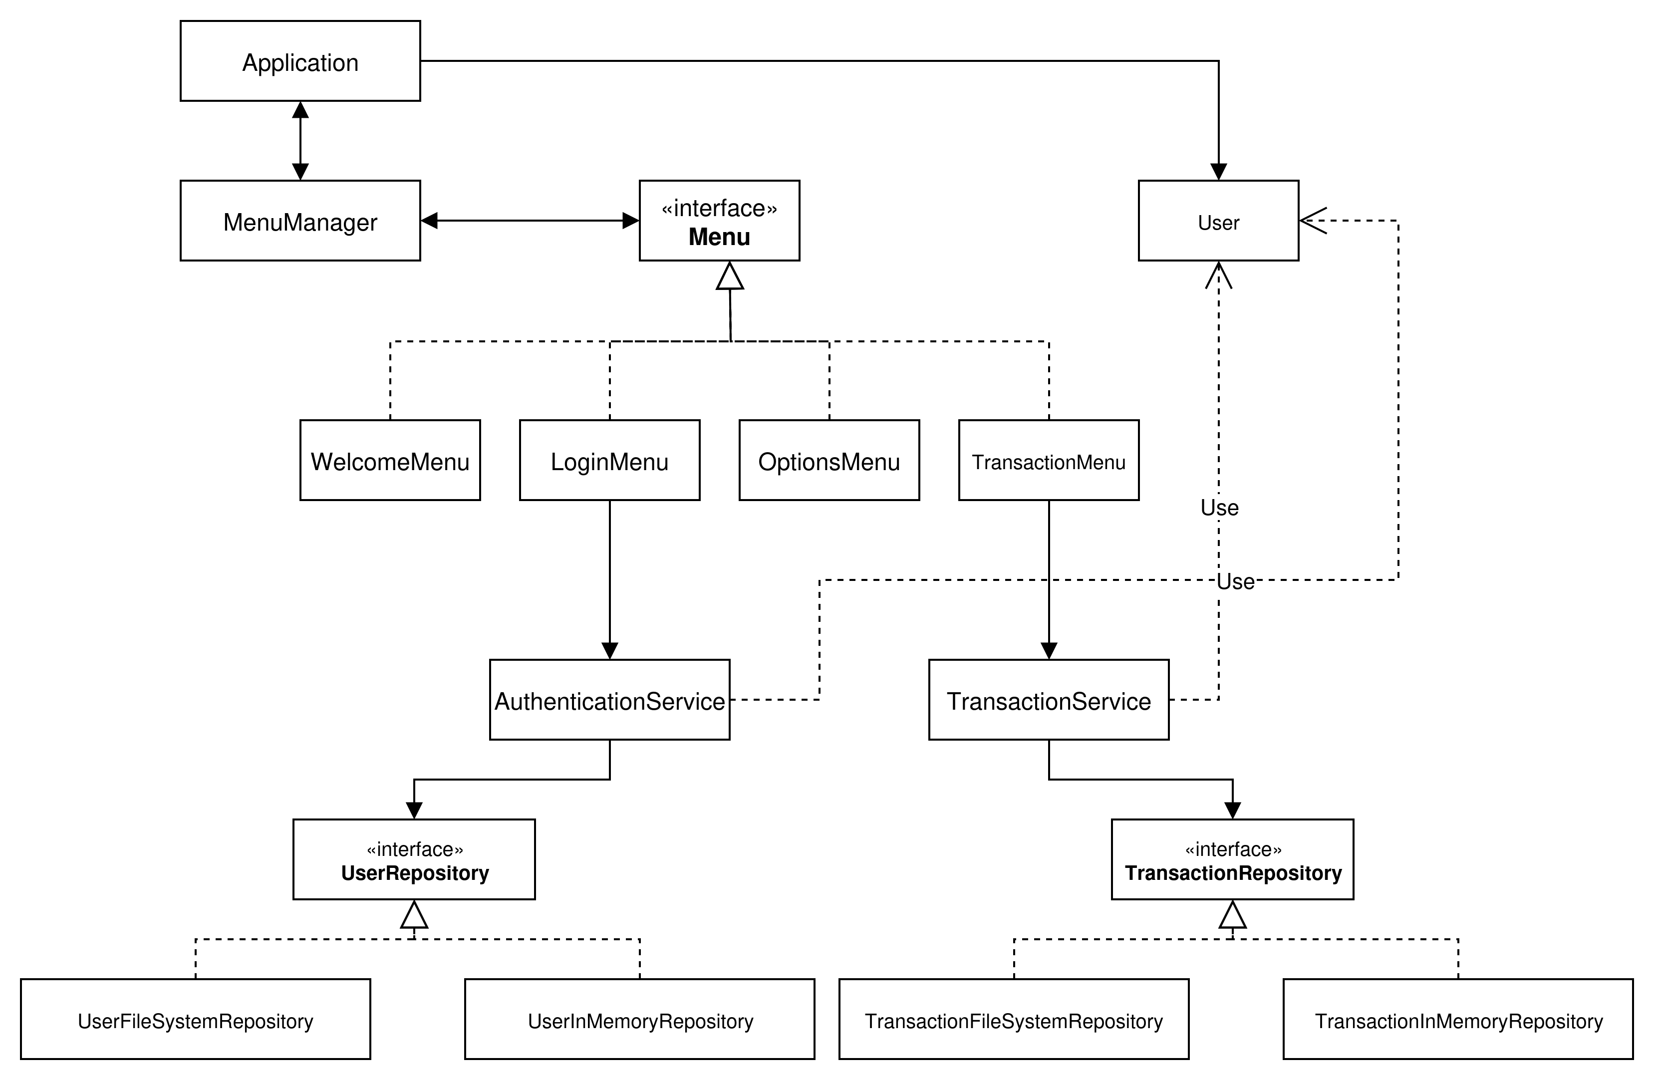

Slide 12
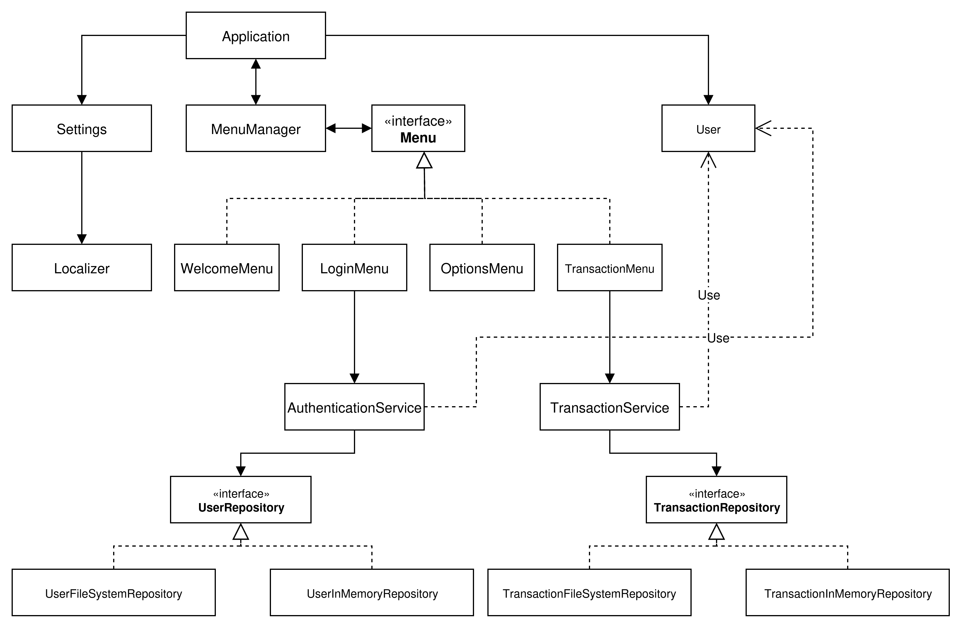

Slide 13
Are we done yet?
We have indicated the classes in our program
But remember, we need to also understand and think about their lifetimes and instances

Slide 14
Let’s think of lifetimes first
How long will instances of each of these classes live?

Slide 15
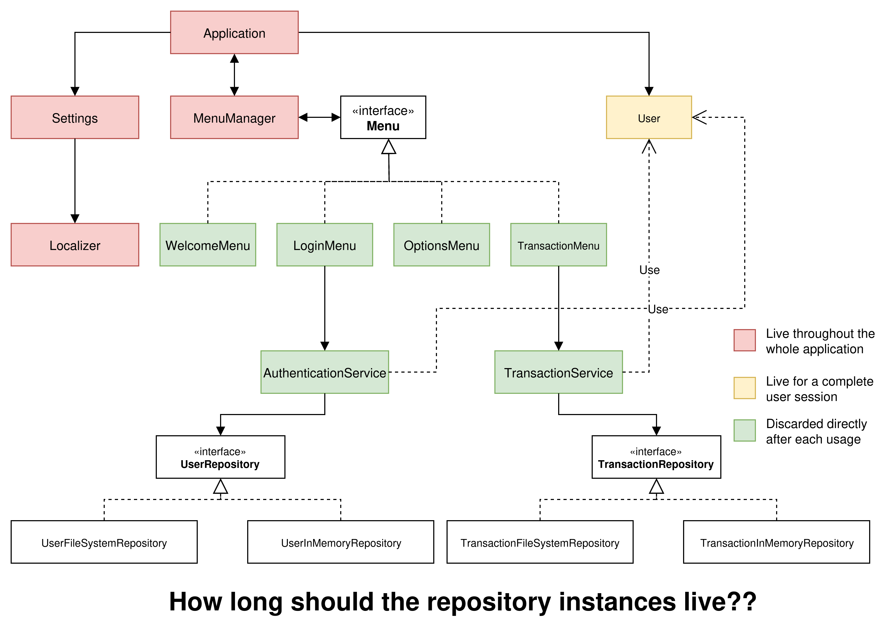

Slide 16
Now regarding instances, how many instances can exist from each class? How many at the same time?

Slide 17
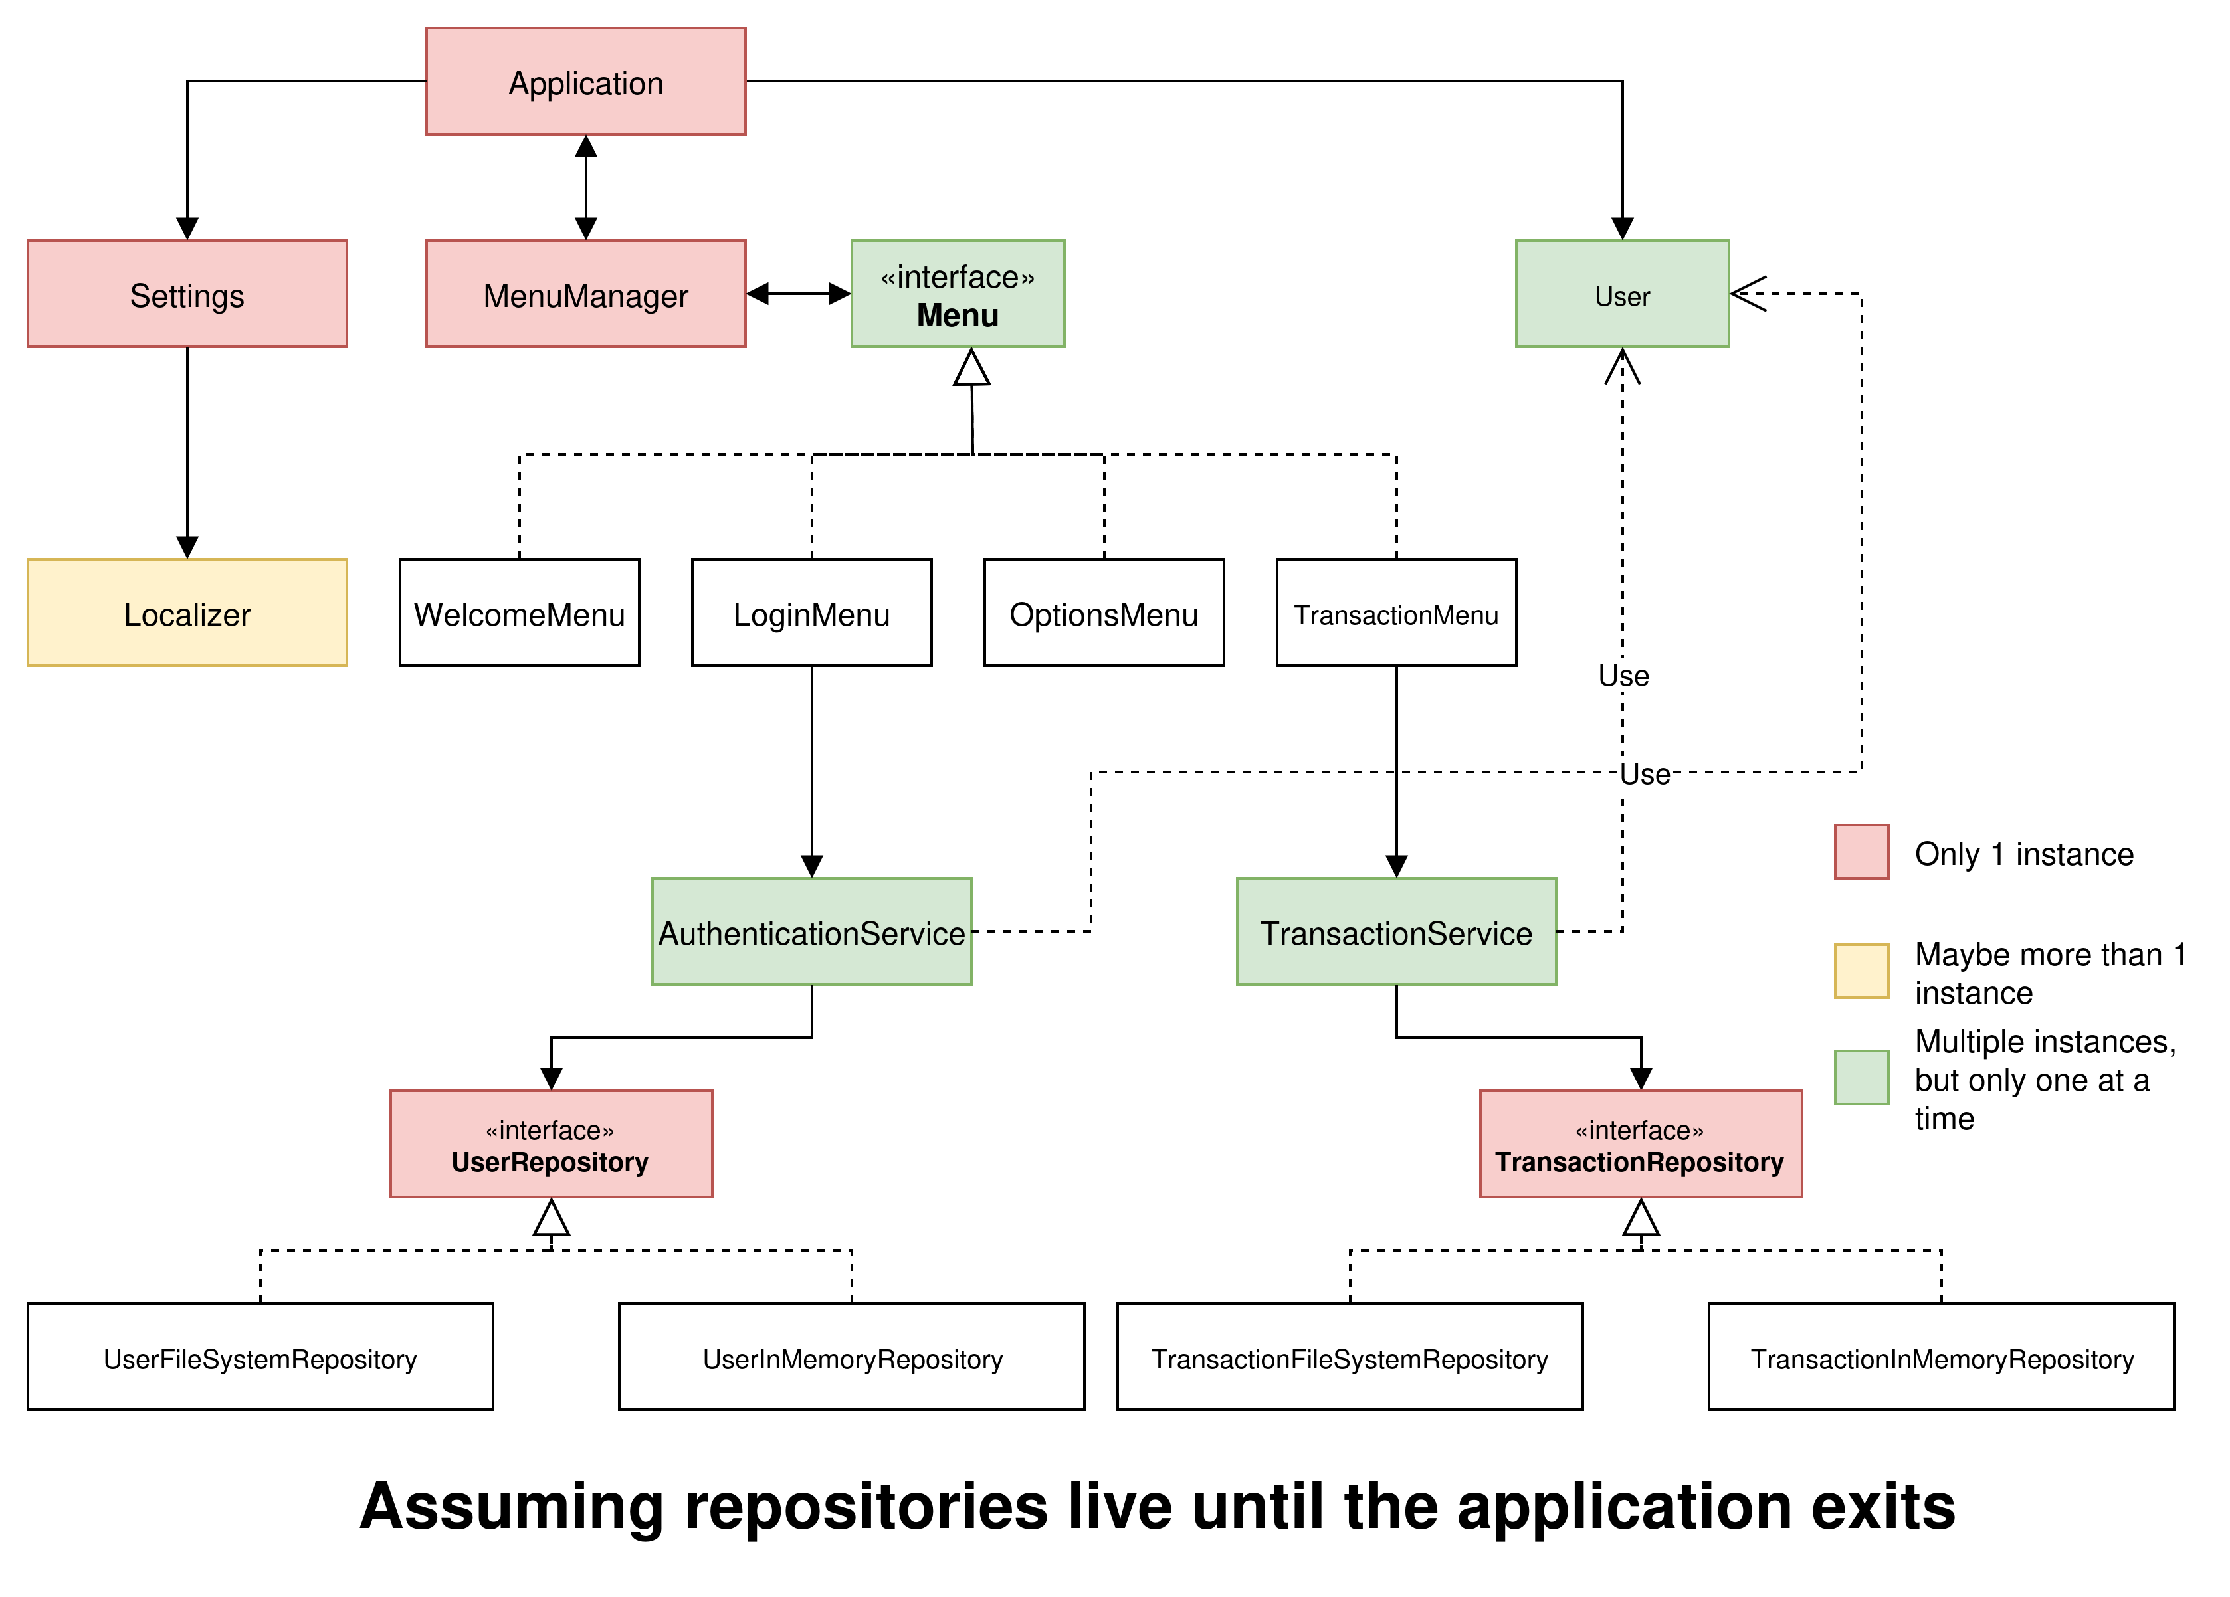

Slide 18
SOLID
Single responsibility principle
Open-closed principle
Liskov substitution principle
Interface segregation principle
Dependency inversion principle
https://en.wikipedia.org/wiki/SOLID

Slide 19
We have covered a lot of concepts regarding design
But there are also decisions to be made that affect implementations

Slide 20
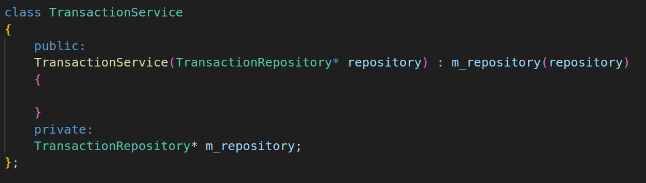
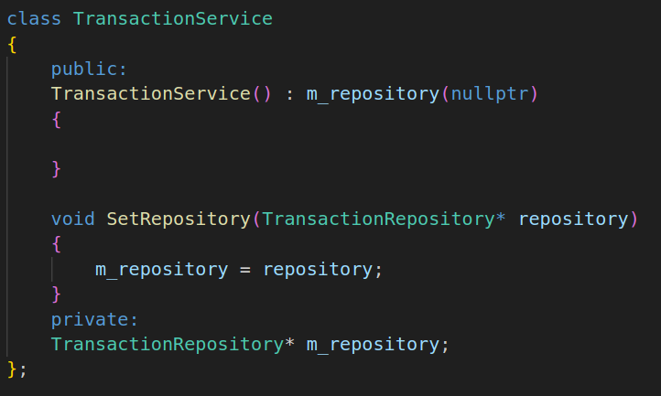
For example, how to pass objects we depend on?

Slide 21
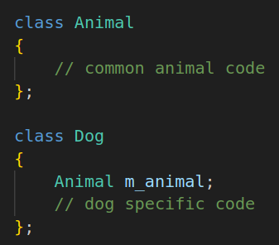
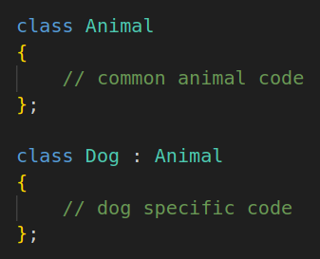
Inheritance (left) vs composition (right)

Slide 22
Practice is key
By practicing writing OOP projects, you will gain experience on the advantages and disadvantages of these and many more similar choices

Slide 23
Is OOP better?
OOP aims to make the program design easier for humans
However, computers don’t work the same way we think about the program
If performance is a critical goal, it is better to write the code in a way that is better for the computer, not people

Slide 24
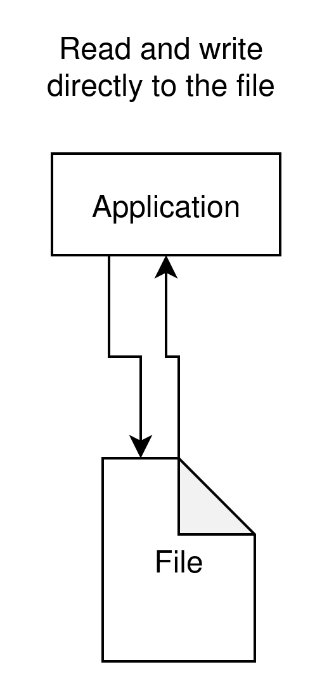
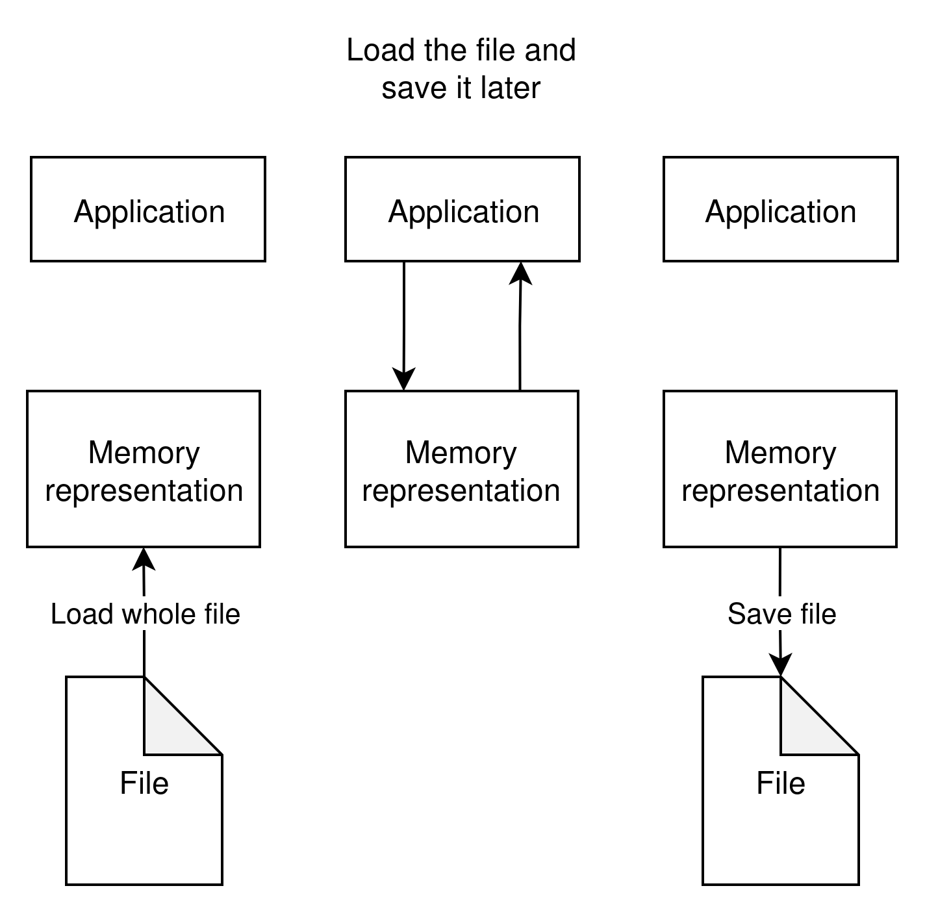
Another design question
How should our data be stored during the application runtime?

