Slide 1
Today’s Goals
Learn about RAII
Review files and string operations
Intro to Qt (if we have time)

Slide 2
Memory Management Problem
We have seen in C++ that we can allocate and free memory on the heap using new and delete operators
This way we have full control on the allocated memory lifetime
But since we can make mistakes, several problems can occur if we don’t manage memory correctly:
      We can forget to free memory we have allocated, leading to a situation known as memory leak, this leads to unbounded increase in memory consumption as the program is running, eventually leading to program or system crash
      We may forget that we have freed a specific place in memory and that it is no longer allocated, leading to a problem called use after free, which can cause a crash, data corruption, or a malicious attack.

Slide 3
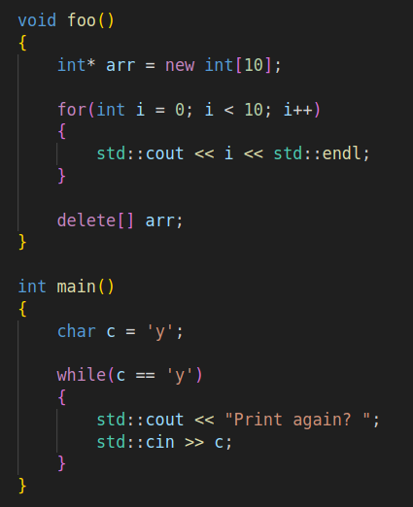
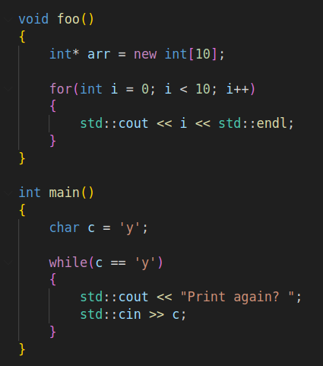
Memory leaks
Solution

Slide 4
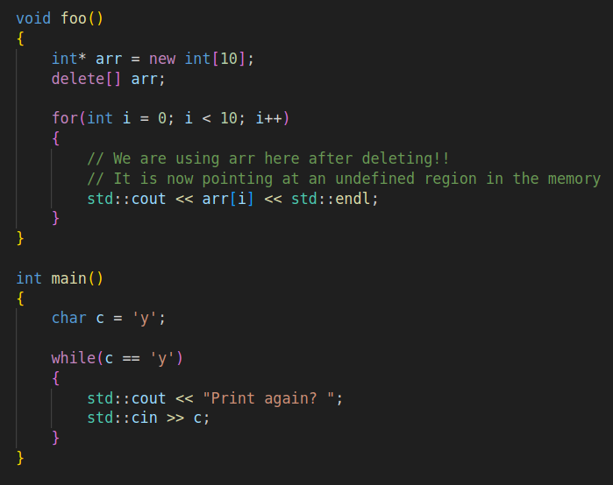
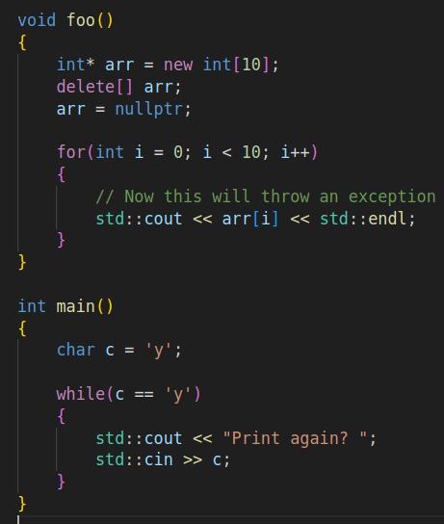
Use after free
Solution

Slide 5
This Applies to all Resources
Although we used memory to describe the previous problems regarding resource management, these concepts apply to all resources
Example resources:
  Memory on the heap
  Threads and processes (CPU time and system memory)
  Files on disk (open files must be closed to release resources)
  Remote connections (After connecting and using the services of a server, we must disconnect to avoid unnecessary usages)

Slide 6
Ownership
Now we need to understand a concept known as ownership
Ownership in the context of resource management refers to: The responsibility of allocating and freeing a resource
The object that currently has an ownership of a resource is called the owner of that resource
Ownership may be moved from one object to another, in this case, if the first object is no longer an owner, we must invalidate its relation to the resource

Slide 7
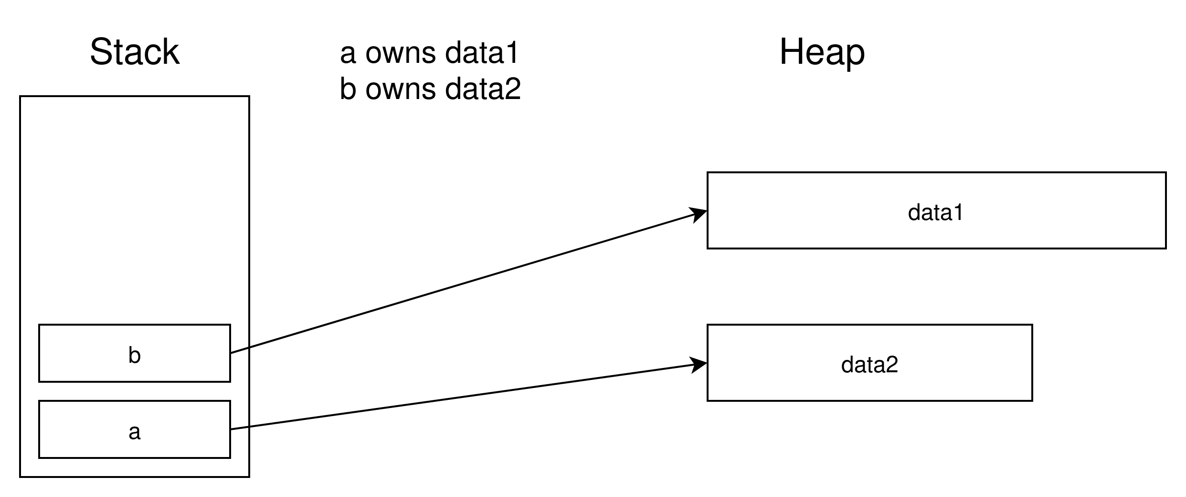
Ownership
a
b

Slide 8
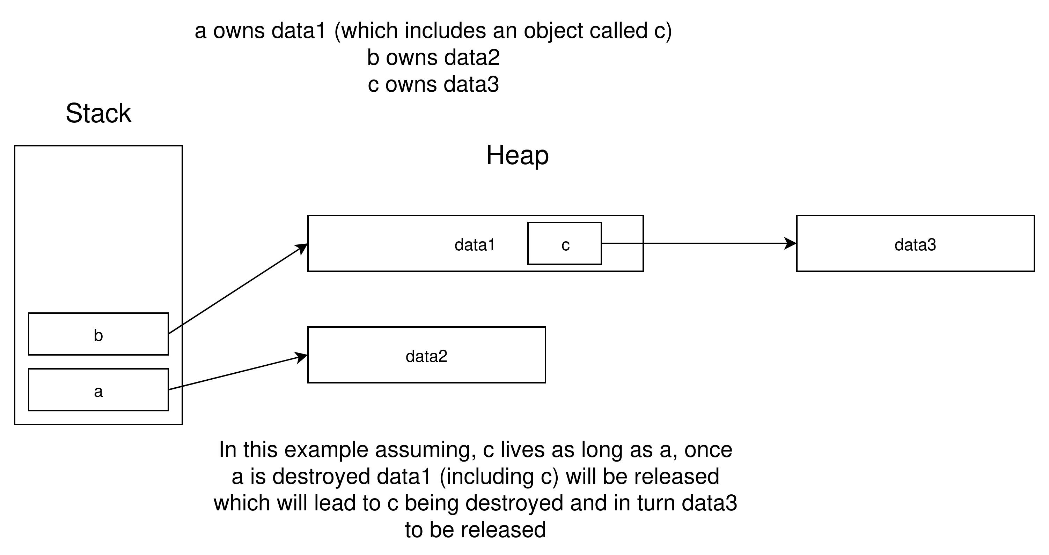
Ownership chain
a
b

Slide 9
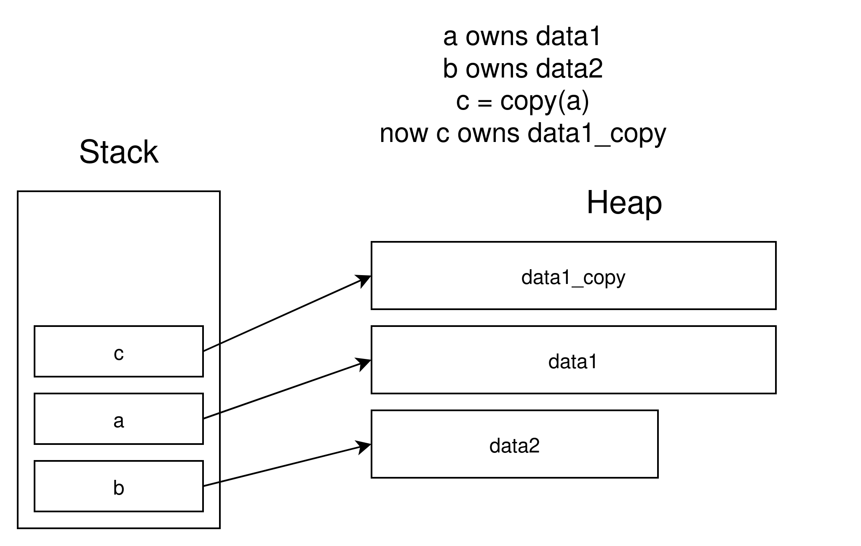
Copying results in a new object and a new resource allocation

Slide 10
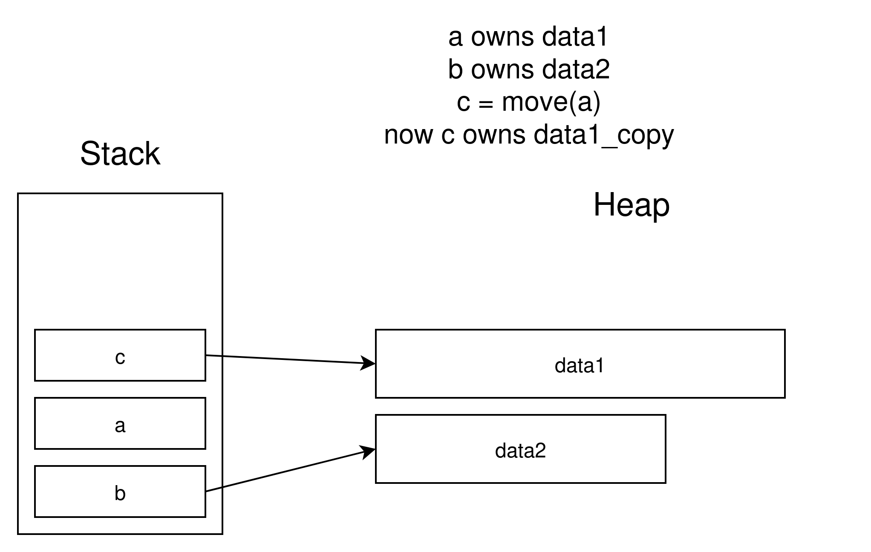
Moving results in a new object that takes ownership of the data and removes it from the old object
The old object must still be in a valid state, but it should lose all its relations to the moved data

Slide 11
So What is RAII?
RAII stands for Resource Acquisition Is Initialization
It refers to making every resource lifetime bound to life time of an object
So the resource is allocated during the initialization (usually constructor) of an object and freed or released when the object is destroyed (in its destructor)
The ownership chain should always lead to a stack variable

Slide 12
Let’s see some demos

