Slide 1
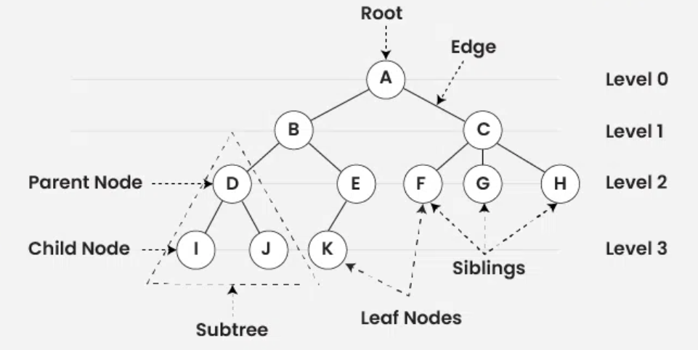
Tree
A
B
D
I
J
E
K
C
F
H
Path: A.B.E.K
A, B, D, I, J, E, K, C, F, H
A, (B, (D, I, J), (E, K)), (C, F, H)
preorder traversal of a tree (parent -> left child -> right child)

Slide 2
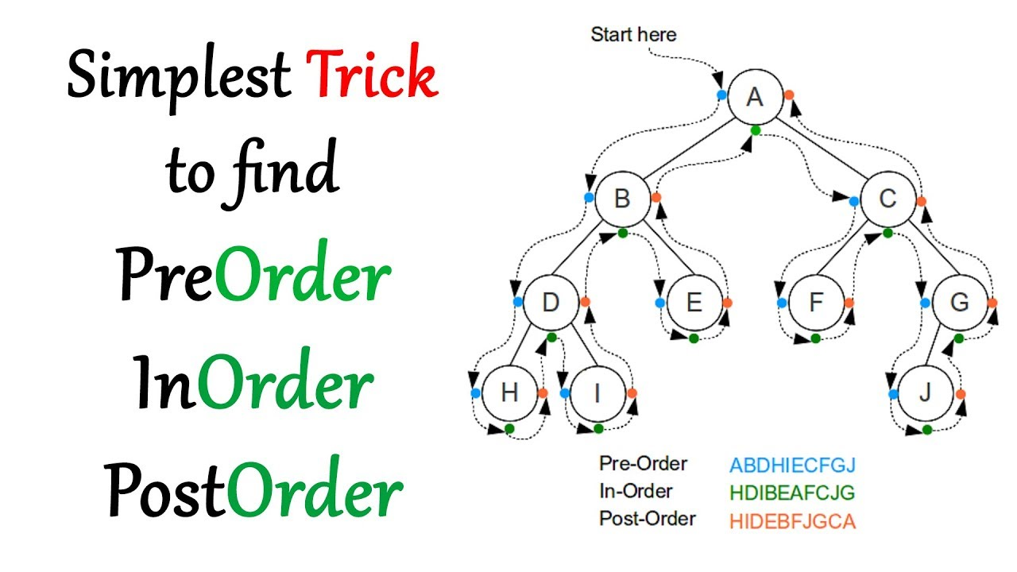

Slide 3
50, 31, 67, 28, 98, 45, 12, 41, 83, 76
50
31
67
28
45
98
12
41
83
76
12, 28, 31, 41, 45, 50, 67, 76, 83, 98
inorder traversal of a tree (left child -> parent -> right child)

