Slide 1
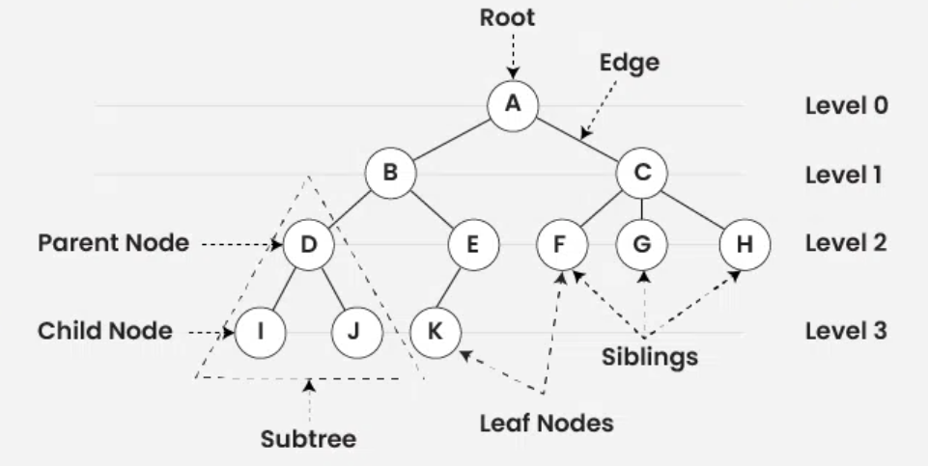
Tree
A
B
D
I
J
E
K
C
F
H
Path: A.B.E.K
A, B, D, I, J, E, K, C, F, H
A, (B, (D, I, J), (E, K)), (C, F, H)
preorder traversal of a tree (parent -> left child -> right child)

Slide 2
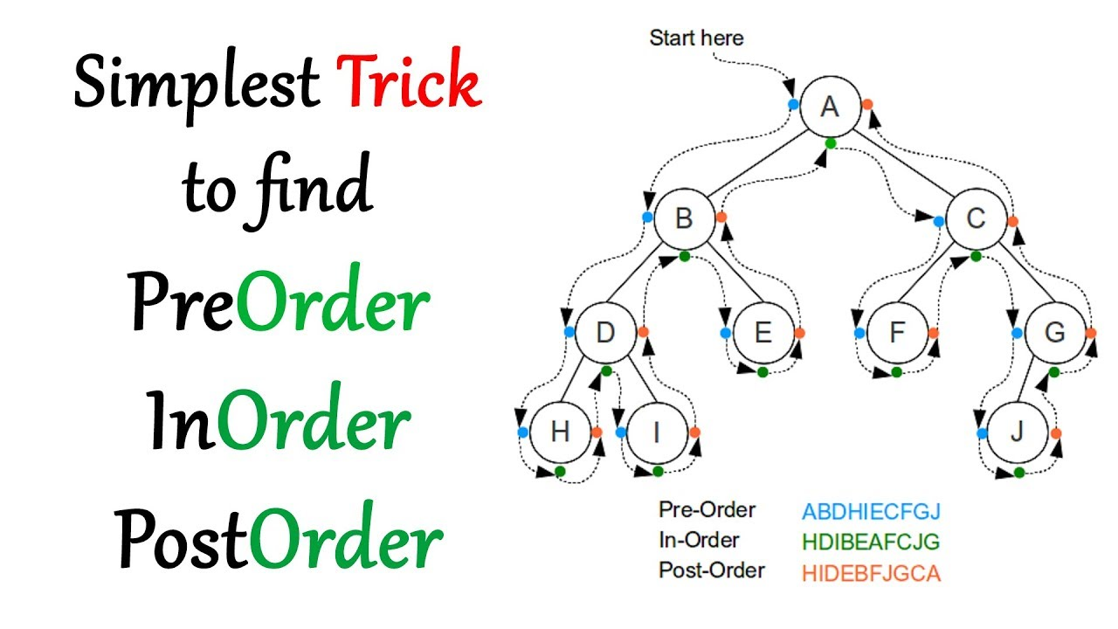

Slide 3
Sorted Tree
50, 31, 67, 28, 98, 45, 12, 41, 83, 76
50
31
67
28
45
98
12
41
83
76
12, 28, 31, 41, 45, 50, 67, 76, 83, 98
inorder traversal of a tree (left child -> parent -> right child)

Slide 4
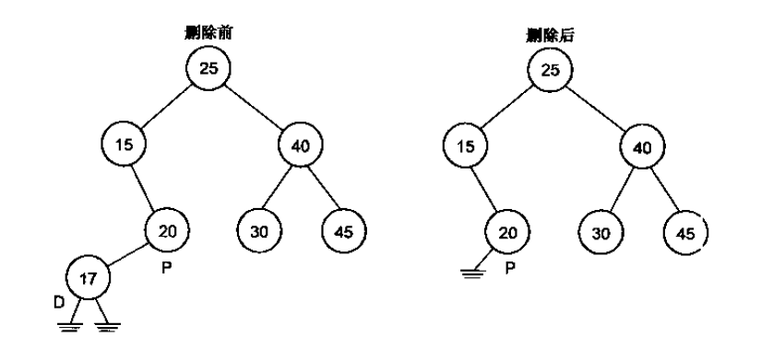
Delete Node in Sorted tree
D: the node to be deleted
P: the parent node of the node to be deleted
CASE 01
There is no any child of the node to be deleted
Before deletion
After deletion
R:null

Slide 5
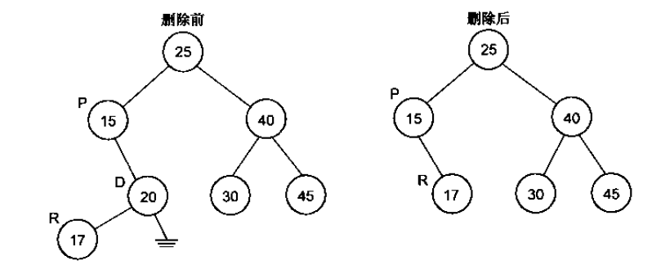
Delete Node in Sorted tree
D: the node to be deleted
P: the parent node of the node to be deleted
R: the replaced node after deletion
CASE 02
There is the left child of the node to be deleted
Before deletion
After deletion

Slide 6
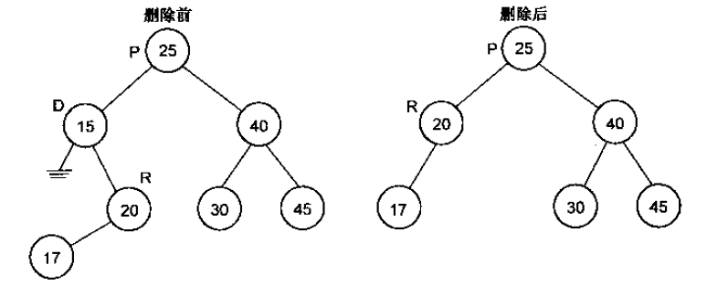
Delete Node in Sorted tree
CASE 03
There is the right child of the node to be deleted
Before deletion
After deletion

Slide 7
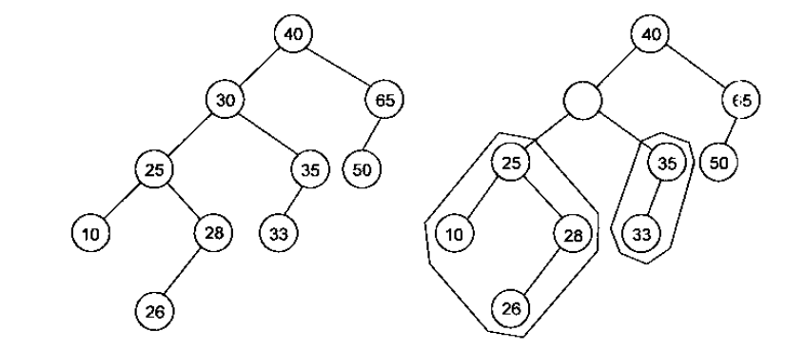
Delete Node in Sorted tree
CASE 04
There are both children of the node to be deleted
The maximum value in the left side
Delete this node (case 01, 02)
Replace the value

Slide 8
18, 29, 129, 232, 321, 913, 232, 388, 383, 281, 128, 828, 727, 393, 482
18
29
129
128
232
321
281
913
388
383
828
727
393
484

Slide 9
388, 128, 727, 232, 29, 129, 321, 913, 232,383, 281, 828, 393, 482, 18
388
128
727
29
232
393
913
18
129
321
482
828
281
383

Slide 10
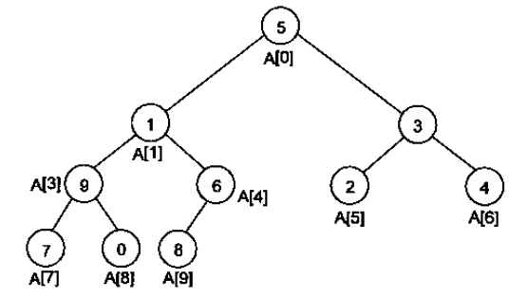

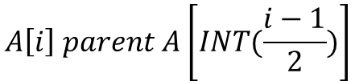

388, 128, 727, 232, 29, 129, 321, 913, 232,383, 281, 828, 393, 482, 18
388
128
727
29
232
393
913
18
129
321
482
828
281
383
0
1
2
3
$$A\left[i\right] left child A\left[2∗i+1\right]$$
388
128
727
29
232
$$A\left[i\right] right child A\left[2∗i+2\right]$$
$$A\left[i\right] parent A\left[INT(\frac{i−1}{2})\right]$$

Slide 11
ID01
ID (key=unique) | Name | age
ID02
ID03
index
ID
pointer
name01
arrayList
0
1
2
name02
name03
ID:178
ID:212
ID:241
ID
pointer
pointer
ID: 192

Slide 12

Tournament sort
$$O\left(n×\log_{2}n\right)$$
David
David
Don
David
Don
Alan
Manny
David
Manny
Manny
Don
Manny
Don
Alan
Manny
Manny

Slide 13
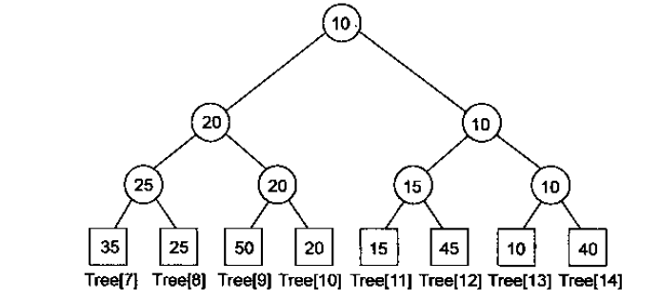
0 | 1 | 2 | 3 | 4 | 5 | 6
10 | 15
0 | 1 | 2 | 3 | 4 | 5 | 6 | 7 | 8 | 9 | 10 | 11 | 12 | 13 | 14
10 | 20 | 10 | 25 | 20 | 15 | 10 | 35 | 25 | 50 | 20 | 15 | 45 | 10 | 40
13
0 | 1 | 2 | 3 | 4 | 5 | 6 | 7 | 8 | 9 | 10 | 11 | 12 | 13 | 14
15 | 20 | 15 | 25 | 20 | 15 | 40 | 35 | 25 | 50 | 20 | 15 | 45 | - | 40
11

Slide 14
0 | 1 | 2 | 3 | 4 | 5 | 6 | 7 | 8 | 9 | 10 | 11 | 12 | 13 | 14
20 | 20 | 40 | 25 | 20 | 45 | 40 | 35 | 25 | 50 | 20 | - | 45 | - | 40
10
0 | 1 | 2 | 3 | 4 | 5 | 6 | 7 | 8 | 9 | 10 | 11 | 12 | 13 | 14
25 | 25 | 40 | 25 | 50 | 45 | 40 | 35 | 25 | 50 | - | - | 45 | - | 40
8
0 | 1 | 2 | 3 | 4 | 5 | 6 | 7 | 8 | 9 | 10 | 11 | 12 | 13 | 14
35 | 35 | 40 | 35 | 50 | 45 | 40 | 35 | - | 50 | - | - | 45 | - | 40
7
0 | 1 | 2 | 3 | 4 | 5 | 6 | 7 | 8 | 9 | 10 | 11 | 12 | 13 | 14
40 | 50 | 40 | - | 50 | 45 | 40 | - | - | 50 | - | - | 45 | - | 40
14
0 | 1 | 2 | 3 | 4 | 5 | 6
10 | 15 | 20 | 25 | 35 | 40

Slide 15
0 | 1 | 2 | 3 | 4 | 5 | 6 | 7 | 8 | 9 | 10 | 11 | 12 | 13 | 14
40 | 50 | 40 | - | 50 | 45 | 40 | - | - | 50 | - | - | 45 | - | 40
14
0 | 1 | 2 | 3 | 4 | 5 | 6 | 7 | 8 | 9 | 10 | 11 | 12 | 13 | 14
45 | 50 | 45 | - | 50 | 45 | - | - | - | 50 | - | - | 45 | - | -
12
0 | 1 | 2 | 3 | 4 | 5 | 6 | 7 | 8 | 9 | 10 | 11 | 12 | 13 | 14
50 | 50 | - | - | 50 | - | - | - | - | 50 | - | - | - | - | -
12
0 | 1 | 2 | 3 | 4 | 5 | 6 | 7
10 | 15 | 20 | 25 | 35 | 40 | 45 | 50

Slide 16

Heap use case:
Garbage collector
Timestamp
Object#1997
Timestamp
Object#1001
Timestamp
Object#2002
Timestamp
Object#1002
Timestamp
Object#1985

Slide 17
Heap use case:
Timestamp
Key-value#1997
Data Access Cache
Timestamp
Object#1001
Timestamp
Key-value#2002
Timestamp
Object#1002
Timestamp
Key-value#1985
Timestamp#2
Key-value#1997
Timestamp
Key-value#2017
Timestamp
Key-value#2017
Timestamp
Key-value#2002
Timestamp
Key-value#1997
Timestamp
Key-value#1985

Slide 18
Process#1
Timestamp
log
LOG Collector
Process#2
Timestamp
log
Timestamp
log
Process#3
Timestamp
log

Slide 19
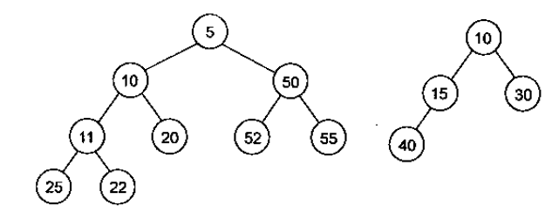
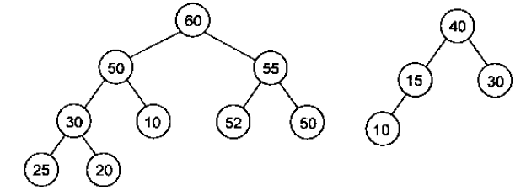
Heap
Minimum heap
Maximum heap

Slide 20
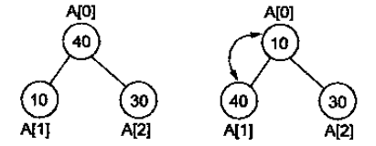
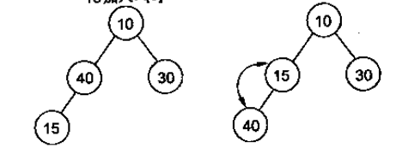
0 | 1 | 2
40 | 10 | 30
A[0] <-> A[1]
0 | 1 | 2
10 | 40 | 30
A[0] <-> A[2]
0 | 1 | 2
10 | 40 | 30
Minimum heap
0 | 1 | 2
10 | 40 | 30
0 | 1 | 2 | 3
10 | 40 | 30 | 15
0 | 1 | 2 | 3
10 | 15 | 30 | 40
0 | 1 | 2 | 3
10 | 15 | 30 | 40

Slide 21
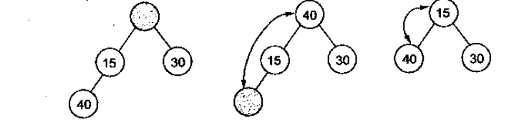
0 | 1 | 2 | 3
10 | 15 | 30 | 40
0 | 1 | 2
40 | 15 | 30
0 | 1 | 2
15 | 40 | 30

Slide 22


0 | 1 | 2
40 | 10 | 30
0 | 1 | 2
10 | 40 | 30
0 | 1 | 2
10 | 30 | 40
Bubble Sort
0 | 1 | 2 | 3
10 | 30 | 40
+15
Binary Search
$$O\left(\log_{2}n\right)$$
Position index=1
$$O\left(\frac{n}{2}\right)$$
0 | 1 | 2 | 3
10 |  | 30 | 40
0 | 1 | 2 | 3
10 | 15 | 30 | 40

Slide 23

50, 20, 60, 65, 15, 25, 10, 30, 4, 45
0 | 1 | 2 | 3 | 4 | 5 | 6 | 7 | 8 | 9
4 | 10 | 15 | 20 | 45 | 60 | 25 | 65 | 30 | 50
Insert / append
parent
parent
4
$$O\left({n×log}_{2}n\right)$$
10
15
Left child
Filter up
20
45
60
25
65
30
50
parent
Left child
right child

Slide 24

Delete
0 | 1 | 2 | 3 | 4 | 5 | 6 | 7 | 8 | 9
4 | 10 | 15 | 20 | 45 | 60 | 25 | 65 | 30 | 50
heap
65
-
-
4
-
-
-
-
$$O\left({n×log}_{2}n\right)$$
10
15
-
-
-
20
45
60
25
Filter down
65
30
50
0 | 1 | 2 | 3 | 4 | 5 | 6 | 7 | 8 | 9
4 | 10 | 15 | 20 | 25 | 30 | 45 | 50 | 60 | 65

Slide 25
IDE: vscode
IDE: codeblocks
MSYS2: UCRT64
pacman -Syu
pacman -S --needed base-devel mingw-w64-ucrt-x86_64-toolchain
pacman -S mingw-w64-ucrt-x86_64-gcc
pacman -S mingw-w64-ucrt-x86_64-gdb
C/C++ compiler: gcc (GNOME C++ Compiler)
C:\msys64\ucrt64\bin\

Slide 26

Test case
Configuration
1
2
Implementation
(black box)
Action
4
3
Expected Response
=
Response

