Slide 1
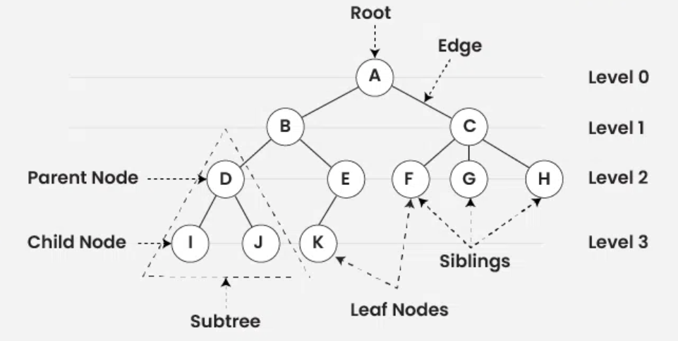
Tree
A
B
D
I
J
E
K
C
F
H
Path: A.B.E.K
A, B, D, I, J, E, K, C, F, H
A, (B, (D, I, J), (E, K)), (C, F, H)
preorder traversal of a tree (parent -> left child -> right child)

Slide 2
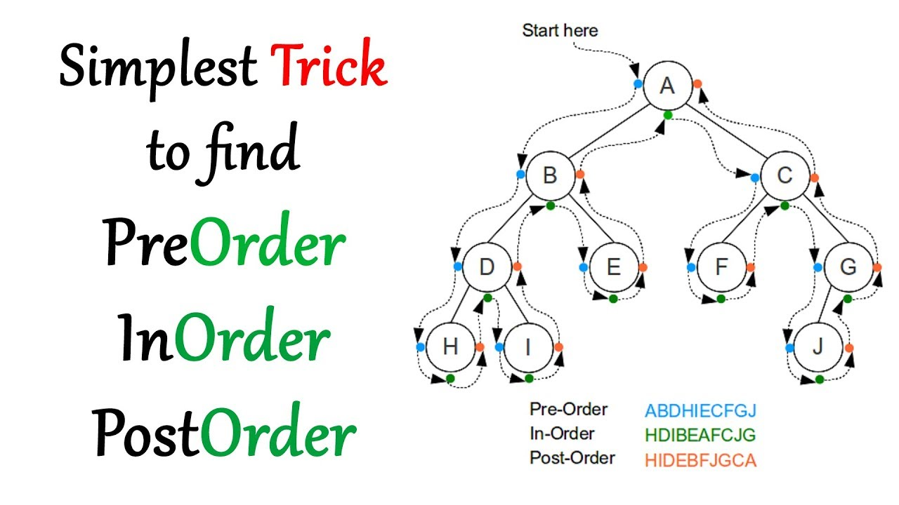

Slide 3
Sorted Tree
50, 31, 67, 28, 98, 45, 12, 41, 83, 76
50
31
67
28
45
98
12
41
83
76
12, 28, 31, 41, 45, 50, 67, 76, 83, 98
inorder traversal of a tree (left child -> parent -> right child)

Slide 4
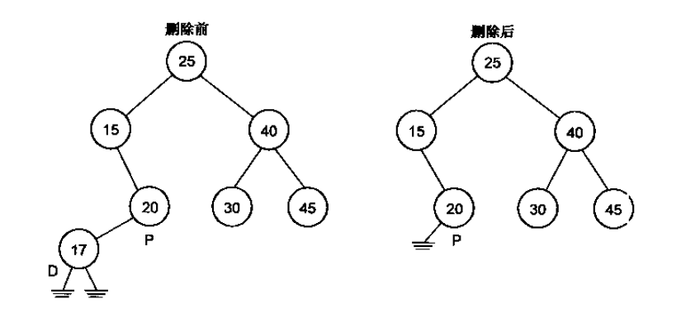
Delete Node in Sorted tree
D: the node to be deleted
P: the parent node of the node to be deleted
CASE 01
There is no any child of the node to be deleted
Before deletion
After deletion
R:null

Slide 5
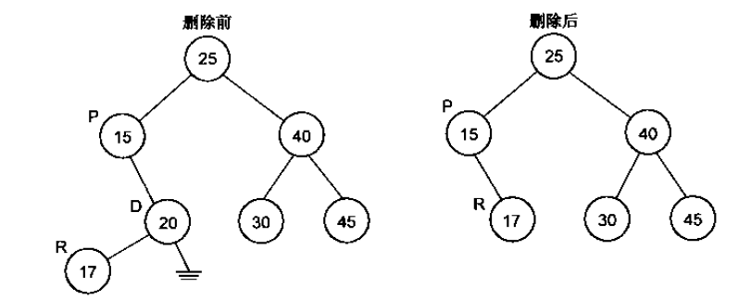
Delete Node in Sorted tree
D: the node to be deleted
P: the parent node of the node to be deleted
R: the replaced node after deletion
CASE 02
There is the left child of the node to be deleted
Before deletion
After deletion

Slide 6
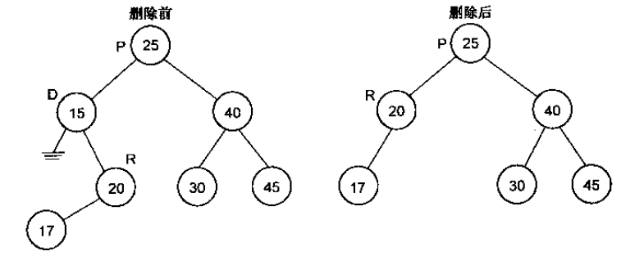
Delete Node in Sorted tree
CASE 03
There is the right child of the node to be deleted
Before deletion
After deletion

Slide 7
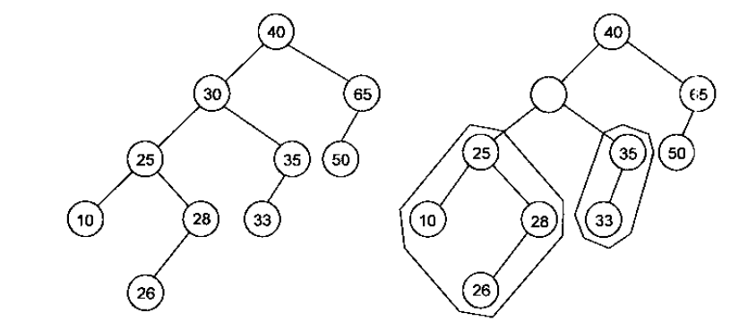
Delete Node in Sorted tree
CASE 04
There are both children of the node to be deleted
The maximum value in the left side
Delete this node (case 01, 02)
Replace the value

Slide 8
18, 29, 129, 232, 321, 913, 232, 388, 383, 281, 128, 828, 727, 393, 482
18
29
129
128
232
321
281
913
388
383
828
727
393
484

Slide 9
388, 128, 727, 232, 29, 129, 321, 913, 232,383, 281, 828, 393, 482, 18
388
128
727
29
232
393
913
18
129
321
482
828
281
383

Slide 10
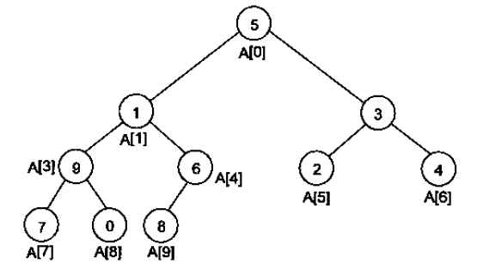

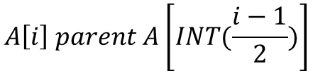

388, 128, 727, 232, 29, 129, 321, 913, 232,383, 281, 828, 393, 482, 18
388
128
727
29
232
393
913
18
129
321
482
828
281
383
0
1
2
3
$$A\left[i\right] left child A\left[2∗i+1\right]$$
388
128
727
29
232
$$A\left[i\right] right child A\left[2∗i+2\right]$$
$$A\left[i\right] parent A\left[INT(\frac{i−1}{2})\right]$$

Slide 11
ID01
ID (key=unique) | Name | age
ID02
ID03
index
ID
pointer
name01
arrayList
0
1
2
name02
name03
ID:178
ID:212
ID:241
ID
pointer
pointer
ID: 192

Slide 12

Tournament sort
$$O\left(n×\log_{2}n\right)$$
David
David
Don
David
Don
Alan
Manny
David
Manny
Manny
Don
Manny
Don
Alan
Manny
Manny

Slide 13
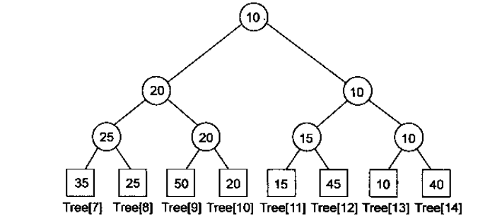



$$PowerOfTwo\left(n\right)=2^{m}$$
$$PowerOfTwo\left(10\right)=2^{4}=16$$
0 | 1 | 2 | 3 | 4 | 5 | 6
10 | 15
$$O\left(n×\log_{2}n\right)$$
0 | 1 | 2 | 3 | 4 | 5 | 6 | 7 | 8 | 9 | 10 | 11 | 12 | 13 | 14
10 | 20 | 10 | 25 | 20 | 15 | 10 | 35 | 25 | 50 | 20 | 15 | 45 | 10 | 40
13
0 | 1 | 2 | 3 | 4 | 5 | 6 | 7 | 8 | 9 | 10 | 11 | 12 | 13 | 14
15 | 20 | 15 | 25 | 20 | 15 | 40 | 35 | 25 | 50 | 20 | 15 | 45 | - | 40
11

Slide 14
0 | 1 | 2 | 3 | 4 | 5 | 6 | 7 | 8 | 9 | 10 | 11 | 12 | 13 | 14
20 | 20 | 40 | 25 | 20 | 45 | 40 | 35 | 25 | 50 | 20 | - | 45 | - | 40
10
0 | 1 | 2 | 3 | 4 | 5 | 6 | 7 | 8 | 9 | 10 | 11 | 12 | 13 | 14
25 | 25 | 40 | 25 | 50 | 45 | 40 | 35 | 25 | 50 | - | - | 45 | - | 40
8
0 | 1 | 2 | 3 | 4 | 5 | 6 | 7 | 8 | 9 | 10 | 11 | 12 | 13 | 14
35 | 35 | 40 | 35 | 50 | 45 | 40 | 35 | - | 50 | - | - | 45 | - | 40
7
0 | 1 | 2 | 3 | 4 | 5 | 6 | 7 | 8 | 9 | 10 | 11 | 12 | 13 | 14
40 | 50 | 40 | - | 50 | 45 | 40 | - | - | 50 | - | - | 45 | - | 40
14
0 | 1 | 2 | 3 | 4 | 5 | 6
10 | 15 | 20 | 25 | 35 | 40

Slide 15
0 | 1 | 2 | 3 | 4 | 5 | 6 | 7 | 8 | 9 | 10 | 11 | 12 | 13 | 14
40 | 50 | 40 | - | 50 | 45 | 40 | - | - | 50 | - | - | 45 | - | 40
14
0 | 1 | 2 | 3 | 4 | 5 | 6 | 7 | 8 | 9 | 10 | 11 | 12 | 13 | 14
45 | 50 | 45 | - | 50 | 45 | - | - | - | 50 | - | - | 45 | - | -
12
0 | 1 | 2 | 3 | 4 | 5 | 6 | 7 | 8 | 9 | 10 | 11 | 12 | 13 | 14
50 | 50 | - | - | 50 | - | - | - | - | 50 | - | - | - | - | -
12
0 | 1 | 2 | 3 | 4 | 5 | 6 | 7
10 | 15 | 20 | 25 | 35 | 40 | 45 | 50

Slide 16

Heap use case:
Garbage collector
Timestamp
Object#1997
Timestamp
Object#1001
Timestamp
Object#2002
Timestamp
Object#1002
Timestamp
Object#1985

Slide 17
Queue (FIFO)
head
tail
head
tail

Slide 18

Priority Queue
Print job:3
Queue
OS kernel CPU
Keystroke input:3
OS audit:1
sound job:3
User process#1:2
$$O\left(n\right)$$
job
User process#1:2
sound job:3
OS audit:1
Keystroke input:3
Print job:3
Job priority
sound job:3
User process#1:2
Keystroke input:3
Print job:3
OS audit:1

Slide 19

Matrix Queue
Print job:3
Queue
OS kernel CPU
Keystroke input:3
OS audit:1
sound job:3
Job priority 0
$$O\left(1\right)$$
User process#1:2
Job priority 1
job
Job priority
Job priority 7

Slide 20
Heap use case:
Timestamp
Key-value#1997
Data Access Cache
Timestamp
Object#1001
Timestamp
Key-value#2002
Timestamp
Object#1002
Timestamp
Key-value#1985
Timestamp#2
Key-value#1997
Timestamp
Key-value#2017
Timestamp
Key-value#2017
Timestamp
Key-value#2002
Timestamp
Key-value#1997
Timestamp
Key-value#1985

Slide 21
Process#1
Timestamp
log
LOG Collector
Process#2
Timestamp
log
Timestamp
log
Process#3
Timestamp
log

Slide 22
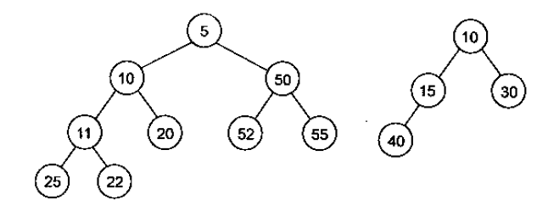
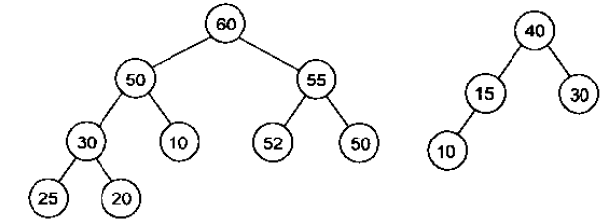
Heap
Minimum heap
Maximum heap

Slide 23
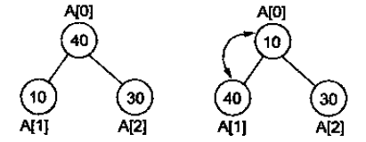
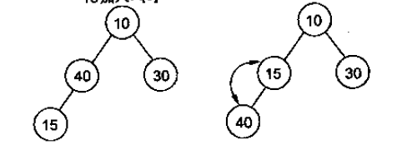
Heap
0 | 1 | 2
40 | 10 | 30
A[0] <-> A[1]
0 | 1 | 2
10 | 40 | 30
A[0] <-> A[2]
0 | 1 | 2
10 | 40 | 30
Minimum heap
0 | 1 | 2
10 | 40 | 30
0 | 1 | 2 | 3
10 | 40 | 30 | 15
0 | 1 | 2 | 3
10 | 15 | 30 | 40
0 | 1 | 2 | 3
10 | 15 | 30 | 40

Slide 24
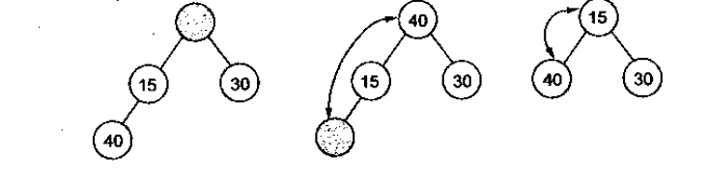
Heap
0 | 1 | 2 | 3
10 | 15 | 30 | 40
0 | 1 | 2
40 | 15 | 30
0 | 1 | 2
15 | 40 | 30

Slide 25


Heap
0 | 1 | 2
40 | 10 | 30
0 | 1 | 2
10 | 40 | 30
0 | 1 | 2
10 | 30 | 40
Bubble Sort
0 | 1 | 2 | 3
10 | 30 | 40
+15
Binary Search
$$O\left(\log_{2}n\right)$$
Position index=1
$$O\left(\frac{n}{2}\right)$$
0 | 1 | 2 | 3
10 |  | 30 | 40
0 | 1 | 2 | 3
10 | 15 | 30 | 40

Slide 26

Heap
50, 20, 60, 65, 15, 25, 10, 30, 4, 45
0 | 1 | 2 | 3 | 4 | 5 | 6 | 7 | 8 | 9
4 | 10 | 15 | 20 | 45 | 60 | 25 | 65 | 30 | 50
Insert / append
parent
Single element insert
parent
4
$$O\left(\log_{2}n\right)$$
10
15
Left child
Filter up
20
45
60
25
65
30
50
parent
Left child
right child

Slide 27

Heap
50, 20, 60, 65, 15, 25, 10, 30, 4, 45
0 | 1 | 2 | 3 | 4 | 5 | 6 | 7 | 8 | 9
4 | 10 | 15 | 20 | 45 | 60 | 25 | 65 | 30 | 50
Insert / append
parent
For the whole array
parent
4
$$O\left({n×log}_{2}n\right)$$
TO BE IMPROVED
10
15
Left child
Filter up
20
45
60
25
65
30
50
parent
Left child
right child

Slide 28



Heapify an array
50, 20, 60, 65, 15, 25, 10, 30, 4, 45
50
n=10
20
60
50 | 20 | 60 | 65 | 15 | 25 | 10 | 30 | 4 | 45
0 | 1 | 2 | 3 | 4 | 5 | 6 | 7 | 8 | 9
65
15
25
10
30
4
45
$$O\left(\frac{n}{2}×\log_{2}{n}\right)$$
$$LeafArrange=\left[\frac{n}{2}, n−1\right]$$
4
15
10
$$ParrentArrange=\left[0, \frac{n}{2}−1\right]$$
20
45
25
60
30
65
50

Slide 29


Heap
Delete
0 | 1 | 2 | 3 | 4 | 5 | 6 | 7 | 8 | 9
4 | 10 | 15 | 20 | 45 | 60 | 25 | 65 | 30 | 50
heap
65
For one element
-
-
$$O\left(\log_{2}n\right)$$
-
-
-
4
-
For the whole array
10
15
-
-
-
$$O\left({n×log}_{2}n\right)$$
20
45
60
25
Filter down
65
30
50
Heap sort
0 | 1 | 2 | 3 | 4 | 5 | 6 | 7 | 8 | 9
4 | 10 | 15 | 20 | 25 | 30 | 45 | 50 | 60 | 65

Slide 30
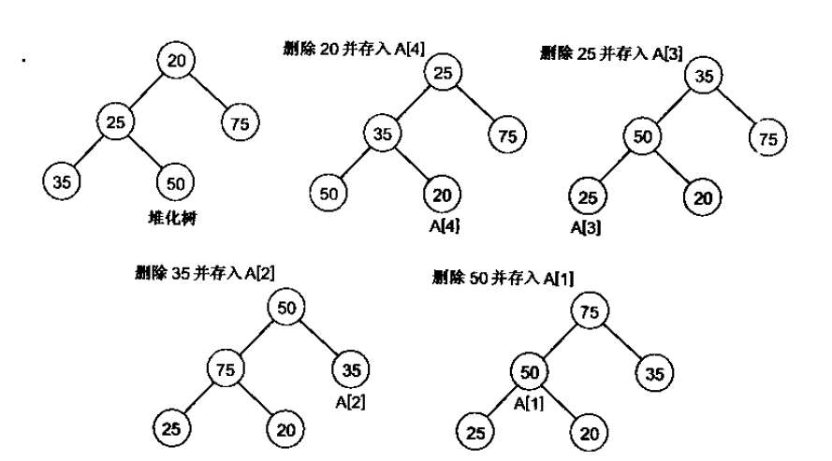

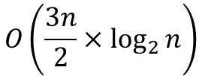

Heap sort
$$O\left(\frac{n}{2}×\log_{2}{n}\right)$$
After heapifization
0 | 1 | 2 | 3 | 4
20 | 25 | 75 | 35 | 50
0 | 1 | 2 | 3 | 4
50 | 25 | 75 | 35 | 20
0 | 1 | 2 | 3 | 4
25 | 35 | 75 | 50 | 20
0 | 1 | 2 | 3 | 4
50 | 35 | 75 | 25 | 20
0 | 1 | 2 | 3 | 4
35 | 50 | 75 | 25 | 20
Heap Sort
0 | 1 | 2 | 3 | 4
75 | 50 | 35 | 25 | 20
$$O\left(\frac{3n}{2}×\log_{2}{n}\right)$$
$$O\left(n×\log_{2}{n}\right)$$
0 | 1 | 2 | 3 | 4
75 | 50 | 35 | 25 | 20

Slide 31

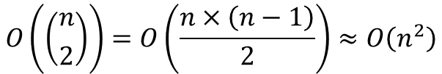
Exchange sort
Introduction to Exchange Sort Algorithm - GeeksforGeeks
Example:
Input: arr[] = {5, 1, 4, 2, 8}
Output: {1, 2, 4, 5, 8}
Explanation: Working of exchange sort:
1st Pass:
Exchange sort starts with the very first elements, comparing with other elements to check which one is greater.
( 5 1 4 2 8 ) –> ( 1 5 4 2 8 ).
Here, the algorithm compares the first two elements and swaps since 5 > 1.
No swap since none of the elements is smaller than 1 so after 1st iteration (1 5 4 2 8)
2nd Pass:
(1 5 4 2 8 ) –> ( 1 4 5 2 8 ), since 4 < 5
( 1 4 5 2 8 ) –> ( 1 2 5 4 8 ), since 2 < 4
( 1 2 5 4 8 ) No change since in this there is no other element smaller than 2
3rd Pass:
(1 2 5 4 8 ) -> (1 2 4 5 8 ), since 4 < 5
after completion of the iteration, we found array is sorted
After completing the iteration it will come out of the loop, Therefore array is sorted.
$$O\left(\left({n \atop 2}\right)\right)=O\left(\frac{n×\left(n−1\right)}{2}\right)≈O\left(n^{2}\right)$$
0 | 1 | 2 | 3 | 4
5 | 1 | 4 | 2 | 8
0 | 1 | 2 | 3 | 4
1 | 5 | 4 | 2 | 8
0 | 1 | 2 | 3 | 4
1 | 2 | 5 | 4 | 8
0 | 1 | 2 | 3 | 4
1 | 2 | 4 | 5 | 8
0 | 1 | 2 | 3 | 4
1 | 2 | 4 | 5 | 8

Slide 32

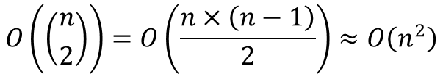
Bubble Sort
0 | 1 | 2 | 3 | 4
5 | 1 | 4 | 2 | 8
0 | 1 | 2 | 3 | 4
1 | 5 | 2 | 4 | 8
0 | 1 | 2 | 3 | 4
1 | 2 | 5 | 4 | 8
0 | 1 | 2 | 3 | 4
1 | 2 | 4 | 5 | 8
0 | 1 | 2 | 3 | 4
5 | 1 | 2 | 4 | 8
0 | 1 | 2 | 3 | 4
1 | 5 | 2 | 4 | 8
0 | 1 | 2 | 3 | 4
1 | 2 | 4 | 5 | 8
0 | 1 | 2 | 3 | 4
5 | 1 | 2 | 4 | 8
0 | 1 | 2 | 3 | 4
1 | 2 | 5 | 4 | 8
0 | 1 | 2 | 3 | 4
1 | 5 | 2 | 4 | 8
$$O\left(\left({n \atop 2}\right)\right)=O\left(\frac{n×\left(n−1\right)}{2}\right)≈O\left(n^{2}\right)$$

Slide 33

Merge sort
Sorted array 1
Sorted array 2
1 | 6 | 10 | 12 | 15
3 | 6 | 7 | 8
1
1 | 6 | 10 | 12 | 15
3 | 6 | 7 | 8
1 | 3
1 | 6 | 10 | 12 | 15
3 | 6 | 7 | 8
1 | 3 | 6
1 | 6 | 10 | 12 | 15
3 | 6 | 7 | 8
1 | 3 | 6 | 6
1 | 6 | 10 | 12 | 15
3 | 6 | 7 | 8
1 | 3 | 6 | 6 | 7
1 | 6 | 10 | 12 | 15
3 | 6 | 7 | 8
1 | 3 | 6 | 6 | 7 | 8
n
m
$$O\left(n+m\right)$$
1 | 3 | 6 | 6 | 7 | 8 | 10 | 12 | 15

Slide 34




Merge sort
0 | 1 | 2 | 3 | 4
5 | 1 | 4 | 2 | 8
5 | 1
4 | 2 | 8
5
1
4
2 | 8
$$O\left(n\right)$$
1 | 5
2 | 4 | 8
$$\log_{2}{n}$$
$$O\left(n×\log_{2}{n}\right)$$
$$O\left(n\right)$$
1 | 2 | 4 | 5 | 8

Slide 35

Sort???
23, 31, 13, 47, 28, 87, 51, 65, 95, 38, 27, 61, 25, 33, 74, 54
n
0
1
61
51
31
2
3
33
13
23
4
54
74
5
25
95
65
6
7
27
87
47
8
38
28
9
Queue (FIFO)
ental
$$O\left(w×n\right)≈O\left(n\right) w≪n$$
31, 51, 61, 23, 13, 33, 74, 54, 65, 95, 25, 47, 87, 27, 28, 38
0
1
13
2
28
27
25
23
3
38
33
31
4
47
5
54
51
6
65
61
7
74
8
87
9
95
tiotal
13, 23, 25, 27, 28, 31, 33, 38, 47, 51, 54, 61, 65, 74, 87, 95

Slide 36
IDE: vscode
IDE: codeblocks
MSYS2: UCRT64
pacman -Syu
pacman -S --needed base-devel mingw-w64-ucrt-x86_64-toolchain
pacman -S mingw-w64-ucrt-x86_64-gcc
pacman -S mingw-w64-ucrt-x86_64-gdb
C/C++ compiler: gcc (GNOME C++ Compiler)
C:\msys64\ucrt64\bin\

Slide 37

Test case
Configuration
1
2
Implementation
(black box)
Action
4
3
Expected Response
=
Response

