Slide 1

The battery free computer
____________

Slide 2
Presentation overview
Battery free calculator that can do everything at math
Battery free encryption system at mapping, transposition, bitwise mapping and bitwise transposition
Battery free hash code system
Some more features...

Slide 3
Let us start...
I made this computer because the regular computer
had taken too much electricity that is not good which can cause big problems.
Today I want show you this computer and it sounds impossible. If you think the computer looks like a regular computer you have wrong, this computer looks a bit strange, it is in PIECES, not ALL-IN-ONE.
Contents of chapters:
Battery free calculator
The encryption machine
Hashcode machine

Slide 4
1. Battery free calculator
This calculator is not just a regular calculator, more like graphical calculator and it use no energy.
The calculator seperates in PIECES.
Contents of this chapter:
1.1 Slide rule(multiplication, divition, forlong, forshort)
1.2 The wallet extra(addition, subtraction, mod, compair, mode, median and average)
1.3 Divition operaters
1.4 draw circle diagram machine
1.5 external events...

Slide 5
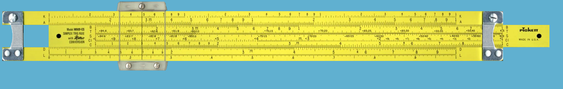
1.1 Piece 1 the slide rule
The slide rule looks like below of this page this can do multiplication, divition, forshort a divition and forlong a divition. It seemed like low-technology but I chose it because it take no electricity. The only energy is when you move the ruler that is middle of the rule.
Here is the ruler below this text:

Slide 6
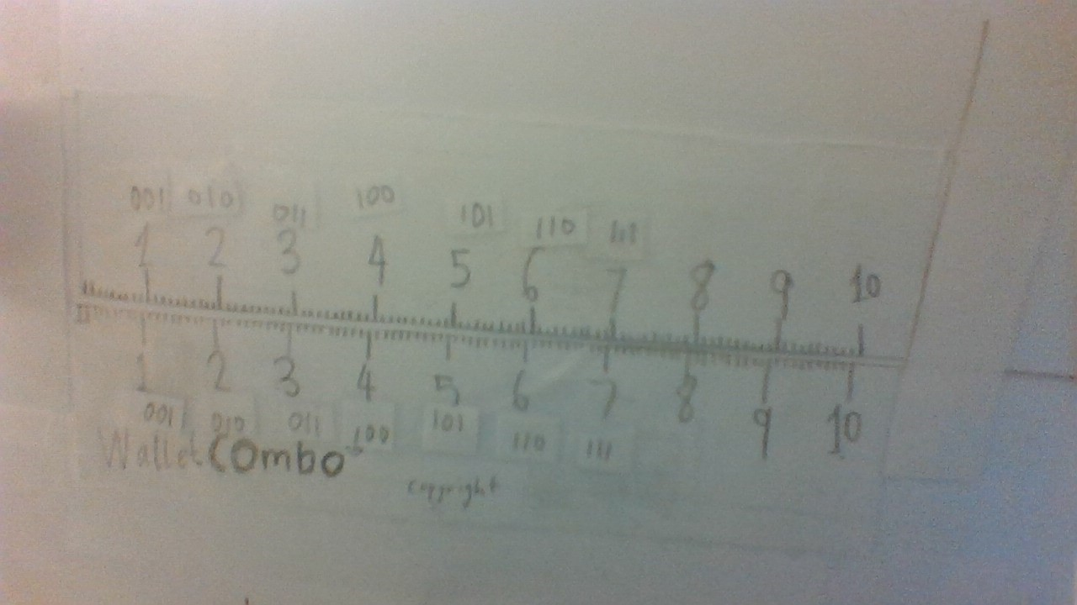
1.2/2.1 : The wallet extra
This can used by very many things:
Math: Addition, subtraction, conpair, mode, median and average, you should read the instructions to know how to handle this because in this presentation I had not write because of no space
Encryption: You can use it for mapping and bitwise mapping
The bold text means focus of this chapter
The italical text means you should know about the machine(piece) of this chapter

Slide 7
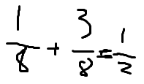


1.3: Divition operators
This is use for divition for example
and and more.
I had no idea to make this pic

Slide 8
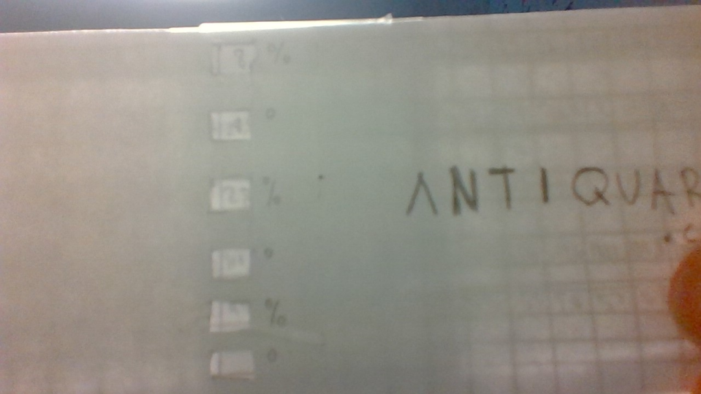
1.4: The draw circlediagram machine
This is a machine in statistic and this pictrue and
this will make easier to make the circle diagram.

Slide 9
2. The encryption machine
This machine used by to encode and decode texts. The first piece is combined with the computer
Contents of this chapter:
2.1 The wallet extra(mapping, bitwise mapping)
2.2 The slide rule extra(bitwise transposition)
2.3 The nextstep rule(transposition)

Slide 10
2.1/1.2 : The wallet extra
This can used by very many things:
Math: Addition, subtraction, conpair, mode, median and average, you should read the instructions to know how to handle this because in this presentation I had not write because of no space
Encryption: You can use it for mapping and bitwise mapping
The bold text means focus of this chapter
The italical text means you should know about the machine(piece) of this chapter

Slide 11
2.2: The slide rule extra
--- Not finished yet--

Slide 12
2.3: The nextstep rule
--- Not finished yet--

Slide 13
3. Hashcode machine
--I had not planned yet--

Slide 14
4. Regular Applications
These regular applications is built in at the computer, then your computer is very like all-in-one computer.
Contents of this chapter:
4.1 Calendar
4.2 Maps
4.3 ...
Not finished yet

Slide 15

www.setsolotion.it

