Slide 1

The battery free computer
____________

Slide 2
Let us start...
I made this computer because the regular computer
had taken too much electricity that is not good which can cause big problems.
Today I want show you this computer and it sounds impossible. If you think the computer looks like a regular computer you have wrong, this computer looks a bit strange, it is in PIECES, not ALL-IN-ONE.
Contents of chapters:
Battery free calculator
The encryption machine
Hashcode machine

Slide 3
1. Battery free calculator
This calculator is not just a regular calculator, more like graphical calculator and it use no energy.
The calculator seperates in PIECES.
Contents of this chapter:
1.1 Slide rule(multiplication, divition, forlong, forshort)
1.2 The wallet extra(addition, subtraction, mod, compair, mode, median and average)
1.3 Convertation table
1.4 Time operator

Slide 4
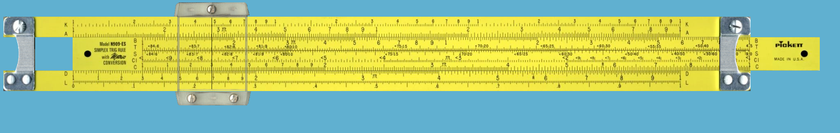
1.1 Piece 1 the slide rule
The slide rule looks like below of this page this can do multiplication, divition, forshort a divition and forlong a divition. It seemed like low-technology but I chose it because it take no electricity. The only energy is when you move the ruler that is middle of the rule.
Here is the ruler below this text:

Slide 5
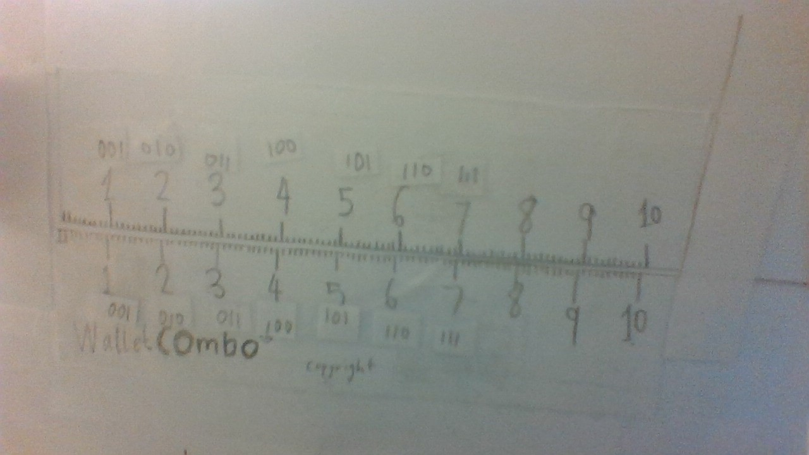
1.2/2.1 : The wallet extra
This can used by very many things:
Math: Addition, subtraction, conpair, mode, median and average, you should read the instructions to know how to handle this because in this presentation I had not write because of no space
Encryption: You can use it for mapping and bitwise mapping
The bold text means focus of this chapter
The italical text means you should know about the machine(piece) of this chapter

Slide 6
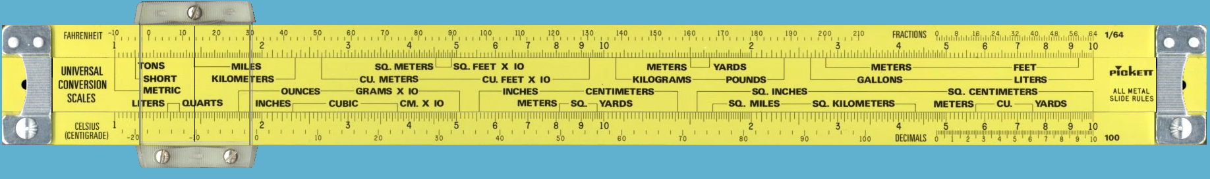
1.3 Convertation table
If you want to convertation and you didn’t know the scale of two units, you should use this machine. You can convertate weight, length, temperature, speed, volume and more.
This will also looks like low-technology like the slide rule at 1.1 but it don’t use any power.

Slide 7
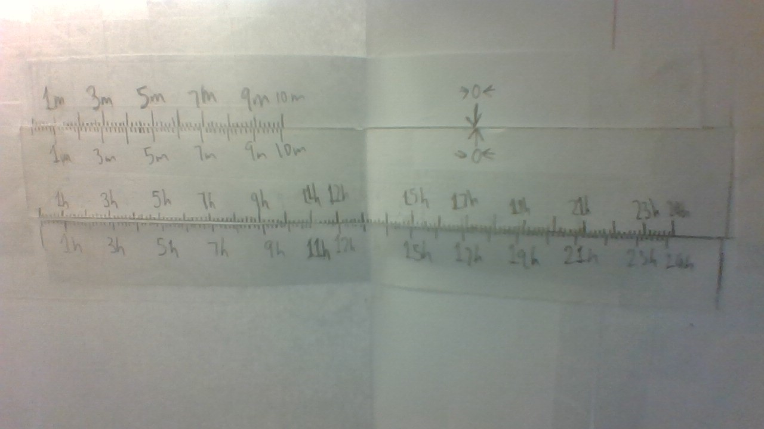
1.4 Time operators
Using this slide rule I can add and subtract the time

Slide 8
2. The encryption machine
This machine used by to encode and decode texts. The first piece is combined with the computer
Contents of this chapter:
2.1 The wallet extra(mapping, bitwise mapping)
2.2 The slide rule extra(bitwise transposition)
2.3 The nextstep rule(transposition)

Slide 9
2.1/1.2 : The wallet extra
This can used by very many things:
Math: Addition, subtraction, conpair, mode, median and average, you should read the instructions to know how to handle this because in this presentation I had not write because of no space
Encryption: You can use it for mapping and bitwise mapping
The bold text means focus of this chapter
The italical text means you should know about the machine(piece) of this chapter

Slide 10
2.2: The slide rule extra
This slide rule is a rules with full of binary numbers. The code is for example 45670123 and the code you have is 01234567 and you had to draw off some ruler to get the code to 45670123 and then you fininshed! You take a plain text and use it for encrypt and this will be EASIER and FASTER and you shouldn’t calculate every byte!
?
This lost a pic...

Slide 11
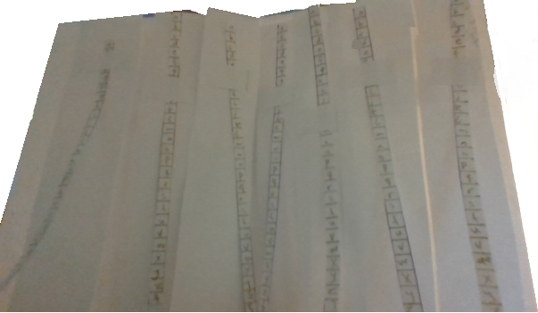
2.3: The nextstep rule
This rule use by encoding/decoding transposition cypher and it seemed like a new invention of slide rule and I have a picture below:

Slide 12
3. Hashcode machine
--I have no idea for that--

Slide 13
4. Regular Applications
These regular applications is built in at the computer, then your computer is very like all-in-one computer.
Contents of this chapter:
4.1 Calendar
4.2 Maps
4.3 ...
Not finished yet

Slide 14

www.setsolution.com

