Slide 1














CULTURE & INFLUENCING FACTORS
WHY
WHAT
Emotion
HOW
Religion
Culture
Politics
Economics
Technology & Science
Culture is considered a central concept in anthropology, encompassing the range of phenomena that are transmitted through social learning in human societies. Cultural universals are found in all human societies. These include expressive forms like art, music, dance, ritual, religion, and technologies like tool usage, cooking, shelter, and clothing. The concept of material culture covers the physical expressions of culture, such as technology, architecture and art, whereas the immaterial aspects of culture such as principles of social organization (including practices of political organization and social institutions), mythology, philosophy, literature (both written and oral), and science comprise the intangible cultural heritage of a society.

Slide 2



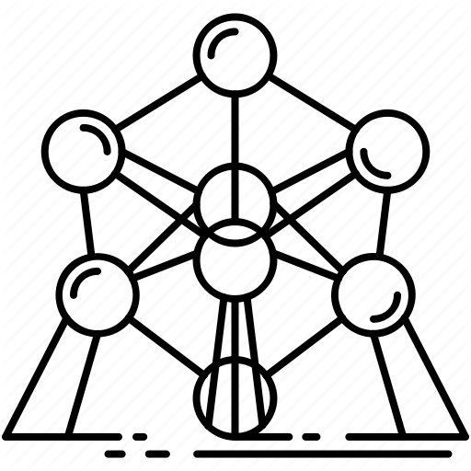






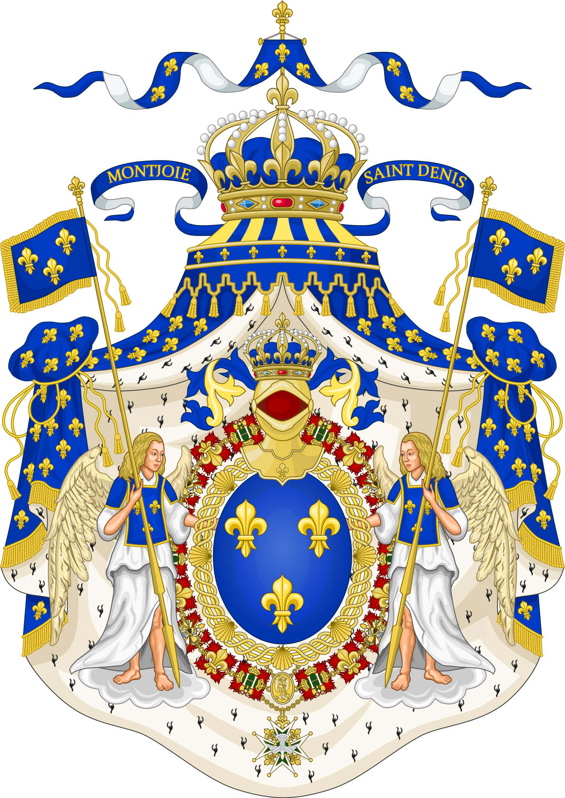
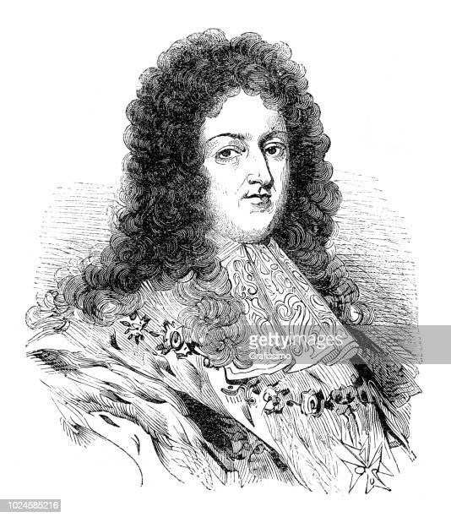


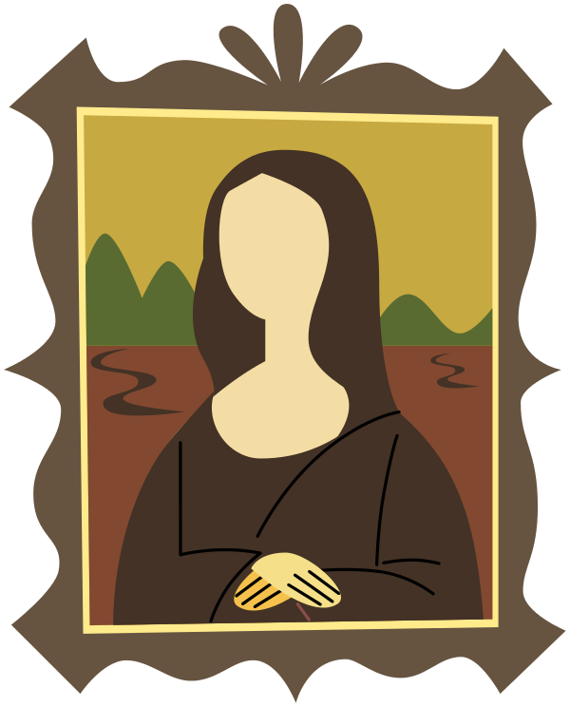





CULTURE HISTORY
Naturaism
perspective
Realism
Romanticism
Post-modernism
Culture of Ancient Greek and Roman
Humanism
Classicism
Neoclassicism
Modernism
camera
Rococo
Medieval Christian Culture
Baroque
Rise of Prussia
Louis XIV
Louis XV
Bourbon
1517 Martin Luther (Protestant)
Franska revolutionen 1789-1799
Renaissance
-800
-146
476
1400
1500
1600
1700
Upplysningen
1715-1789
1800
1900
Antikens Grekland
Romarriket
Medeltiden
(500-talet – 1500-talet)

Slide 3



WHY
WHY
WHAT
HOW
Baroque
Rococo
For palace
Culture of Ancient Greek and Roman
Humanism
Romanticism
For borgarklassen
Post-modernism
Classicism
Neoclassicism
Modernism
Medieval Christian Culture
Naturaism
Realism
For religion
(-800 - 1500)
For people (economics & politics)
(1400 - 1900)
For own heart
(1900 - now)
For the bottom of society

Slide 4


WHAT
WHY
WHAT
Humanism
HOW
Culture of Ancient Greek and Roman
Baroque
Rococo
Medieval Christian Culture
Classicism
Neoclassicism
Actually seen
Romanticism
Naturaism
Realism
Imagination
Post-modernism
Modernism

Slide 5

HOW
WHY
WHAT
HOW
Perspective & Geometry
camera
Baroque
Rococo
film
Culture of Ancient Greek and Roman
Humanism
Romanticism
Post-modernism
Classicism
Neoclassicism
Modernism
Medieval Christian Culture
Naturaism
Realism
Perfection
(-800 - 1500)
Close to reality (1400 - 1900)
Rich imagination
(1900 - now)

