Slide 1












LITERATURE & INFLUENCING FACTORS
Literature
WHY
WHAT
Emotion
HOW
Religion
Culture
Politics
Economics
Technology & Science
Literature broadly is any collection of written work, but it is also used more narrowly for writings specifically considered to be an art form, especially prose fiction, drama, and poetry.^{[2]} In recent centuries, the definition has expanded to include oral literature, much of which has been transcribed.^{[3]} Literature is a method of recording, preserving, and transmitting knowledge and entertainment.

Slide 2







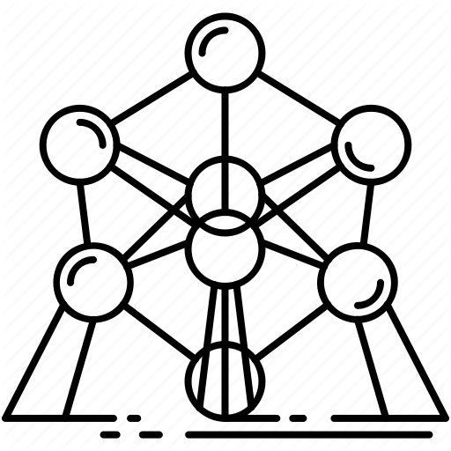




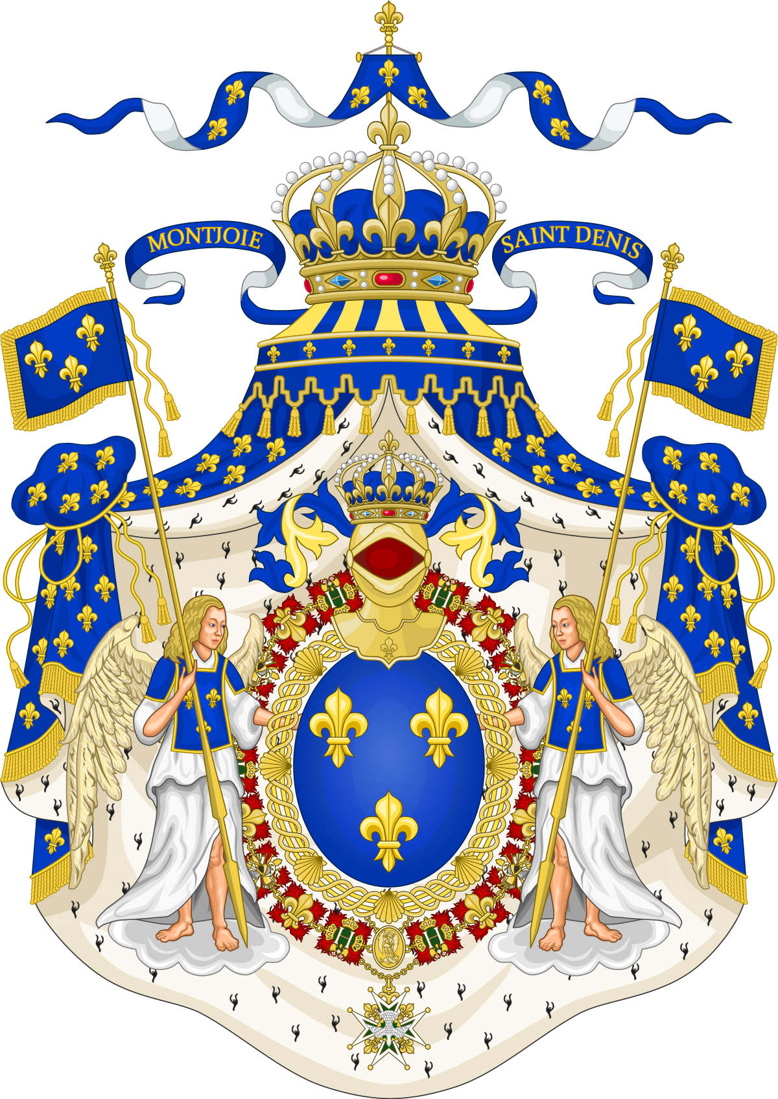
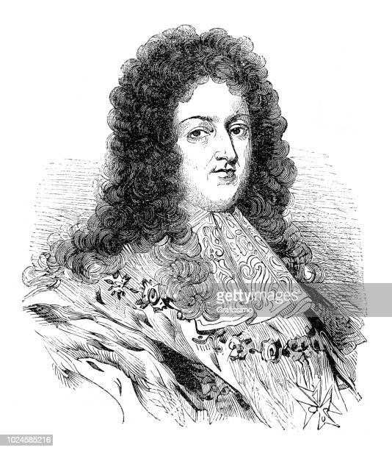








CULTURE HISTORY
Naturaism
perspective
Realism
Romanticism
Post-modernism
Culture of Ancient Greek and Roman
Humanism
Classicism
Neoclassicism
Modernism
camera
Rococo
Medieval Christian Culture
Baroque
Rise of Prussia
Louis XIV
Louis XV
Bourbon
1517 Martin Luther (Protestant)
Franska revolutionen 1789-1799
Renaissance
-800
-146
476
1400
1500
1600
1700
Upplysningen
1715-1789
1800
1900
Antikens Grekland
Romarriket
Medeltiden
(500-talet – 1500-talet)

Slide 3
Naturaism
O. Henry
”The Last Leaf”
(Realism)
Realism
Post-modernism
Modernism
Marcel Aymé
”Le passe-muraille”
(A unique expression technique that combines realism and modernism)
Ernest Hemingway
” Cat in the Rain”
(Symbolism, sub-branch of Modernism)

