Slide 1


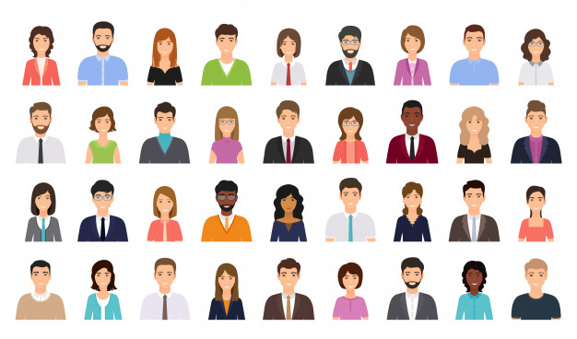
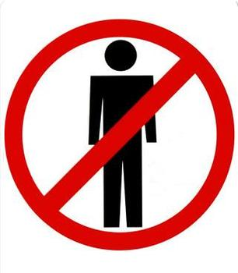
WHAT IS POLITICS
Politics is the set of activities that are associated with making decisions in groups, or other forms of power relations between individuals, such as the distribution of resources or status. The branch of social science that studies politics is referred to as political science.
Republic / parliamentary democracy
Sociocracy
Anarchism
dictatorship / autocracy
WHO SHOULD MAKE DECISIONS FOR ALL?
ONE?
SOME?
ALL?
NO ONE?

Slide 2
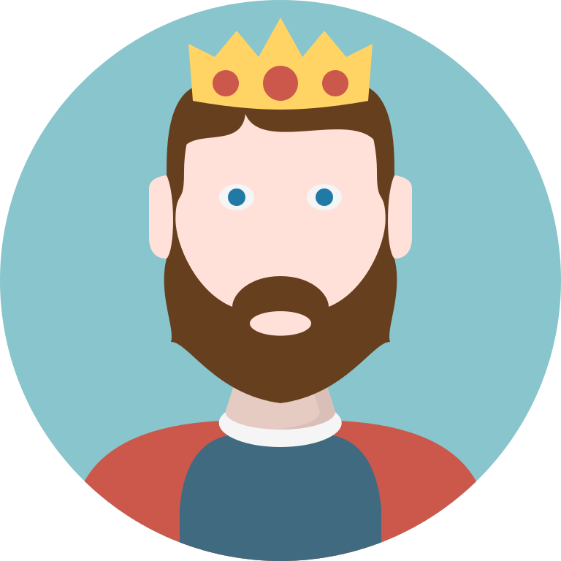
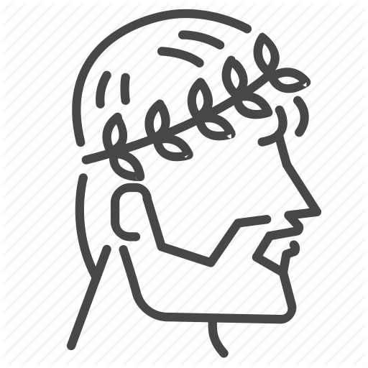


KING = DICTATOR?
DICTATOR
Republic
King
A republic is a form of government in which "power is held by the people and their elected representatives".
dictatorship / autocracy
Emperor
President
President/prime minister
representatives
King
ONE
Chairman

Slide 3

REPUBLIC = DEMOCRACY?
A republic is a form of government in which "power is held by the people and their elected representatives".
Republic Democracy
Democracy
Democracy
Democracy
Democracy is a form of government in which the people have the authority to choose their governing legislators.
”Republic”
”Republic”
President/Chairman
President/Chairman
President/prime minister
King
representatives

Slide 4
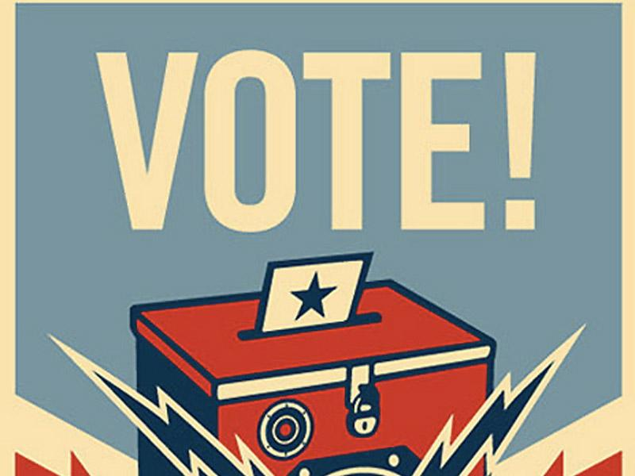

SOCIOCRACY vs DEMOCRACY?
Sociocracy, also called dynamic governance, is a system of governance which seeks to create psychologically safe environments and productive organizations. It is distinguished by the use of consent, rather than majority voting, in discussion and decision-making by people who have a shared objective or work process.
Democracy is a form of government in which the people have the authority to choose their governing legislators. The decisions on who is considered part of the people and how authority is shared among or delegated by the people have changed over time and at different speeds in different countries, but they have included more and more of the inhabitants of all countries.
consent
majority voting
President/prime minister

Slide 5
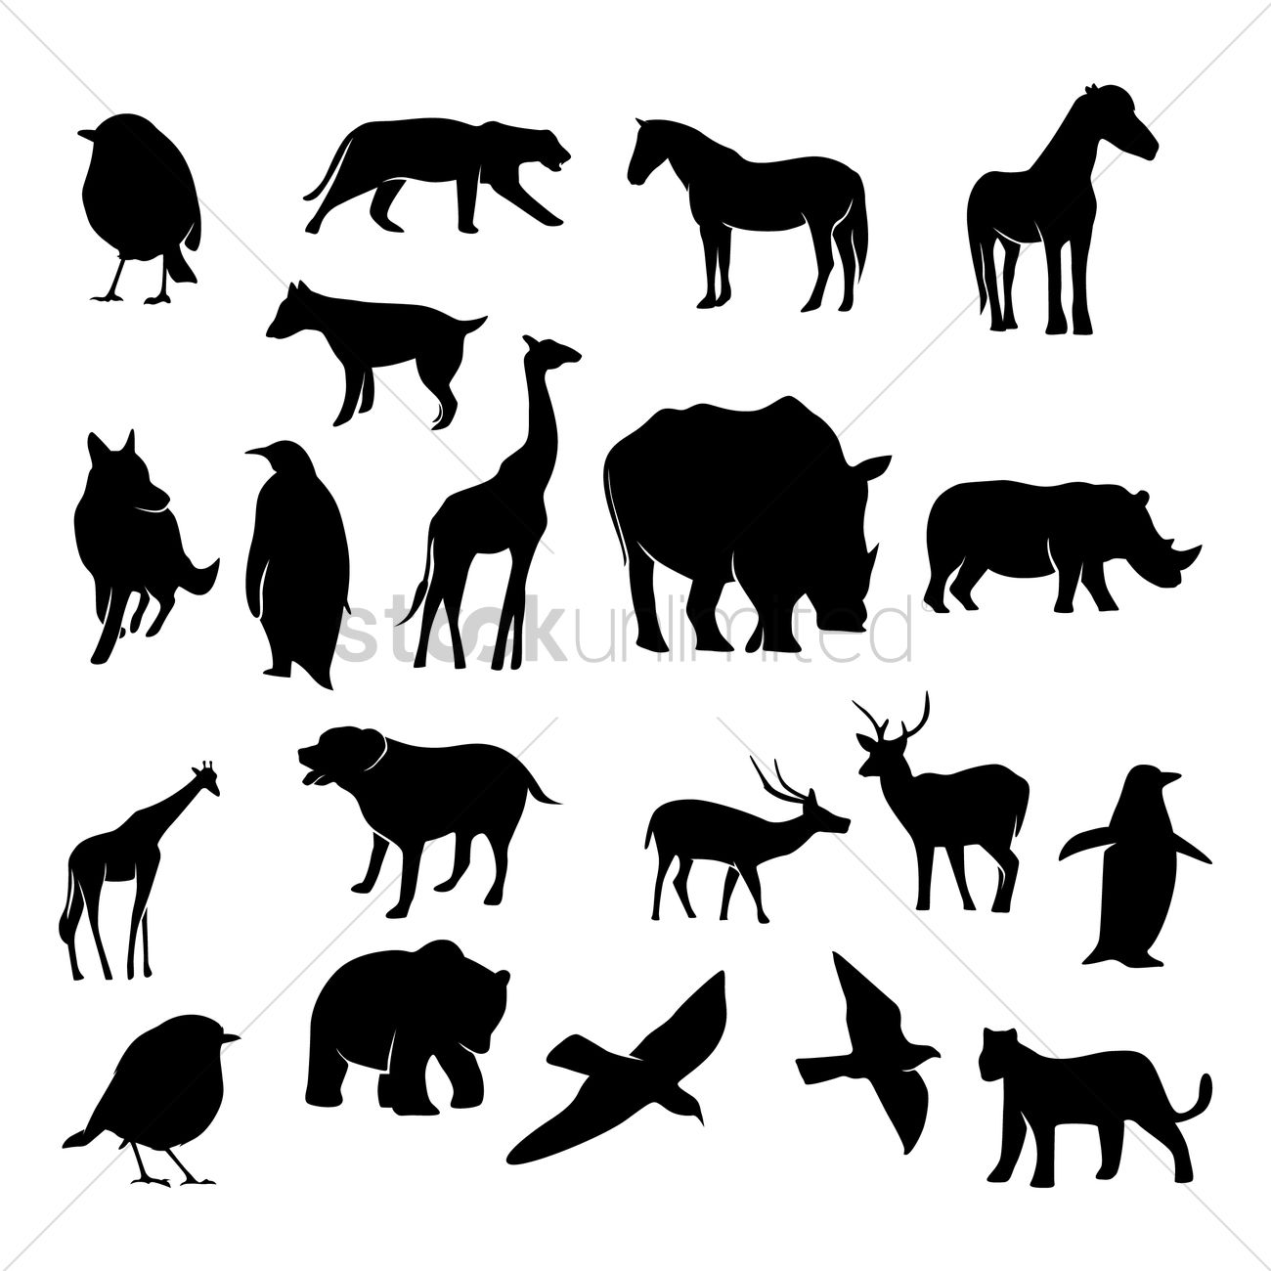
TAKE AWAY
Efficiency
dictatorial rule
majority voting
consent
Anarchism
dictatorship / autocracy
Republic
Sociocracy
ALL
SOME
ONE
NO ONE
(Cover all?)
Democracy

