Slide 1

COLOR DETECTOR – HARDWARE CONNECTION
16x2 LCD screen with I2C
A5
SCL
UNO R3 with USB
A4
SDA
USB
VCC
5V
GND
GND
GND
2
~3
4
~5
~6
Breadboard
+
-
Color Sensor TCS 3200
V
G
OE
LED
OUT
S3
S2
S1
S0

Slide 2

COLOR DETECTOR – HARDWARE OVERVIEW
16x2 LCD screen with I2C
(output)
A5
SCL
UNO R3 with USB
A4
Flash
POWER
SDA
USB
VCC
5V
SERIAL
GND
GND
GND
2
~3
4
~5
~6
Breadboard
+
-
Color Sensor TCS 3200
(input)
V
G
OE
LED
OUT
S3
S2
S1
S0

Slide 3
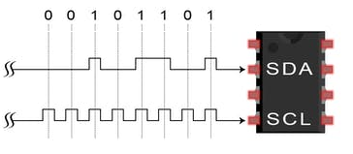

16x2 LCD screen with I2C
LiquidCrystal_I2C lcd(0x27, 16, 2);
void setup()
{
lcd.begin();
lcd.clear();
lcd.setCursor(0,0);
lcd.write(‘-’);
}
SDA: Serial Data Line
I2C
16x2 LCD
1
D0
0
D1
1
D2
1
D3
SCL: Serial Clock Line
0
D4
1
D5
0
D6
0
D7
-
sketch.ino - Wokwi Arduino and ESP32 Simulator
Interface I2C 16x2 LCD with Arduino Uno (Just 4 wires) - Arduino Project Hub

Slide 4
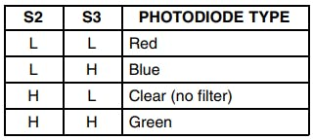
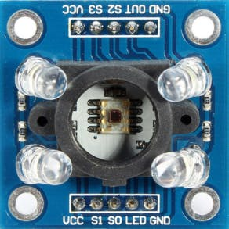
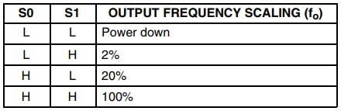
Color Sensor TCS 3200
#define s0 6
#define s1 5
#define s2 4
#define s3 3
#define out 2
3
void loop()
{
digitalWrite(s2,LOW);
digitalWrite(s3,LOW);
red = GetData();
digitalWrite(s2,LOW);
digitalWrite(s3,HIGH);
blue = GetData();
digitalWrite(s2,HIGH);
digitalWrite(s3,HIGH);
green = GetData();
delay(2000);
}
unsigned long GetData(){
data=pulseIn(out,LOW);
delay(20);
return data;
}
1
2
4
3
UNO R3
~6
~5
// Set highest output frequency scalling
digitalWrite(s0,HIGH);
digitalWrite(s1,HIGH);
2
Color Detection Using TCS3200/230 - Arduino Project Hub

Slide 5
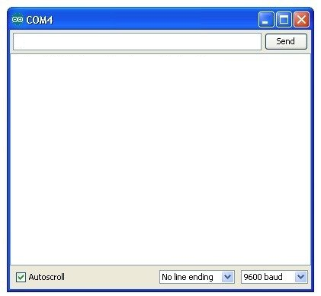
Serial (debug information only for programmer)
UNO R3 with USB
Arduino serial monitor
Flash
void setup() {
// put your setup code here, to run once:
Serial.begin(9600);
Serial.print("\nHello, Mo!\tThis is your new world!\n");
}
void loop() {
// put your main code here, to run repeatedly:
Serial.print(“still running, no bug! :-)\n”);
delay(1000);
}
Hello, Mo! This is your new world!
Still running, no bug! :-)
Still running, no bug! :-)
Still running, no bug! :-)
SERIAL

Slide 6
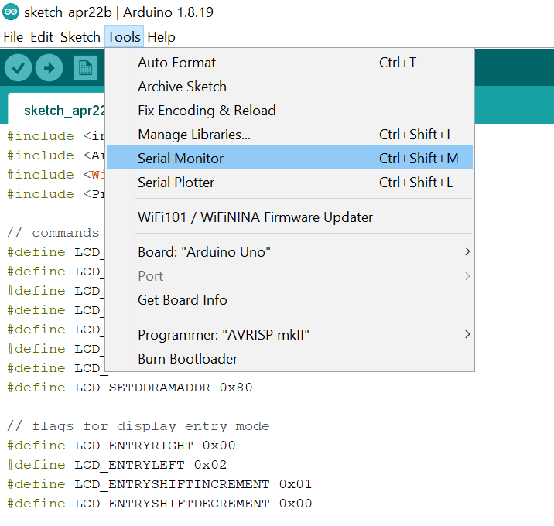
Serial (configuration)

Slide 7
About Colors
lcd.clear();
if (red < blue && red < green){
Serial.println("\tRed Color");
lcd.print("Red Color");
} else if (blue < red && blue < green){
Serial.println("\tBlue Color");
lcd.print("Blue Color");
} else if (green < red && green < blue){
Serial.println("\tGreen Color");
lcd.print("Green Color");
} else if (red == green && red == blue){
Serial.println("\tGreyscale");
lcd.print("Greyscale");
} else if (red == green){
Serial.println("\tYellow color");
lcd.print("Yellow color");
} else {
lcd.print("invalid color!");
}

