Slide 1
FinHeartBel
Marko, Nathan & Mo

Slide 2
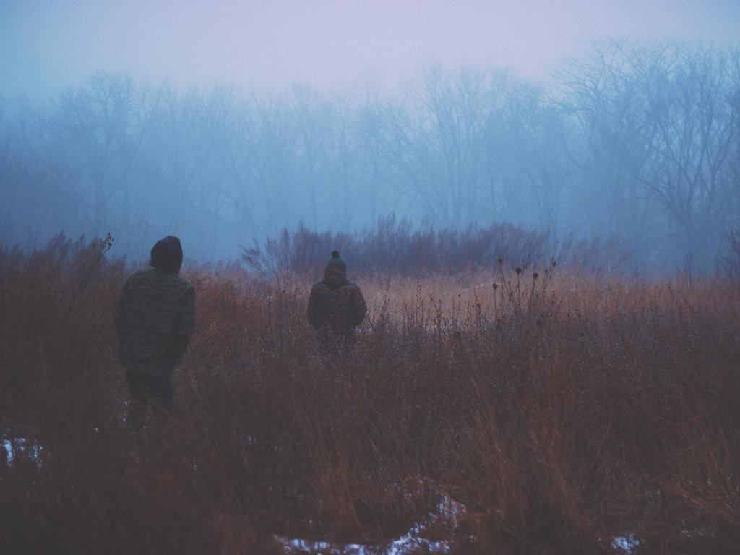
EDIT IN GOOGLE SLIDES
Click on the button under the presentation preview that says "Use as Google Slides Theme".
You will get a copy of this document on your Google Drive and will be able to edit, add or delete slides.
You have to be signed in to your Google account.
EDIT IN POWERPOINT®
Click on the button under the presentation preview that says "Download as PowerPoint template". You will get a .pptx file that you can edit in PowerPoint.
Remember to download and install the fonts used in this presentation (you’ll find the links to the font files needed in the Presentation design slide)
More info on how to use this template at www.slidescarnival.com/help-use-presentation-template
This template is free to use under Creative Commons Attribution license. You can keep the Credits slide or mention SlidesCarnival and other resources used in a slide footer.

Slide 3
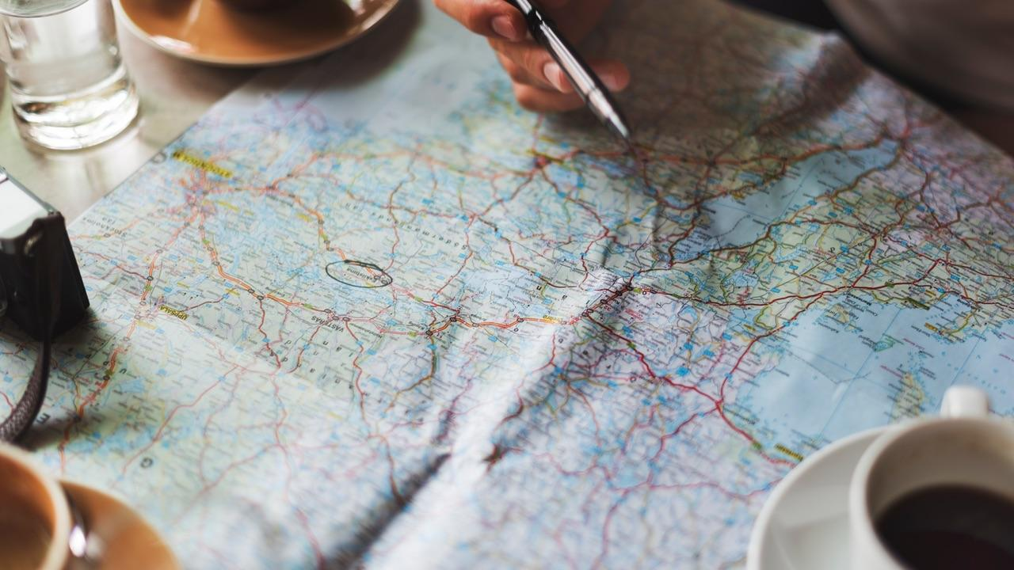
Shocking Facts all around the world
1 out of 18 has Cardiac Arrhythmia worldwide.
Cardiovascular diseases are the leading cause of death in the EU.
(2013 = 37,5%)
Heart disease is the number 1 death cause in Russia.
Approximately 500.000 Americans die every year from a heart disease, Cardiac Arrhythmia causes the majority of that.
18% of all deaths in South Africa are cause by Cardiovascular diseases.

Slide 4
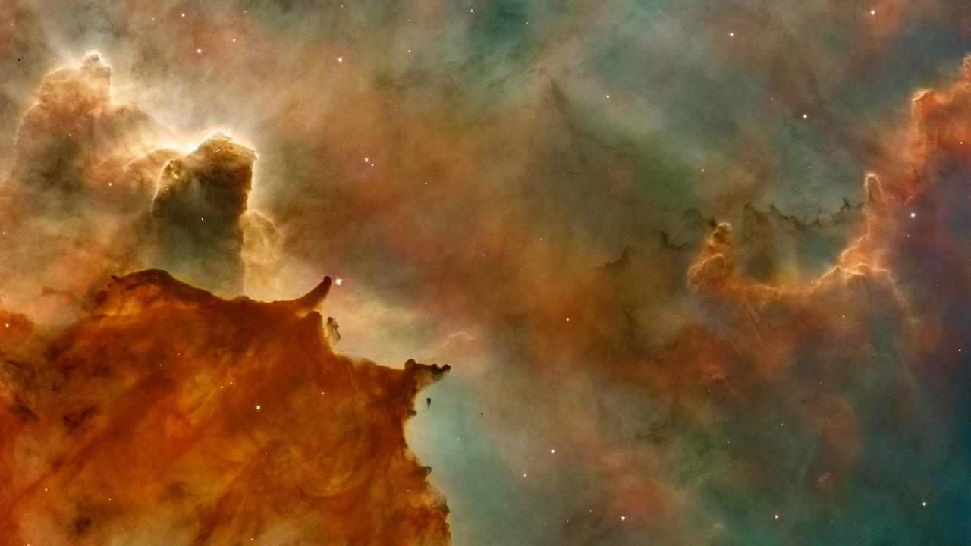
The Idea
Inform people in advance and offer them a simple solution of keeping track of their health with FinHeartBel.

Slide 6

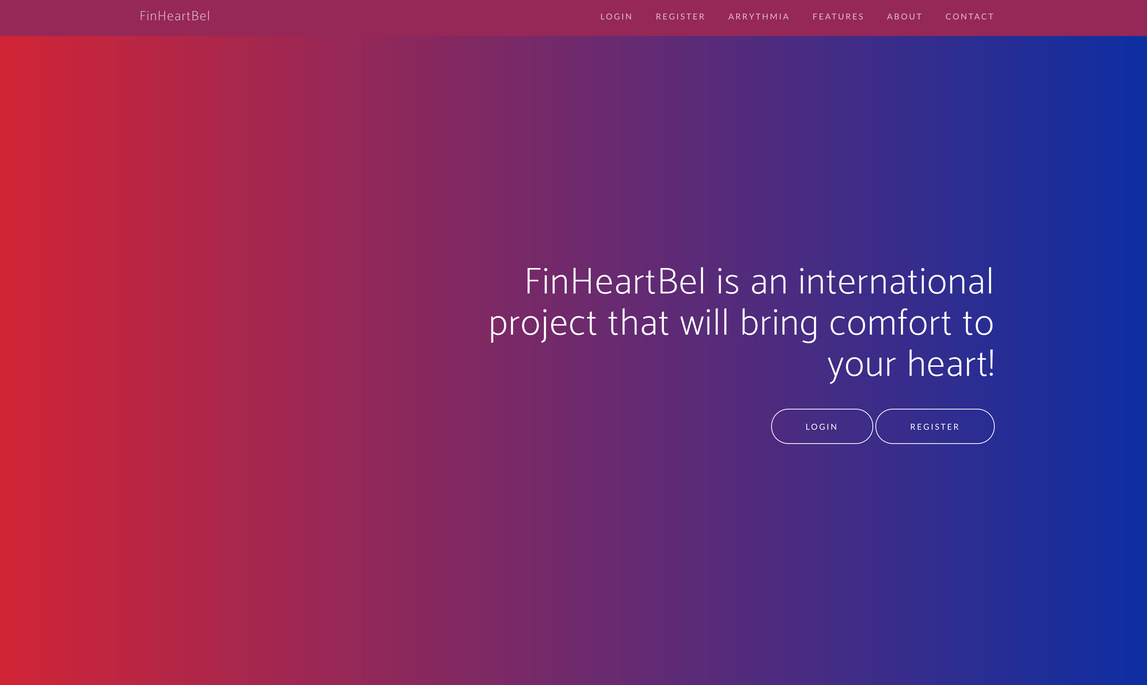
FinHeartBel
Place your screenshot here
Demonstration

Slide 7
1.
TRANSITION HEADLINE
Let’s start with the first set of slides

Slide 8
Quotations are commonly printed as a means of inspiration and to invoke philosophical thoughts from the reader.

Slide 9
THIS IS A SLIDE TITLE
Here you have a list of items
And some text
But remember not to overload your slides with content
Your audience will listen to you or read the content, but won’t do both.

Slide 10
YOU CAN ALSO SPLIT YOUR CONTENT
White
Is the color of milk and fresh snow, the color produced by the combination of all the colors of the visible spectrum.
Black
Is the color of coal, ebony, and of outer space. It is the darkest color, the result of the absence of or complete absorption of light.

Slide 11
IN TWO OR THREE COLUMNS
Yellow
Is the color of gold, butter and ripe lemons. In the spectrum of visible light, yellow is found between green and orange.
Blue
Is the colour of the clear sky and the deep sea. It is located between violet and green on the optical spectrum.
Red
Is the color of blood, and because of this it has historically been associated with sacrifice, danger and courage.

Slide 12
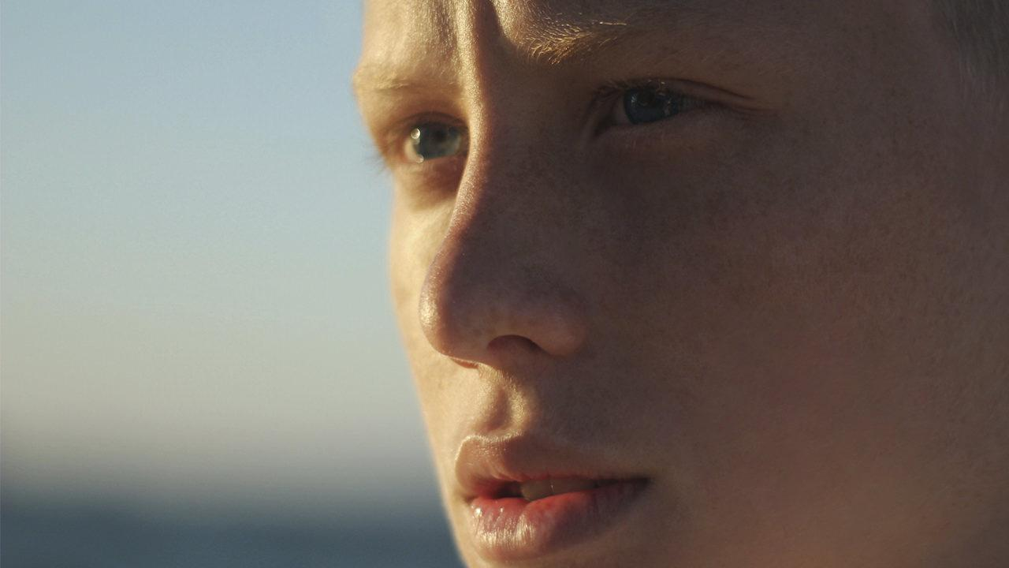
A PICTURE IS WORTH A THOUSAND WORDS
A complex idea can be conveyed with just a single still image, namely making it possible to absorb large amounts of data quickly.

Slide 13
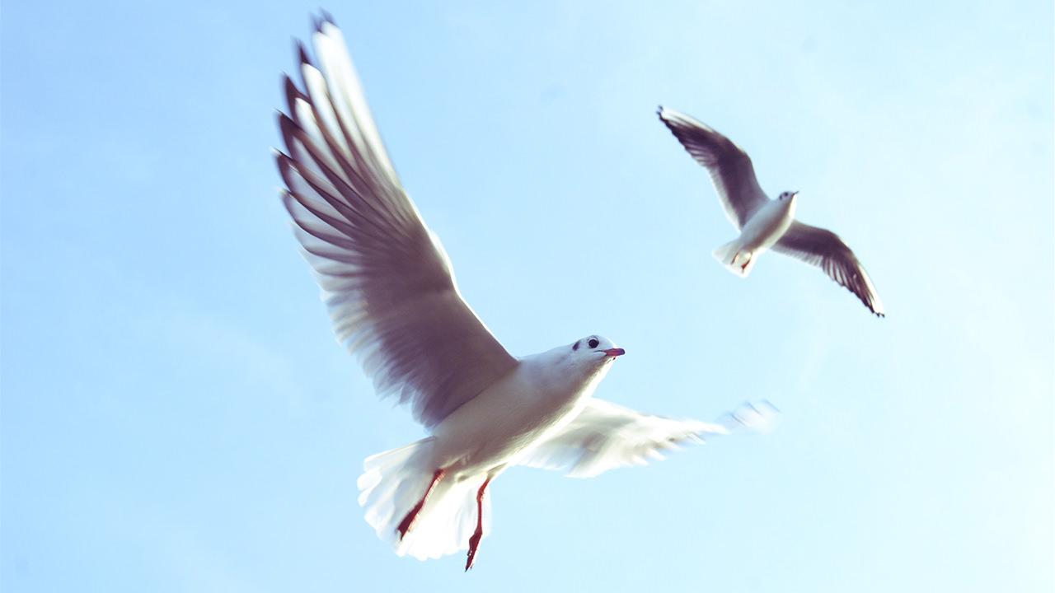
WANT BIG IMPACT?
USE BIG IMAGE

Slide 14
USE CHARTS TO EXPLAIN YOUR IDEAS
White
Black
Gray

Slide 15
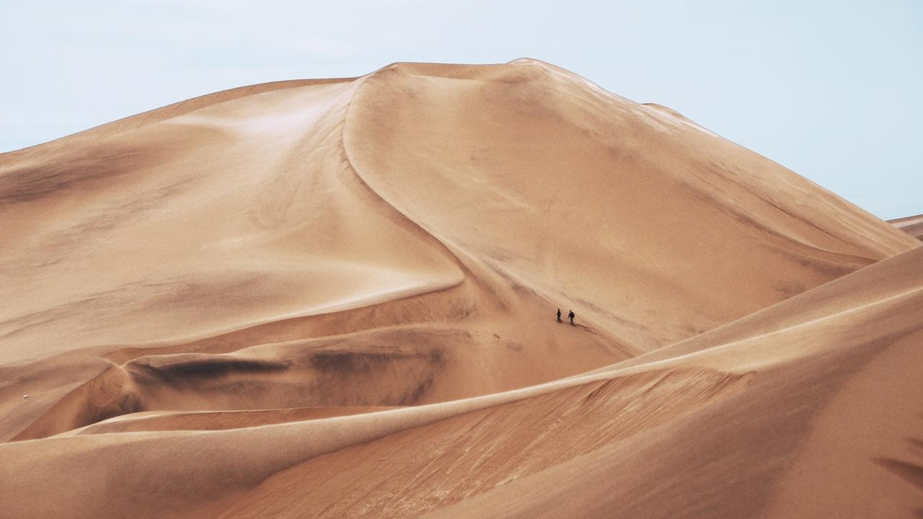
AND TABLES TO COMPARE DATA
 | A | B | C
Yellow | 10 | 20 | 7
Blue | 30 | 15 | 10
Orange | 5 | 24 | 16

Slide 16
89,526,124
Whoa! That’s a big number, aren’t you proud?

Slide 17
89,526,124$
185,244 users
100%
That’s a lot of money
And a lot of users
Total success!

Slide 18
OUR PROCESS IS EASY
Measurements with device
Analyze with our algorithm
Diagnose online

Slide 19
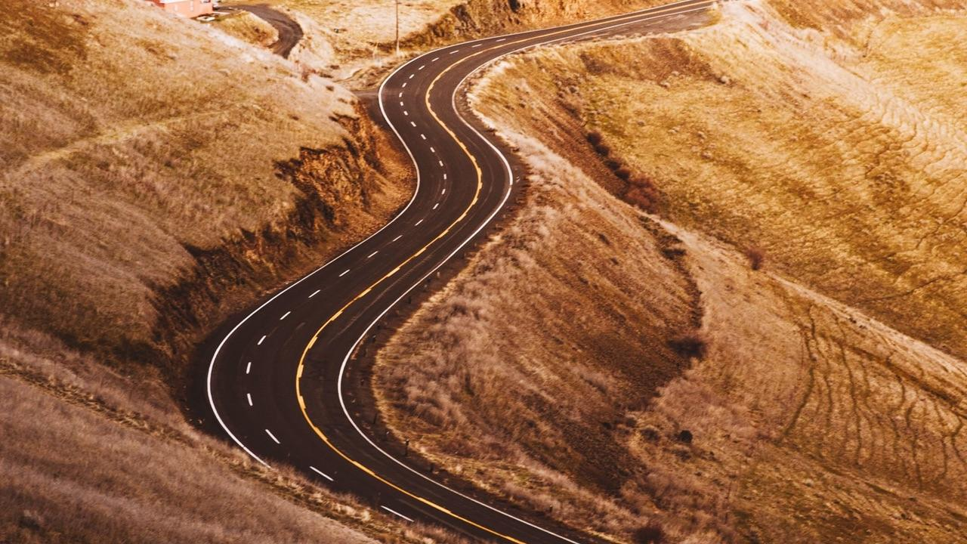
LET’S REVIEW SOME CONCEPTS
Yellow
Is the color of gold, butter and ripe lemons. In the spectrum of visible light, yellow is found between green and orange.
Blue
Is the colour of the clear sky and the deep sea. It is located between violet and green on the optical spectrum.
Red
Is the color of blood, and because of this it has historically been associated with sacrifice, danger and courage.
Yellow
Is the color of gold, butter and ripe lemons. In the spectrum of visible light, yellow is found between green and orange.
Blue
Is the colour of the clear sky and the deep sea. It is located between violet and green on the optical spectrum.
Red
Is the color of blood, and because of this it has historically been associated with sacrifice, danger and courage.

Slide 20
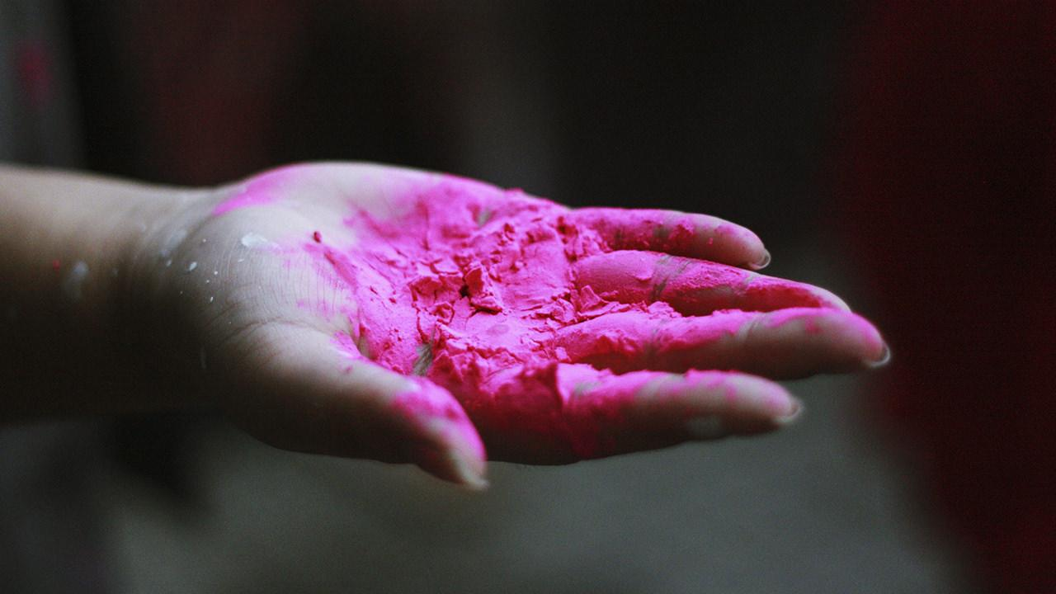
THANKS!
Any questions?
You can contact us
nathan.aertgeerts@student.ap.be
mo.bouzim@student.ap.be
marko.ylikulju@student.ap.be

Slide 21
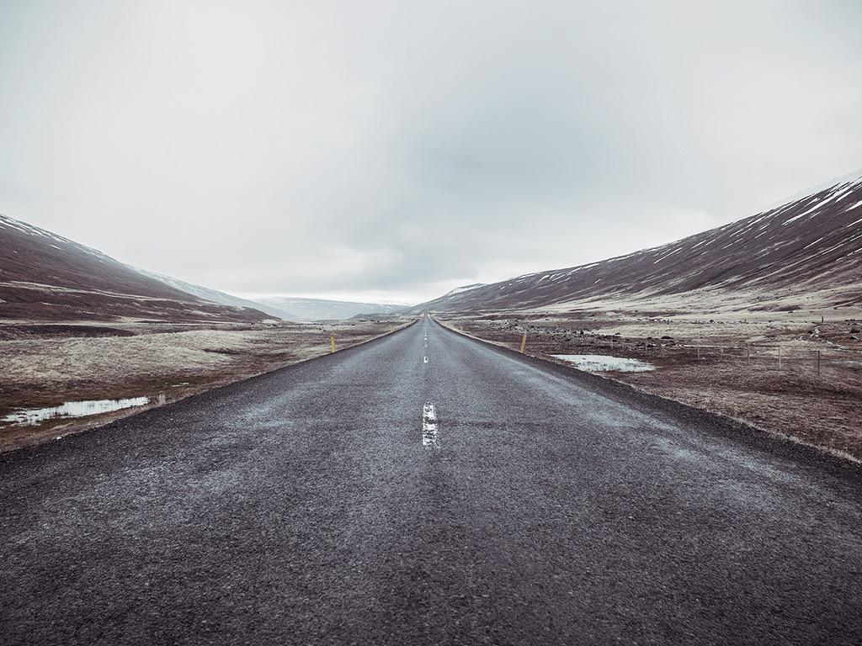
CREDITS
Special thanks to all the people who helped making this possible:
Tom & Luc Peeters
Pekka Alaluukas
Marko, Nathan & Mo

