Slide 1
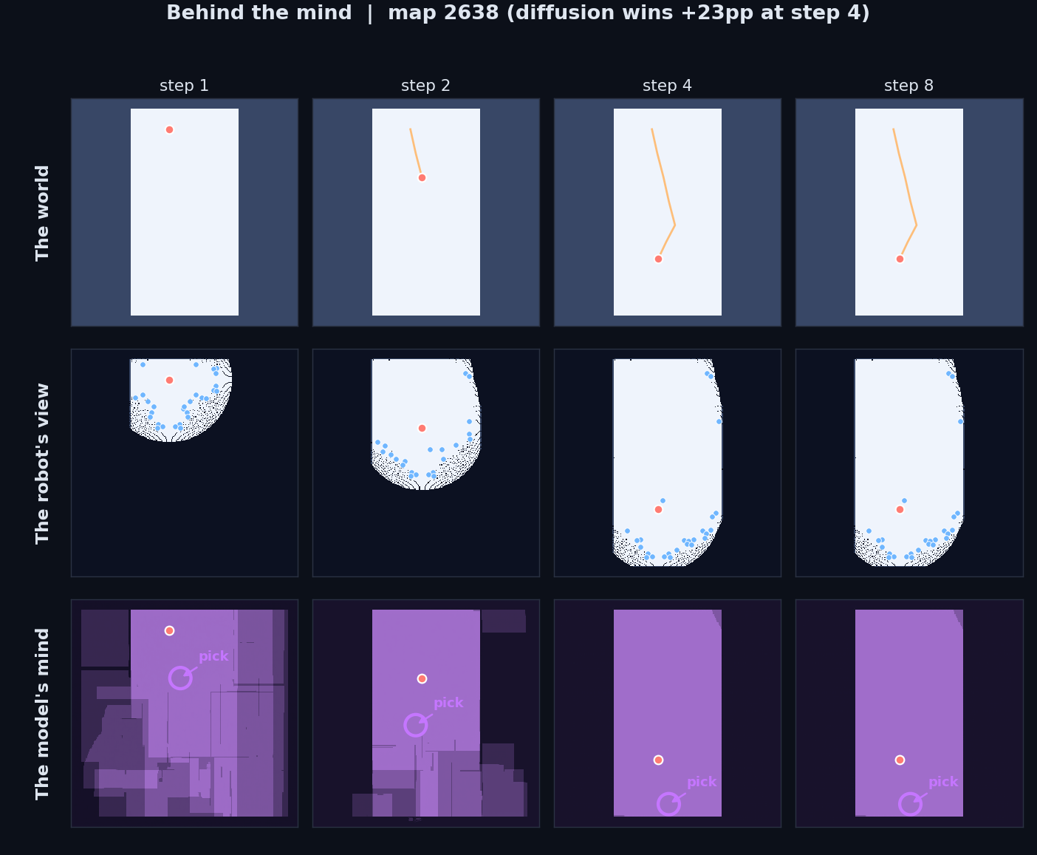
Project Goal
Autonomous mapping of an unknown building, one frontier decision at a time.
• Setup: a robot is dropped at the door of a building it has never seen, with only a 2D lidar.
• Input each step: the partial occupancy grid the robot has accumulated so far.
• Output each step: the next frontier to drive to — the boundary between known and unknown.
• Assumption: the deployment environment shares structural distribution with training data (real residential floor plans).
• What's broken with the standard approach: classical frontier scoring is memoryless — it picks based on nearby unknown cells minus distance, throwing away the fact that real buildings have walls that run straight, hallways that connect rooms, doors that cluster.
the structural prior the heuristic ignores
1

Slide 2
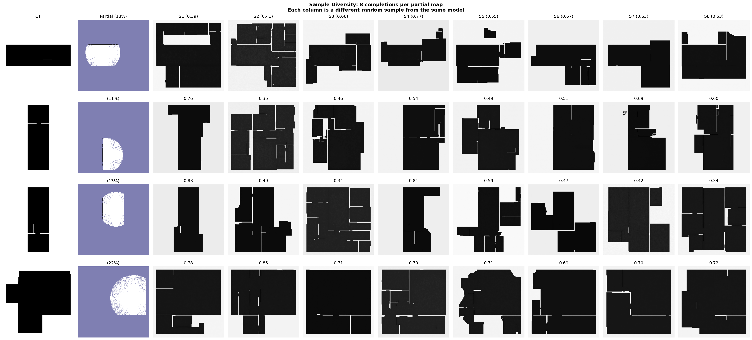
Novelty & Hypothesis
What's new here
• We treat diffusion samples as imagined buildings, not just predictions. K=8 plausible completions per frontier decision.
• We use K-sample disagreement as an upper-confidence-bound exploration signal — the variance is the feature, not noise to be averaged out.
• We isolate where the wins come from with a 4-baseline ablation (nearest / info-gain / info-gain + distance / ours), plus an out-of-domain control that proves the prior is doing real structural work.
Hypothesis
A learned generative prior of building layouts gives a robot a measurable early-budget head start in frontier exploration — but only when (1) the training distribution matches deployment, (2) the step budget is tight, and (3) inference is fast enough to drive.
2

