Slide 1
COSC 81/281 · FINAL PROJECT · SPRING 2026
Diffusion-Guided Frontier Exploration
Can a generative model of buildings help a robot decide where to drive next — and just as importantly, when can it not?
Moin Mattar
Dartmouth · June 1, 2026
AI helped me in formatting and writing (HTML/CSS/LaTeX), as well as explained concepts.
1

Slide 2
1
Novelty & Motivation
A robot at the door of a building it has never seen.
2

Slide 3
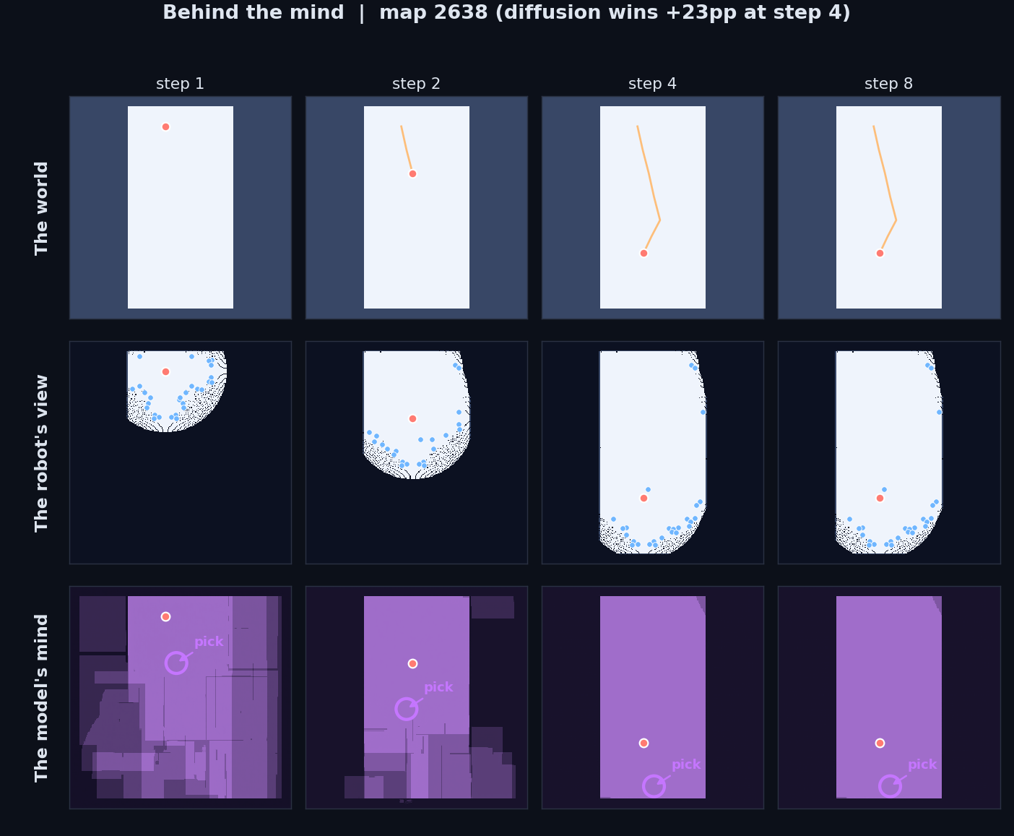
Project Goal
Autonomous mapping of an unknown building, one frontier decision at a time.
• Setup: a robot is dropped at the door of a building it has never seen, with only a 2D lidar.
• Input each step: the partial occupancy grid the robot has accumulated.
• Output each step: the next frontier to drive to.
• Assumption: deployment environment shares structural distribution with training data.
• What's broken: classical frontier scoring is memoryless — it throws away the fact that real buildings have walls that run straight, hallways that connect rooms, doors that cluster.
3

Slide 4
Novelty?
• We treat diffusion samples as imagined buildings, not just predictions. K=8 plausible completions per frontier decision.
• We use K-sample disagreement as an upper-confidence-bound exploration signal — the variance is the feature, not noise to average out.
• We isolate where the wins come from with a 4-baseline ablation, plus an out-of-domain control that proves the prior is doing real structural work.
4

Slide 5
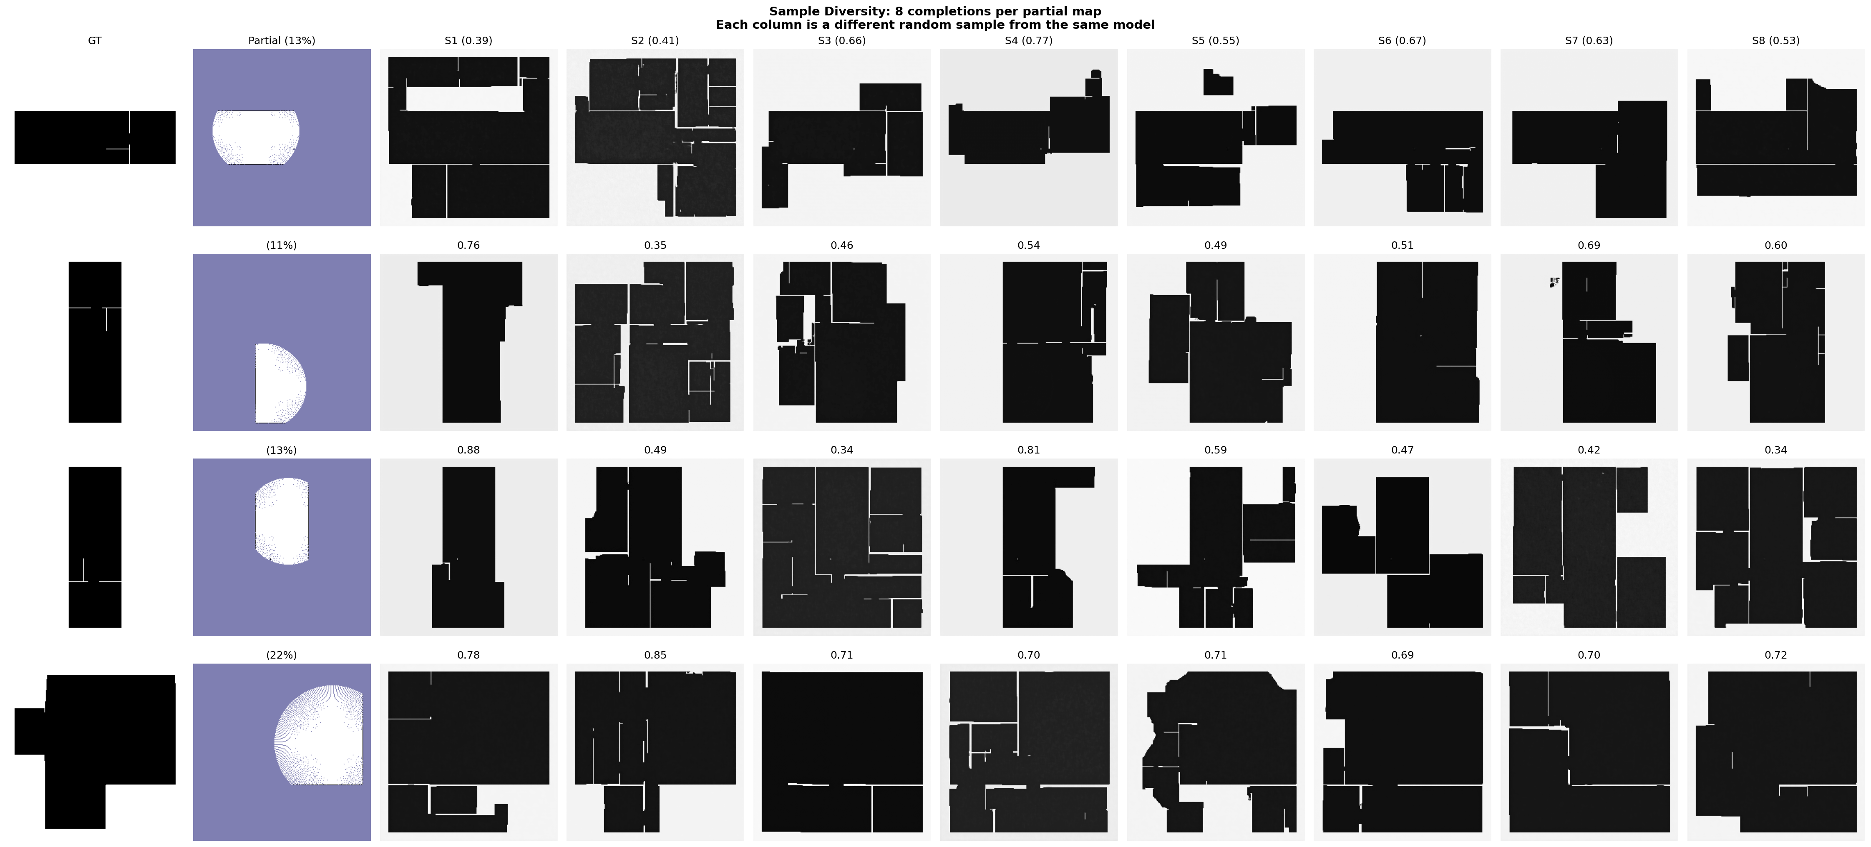
Hypothesis
A learned generative prior of building layouts gives a robot a measurable early-budget head start in frontier exploration — but only when (1) the training distribution matches deployment, (2) the step budget is tight, and (3) inference is fast enough to drive.
5

Slide 6
2
Our System
HouseExpo → Conditional U-Net (DDPM) → K-sample scoring → Frontier pick
6

Slide 7
End-to-End Pipeline I Implemented
01
02
03
04
Data Collection
U-Net + DDPM
K-Sample Scoring
ROS 2 Integration
HouseExpo: 35,126 residential floor plans. Per plan, partial views + hidden remainders → 2.66M training pairs after augmentation.
Conditional U-Net, 4.16M params. MSE on noise. 29 epochs on T4 GPU. Loss 0.033 → 0.0007.
K=8 DDIM completions. Score = E[gain] + λ·Std[gain] − β·dist. Variance = UCB exploration bonus.
ROS 2 node publishes /best_frontier. Exploration manager (from PA3) drives robot in Stage maze.
7

Slide 8
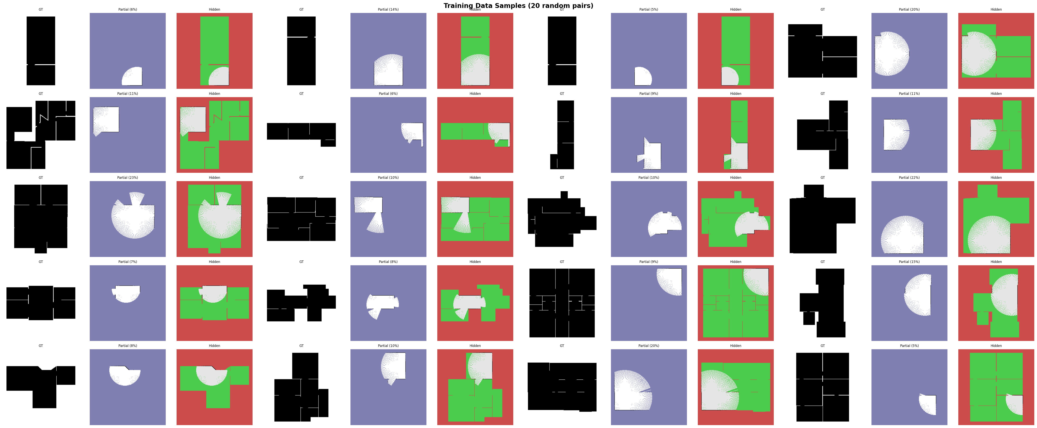
The Data — HouseExpo
Augmentation (4 rotations + flips) was the dominant lever for sample diversity.
Source
Plans
Pairs after augmentation
Purpose
HouseExpo (residential)
35,126
2.66M
training
Held-out HouseExpo
30
—
evaluation
Synthetic warehouse
—
small set
OOD control
8

Slide 9
Baseline Objective (DDPM)
Forward process:
x_τ = √(α̅_τ) · x₀ + √(1 − α̅_τ) · ε, ε ~ N(0, I)
One-step objective:
L_base = E [ ‖ε̂_θ(x_τ, τ, partial) − ε‖² ]
• Conditioned on the partial occupancy grid + a known-mask channel.
• Single-step denoising target — MSE on the noise added at step τ.
• DDIM at inference: 30 steps, K=8 samples per batched call (~2 s on T4).
9

Slide 10
Frontier Scoring Objective
For each frontier cluster f, with K=8 imagined completions:
score(f) = E_k[ G_k(f) ] + λ · Std_k[ G_k(f) ] − β · dist(robot, f)
where G_k(f) = unknown cells inside frontier sensor footprint under completion k.
• Mean gain — how much the robot expects to discover at this frontier.
• Variance bonus — UCB-style; the model's disagreement is the exploration signal.
• Distance term — travel cost.
• Pick the argmax. Move. Sense. Re-sample. Repeat.
10

Slide 11
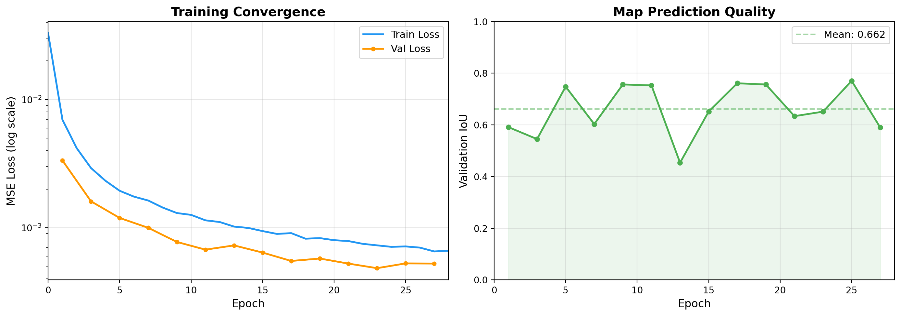
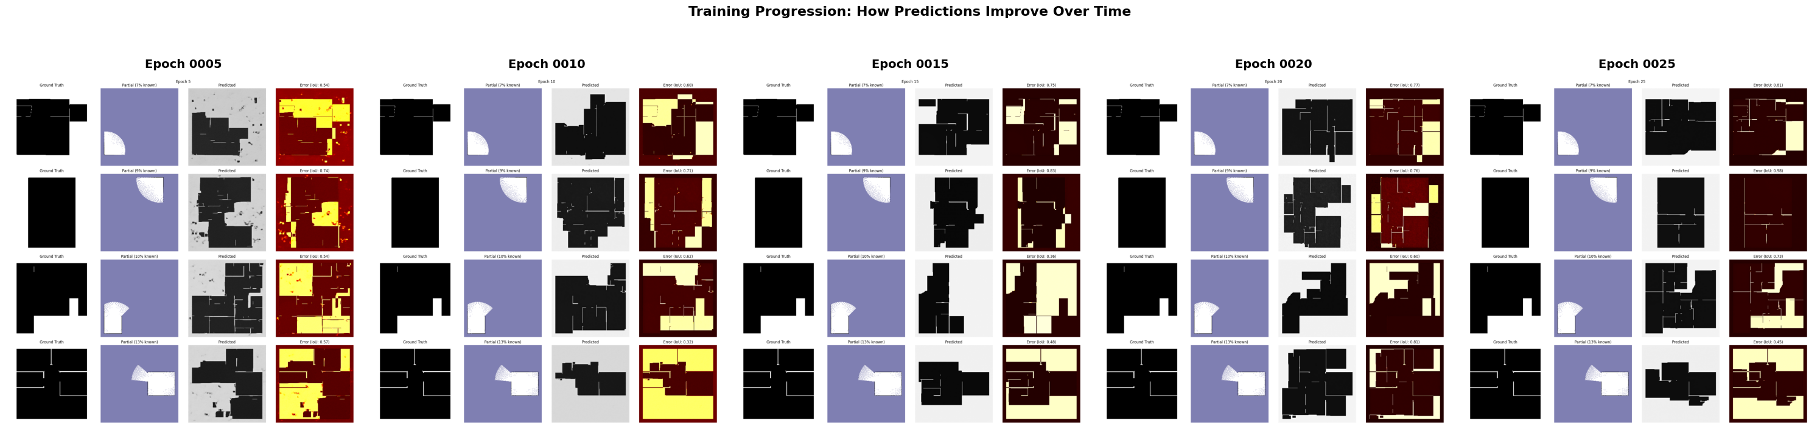
Training Journey: loss 0.033 → 0.0007
29 epochs on T4. Validation IoU averaged 0.66, best 0.77.
Sample quality at epochs 5/10/15/20/25 — the model wakes up.
K=8 DDIM samples per partial input — variance becomes the exploration signal.
11

Slide 12
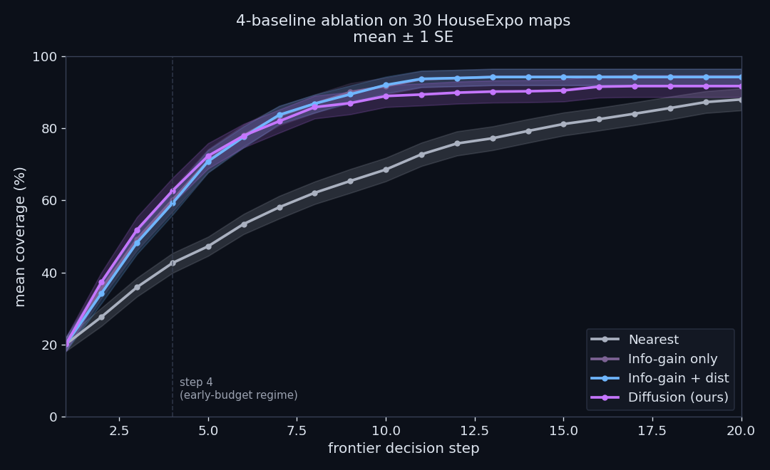
Now you tell me — where do the wins come from?
Four scorers, 30 HouseExpo maps, identical seeds.
+3.5pp
DIFFUSION VS HEURISTIC AT STEP 4. The learned prior on top of info-gain + distance.
+17.5pp
INFO-GAIN VS NEAREST AT STEP 4. Info-gain is doing most of the work.
~0pp
DISTANCE TERM CONTRIBUTION. Decorative on HouseExpo.
12

Slide 13
Behind the mind — the loop made visible
Map 2638 — top: world + trail. Middle: partial map + frontiers. Bottom: K=4 imagined buildings with picked frontier circled. By step 4 the prior carries the robot to 95% coverage.
13

Slide 14
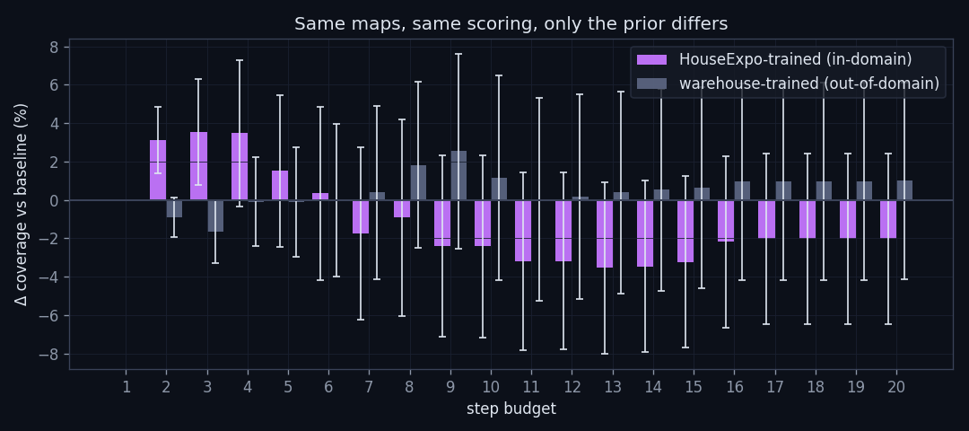
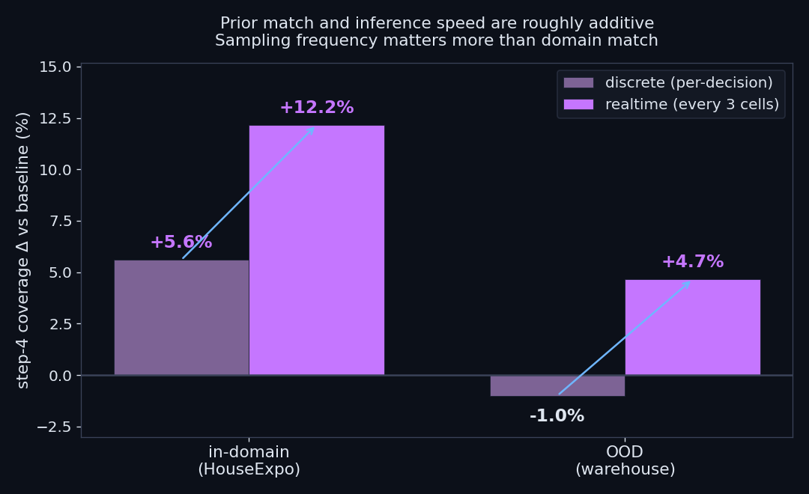
When the prior fails — and what realtime would buy
OOD ablation. Second U-Net trained on synthetic warehouses, evaluated on residential maps. Step-4 advantage drops from +3.5pp to −0.1pp. The prior is not a generic averaging trick.
Realtime upper bound. Re-sampling K=8 every 3 driving cells (the speed a distilled model could achieve) lifts in-domain advantage to +10.0pp. Prior contributes ~4pp; sampling frequency contributes ~7pp.
14

Slide 15
Hardships
Compute / infra:
• Docker QEMU on Apple Silicon too slow for live diffusion in Stage — switched to pre-computed waypoints.
• AWS EC2 g4dn.xlarge (T4 GPU) for training and inference experiments.
• Batched K=8 sampling rewrite — 3× speedup with no quality loss.
Honest limits:
• Asymptotic coverage — baseline catches up by step 20.
• Out-of-domain priors give −0.1pp (the kill experiment).
• 2 / 30 hard failures — K-sample disagreement could flag these.
• Live hardware — Stage works via pre-computed waypoints, not live inference.
15

Slide 16
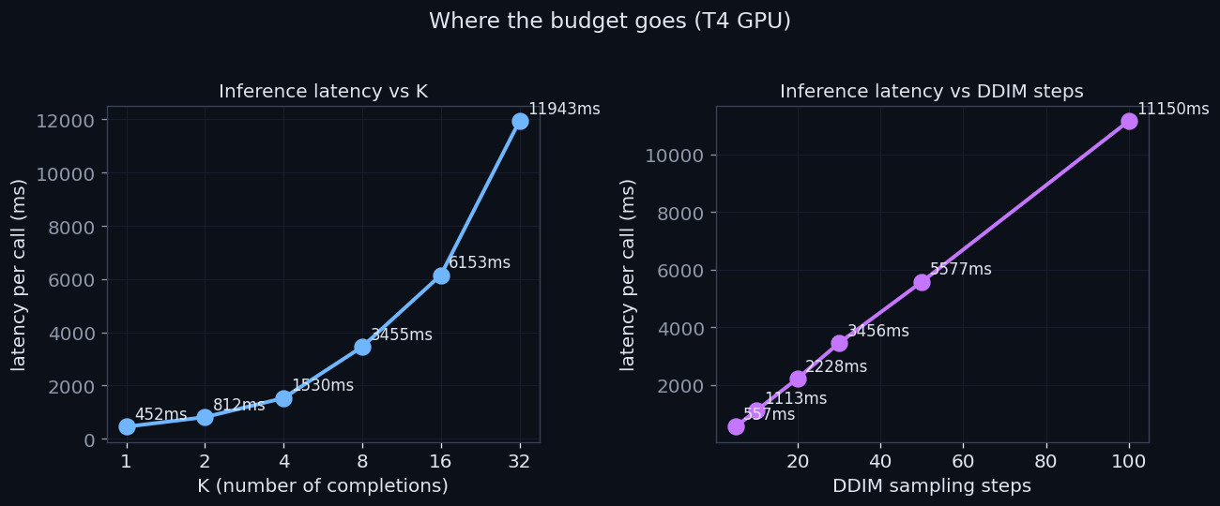
Sampling
• DDPM (1000 steps), K=8: ~40 seconds on T4 — way too slow.
• DDIM (30 steps), K=8: ~2 seconds (20× faster) — what I used for experiments.
• DDIM (10 steps), K=4: ~500 ms (80× faster) — realtime budget.
• Distillation to Jetson would put +10pp in-domain advantage in reach for a real robot.
16

Slide 17
DEMO
Top: diffusion-guided. Bottom: baseline heuristic. Same map, same start, same lidar. Both reach high coverage — diffusion is consistently ahead in the early steps.
17

Slide 18
What's Next?
• Distillation of the U-Net to Jetson for sub-second inference on a ROSbot.
• Richer training domains — Gibson, Matterport, real BIM data — for cross-environment generalisation.
• K-sample disagreement as an "I don't know" flag — fall back to heuristic on hard maps.
• Diffusion Forcing for maps — sequential prediction over multiple exploration timesteps.
• Live ROSbot deployment in a matched-distribution building (residential / hospital / warehouse).
18

Slide 19
Thanks for your attention.
Questions?
Moin Mattar · COSC 81/281 · June 1, 2026
AI helped me in formatting and writing (HTML/CSS/LaTeX), as well as explained concepts.
19

