Slide 1
COSC 81/281 · FINAL PROJECT
Diffusion-Guided Frontier Exploration
A learned prior of building layouts as a robot's exploration signal.
Moin Mattar · June 1, 2026
AI helped me in formatting and writing (HTML/CSS/LaTeX), as well as explained concepts.
1 / 10

Slide 2
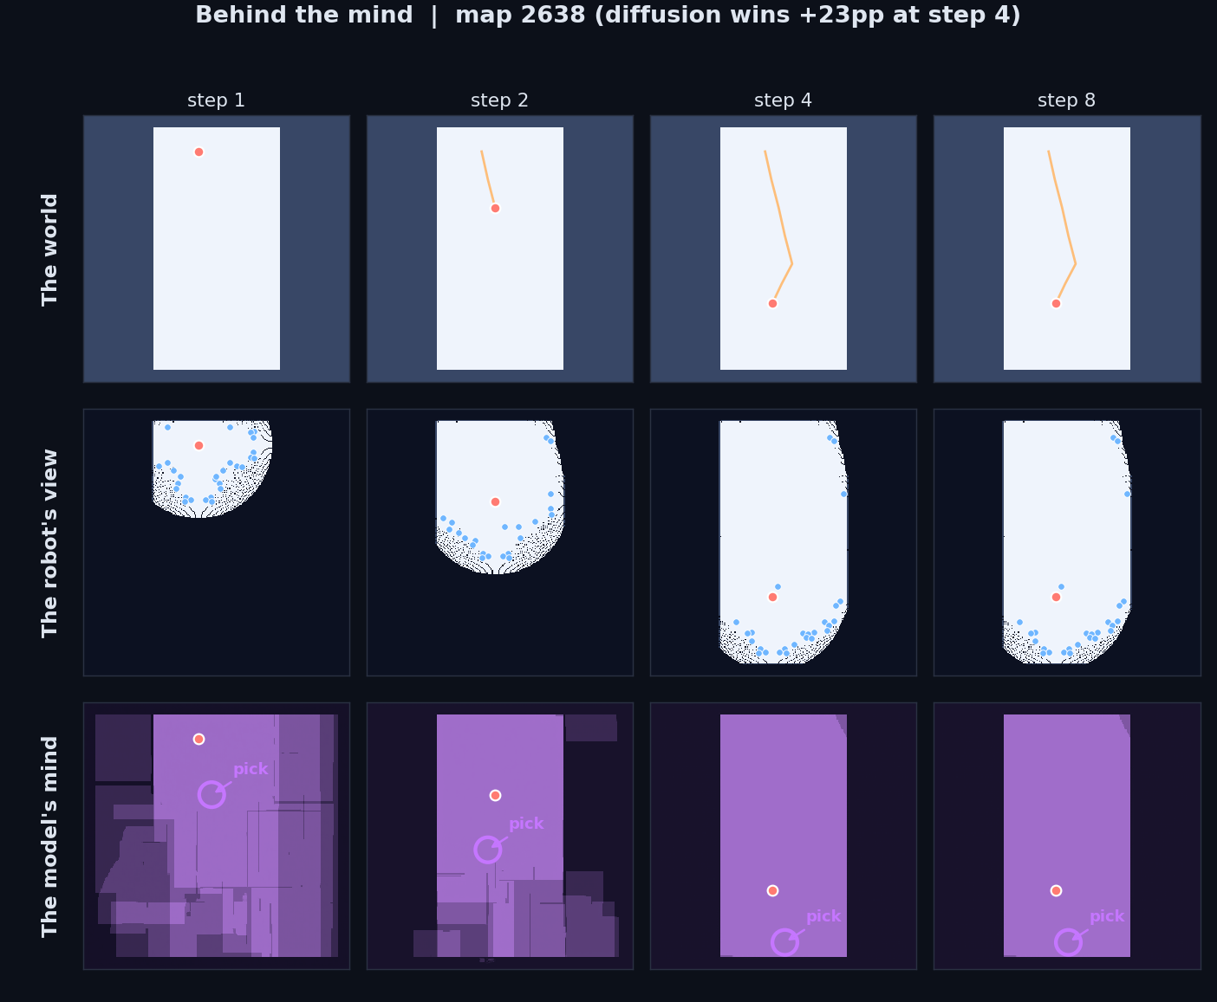
Project Goal + Hypothesis
The problem
• Robot dropped at the door of an unknown building, only 2D lidar.
• Input: partial occupancy grid. Output: next frontier to drive to.
• Classical scorer is memoryless — throws away building structure.
Hypothesis
A learned generative prior helps only when (1) training distribution matches deployment, (2) the step budget is tight, and (3) inference is fast enough to drive.
2 / 10

Slide 3
Approach — End-to-End Pipeline
01
02
03
04
Data
Model
Scoring
Integration
HouseExpo: 35k floor plans → 2.66M (partial, hidden) pairs after augmentation.
Conditional U-Net, 4.16M params. DDPM, MSE on noise. 29 epochs on T4 GPU.
K=8 DDIM completions. score = E[gain] + λ·Std[gain] − β·dist.
ROS 2 node publishes /best_frontier. Stage maze via pre-computed waypoints.
3 / 10

Slide 4
DEMO — the loop running
Partial map (with frontiers) → diffusion's prediction → ground truth (robot doesn't see) → coverage growing.
4 / 10

Slide 5
DEMO — diffusion vs baseline, same map
Top: diffusion-guided. Bottom: heuristic baseline. Same map, same start. Diffusion commits to the unseen wing one or two steps earlier.
5 / 10

Slide 6
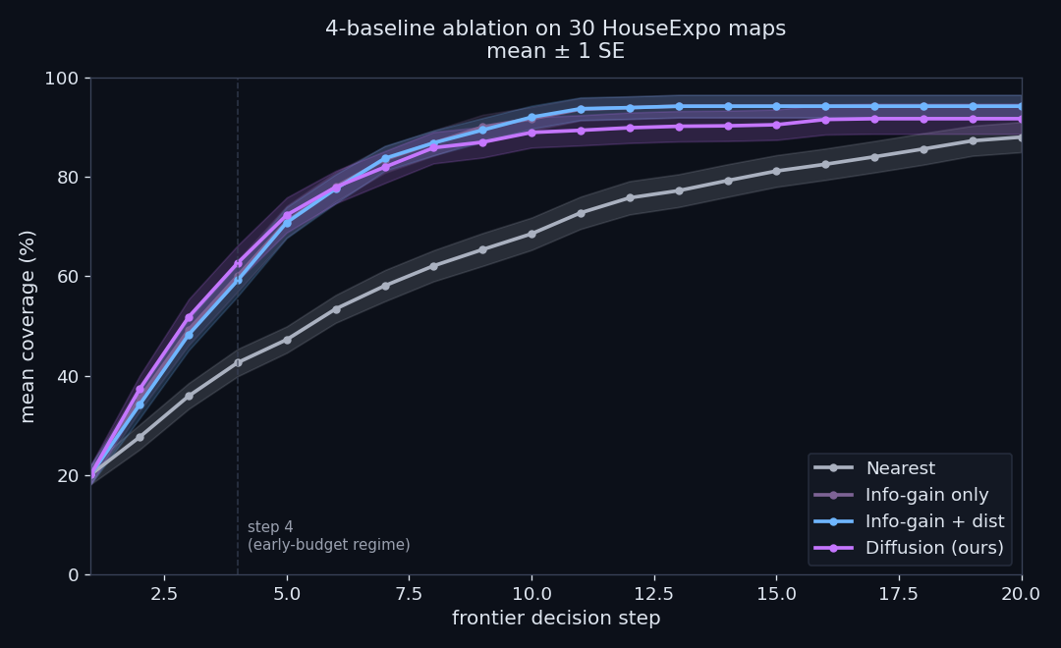
Results — where do the wins come from?
+3.5pp
Diffusion vs heuristic at step 4. The learned prior on top.
+17.5pp
Info-gain vs nearest. Info-gain is doing most of the work.
~0pp
Distance term contribution. Decorative on HouseExpo.
6 / 10

Slide 7
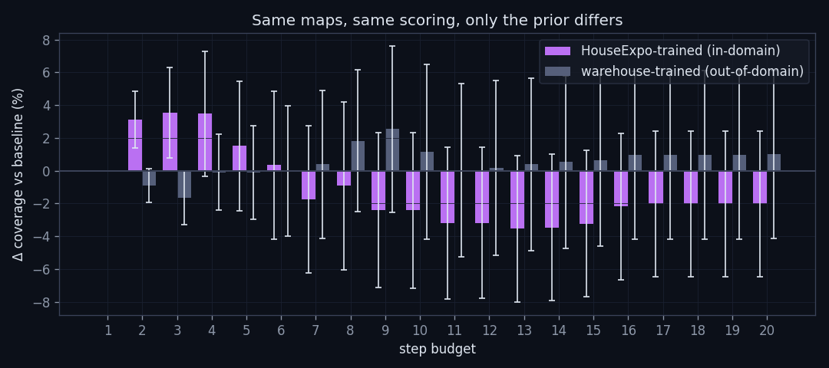
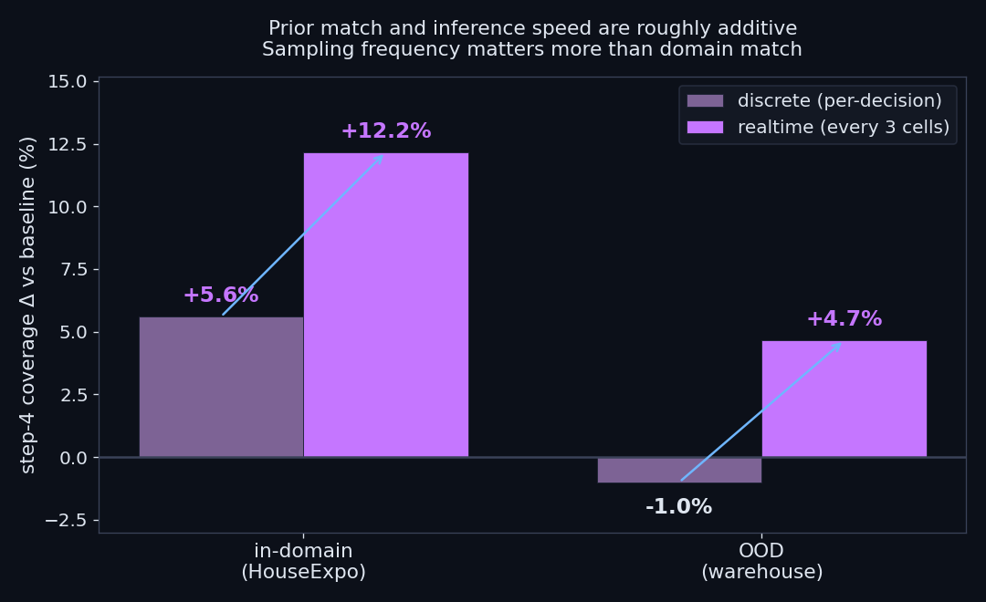
When it fails + what realtime would buy
OOD kill. Warehouse-trained model on residential maps: advantage drops from +3.5pp to −0.1pp. The prior is doing real structural work, not averaging.
Realtime upper bound. K=4 / DDIM=10 = ~500 ms on T4. Sampling every 3 cells lifts advantage to +10.0pp. Distillation is the path.
7 / 10

Slide 8
Hardships + Honest limits
• Docker QEMU on Apple Silicon too slow for live diffusion in Stage — pre-computed waypoints instead.
• Asymptotic catch-up — baseline catches up by step 20.
• 2 / 30 hard failures — K-sample disagreement could flag these.
• Live hardware deployment blocked by latency on Apple Silicon emulation.
• Mismatched priors give zero help — the OOD ablation confirms this.
8 / 10

Slide 9
What's Next
• Distillation of the U-Net to Jetson for sub-second inference on a real robot.
• Richer training domains — Gibson, Matterport, BIM — for cross-environment generalisation.
• K-sample disagreement as an "I don't know" flag — fall back to heuristic on hard maps.
• Live ROSbot deployment in a matched-distribution building.
9 / 10

Slide 10
Thanks for your attention.
Questions?
Moin Mattar · COSC 81/281 · June 1, 2026
AI helped me in formatting and writing (HTML/CSS/LaTeX), as well as explained concepts.
10 / 10

