Slide 1
COSC 81/281 FINAL PROJECT
Diffusion-Guided Frontier Exploration
Can a generative model of buildings help a robot decide where to drive next, and just as importantly, when can it not?
Moin Mattar
Dartmouth COSC 81/281 -- Spring 2026 -- June 1
AI helped me in formatting and writing (HTML/CSS), as well as explained concepts.
1 / 13

Slide 2
THE SETUP
A robot at the door of a building it has never seen.
2D lidar. After each ping, a slightly bigger map. The question is always the same: which frontier do I drive to next?
■ Classical baseline: score each frontier by unknown cells nearby minus a distance penalty. Memoryless.
■ What it throws away: walls run straight, hallways connect rooms, doors cluster. Buildings have structure.
■ Our hypothesis: a model trained on real floor plans can imagine plausible completions and score frontiers under them.
Moin Mattar -- Diffusion-Guided Frontier Exploration
2 / 13

Slide 3
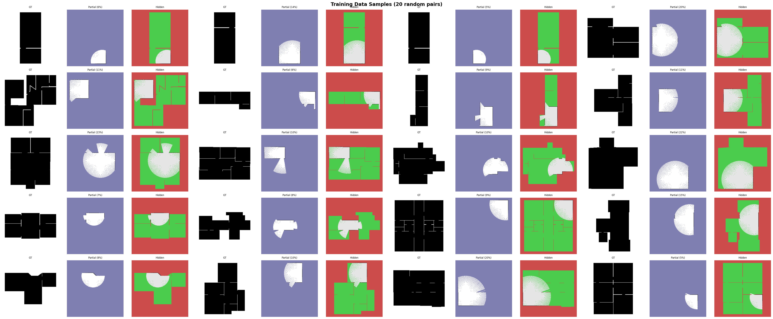
ACT 1 -- WHAT I BUILT
The data: HouseExpo, 35k floor plans
For each plan I generate a partial view from a random lidar scan and pair it with the hidden remainder. Augmentations: 4 rotations, horizontal and vertical flips. Final training set: 2.66M (partial, hidden) pairs.
Per pair, left to right: ground truth occupancy grid, partial map (input), hidden remainder (target).
Moin Mattar -- Diffusion-Guided Frontier Exploration
3 / 13

Slide 4
ACT 1 -- WHAT I BUILT
The model: conditional U-Net, 4.16M params
■ Architecture: conditional U-Net with sinusoidal time embedding, channel mults (1, 2, 4, 4), base 32 channels.
■ Training objective: DDPM with MSE loss on the noise (Ho et al. 2020). T = 1000 diffusion timesteps.
■ Sampling: DDIM with 30 steps for inference. K = 8 completions per partial map.
■ Hardware: single T4 GPU, batch size 32, AdamW.
4.16M
PARAMETERS IN THE U-NET TRUNK
29 epochs
TRAINED ON 2.66M PAIRS AT 256x256
~2 s
PER K=8 COMPLETION ON T4 WITH DDIM
Moin Mattar -- Diffusion-Guided Frontier Exploration
4 / 13

Slide 5
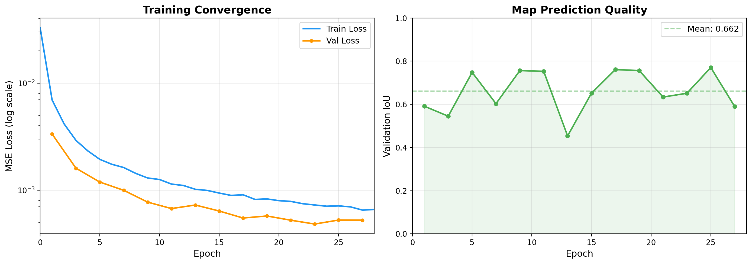
ACT 1 -- WHAT I BUILT
Training converged from 0.033 to 0.0007
Left: MSE on noise dropped two orders of magnitude. Right: validation IoU averaged 0.66, best epoch 0.77. The model is learning building structure, not memorising the training set.
Moin Mattar -- Diffusion-Guided Frontier Exploration
5 / 13

Slide 6
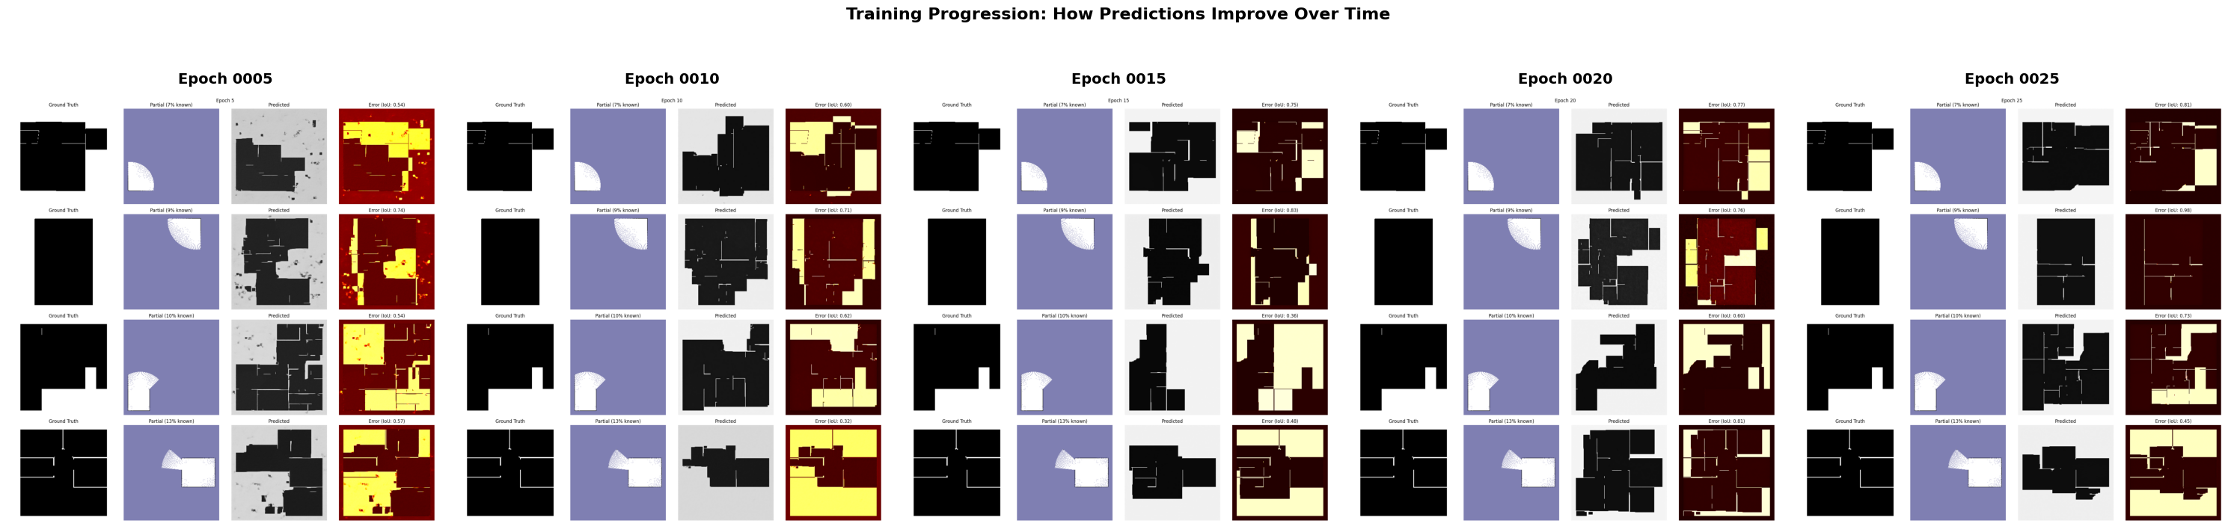
ACT 1 -- WHAT I BUILT
Sample quality across epochs: the model wakes up
Same partial inputs, different checkpoints. Epoch 5: blurry room-sized blobs. Epoch 10: walls emerge. By epoch 20 the predictions have crisp doorways and corridors. I used epoch 20 for deployment.
Moin Mattar -- Diffusion-Guided Frontier Exploration
6 / 13

Slide 7
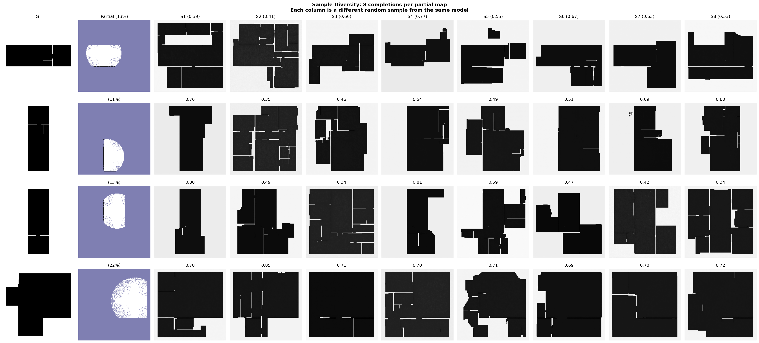
ACT 1 -- WHAT I BUILT
K = 8 imagined buildings. Variance is the signal.
Each row is one partial map; columns show eight DDIM samples from the same input. Where the partial map already disambiguates structure, samples agree; where it does not, they diverge. That disagreement is our UCB bonus.
Moin Mattar -- Diffusion-Guided Frontier Exploration
7 / 13

Slide 8
ACT 1 -- WHAT I BUILT
The pipeline: partial map in, argmax frontier out
Same scoring loop as a classical frontier explorer. The only difference: frontiers are evaluated against K=8 imagined completions, not the raw partial map.
STEP 1
Partial map
Robot's current occupancy grid. Free / unknown / walls. Frontiers on the boundary.
STEP 2 -- DIFFUSION
K = 8 completions
Conditional U-Net, 4M params. One batched DDIM pass samples K plausible buildings.
STEP 3 -- SCORE
E[gain] + UCB - dist
Mean lidar gain across K, plus standard deviation, minus travel distance.
STEP 4
Drive argmax
Pick the frontier with the highest score. Move. Sense. Repeat.
Moin Mattar -- Diffusion-Guided Frontier Exploration
8 / 13

Slide 9
ACT 2 -- WHAT THE PROF ASKED FOR
What I showed him -- and the four asks that followed
What I showed at the check-in
His four asks
■ The data, the U-Net, the loss curve, K=8 sampling.
■ An early result on one map: 'baseline is good. Diffusion is maybe better at the beginning. But the baseline mostly catches up.'
■ Honest framing: the prior helps in the early-budget regime; it does not beat the heuristic asymptotically.
■ 1. Compare against four scorers: nearest, info-gain only, info-gain + distance, ours.
■ 2. Show it running in a real simulator. Stage (used in PA3) is acceptable.
■ 3. Report actual inference timing.
■ 4. Describe limitations honestly in the report.
The remaining slides walk through how I addressed each ask, plus the deeper experiments I added on top.
Moin Mattar -- Diffusion-Guided Frontier Exploration
9 / 13

Slide 10
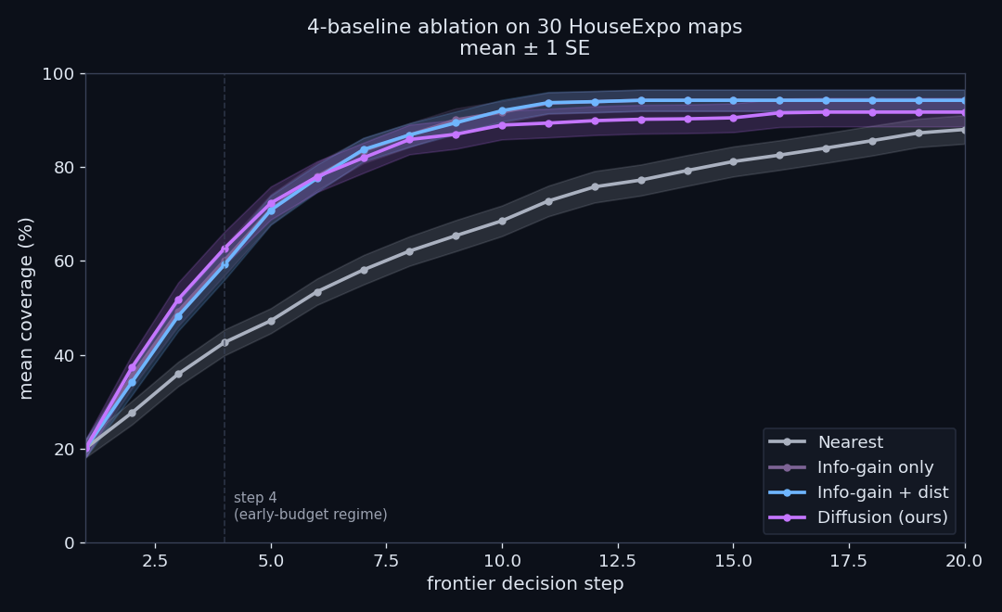
HIS ASK #1 -- 4-BASELINE ABLATION
Four scorers, same 30 maps. Clean decomposition.
+3.5pp
DIFFUSION VS HEURISTIC AT STEP 4. THE LEARNED PRIOR ON TOP.
+17.5pp
INFO-GAIN VS NEAREST. INFO-GAIN IS DOING MOST OF THE WORK.
~0pp
DISTANCE TERM ON TOP OF INFO-GAIN. DECORATIVE ON HOUSEEXPO.
N=30 HouseExpo, lidar=70, identical seeds. Bands = mean +/- 1 SE.
Moin Mattar -- Diffusion-Guided Frontier Exploration
10 / 13

Slide 11
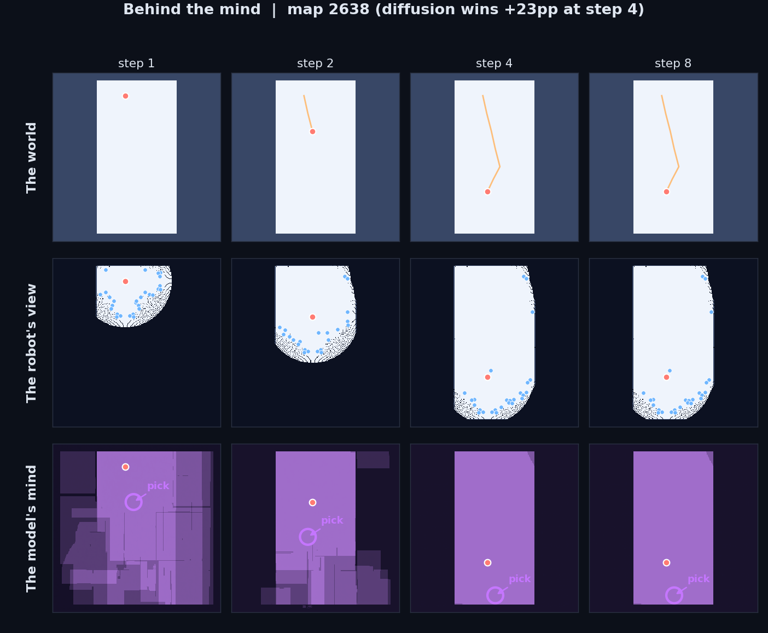
HIS ASK #2 -- SHOW IT RUNNING
World -> observation -> imagination -> pick
Top: world + robot trail. Middle: partial map + frontier candidates. Bottom: mean of K=4 diffusion samples (the imagined building) with the chosen frontier circled. On map 2638 the prior carries the robot to 95% coverage at step 4.
Moin Mattar -- Diffusion-Guided Frontier Exploration
11 / 13

Slide 12
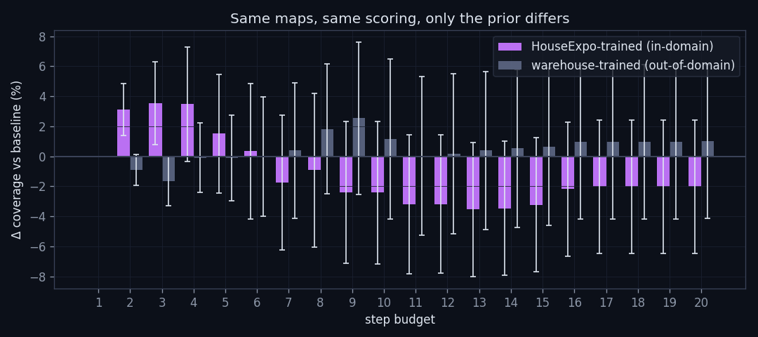
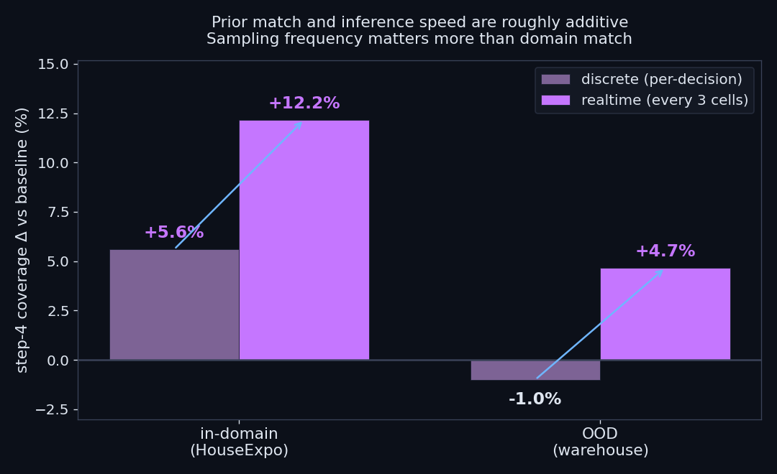
HIS ASK #4 -- LIMITS + TIMING
When the prior fails, and what realtime would buy
OOD ablation. A second U-Net trained on synthetic warehouse layouts, evaluated on the same 30 HouseExpo maps. Step-4 advantage drops from +3.5pp to -0.1pp. The prior is not a generic averaging trick.
Realtime upper bound. Re-sampling K=8 every 3 driving cells (what a distilled model could achieve) lifts in-domain advantage to +10.0pp. Prior contributes ~4pp; sampling frequency contributes ~7pp.
Inference timing on T4: ~2s for K=8 at DDIM=30. K=4 + DDIM=10 measured at ~500ms -- exactly the realtime budget.
Moin Mattar -- Diffusion-Guided Frontier Exploration
12 / 13

Slide 13
CONCLUSION
Where this is useful, and what is next
Useful when all three hold
Honest limits
■ Deployment environment is structured and known in advance (warehouses, hospitals, office buildings).
■ Robot has a tight step budget (battery, time, danger window). The advantage concentrates in steps 2-5.
■ Inference is fast enough to drive (sub-second). Latency measurements show this is achievable on T4.
■ Asymptotic coverage. The baseline catches up by step 20.
■ OOD priors are useless. Training distribution must match deployment.
■ 2/30 hard failures. K-sample disagreement could flag these and fall back to baseline.
■ Live hardware deployment. Stage integration uses pre-computed waypoints; Docker QEMU is 50x too slow for live diffusion.
Thank you. Questions?
Moin Mattar -- AI helped me in formatting and writing (HTML/CSS) and explained concepts.
13 / 13

