Slide 1


Introduction
My name is Mo Sahil (Reg. No. 12216811). This project is part of the Summer PEP evaluation conducted by Lovely Professional University in collaboration with Hitbullseye. The program consisted of 84 hours focused on competitive programming, aimed at enhancing problem-solving skills and algorithmic thinking.

Slide 2


Certificate

Slide 3

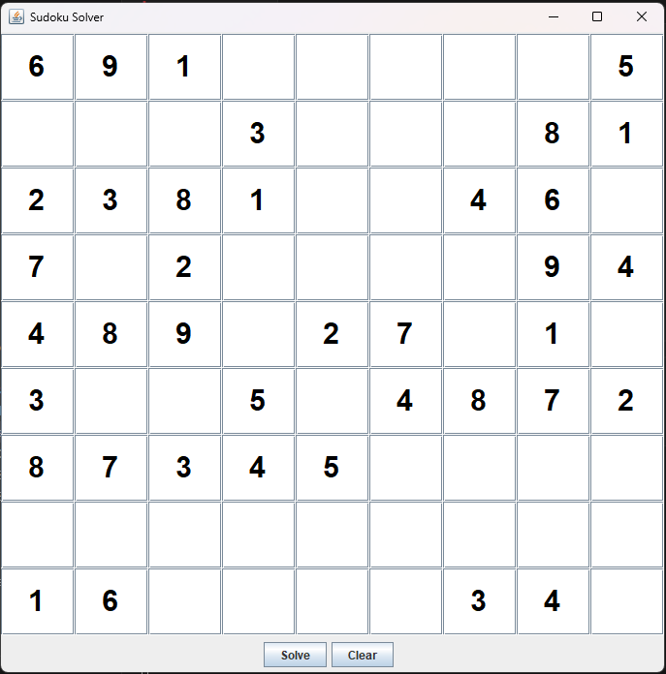
Sudoku Solver: A Java Swing Application
This Java application provides a user-friendly interface for solving Sudoku puzzles. It allows users to input a Sudoku puzzle, solve it, and clear the board. The application uses a backtracking algorithm to find a solution, and it visually updates the board as the algorithm progresses.

Slide 4
User Interface
Input Grid
Solve Button
Clear Button
The application features a 9x9 grid of text fields where users can input the Sudoku puzzle. Each cell represents a square on the Sudoku board. Users can enter numbers from 1 to 9 or leave a cell blank to indicate an unknown value.
The "Solve" button triggers the Sudoku solver algorithm. When clicked, the application attempts to find a solution for the input puzzle. The algorithm will visually update the board as it progresses, highlighting the cells that are being considered.
The "Clear" button resets the input grid to its initial state. This allows users to start a new puzzle or clear any mistakes they may have made during input.

Slide 5

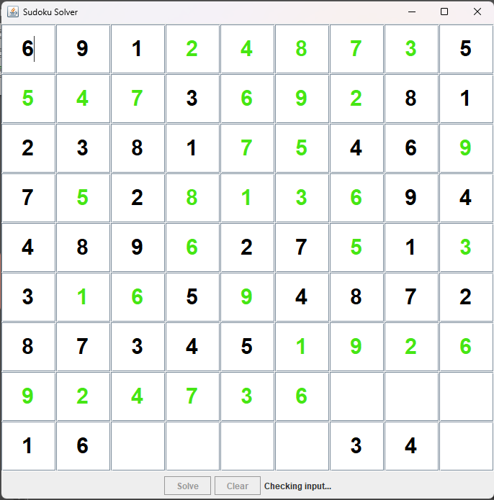
Sudoku Solver Algorithm
1
Input Validation
The algorithm first validates the user's input to ensure that it is a valid Sudoku puzzle. It checks if all numbers are within the range of 1 to 9 and if the initial configuration adheres to Sudoku rules.
2
Backtracking
The algorithm uses a backtracking approach to find a solution. It iterates through each empty cell and tries to fill it with a number from 1 to 9. If a number is valid (doesn't violate Sudoku rules), the algorithm recursively calls itself to try and solve the rest of the puzzle.
3
Solution Verification
If the algorithm successfully finds a solution, it updates the board with the solved values. If no solution is found, the algorithm returns false, indicating that the input puzzle is either invalid or has no solution.

Slide 6

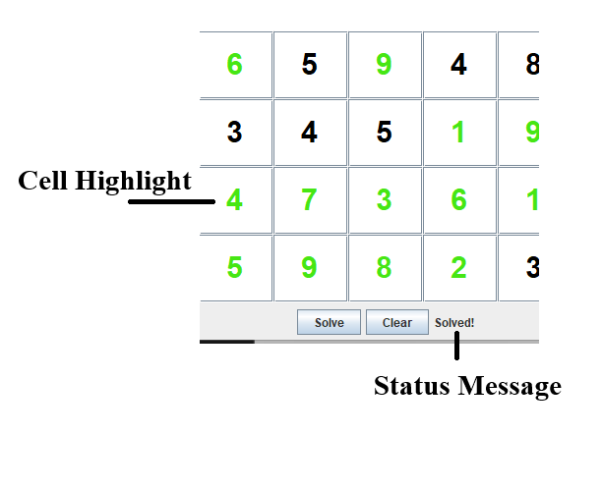
Visual Updates
1
Cell Highlighting
As the algorithm progresses, it highlights the cells that are being considered. This provides visual feedback to the user about the algorithm's progress and helps them understand how the solution is being found.
2
Color Coding
The application uses color coding to distinguish between the initial input values and the values that are filled in by the algorithm. This helps users easily identify the original puzzle and the solved values.
3
Status Message
A status message is displayed to inform the user about the algorithm's progress. The message indicates whether the input is valid, if a solution is found, or if an error occurred.

Slide 7

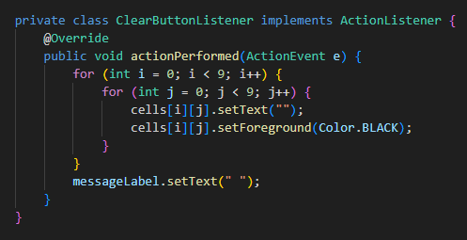
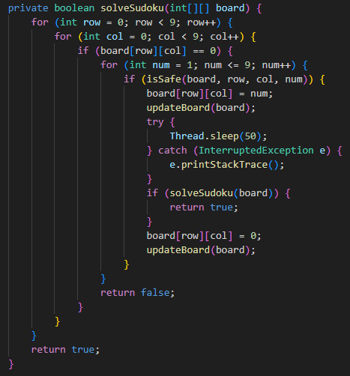
Code Structure
SudokuSolver Class
The main class of the application, responsible for creating the user interface, handling user interactions, and implementing the Sudoku solver algorithm.
SolveButtonListener Class
An inner class that implements the ActionListener interface. It handles the "Solve“ button click event, triggering the Sudoku solver algorithm and updating the user interface.
ClearButtonListener Class
An inner class that implements the ActionListener interface. It handles the "Clear" button click event, resetting the input grid to its initial state.

Slide 8

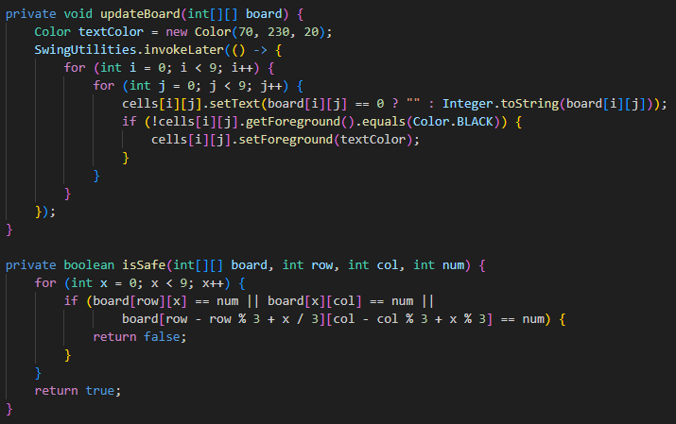



Key Methods
solveSudoku(int[][] board)
The recursive backtracking algorithm that attempts to find a solution for the input Sudoku puzzle. It iterates through each empty cell and tries to fill it with a valid number. If a valid number is found, it recursively calls itself to try and solve the rest of the puzzle.
isSafe(int[][] board, int row, int col, int num)
A helper method that checks if placing a given number in a specific cell is valid according to Sudoku rules. It checks if the number already exists in the same row, column, or 3x3 subgrid.
isValidSudoku(int[][] board)
A method that validates the user's input to ensure that it is a valid Sudoku puzzle. It checks if all numbers are within the range of 1 to 9 and if the initial configuration adheres to Sudoku rules.

Slide 9


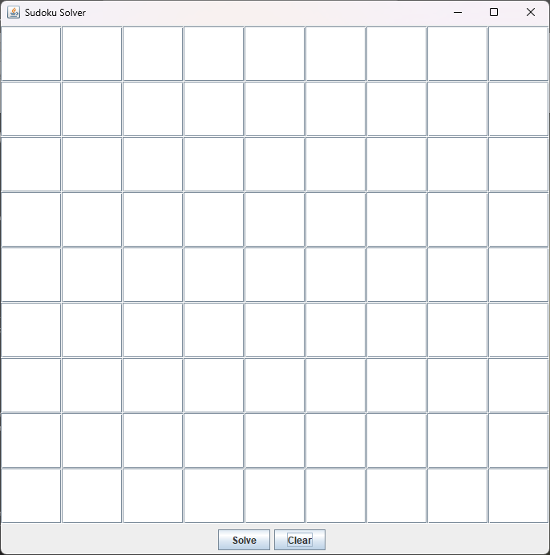



Swing Utilities
GridLayout
The GridLayout manager is used to arrange the input grid cells in a 9x9 grid layout. It ensures that all cells have equal size and spacing.
JButton
JButton components are used to create the "Solve" and "Clear" buttons. These buttons trigger specific actions when clicked, such as starting the solver algorithm or resetting the input grid.
JTextField
JTextField components are used to create the input cells for the Sudoku puzzle. Users can enter numbers into these fields, and the application can read and update their values.
JLabel
JLabel components are used to display status messages and other information to the user. The status message is updated to reflect the progress of the Sudoku solver algorithm.

Slide 10

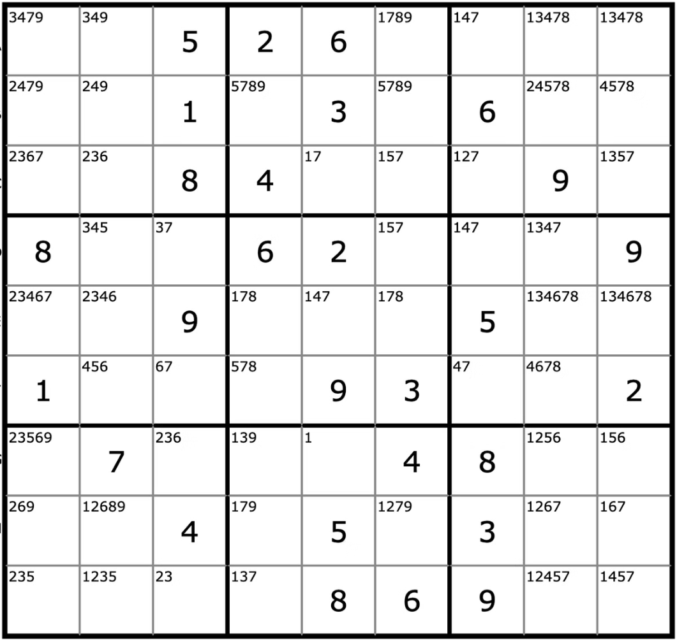
Future Enhancements
1
Pencil Marks
Implement support for pencil marks, allowing users to enter potential candidates for each cell. This can be helpful for solving more challenging Sudoku puzzles.
2
Difficulty Levels
Allow users to select different difficulty levels for the Sudoku puzzles. This can be achieved by generating puzzles with varying numbers of pre-filled cells.
3
Puzzle Generation
Add functionality to generate new Sudoku puzzles. This can be done using algorithms that create valid Sudoku puzzles with different difficulty levels.

Slide 11

Conclusion
This Java Swing application provides a user-friendly and efficient way to solve Sudoku puzzles. It features a visually appealing interface, a robust Sudoku solver algorithm, and clear feedback to the user. The application can be further enhanced by adding features such as pencil marks, difficulty levels, and puzzle generation.

