Slide 1
7-1 INTRODUCTION
The Internet Protocol (IP) is the transmission mechanism used by the TCP/IP protocols at the network layer.
TCP/IP Protocol Suite

Slide 2
Topics Discussed in the Section
Relationship of IP to the rest of the TCP/IP Suite
TCP/IP Protocol Suite

Slide 3
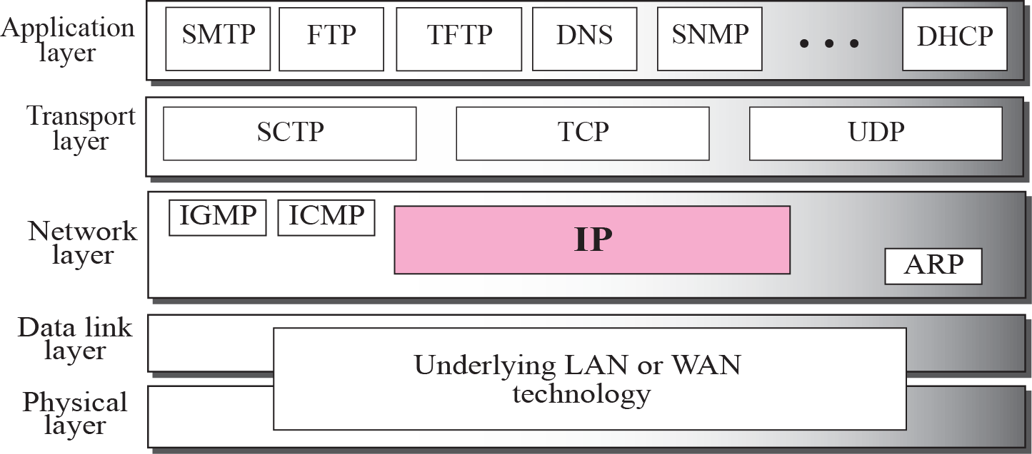
Figure 7.1 Position of IP in TCP/IP protocol suite
TCP/IP Protocol Suite

Slide 4
7-2 DATAGRAMS
Packets in the network (internet) layer are called datagrams. A datagram is a variable-length packet consisting of two parts: header and data. The header is 20 to 60 bytes in length and contains information essential to routing and delivery. It is customary in TCP/IP to show the header in 4-byte sections. A brief description of each field is in order.
TCP/IP Protocol Suite

Slide 5
Topics Discussed in the Section
Format of the datagram packet
Some examples
TCP/IP Protocol Suite

Slide 6
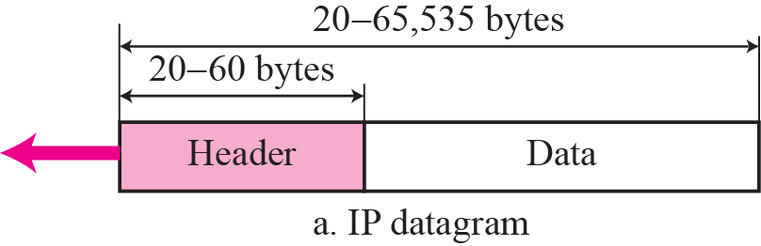
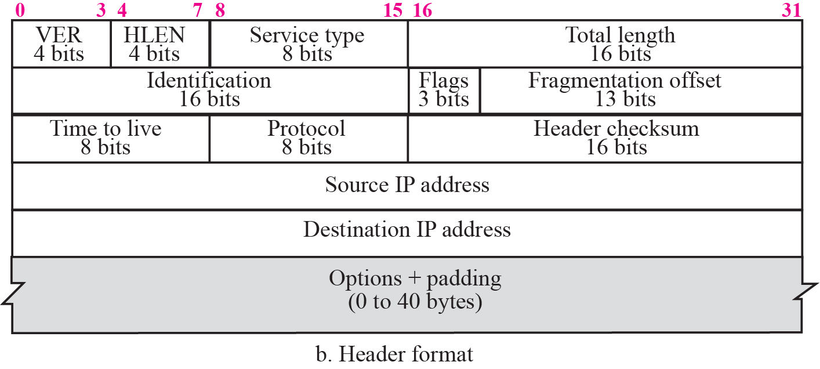
Figure 7.2 IP datagram
TCP/IP Protocol Suite

Slide 7

Figure 20.6 Service type or differentiated services
20.<number>

Slide 8

Table 20.1 Types of service
20.<number>

Slide 9

Note
The total length field defines the total length of the datagram including the header.
TCP/IP Protocol Suite

Slide 10

Figure 7.4 Encapsulation of a small datagram in an Ethernet frame
TCP/IP Protocol Suite

Slide 11
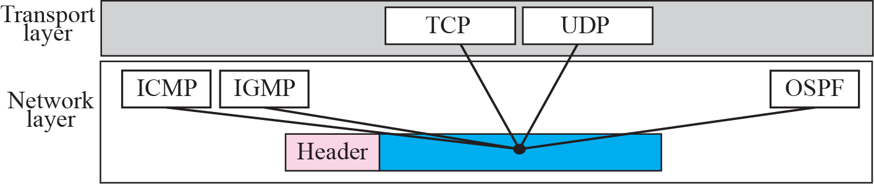
Figure 7.5 Multiplexing
TCP/IP Protocol Suite

Slide 12
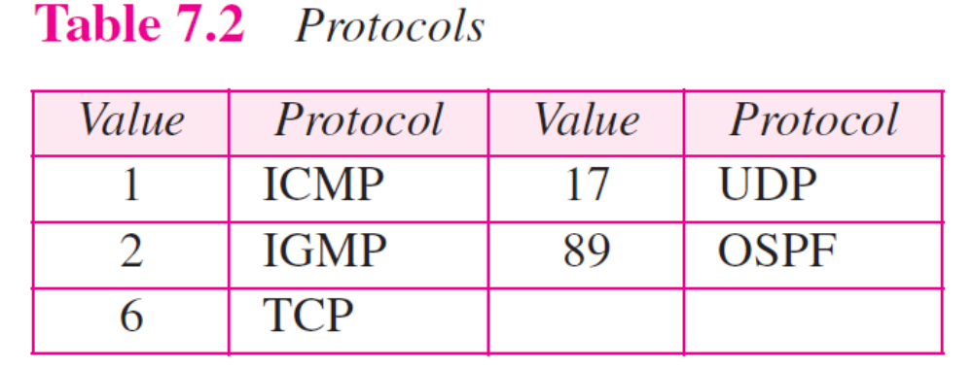
TCP/IP Protocol Suite

Slide 13

Example 7.1
An IP packet has arrived with the first 8 bits as shown:
The receiver discards the packet. Why?
TCP/IP Protocol Suite

Slide 14
Example 7.1
An IP packet has arrived with the first 8 bits as shown:
The receiver discards the packet. Why?
Solution
There is an error in this packet. The 4 left-most bits (0100) show the version, which is correct. The next 4 bits (0010) show the wrong header length (2 × 4 = 8). The minimum number of bytes in the header must be 20. The packet has been corrupted in transmission.
TCP/IP Protocol Suite

Slide 15
Example 7.2
In an IP packet, the value of HLEN is 1000 in binary. How many bytes of options are being carried by this packet?
TCP/IP Protocol Suite

Slide 16
Example 7.2
In an IP packet, the value of HLEN is 1000 in binary. How many bytes of options are being carried by this packet?
Solution
The HLEN value is 8, which means the total number of bytes in the header is 8 × 4 or 32 bytes. The first 20 bytes are the base header, the next 12 bytes are the options.
TCP/IP Protocol Suite

Slide 17
Example 7.3
In an IP packet, the value of HLEN is 5₁₆ and the value of the total length field is 0028₁₆. How many bytes of data are being carried by this packet?
Solution
The HLEN value is 5, which means the total number of bytes in the header is 5 × 4 or 20 bytes (no options). The total length is 40 bytes, which means the packet is carrying 20 bytes of data (40 − 20).
TCP/IP Protocol Suite

Slide 18
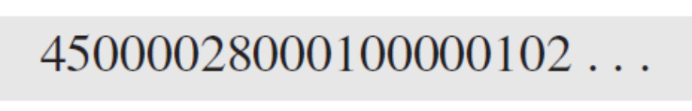
Example 7.4
An IP packet has arrived with the first few hexadecimal digits as shown below:
How many hops can this packet travel before being dropped? The data belong to what upper layer protocol?
Solution
To find the time-to-live field, we skip 8 bytes (16 hexadecimal digits). The time-to-live field is the ninth byte, which is 01. This means the packet can travel only one hop. The protocol field is the next byte (02), which means that the upper layer protocol is IGMP (see Table 7.2)
TCP/IP Protocol Suite

Slide 19
7-3 FRAGMENTATION
A datagram can travel through different networks. Each router decapsulates the IP datagram from the frame it receives, processes it, and then encapsulates it in another frame. The format and size of the received frame depend on the protocol used by the physical network through which the frame has just traveled. The format and size of the sent frame depend on the protocol used by the physical network through which the frame is going to travel.
TCP/IP Protocol Suite

Slide 20
Topics Discussed in the Section
Maximum Transfer Unit (MTU)
Fields Related to Fragmentation
TCP/IP Protocol Suite

Slide 21

Figure 7.6 MTU
TCP/IP Protocol Suite

Slide 22

Table 20.5 MTUs for some networks
20.<number>

Slide 23
Note
Only data in a datagram is fragmented.
TCP/IP Protocol Suite

Slide 24

Figure 7.7 Flags field
TCP/IP Protocol Suite

Slide 25
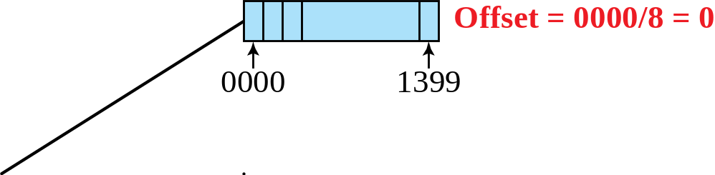
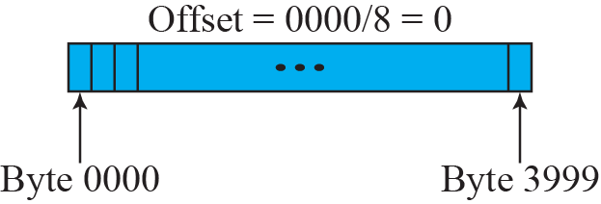
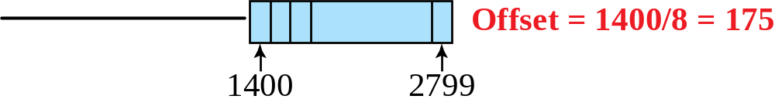
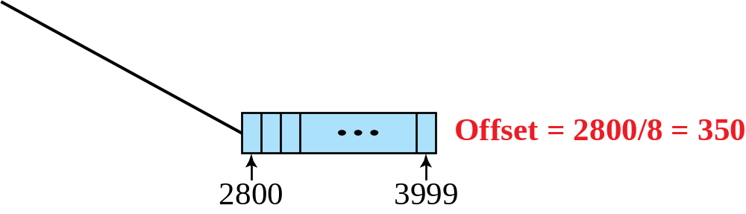
Figure 7.8 Fragmentation example
TCP/IP Protocol Suite

Slide 26
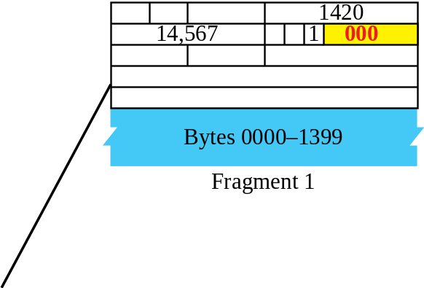
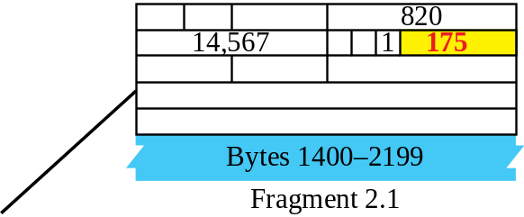
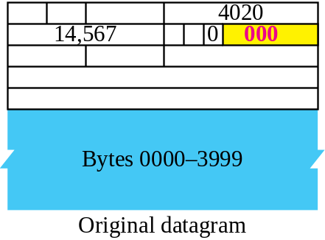
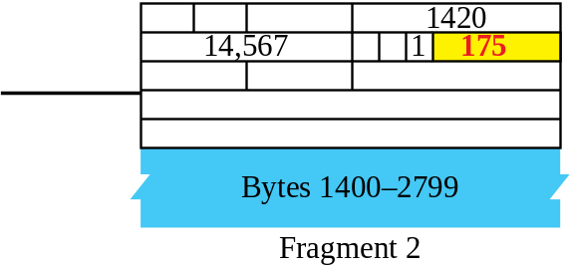
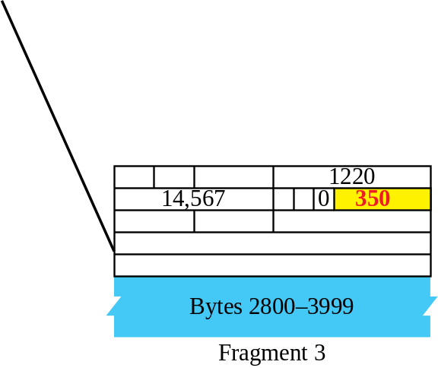
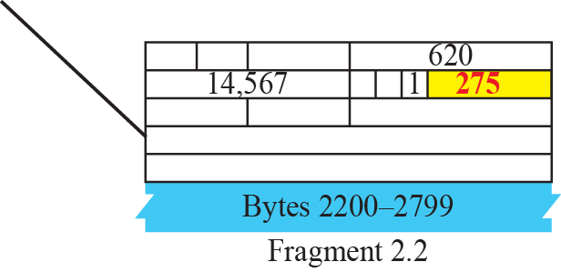
Figure 7.9 Detailed fragmentation example
TCP/IP Protocol Suite

Slide 27
Example 7.5
A packet has arrived with an M bit value of 0. Is this the first fragment, the last fragment, or a middle fragment? Do we know if the packet was fragmented?
Solution
If the M bit is 0, it means that there are no more fragments; the fragment is the last one. However, we cannot say if the original packet was fragmented or not. A nonfragmented packet is considered the last fragment.
TCP/IP Protocol Suite

Slide 28
Example 7.6
A packet has arrived with an M bit value of 1. Is this the first fragment, the last fragment, or a middle fragment? Do we know if the packet was fragmented?
Solution
If the M bit is 1, it means that there is at least one more fragment. This fragment can be the first one or a middle one, but not the last one. We don’t know if it is the first one or a middle one; we need more information (the value of the fragmentation offset). See also the next example.
TCP/IP Protocol Suite

Slide 29
Example 7.7
A packet has arrived with an M bit value of 1 and a fragmentation offset value of zero. Is this the first fragment, the last fragment, or a middle fragment?
Solution
Because the M bit is 1, it is either the first fragment or a middle one. Because the offset value is 0, it is the first fragment.
TCP/IP Protocol Suite

Slide 30
Example 7.8
A packet has arrived in which the offset value is 100. What is the number of the first byte? Do we know the number of the last byte?
Solution
To find the number of the first byte, we multiply the offset value by 8. This means that the first byte number is 800. We cannot determine the number of the last byte unless we know the length of the data.
TCP/IP Protocol Suite

Slide 31
Example 7.9
A packet has arrived in which the offset value is 100, the value of HLEN is 5 and the value of the total length field is 100. What is the number of the first byte and the last byte?
Solution
The first byte number is 100 × 8 = 800. The total length is 100 bytes and the header length is 20 bytes (5 × 4), which means that there are 80 bytes in this datagram. If the first byte number is 800, the last byte number must be 879.
TCP/IP Protocol Suite

Slide 32

Figure 20.13 Example of checksum calculation in IPv4
20.<number>

Slide 33
7-4 OPTIONS
The header of the IP datagram is made of two parts: a fixed part and a variable part. The fixed part is 20 bytes long and was discussed in the previous section. The variable part comprises the options, which can be a maximum of 40 bytes.
Options, as the name implies, are not required for a datagram. They can be used for network testing and debugging. Although options are not a required part of the IP header, option processing is required of the IP software.
TCP/IP Protocol Suite

Slide 34
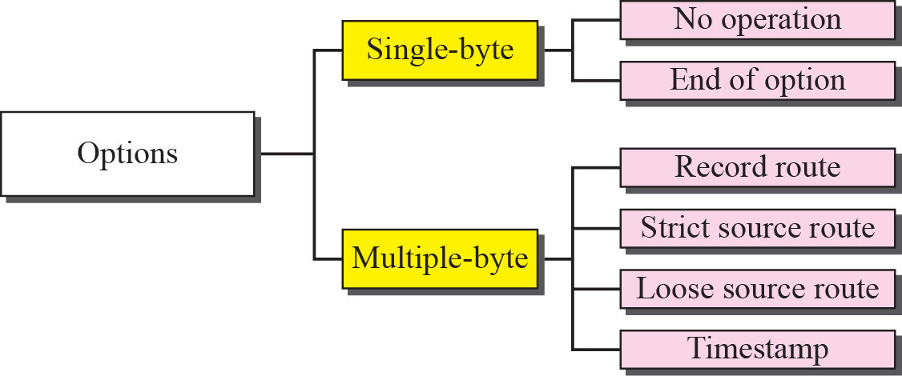
Figure 7.11 Categories of options
TCP/IP Protocol Suite

Slide 35
changes implemented in the protocol in addition to changing address size and format.
❑ Better header format. IPv6 uses a new header format in which options are separated from the base header and inserted, when needed, between the base header and the data. This simplifies and speeds up the routing process because most of the options do not need to be checked by routers.
❑ New options. IPv6 has new options to allow for additional functionalities.
❑ Allowance for extension. IPv6 is designed to allow the extension of the protocol if required by new technologies or applications.
TCP/IP Protocol Suite

Slide 36
❑ Support for resource allocation. In IPv6, the type-of-service field has been removed, but two new fields, traffic class and flow label, have been added to enable the source to request special handling of the packet. This mechanism can be used to support traffic such as real-time audio and video.
❑Support for more security. The encryption and authentication options in IPv6 provide confidentiality and integrity of the packet
TCP/IP Protocol Suite

Slide 37
27-2 PACKET FORMAT
The IPv6 packet is shown in Figure 27.1. Each packet is composed of a mandatory base header followed by the payload. The payload consists of two parts: optional extension headers and data from an upper layer. The base header occupies 40 bytes, whereas the extension headers and data from the upper layer contain up to 65,535 bytes of information.
TCP/IP Protocol Suite

Slide 38
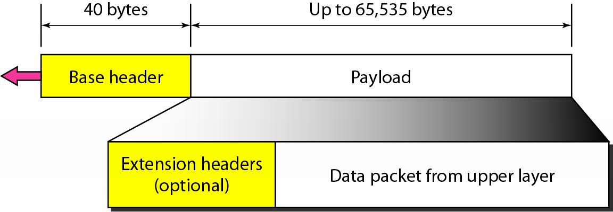
Figure 20.15 IPv6 datagram header and payload
20.<number>

Slide 39
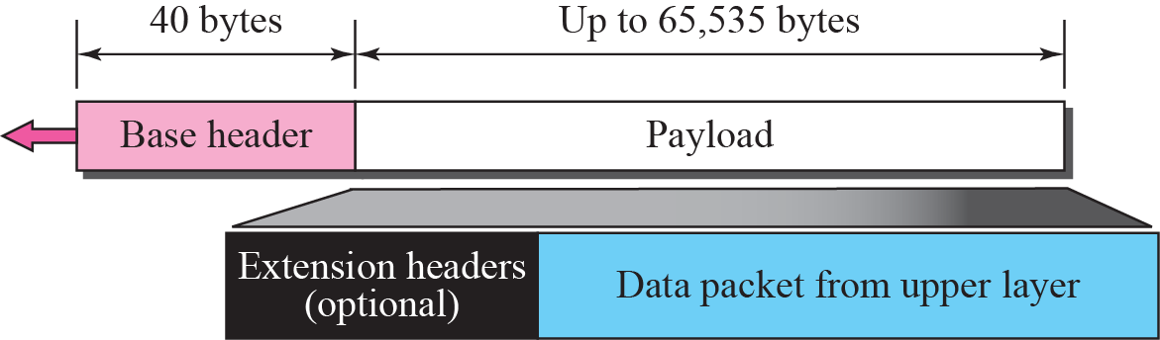
Figure 27.1 IPv6 datagram
TCP/IP Protocol Suite

Slide 40
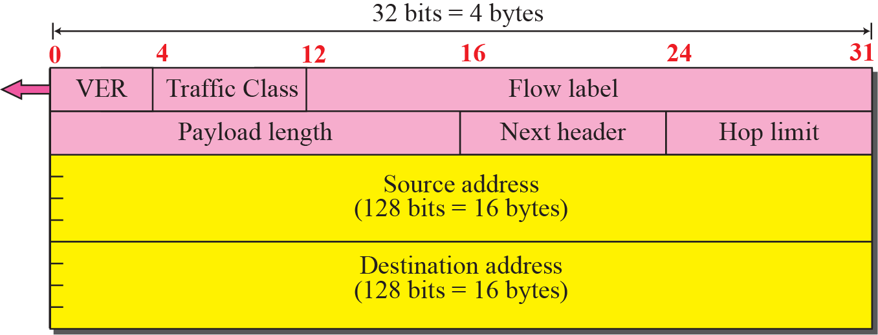
Figure 27.2 Format of the base header
TCP/IP Protocol Suite

Slide 41
Version. The 4-bit version field defines the version number of the IP. For IPv6, the value is 6.
❑ Traffic class. The 8-bit traffic class field is used to distinguish different payloads with different delivery requirements. It replaces the type-of-service field in IPv4.
❑ Flow label. The flow label is a 20-bit field that is designed to provide special han_x0002_dling for a particular flow of data. We will discuss this field later.
❑ Payload length. The 2-byte payload length field defines the length of the IP datagram excluding the header. Note that IPv4 defines two fields related to the length: header length and total length. In IPv6, the length of the base header is fixed (40 bytes); only the length of the payload needs to be defined..
TCP/IP Protocol Suite

Slide 42
❑ Next header. The next header is an 8-bit field defining the type of the first extension header (if present) or the type of the data that follows the base header in the datagram. This field is similar to the protocol field in IPv4, but we talk more about it when we discuss the payload
TCP/IP Protocol Suite

Slide 43
Hop limit. The 8-bit hop limit field serves the same purpose as the TTL field in IPv4.
❑ Source and destination addresses. The source address field is a 16-byte (128-bit) Internet address that identifies the original source of the datagram. The destination address field is a 16-byte (128-bit) Internet address that identifies the destination of the datagram.
❑ Payload. Compared to IPv4, the payload field in IPv6 has a different format
TCP/IP Protocol Suite

Slide 44
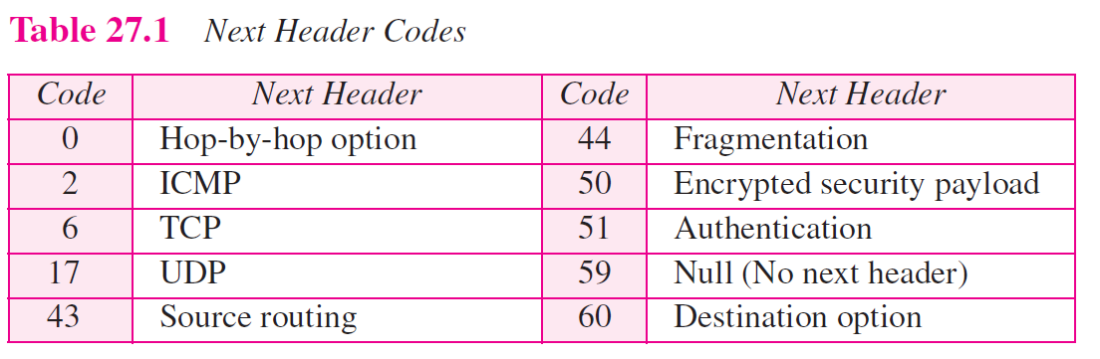
TCP/IP Protocol Suite

Slide 45
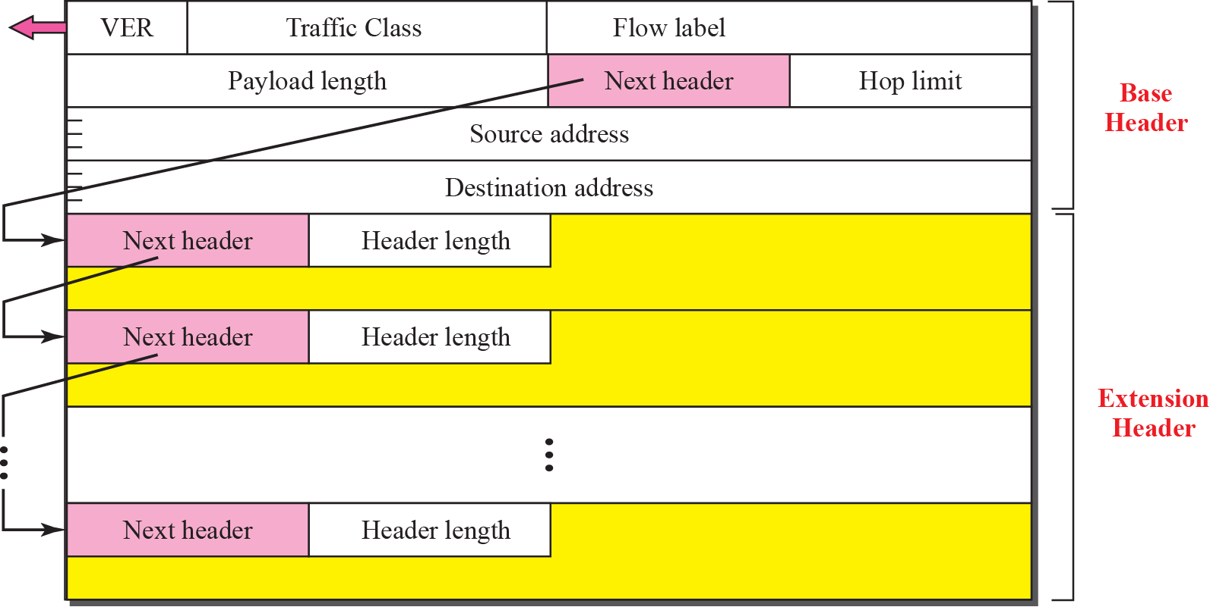
Figure 27.3 Extension header format
TCP/IP Protocol Suite

Slide 46
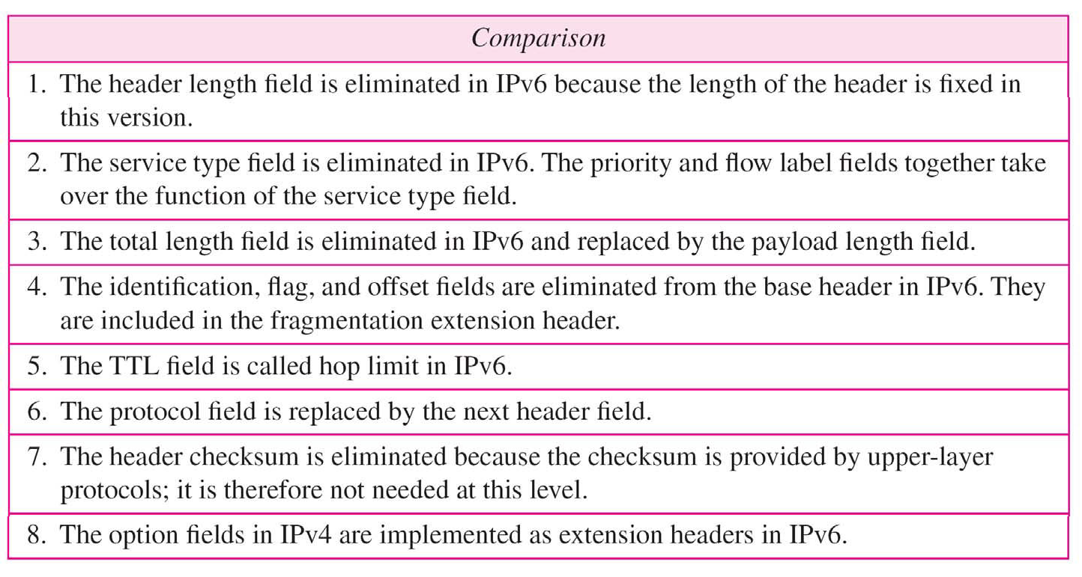
Table 20.9 Comparison between IPv4 and IPv6 packet headers
20.<number>

Slide 47

Figure 20.17 Extension header types
20.<number>

Slide 48
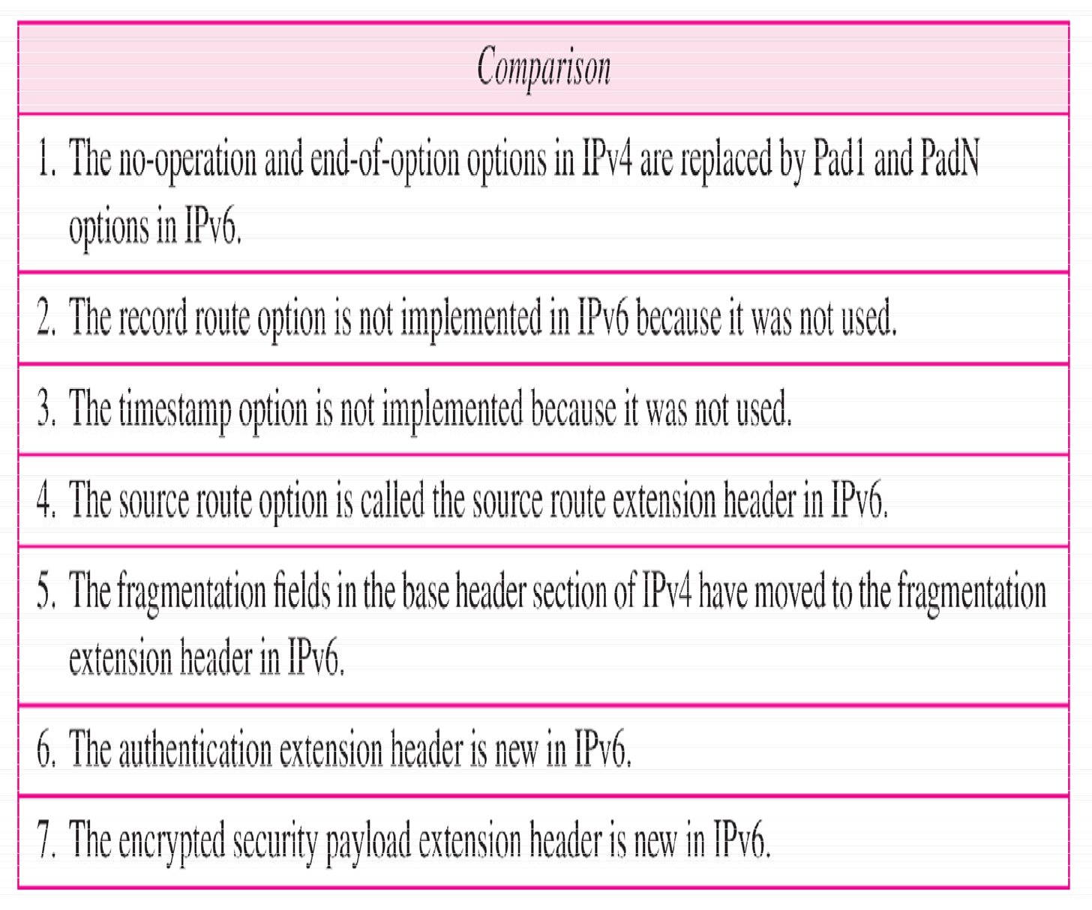
Table 20.10 Comparison between IPv4 options and IPv6 extension headers
20.<number>

Slide 49
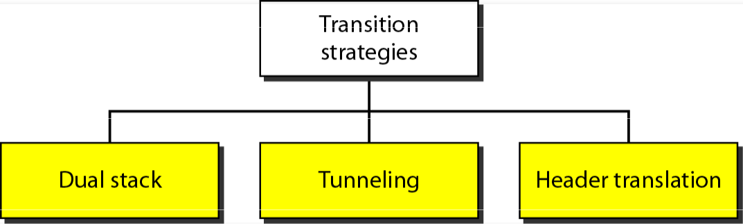
Transition from IPv4 to IPv6

Slide 50
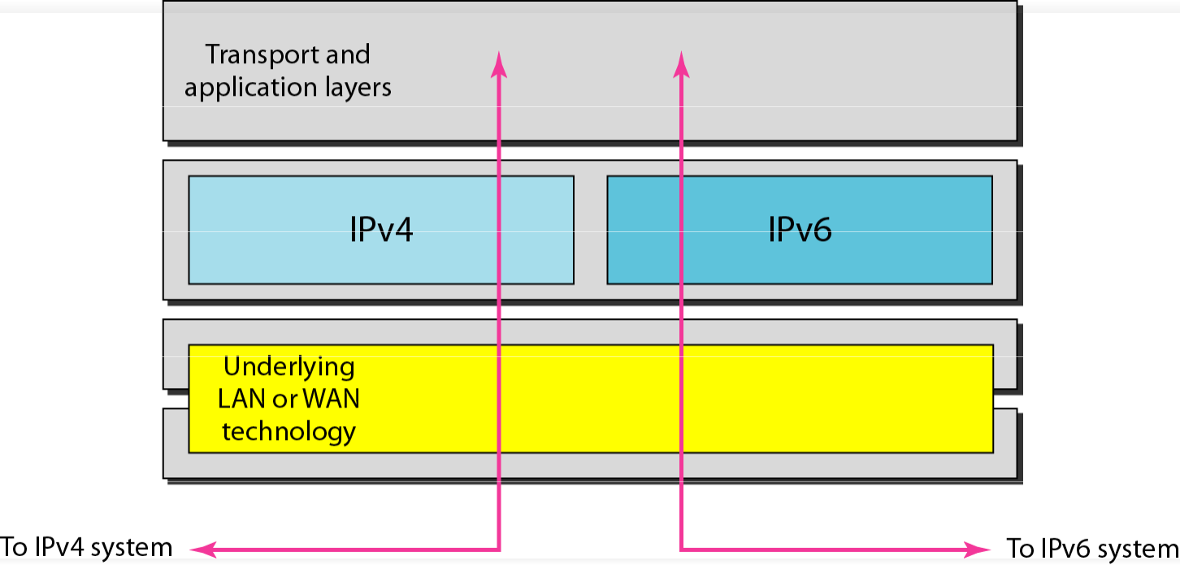
Figure 20.19 Dual stack
20.<number>

Slide 51
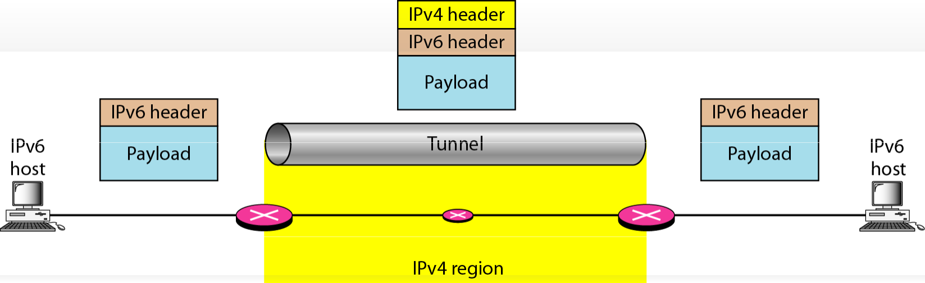
Figure 20.20 Tunneling strategy
20.50

Slide 52
