Slide 1
UNICAST ROUTING PROTOCOLS
A routing table can be either static or dynamic. A static table is one with manual entries. A dynamic table is one that is updated automatically when there is a change somewhere in the Internet. A routing protocol is a combination of rules and procedures that lets routers in the Internet inform each other of changes.
22.<number>

Slide 2

Figure 22.12 Autonomous systems
22.<number>

Slide 3
Autonomous system (AS) is a large network or group of networks that has a unified routing policy.
Imagine an AS as being like a town's post office. Mail goes from post office to post office until it reaches the right town, and that town's post office will then deliver the mail within that town. Similarly, data packets cross the Internet by hopping from AS to AS until they reach the AS that contains their destination Internet Protocol (IP) address. Routers within that AS send the packet to the IP address.

Slide 4
When it receives a packet, to which network should it pass the packet?
The decision is based on optimization: Which of the available pathways is the optimum pathway?
22.<number>

Slide 5
One approach is to assign a cost for passing through a network. We call this cost a metric.
However, the metric assigned to each network depends on the type of protocol.
Some simple protocols, such as the Routing Information Protocol (RIP), treat all networks as equals. The cost of passing through a network is the same; it is one hop count.
22.<number>

Slide 6
So if a packet passes through 10 networks to reach the destination, the total cost is 10 hop counts
Another method can be type of service
22.<number>

Slide 7

Figure 22.13 Popular routing protocols
22.<number>

Slide 8
Interdomain Routing is the protocol in which the routing algorithm works both within and between domains. Domains must be connected in some way, for hosts inside one domain to exchange data with hosts in other domains.
Intradomain Routing is the routing protocol that operates only within a domain. In other words, intradomain routing protocols are used to route packets within a specific domain, such as within an institutional network for e-mail or web browsing. Unlike interdomain routing protocols, it doesn't communicate with other domains.

Slide 9
In distance vector routing, the least-cost route between any two nodes is the route with minimum distance.
In this protocol, as the name implies, each node maintains a vector (table) of minimum distances to every node.
The table at each node also guides the packets to the desired node by showing the next stop in the route (next-hop routing).
22.<number>

Slide 10

Figure 22.15 Initialization of tables in distance vector routing
22.<number>

Slide 11

Note
In distance vector routing, each node shares its routing table with its
immediate neighbors periodically and when there is a change.
22.<number>

Slide 12

Figure 22.16 Updating in distance vector routing
22.<number>

Slide 13

Figure 22.14 Distance vector routing tables
22.<number>

Slide 14
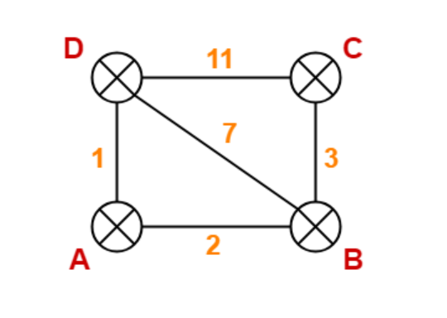

Slide 15
Destination | Distance | Next Hop
A | 0 | A
B | 2 | B
C | ∞ | –
D | 1 | D
Destination | Distance | Next Hop
A | 0 | A
B | 2 | B
C | ∞ | –
D | 1 | D
Destination | Distance | Next Hop
A | 0 | A
B | 2 | B
C | ∞ | –
D | 1 | D
Destination | Distance | Next Hop
A | 0 | A
B | 2 | B
C | ∞ | –
D | 1 | D

Slide 16
Destination | Distance | Next Hop
A | 0 | A
B | 2 | B
C | 5 | B
D | 1 | D
Destination | Distance | Next Hop
A | 0 | A
B | 2 | B
C | 5 | B
D | 1 | D
Destination | Distance | Next Hop
A | 5 | B
B | 3 | B
C | 0 | C
D | 10 | B
Destination | Distance | Next Hop
A | 1 | A
B | 3 | A
C | 10 | B
D | 0 | D

Slide 17
Destination | Distance | Next Hop
A | 0 | A
B | 2 | B
C | 5 | B
D | 1 | D
Destination | Distance | Next Hop
A | 2 | A
B | 0 | B
C | 3 | C
D | 3 | A
Destination | Distance | Next Hop
A | 5 | B
B | 3 | B
C | 0 | C
D | 6 | B
Destination | Distance | Next Hop
A | 1 | A
B | 3 | A
C | 6 | A
D | 0 | D

Slide 18
When does a node send its partial routing table (only two columns) to all its immediate neighbors?
Periodic Update: A node sends its routing table, normally every 30 s, in a periodic update. The period depends on the protocol that is using distance vector routing.
Triggered Update: A node sends its two-column routing table to its neighbors anytime there is a change in its routing table. This is called a triggered update.
The change can result from the following:
1. A node receives a table from a neighbor, resulting in changes in its own table after updating.
2. A node detects some failure in the neighboring links which results in a distance change to infinity.

Slide 19
Count to Infinity
A problem with distance-vector routing is that any decrease in cost (good news) propa_x0002_gates quickly, but any increase in cost (bad news) will propagate slowly.
For a routing protocol to work properly, if a link is broken (cost becomes infinity), every other router should be aware of it immediately, but in distance-vector routing, this takes some time. The problem is referred to as count to infinity. It sometimes takes several updates before the cost for a broken link is recorded as infinity by all routers.

Slide 20

Figure 22.17 Two-node instability
22.<number>

Slide 21
Defining Infinity
The first obvious solution is to redefine infinity to a smaller number, such as 100.
For our previous scenario, the system will be stable in less than 20 updates. As a matter of fact, most implementations of the distance vector protocol define the distance between each node to be I and define 16 as infinity.
However, this means that the distance vector routing cannot be used in large systems.
The size of the network, in each direction, can not exceed 15 hops.
22.<number>

Slide 22
Split Horizon
If node B thinks that the optimum route to reach X is via A, it does not need to advertise this piece of information to A; the information has come from A (A already knows).
Taking information from node A, modifying it, and sending it back to node A creates the confusion.

Slide 23
Split Horizon and Poison Reverse
Normally, the distance vector protocol uses a timer, and if there is no news about a route, the node deletes the route from its table.
When node B in the previous scenario eliminates the route to X from its advertisement to A, node A cannot guess that this is due to the split horizon strategy (the source of information was A) or because B has not received any news about X recently.
The split horizon strategy can be combined with the poison reverse strategy.
Node B can still advertise the value for X, but if the source of information is A, it can replace the distance with infinity as a warning: "Do not use this value; what I know about this route comes from you."
22.<number>

Slide 24
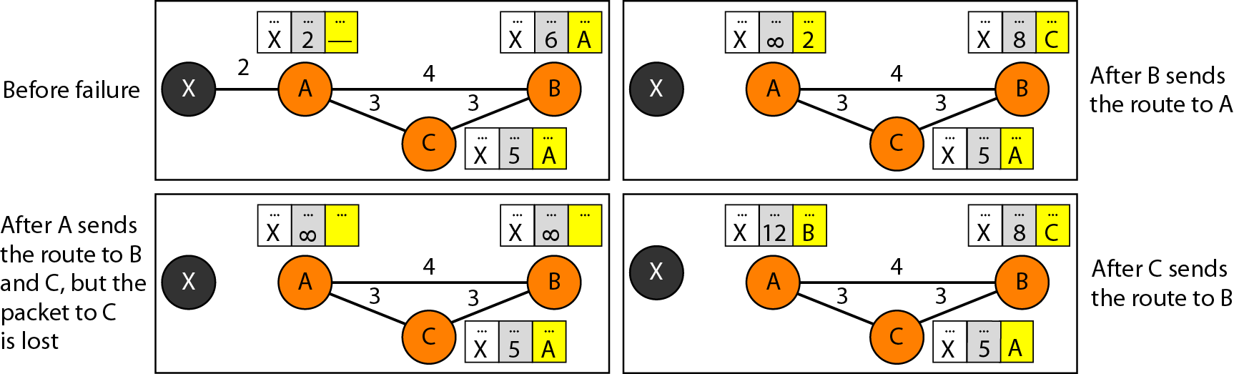
Figure 22.18 Three-node instability
22.<number>

Slide 25
Routing Information Protocol (RIP)
It is an Intradomain routing protocol used inside an autonomous system. It is a very simple protocol based on distance vector routing.
RIP implements distance vector routing directly with some considerations:
1. In an autonomous system, we are dealing with routers and networks (links). The
routers have routing tables; networks do not.
2. The destination in a routing table is a network, which means the first column
defines a network address.
3. The metric used by RIP is very simple; the distance is defined as the number of
links (networks) to reach the destination. For this reason, the metric in RIP is called
a hop count.
4. Infinity is defined as 16, which means that any route in an autonomous system using RIP cannot have more than 15 hops.
5. The next-node column defines the address of the router to which the packet is to be sent to reach its destination.

Slide 26

Figure 22.19 Example of a domain using RIP
22.<number>

Slide 27
Link state routing
In link state routing, each node in the domain has the entire topology of the domain
List of nodes and links, how they are connected including cost (metric), and condition of the links (up or down)
22.<number>

Slide 28

Link state knowledge

Slide 29
Build routing table
In link state routing, four sets of actions are required to ensure that each node has the
routing table showing the least-cost node to every other node.
1. Creation of the states of the links by each node, called the link state packet (LSP).
2. Dissemination of LSPs to every other router, called flooding, in an efficient and
reliable way.
3. Formation of a shortest path tree for each node.
4. Calculation of a routing table based on the shortest path tree.
Creation of Link State Packet (LSP) -
A link state packet can carry a large amount of information.
For the moment, however, we assume that it carries a minimum amount of data:
  node identity
  list of links
  sequence number,
  age.
The first two, node identity and the list of links, are needed to make the topology. The third, sequence number, facilitates flooding and distinguishes new LSPs from old ones.
The fourth, age, prevents old LSPs from remaining in the domain for a long time
22.<number>

Slide 30
LSPs are generated on two occasions:
  When there is a change in the topology of the domain
  On a periodic basis
Flooding of LSPs-
The creating node sends a copy of the LSP out of each interface.
A node that receives an LSP compares it with the copy it may already have.
If the newly arrived LSP is older than the one it has, it discards the LSP. If it is newer, the node does the following:
a. It discards the old LSP and keeps the new one.
b. It sends a copy of it out of each interface except the one from which the packet arrived.
22.<number>

Slide 31

Figure 22.23 Example of formation of shortest path tree
22.<number>

Slide 32

Figure 22.22 Dijkstra algorithm
22.<number>

Slide 33

Table 22.2 Routing table for node A
22.<number>

Slide 34
OSPF
The Open Shortest Path First (OSPF) protocol is an intradomain routing protocol based on link state routing. Its domain is also an autonomous system.
TCP/IP Protocol Suite

Slide 35
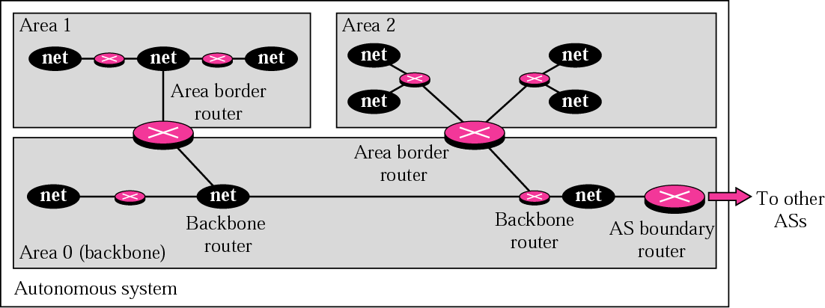
Figure 14.19 Areas in an autonomous system
TCP/IP Protocol Suite

Slide 36
Metric in OSPF
OSPF allows administrator to assign a cost called metric.
The metric can be based on type of service- minimum delay, maximum throughput and so on.
Therefore, a router can have multiple routing tables based on different type of service.
TCP/IP Protocol Suite

Slide 37
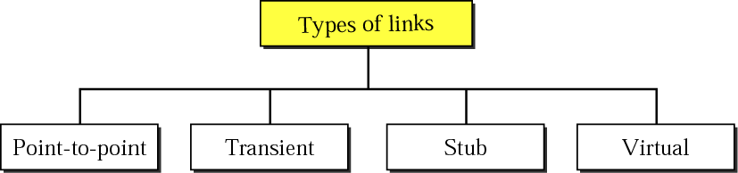
Figure 14.20 Types of links
TCP/IP Protocol Suite

Slide 38
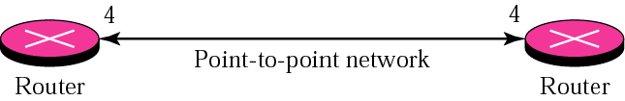
Figure 14.21 Point-to-point link
TCP/IP Protocol Suite

Slide 39
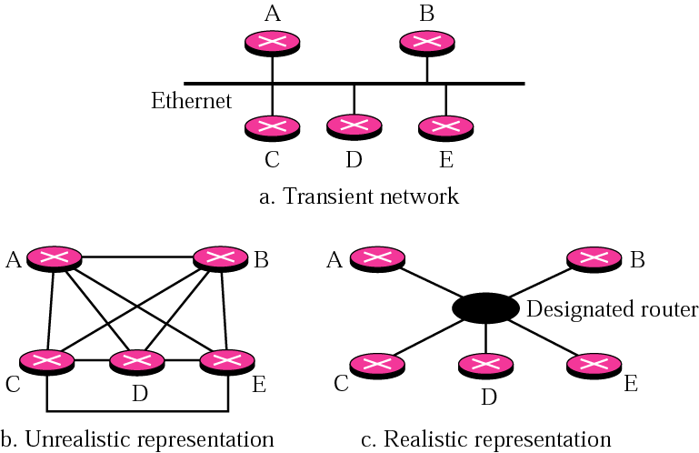
Figure 14.22 Transient link
TCP/IP Protocol Suite

Slide 40
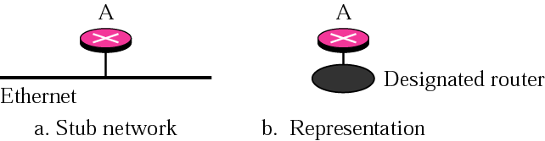
Figure 14.23 Stub link
TCP/IP Protocol Suite

Slide 41
PATH VECTOR ROUTING
Path vector routing is similar to distance vector routing. There is at least one node, called the speaker node, in each AS that creates a routing table and advertises it to speaker nodes in the neighboring ASs..
The topics discussed in this section include:
Initialization
Sharing
Updating
TCP/IP Protocol Suite

Slide 42
Problem in distance vector is node instability.
Problem in link state routing is heavy traffic due to flooding and extra resources required for generating routing tables.
TCP/IP Protocol Suite

Slide 43
Steps in path vector Routing
Initialization
Sharing
Updating– Loop prevention, policy routing, optimum path.
TCP/IP Protocol Suite

Slide 44
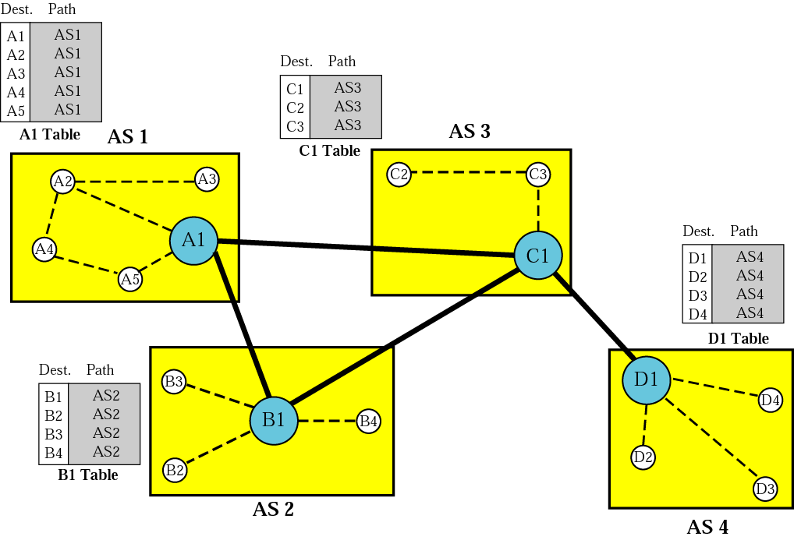
Figure 14.48 Initial routing tables in path vector routing
TCP/IP Protocol Suite

Slide 45
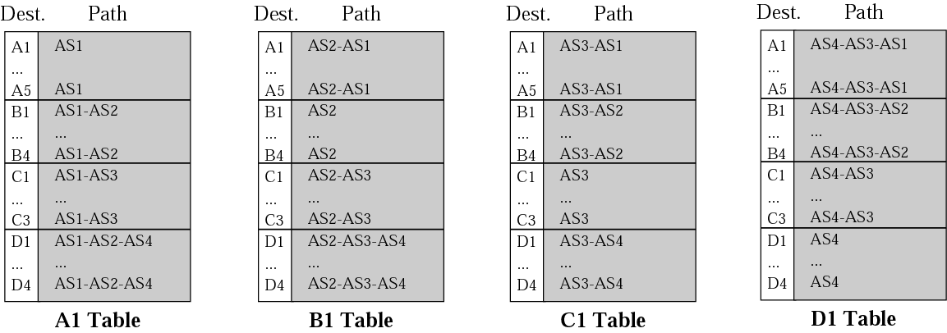
Figure 14.49 Stabilized tables for four autonomous systems
TCP/IP Protocol Suite

Slide 46
14.7 BGP
Border Gateway Protocol (BGP) is an interdomain routing protocol using path vector routing. It first appeared in 1989 and has gone through four versions.
The topics discussed in this section include:
Types of Autonomous Systems
Path Attributes
BGP Sessions
External and Internal BGP
TCP/IP Protocol Suite

Slide 47
Path Attributes
Well Known attribute
  Mandatory
  Discretionary
Optional attribute
  Transitive
  Non-transitive
TCP/IP Protocol Suite

Slide 48
BGP Sessions
Using TCP connections—reliable
Last for long time so it is called as semi permanent connections.
TCP/IP Protocol Suite

Slide 49
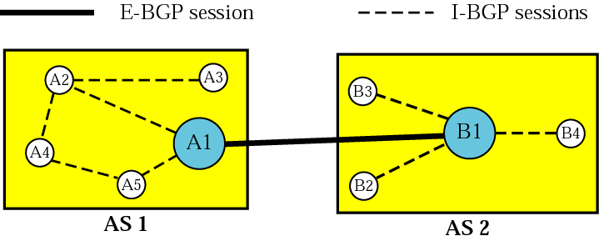
Figure 14.50 Internal and external BGP sessions
TCP/IP Protocol Suite

