Slide 1

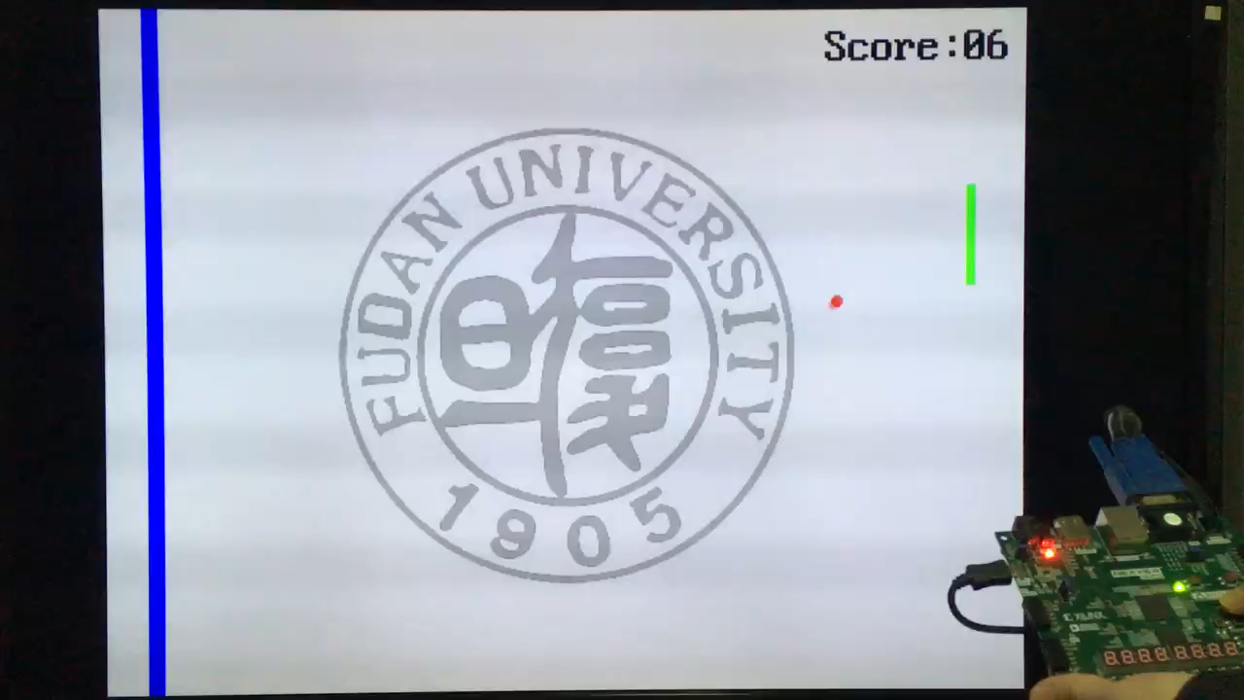
基于FPGA原型的游戏设计
2023-12-10
Notes:
缺陷：得分为十六进制、得分只有个位数变化、按键没有去抖、乒乓球在球拍和右侧屏幕之间没有反弹……

Slide 2
1
Picture
ping-pong

Slide 3

显示 sprite 原理
② Bit-mapped
二维小图像
Vertical Sync 场同步信号
2 行
H-Sync
行同步信号
场显示后沿
Vertical Blank (Top)
29 行
行显示
后沿
Horizontal Back Porch
640 x 480
行显示
前沿
Horizontal Front Porch
(0, 0)
(C1, R1)
R1
521 行
480 行
C1
96 像素
48像素
640 像素
16像素
场显示前沿 Vertical Blank (Bottom)
10 行
800 像素

Slide 4

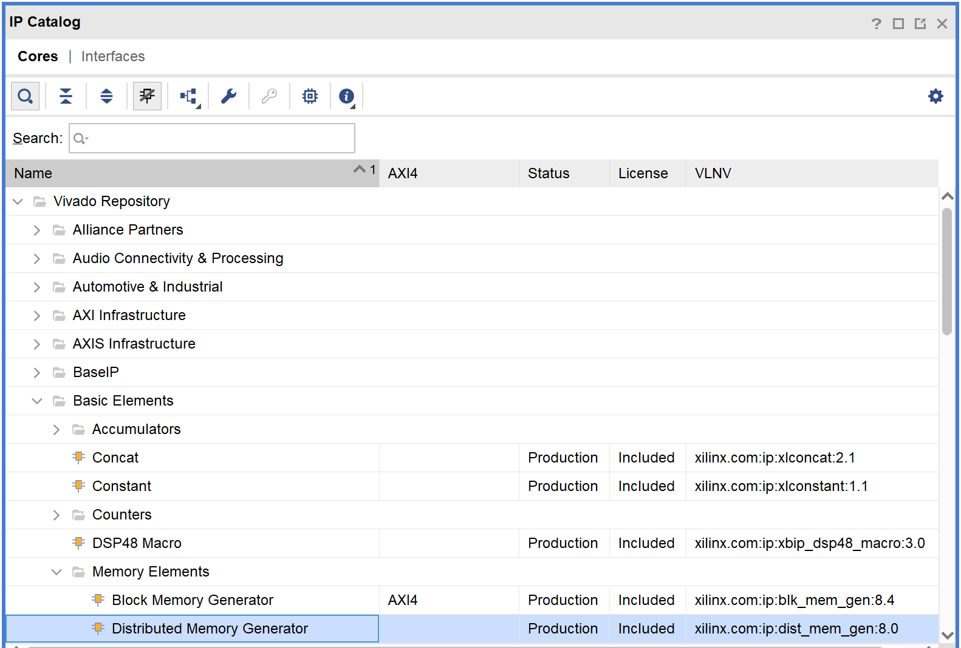
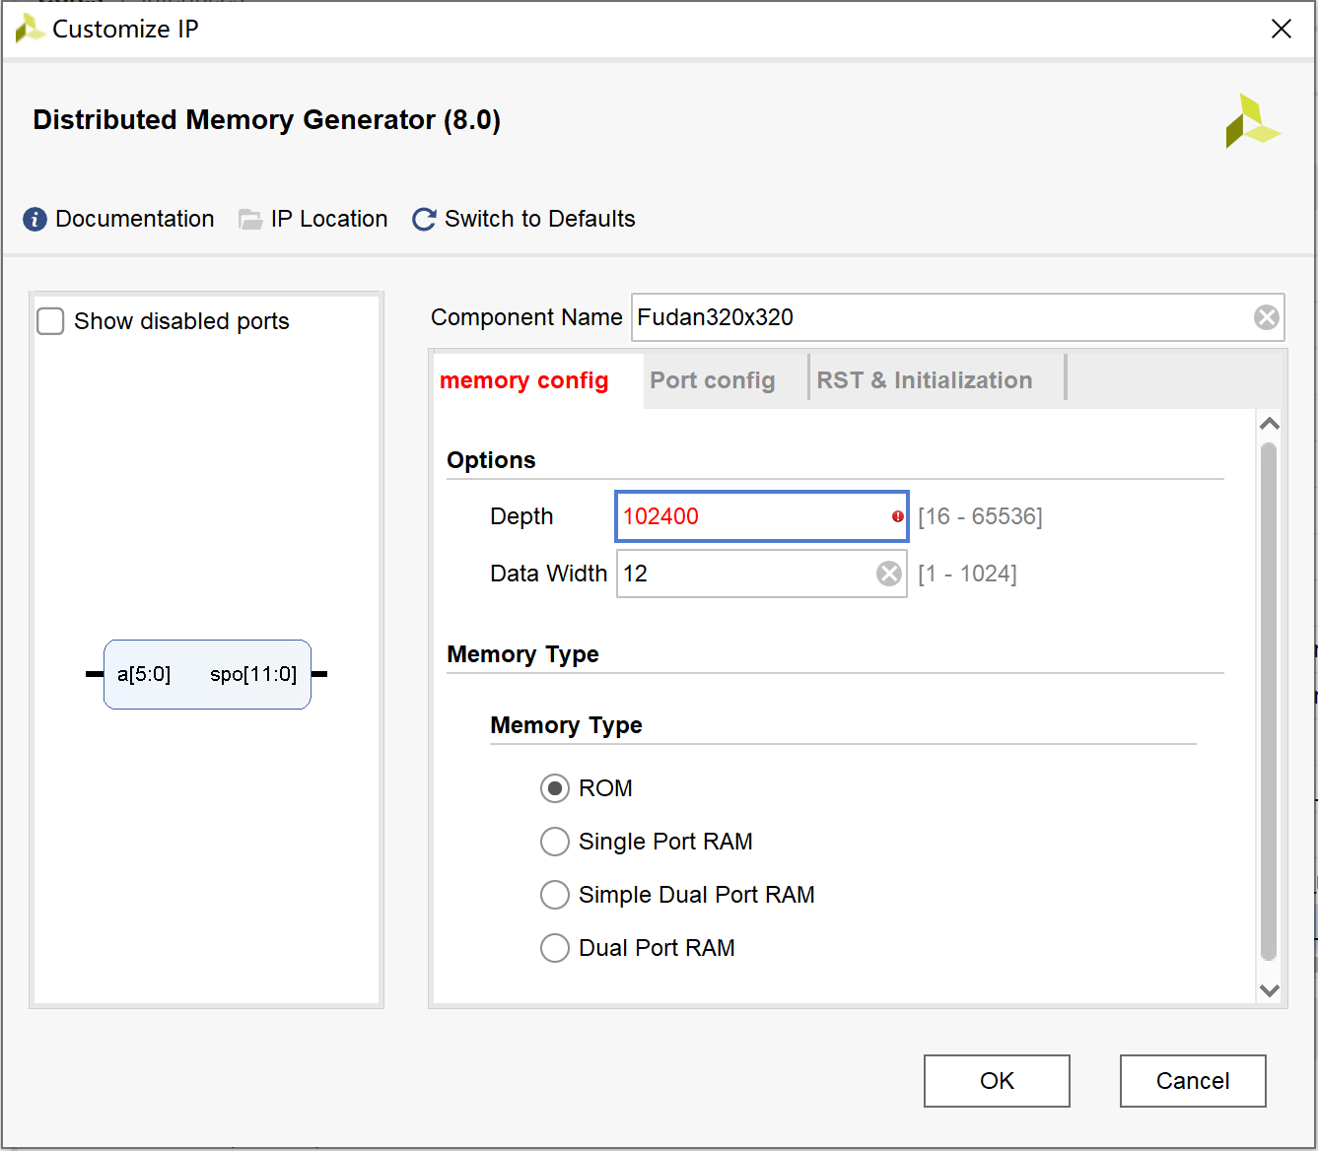

Distributed Memory
② Bit-mapped
不够用！
320pixel * 320pixel =102400
102400 * 12 = 1,228,800 bit

Slide 5
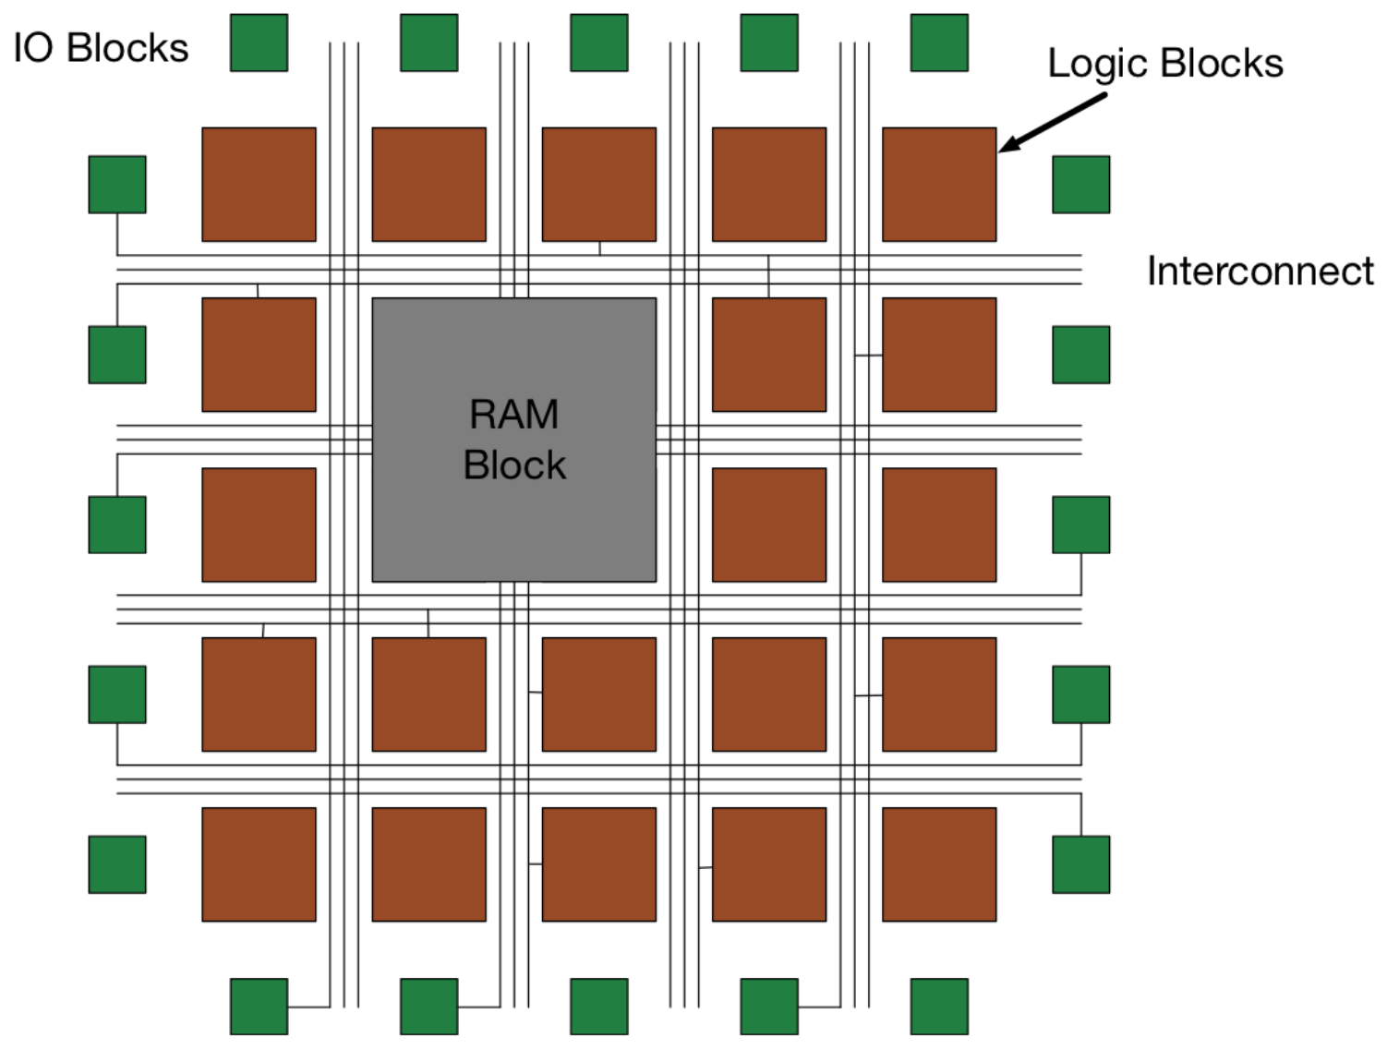
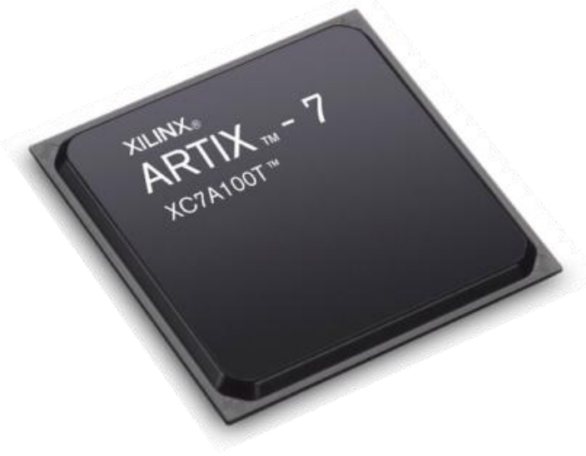
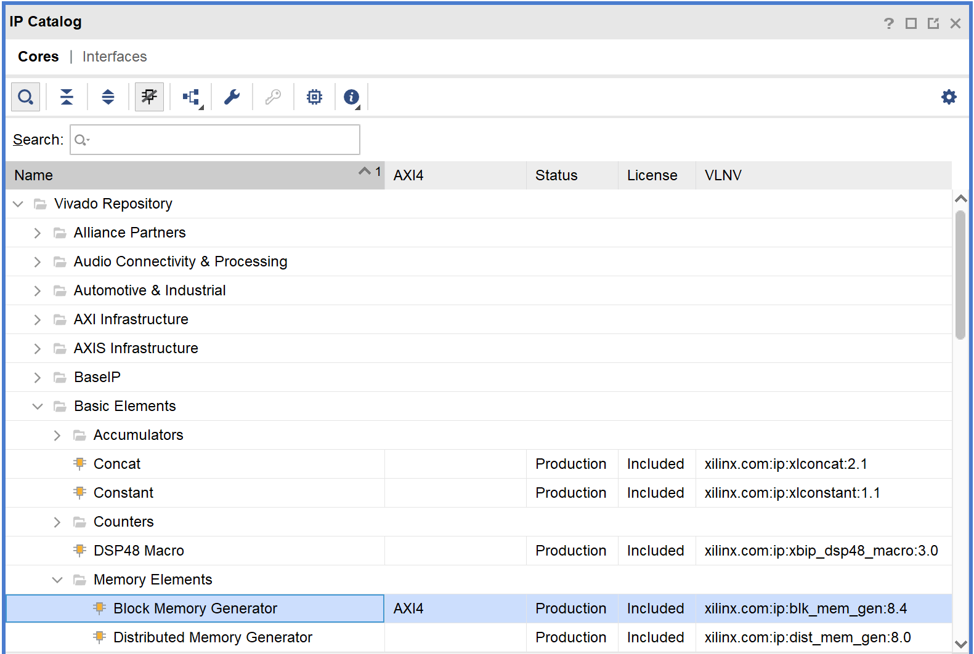
BRAM
② Bit-mapped
4,860 Kbits of fast block RAM
Logical structure of an FPGA.

Slide 6
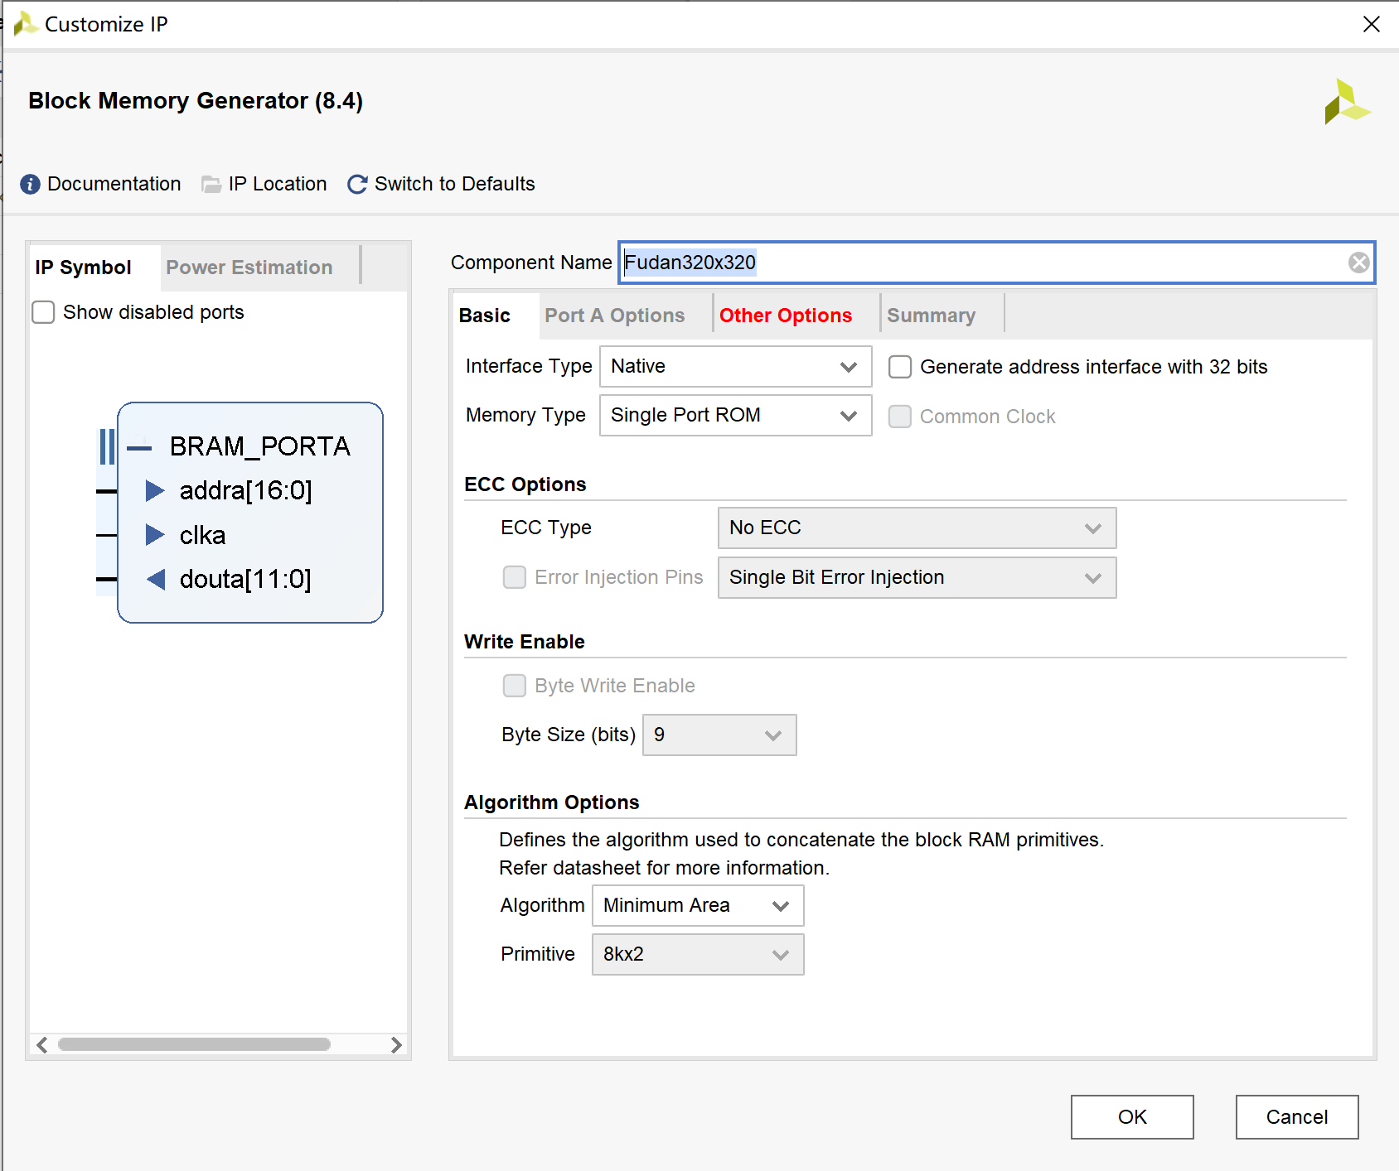
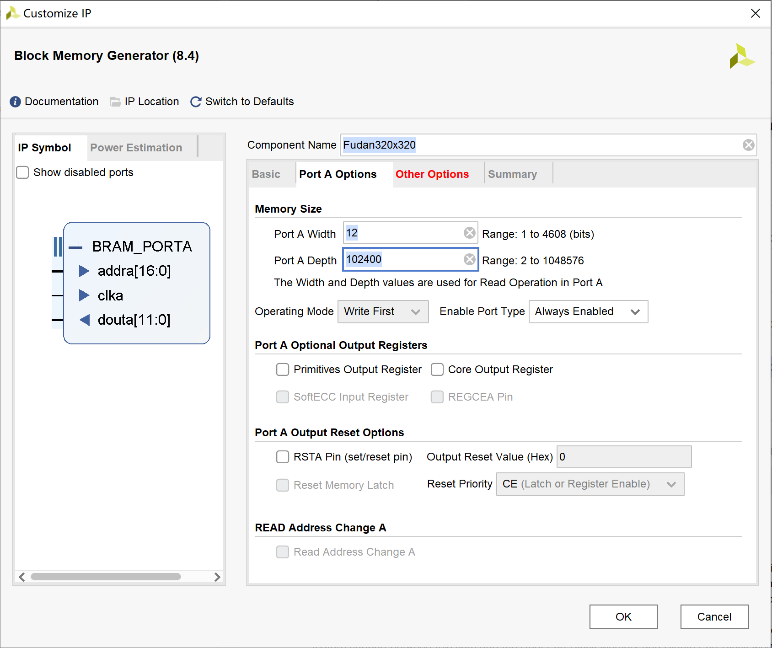
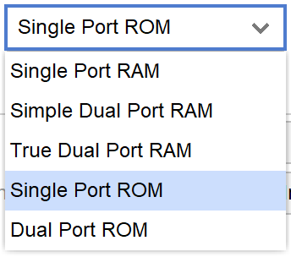
复旦图标BRAM生成-1
② Bit-mapped
320pixel * 320pixel =102400

Slide 7
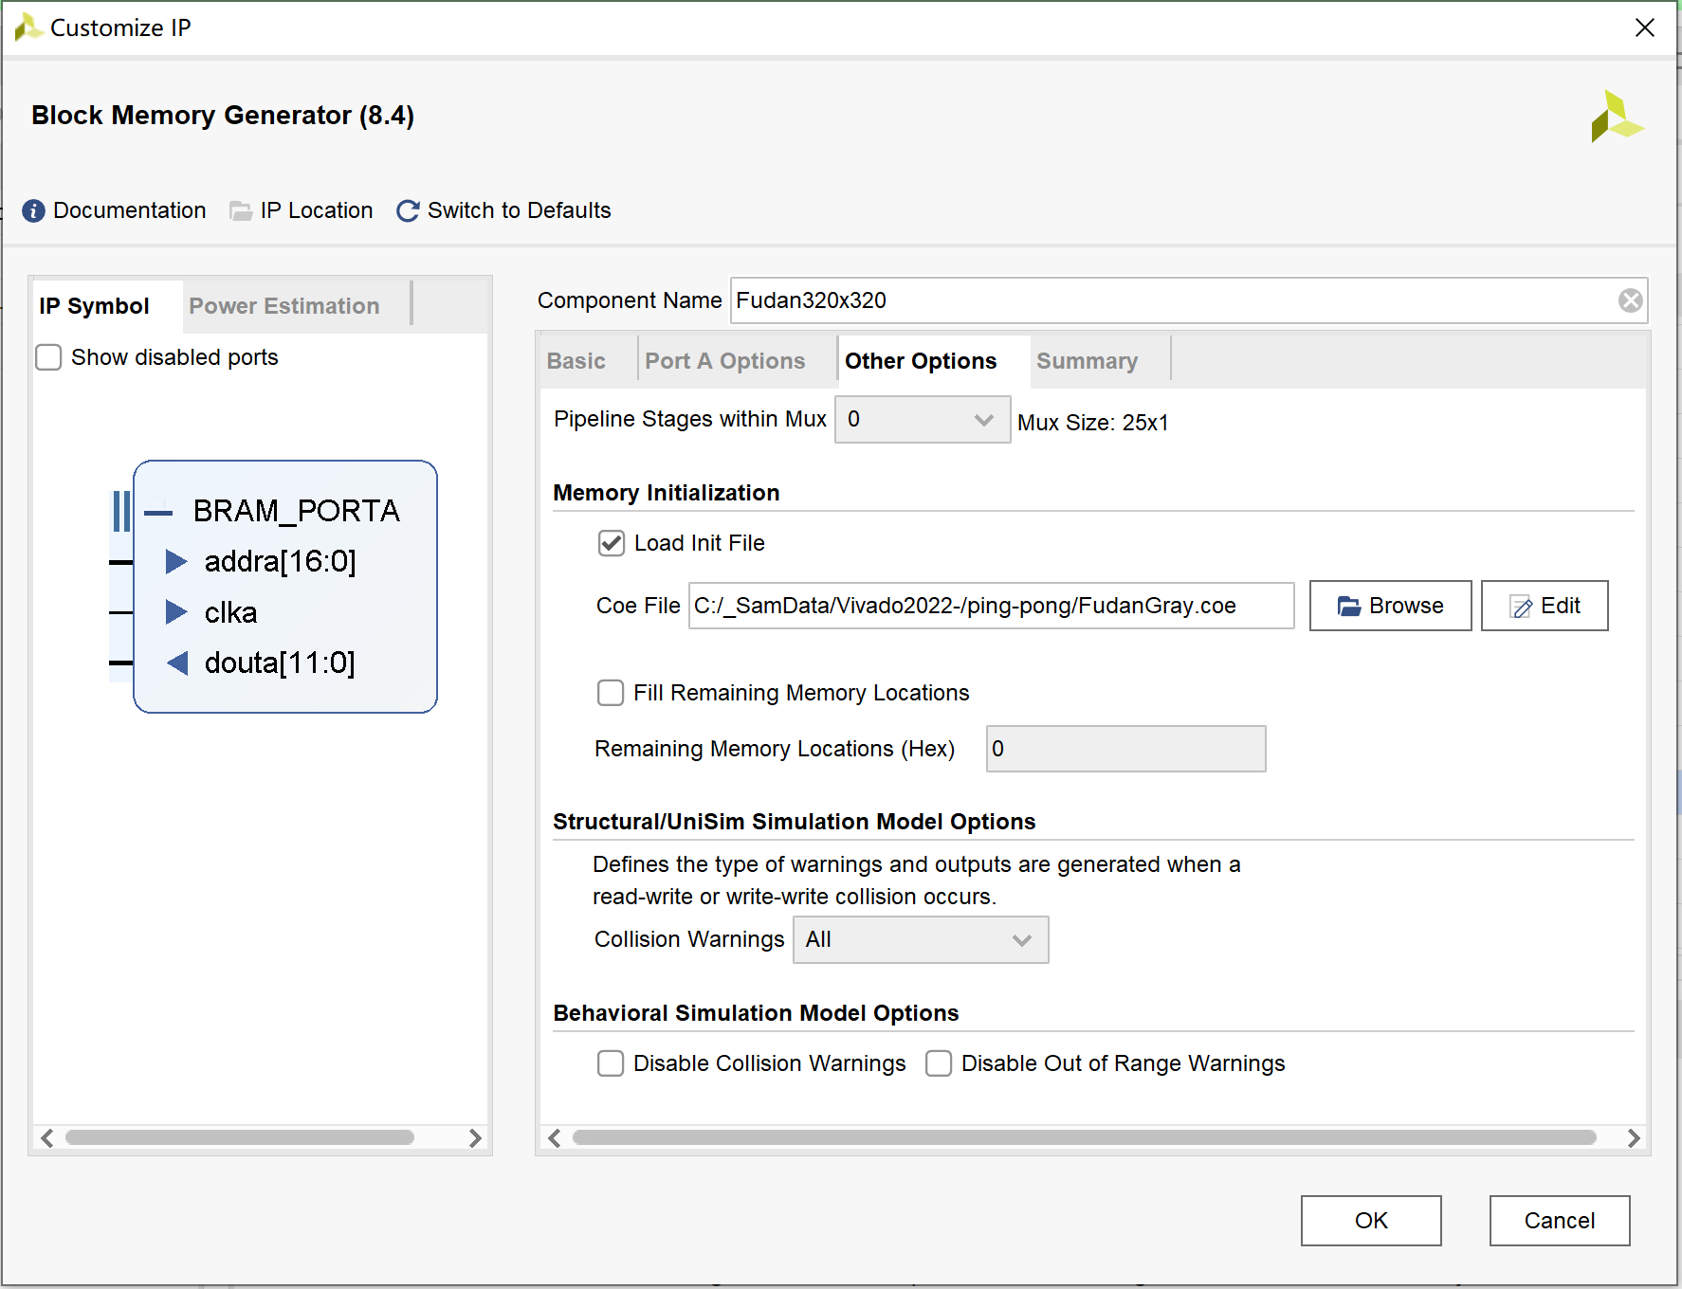
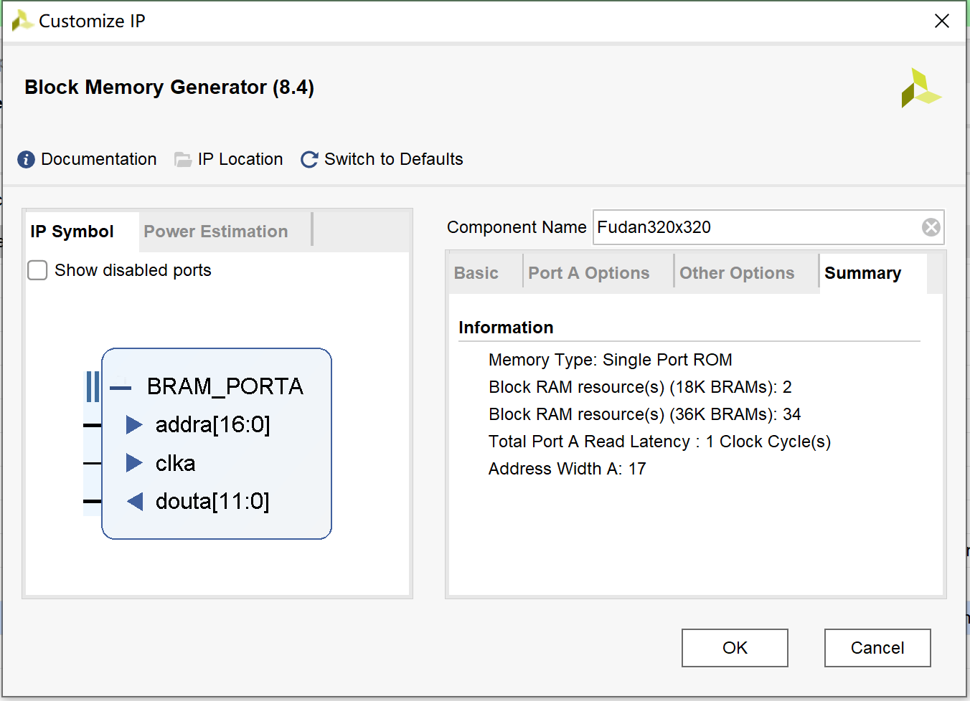
复旦图标BRAM生成-2
② Bit-mapped
COE文件用来初始化RAM内容。

Slide 8
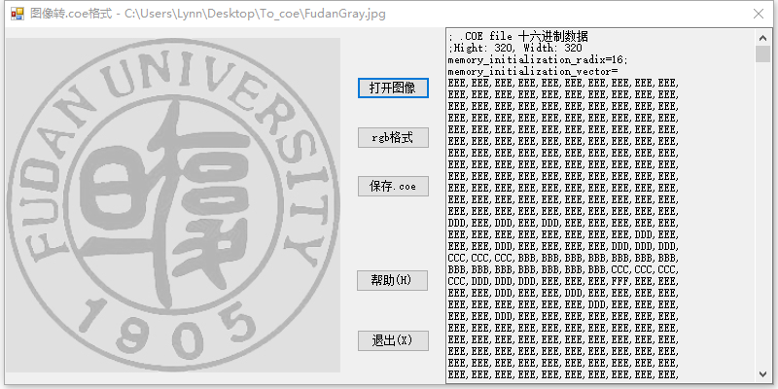
.coe 文件
② Bit-mapped
数据格式可以是2，10或16进制。
分号后为注释内容，
每一个数据用逗号和换行实现，
最后一行数据用分号表示结束。

Slide 9
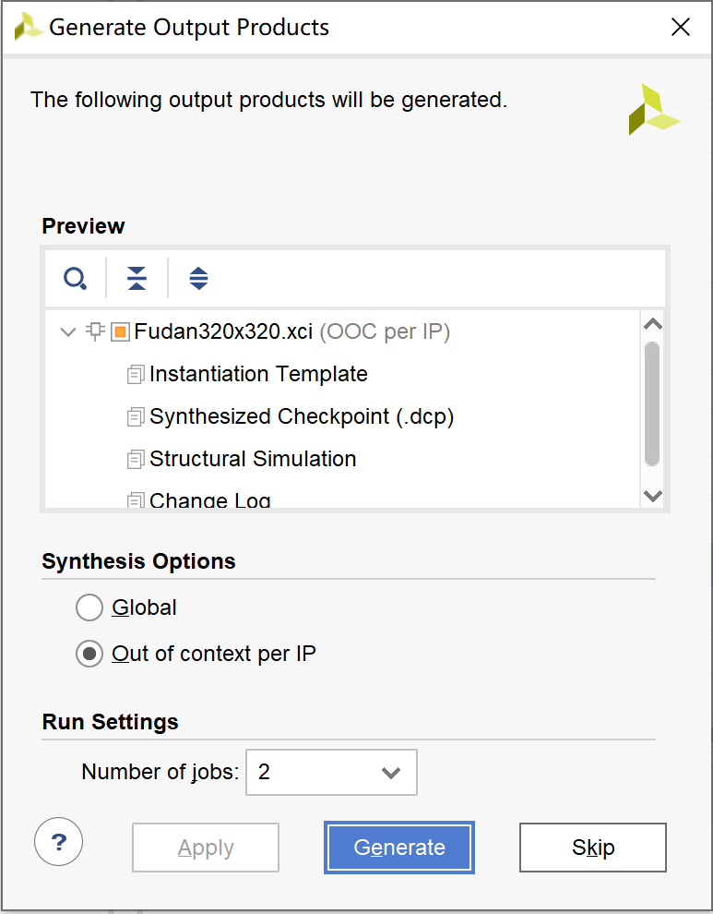
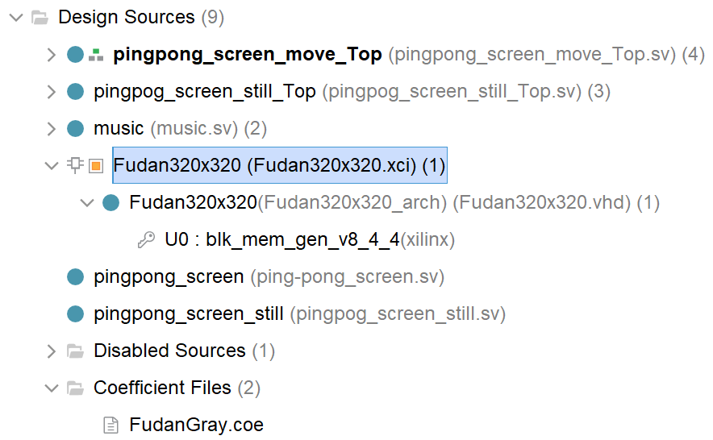
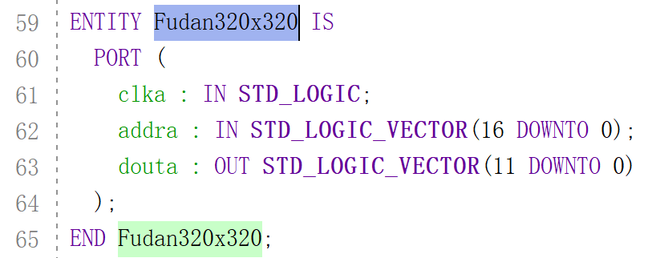
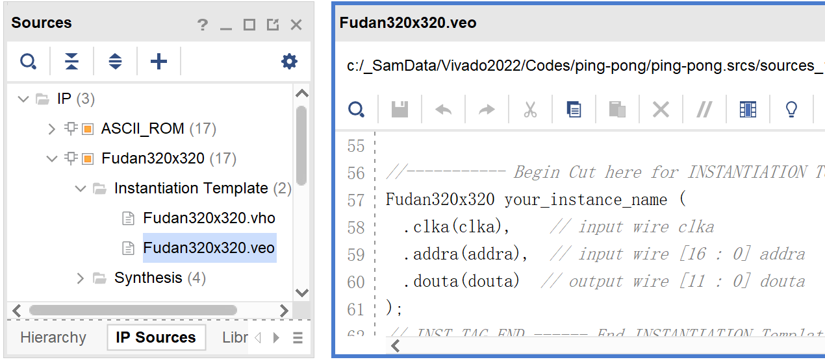
复旦图标BRAM生成-3
② Bit-mapped
方法 1
方法 1
方法 2

Slide 10
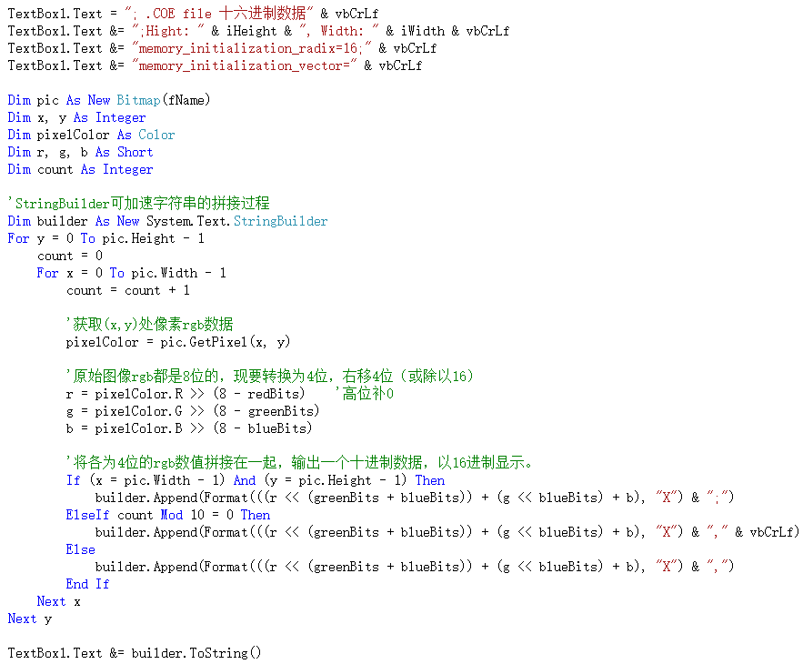
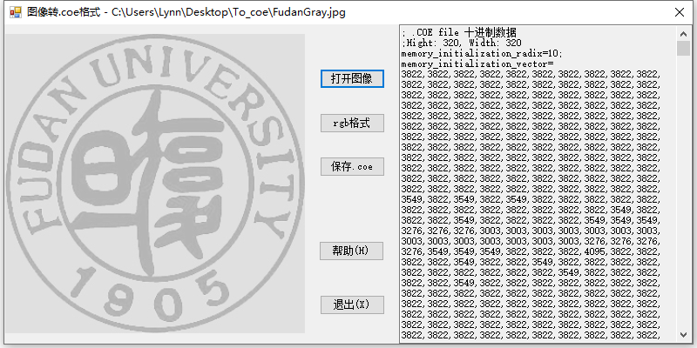
由图像生成.coe文件
② Bit-mapped
8 | 7 | 6 | 5 | 4 | 3 | 2 | 1
8 | 7 | 6 | 5 | 4 | 3 | 2 | 1
8 | 7 | 6 | 5 | 4 | 3 | 2 | 1
4 | 3 | 2 | 1
4 | 3 | 2 | 1
4 | 3 | 2 | 1
Notes:
RGB每个都是由8-bit变为4-bit数据

Slide 11
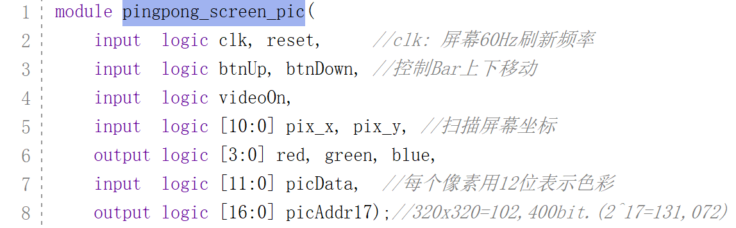
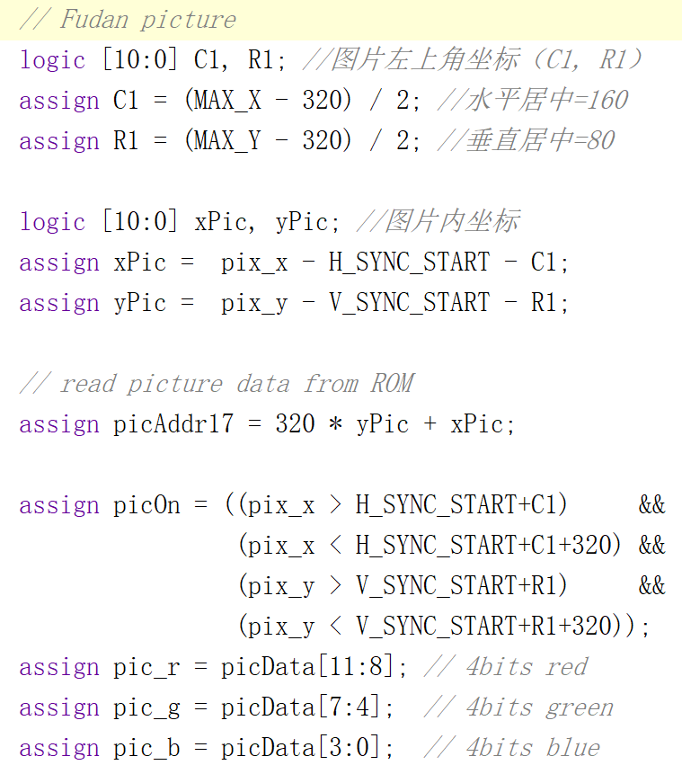
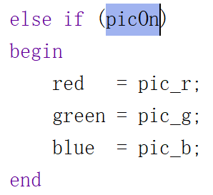
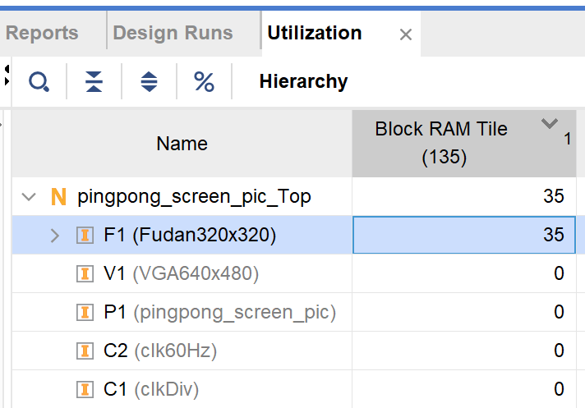
乒乓球：复旦图标
② Bit-mapped
Notes:
module pingpong_screen_pic(
input logic clk, reset, //clk: 屏幕60Hz刷新频率
input logic btnUp, btnDown, //控制Bar上下移动
input logic videoOn,
input logic [10:0] pix_x, pix_y, //扫描屏幕坐标
output logic [3:0] red, green, blue,
input logic [11:0] picData, //每个像素用12位表示色彩
output logic [16:0] picAddr17);//320x320=102,400bit.(2^17=131,072)
localparam
MAX_X = 640, MAX_Y = 480, //(0.0) to (639,479)
// 屏幕参数
H_SYNC = 96, // horizontal sync width
H_BACK = 48, // left border (back porch)
H_SYNC_START = H_SYNC + H_BACK, //行显示后沿 = 144(96+48)
V_SYNC = 2, // vertical sync lines
V_TOP = 29, // vertical top border
V_SYNC_START = V_SYNC + V_TOP, //场显示后沿 = 31(2+29)
// === wall ===
WALL_X_L = H_SYNC_START + 30, // left boundary
WALL_X_R = H_SYNC_START + 40, // right boundary
// === bar ===
BAR_X_L = H_SYNC_START + 600, // left boundary
BAR_X_R = H_SYNC_START + 605, // right boundary
BAR_Y_SIZE = 70, // bar 的高度
BAR_Y_T = V_SYNC_START + MAX_Y/2 - BAR_Y_SIZE/2, //Top=204
BAR_Y_B = BAR_Y_T + BAR_Y_SIZE -1, // bottom boundary
BAR_V = 4, // 每次移动 bar 的距离
// === ball ===
BALL_SIZE = 8,
BALL_X_L = H_SYNC_START + 580, // left boundary
BALL_X_R = BALL_X_L + BALL_SIZE - 1, // right boundary
BALL_Y_T = V_SYNC_START + MAX_Y/2 -BALL_SIZE/2,//top boundary
BALL_Y_B = BALL_Y_T + BALL_SIZE - 1, // bottom boundary
BALL_V = 2; // 每次移动 ball 的距离
logic wallOn, barOn, ballOn, picOn;
logic [3:0] wall_r, wall_g, wall_b;
logic [3:0] bar_r, bar_g, bar_b;
logic [3:0] ball_r, ball_g, ball_b;
logic [3:0] pic_r, pic_g, pic_b;
// (wall) : pixel within wall
assign wallOn = (WALL_X_L <= pix_x) && (pix_x <= WALL_X_R);
assign wall_r = 4'b0000;
assign wall_g = 4'b0000;
assign wall_b = 4'b1111; // blue
// (bar) : pixel within bar
logic [10:0] bar_y_t, bar_y_b; // bar top, bottom boundary
// new bar y-position
always @(posedge clk, posedge reset)
begin
if (reset)
begin
bar_y_t <= BAR_Y_T;
end
else if (btnDown & (bar_y_b <= (V_SYNC_START+MAX_Y-1-BAR_V)))
bar_y_t <= bar_y_t + BAR_V; // move down
else if (btnUp & (bar_y_t >= (V_SYNC_START+BAR_V)))
bar_y_t <= bar_y_t - BAR_V; // move up
end
assign bar_y_b = bar_y_t + BAR_Y_SIZE - 1;
assign barOn = ((BAR_X_L<=pix_x) && (pix_x<=BAR_X_R) &&
(bar_y_t<=pix_y) && (pix_y<=bar_y_b)); //变量
assign bar_r = 4'b0000;
assign bar_g = 4'b1111; // green
assign bar_b = 4'b0000;
/*
// (ball): pixel within squared ball
assign ballOn = ((BALL_X_L<=pix_x) && (pix_x<=BALL_X_R) &&
(BALL_Y_T<=pix_y) && (pix_y<=BALL_Y_B));
assign ball_r = 4'b1111; // red
assign ball_g = 4'b0000;
assign ball_b = 4'b0000;
*/
// （round ball）
logic [10:0] ball_x_l, ball_x_r; // ball left, right boundary
logic [10:0] ball_y_t, ball_y_b; // ball top, bottom boundary
logic [10:0] ball_dx , ball_dy ; // ball x, y 增量
// new ball x,y-position
always @(posedge clk, posedge reset) begin
if (reset) begin
ball_x_l <= BALL_X_L;
ball_y_t <= BALL_Y_T;
ball_dx <= -1 * BALL_V;
ball_dy <= -1 * BALL_V;
end
else begin
ball_x_l <= ball_x_l + ball_dx;
ball_y_t <= ball_y_t + ball_dy;
// ------------------ ball bounce back -----------------------
if (ball_y_t <= V_SYNC_START) //reach top screen
ball_dy <= BALL_V;
else if (ball_y_b >= V_SYNC_START + MAX_Y) //reach bottom screen
ball_dy <= -1 * BALL_V;
else if (ball_x_l <= WALL_X_R) //reach left wall
ball_dx <= BALL_V;
else if ((ball_x_r >= BAR_X_L) && //reach right bar
(ball_x_r <= BAR_X_R) &&
(ball_y_b >= bar_y_t) && (ball_y_t <= bar_y_b))
ball_dx <= -1 * BALL_V;
else if (ball_x_r >= H_SYNC_START + MAX_X) //reach right screen
ball_dx <= -1 * BALL_V;
end
end
assign ball_x_r = ball_x_l + BALL_SIZE - 1;
assign ball_y_b = ball_y_t + BALL_SIZE - 1;
logic [2:0] rom_addr, rom_col; // ROM中8行、8列
logic rom_bit; // ROM中每个像素值
logic [7:0] rom_data;
always_comb // image ROM
case (rom_addr)
3'h0: rom_data = 8'b0011_1100; // ****
3'h1: rom_data = 8'b0111_1110; // ******
3'h2: rom_data = 8'b1111_1111; // ********
3'h3: rom_data = 8'b1111_1111; // ********
3'h4: rom_data = 8'b1111_1111; // ********
3'h5: rom_data = 8'b1111_1111; // ********
3'h6: rom_data = 8'b0111_1110; // ******
3'h7: rom_data = 8'b0011_1100; // ****
endcase
assign rom_col = pix_x[2:0] - ball_x_l[2:0]; // ROM列
assign rom_addr = pix_y[2:0] - ball_y_t[2:0]; // ROM行
assign rom_bit = rom_data[rom_col]; //ROMaddr行中col列值
// pixel within ball
assign ballOn = ((ball_x_l<=pix_x) && (pix_x<=ball_x_r) && //变量
(ball_y_t<=pix_y) && (pix_y<=ball_y_b)) & //变量
rom_bit; // round ball
assign ball_r = 4'b1111; // red
assign ball_g = 4'b0000; // red
assign ball_b = 4'b0000; // red
// Fudan picture
logic [10:0] C1, R1; //图片左上角坐标（C1, R1）
assign C1 = (MAX_X - 320) / 2; //水平居中=160
assign R1 = (MAX_Y - 320) / 2; //垂直居中=80
logic [10:0] xPic, yPic; //图片内坐标
assign xPic = pix_x - H_SYNC_START - C1;
assign yPic = pix_y - V_SYNC_START - R1;
// read picture data from ROM
assign picAddr17 = 320 * yPic + xPic;
assign picOn = ((pix_x > H_SYNC_START+C1) &&
(pix_x < H_SYNC_START+C1+320) &&
(pix_y > V_SYNC_START+R1) &&
(pix_y < V_SYNC_START+R1+320));
assign pic_r = picData[11:8]; // 4bits red
assign pic_g = picData[7:4]; // 4bits green
assign pic_b = picData[3:0]; // 4bits blue
always_comb // ===== rgb 输出 ======
if (~videoOn)
begin
red = 4'b0000; // blank
green = 4'b0000; // blank
blue = 4'b0000; // blank
end
else if (wallOn)
begin
red = wall_r;
green = wall_g;
blue = wall_b;
end
else if (ballOn)
begin
red = ball_r;
green = ball_g;
blue = ball_b;
end
else if (barOn)
begin
red = bar_r;
green = bar_g;
blue = bar_b;
end
else if (picOn)
begin
red = pic_r;
green = pic_g;
blue = pic_b;
end
else
begin // gray background
red = 4'b1110;
green = 4'b1110;
blue = 4'b1110;
end
endmodule

Slide 12
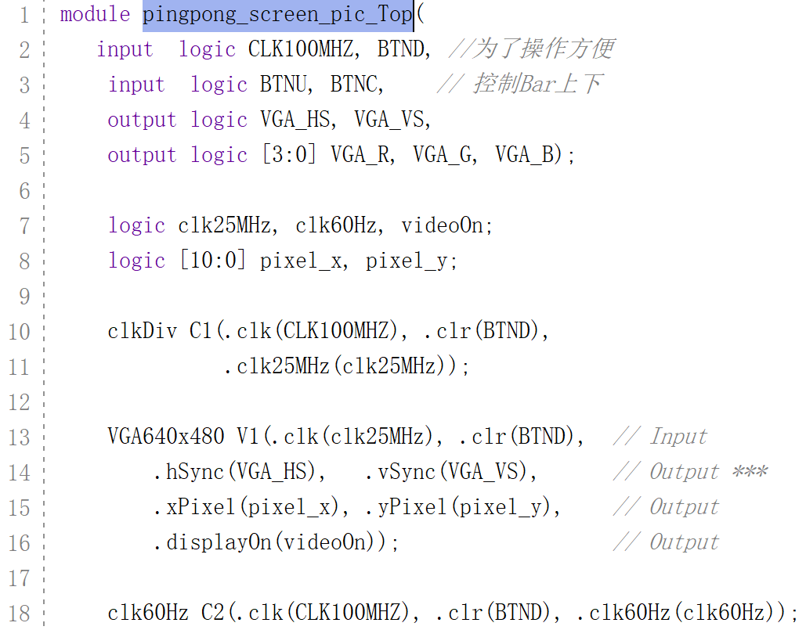

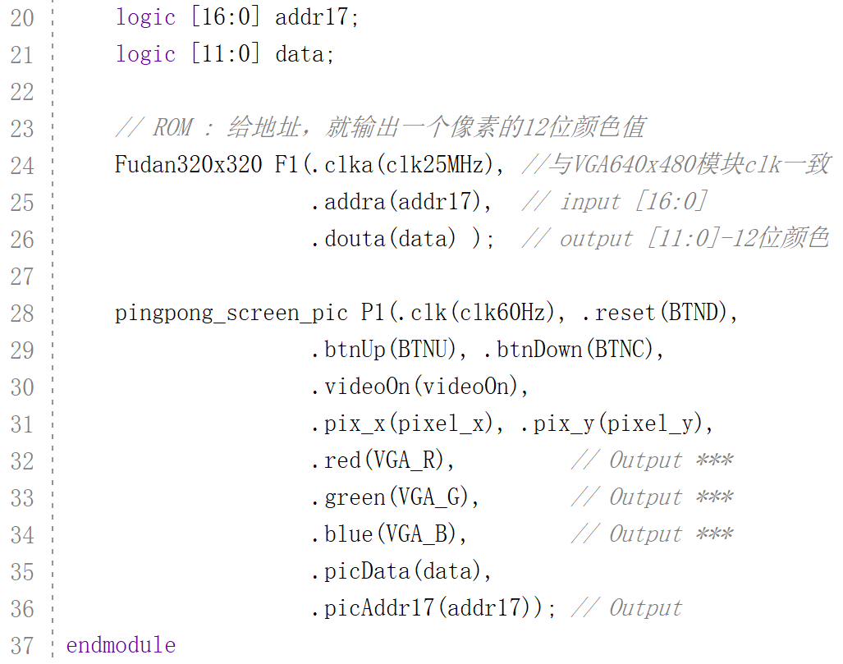
乒乓球：复旦图标 顶层文件
② Bit-mapped
Notes:
module pingpong_screen_pic_Top(
input logic CLK100MHZ, BTND, //为了操作方便
input logic BTNU, BTNC, // 控制Bar上下
output logic VGA_HS, VGA_VS,
output logic [3:0] VGA_R, VGA_G, VGA_B);
logic clk25MHz, clk60Hz, videoOn;
logic [10:0] pixel_x, pixel_y;
clkDiv C1(.clk(CLK100MHZ), .clr(BTND),
.clk25MHz(clk25MHz));
VGA640x480 V1(.clk(clk25MHz), .clr(BTND), // Input
.hSync(VGA_HS), .vSync(VGA_VS), // Output ***
.xPixel(pixel_x), .yPixel(pixel_y), // Output
.displayOn(videoOn)); // Output
clk60Hz C2(.clk(CLK100MHZ), .clr(BTND), .clk60Hz(clk60Hz));
logic [16:0] addr17;
logic [11:0] data;
// ROM : 给地址，就输出一个像素的12位颜色值
Fudan320x320 F1(.clka(clk25MHz), //与VGA640x480模块clk一致
.addra(addr17), // input [16:0]
.douta(data) ); // output [11:0]-12位颜色
pingpong_screen_pic P1(.clk(clk60Hz), .reset(BTND),
.btnUp(BTNU), .btnDown(BTNC),
.videoOn(videoOn),
.pix_x(pixel_x), .pix_y(pixel_y),
.red(VGA_R), // Output ***
.green(VGA_G), // Output ***
.blue(VGA_B), // Output ***
.picData(data),
.picAddr17(addr17)); // Output
endmodule

Slide 13
【作业3】图像展示
用FPGA展示你喜欢的一幅画，
考虑屏幕像素大小和A7芯片内存限制。

Slide 14
2
Sound
ping-pong

Slide 15
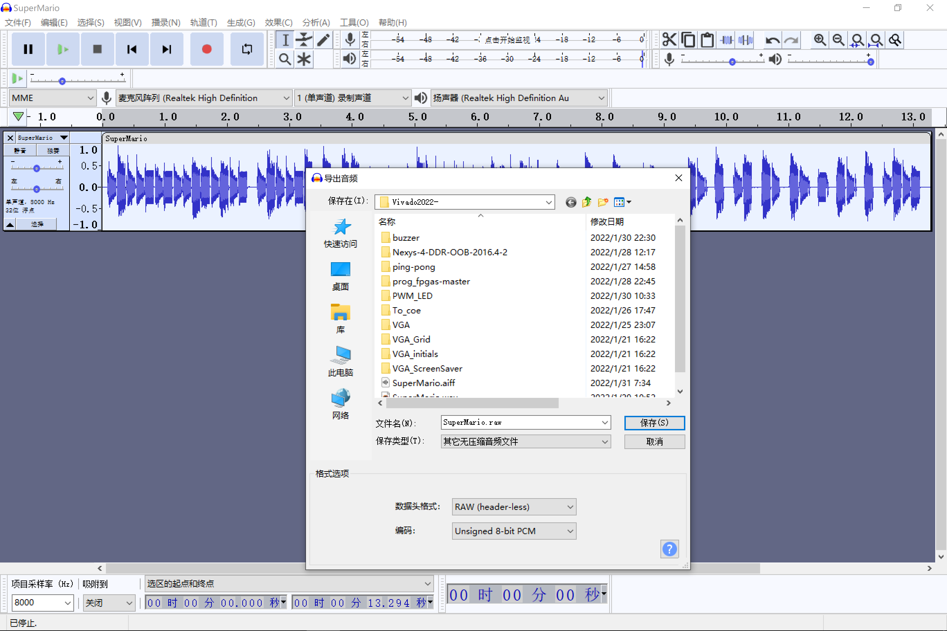
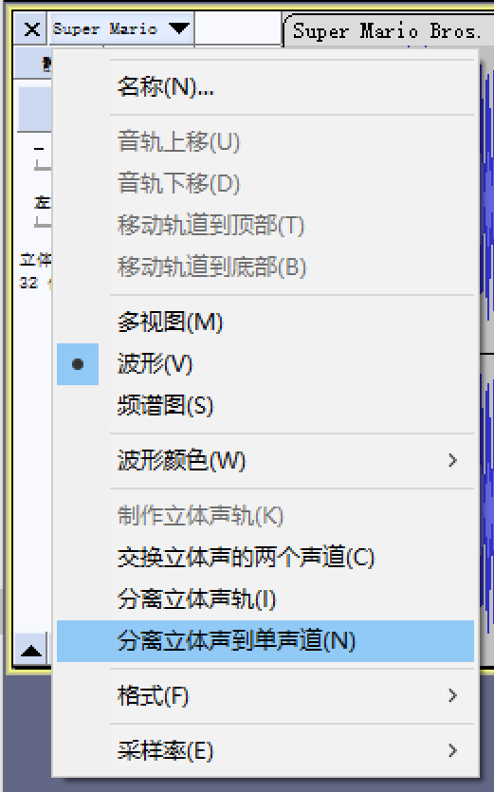
导出raw音频数据
audacity-win-3.1.3-64bit.exe
www.audacityteam.org
单声道
编码：无符号8-bit
采样频率：8000Hz
Notes:
Programming FPGAs Getting Started with Verilog by Simon Monk.pdf

Slide 16
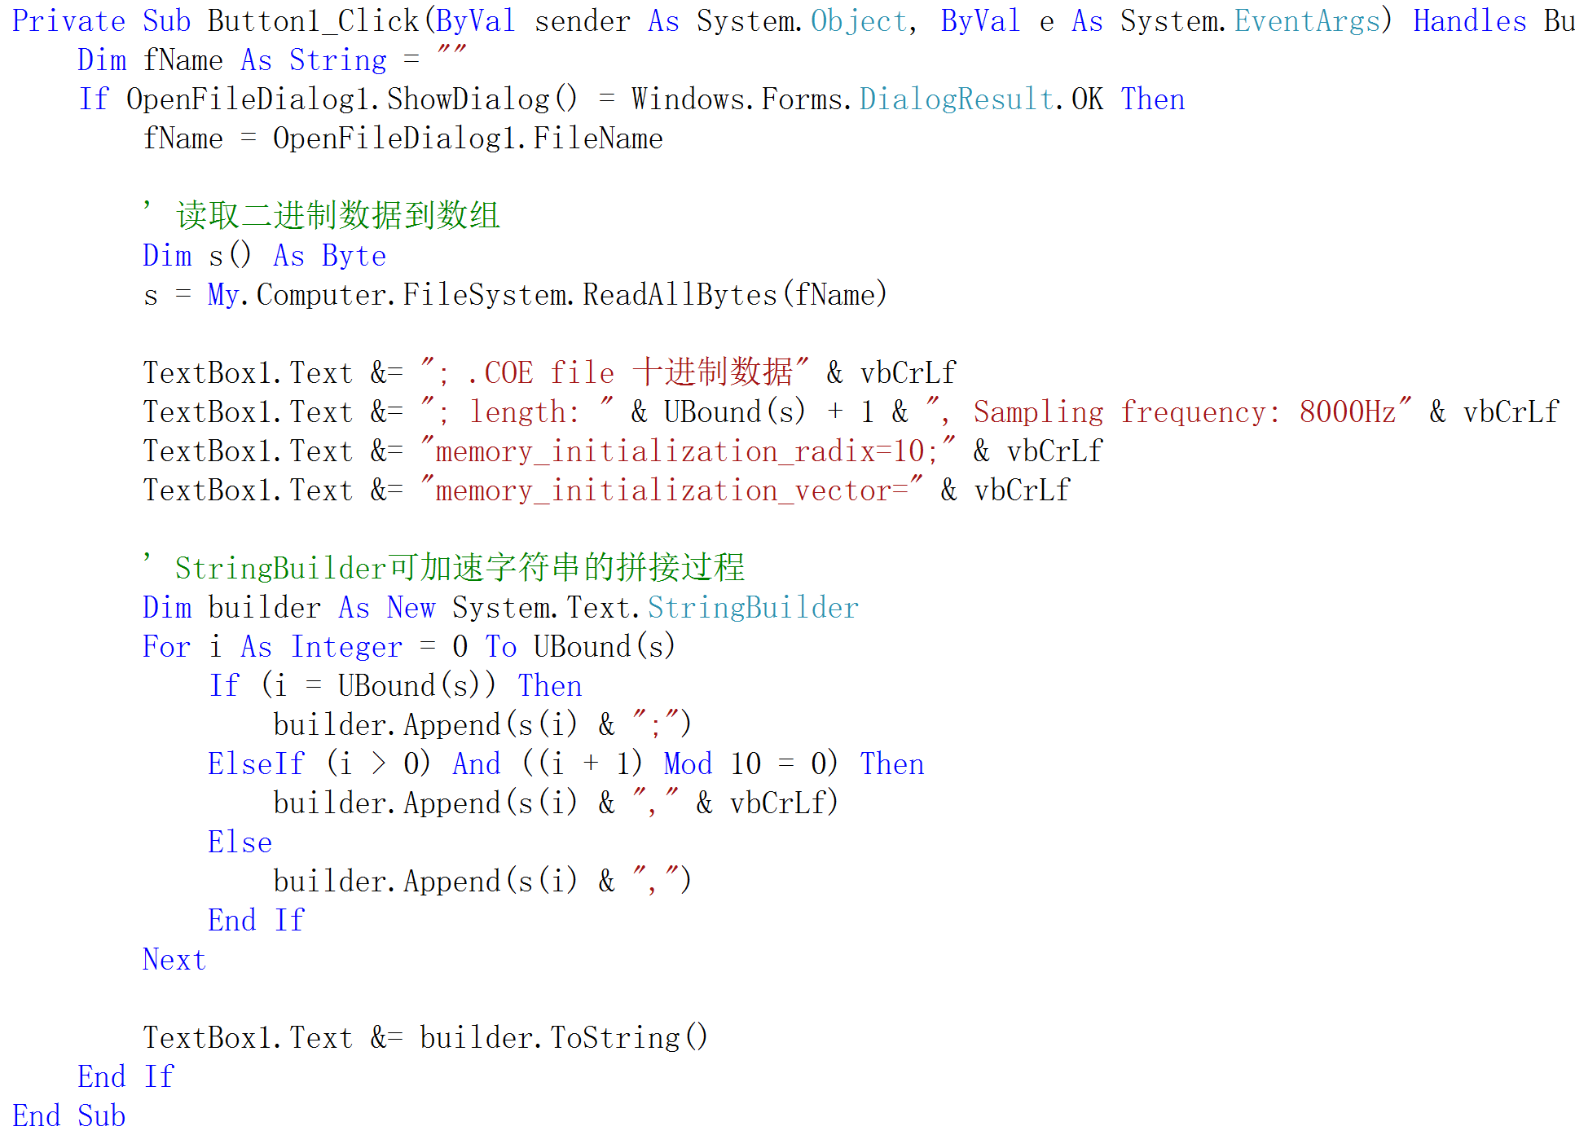
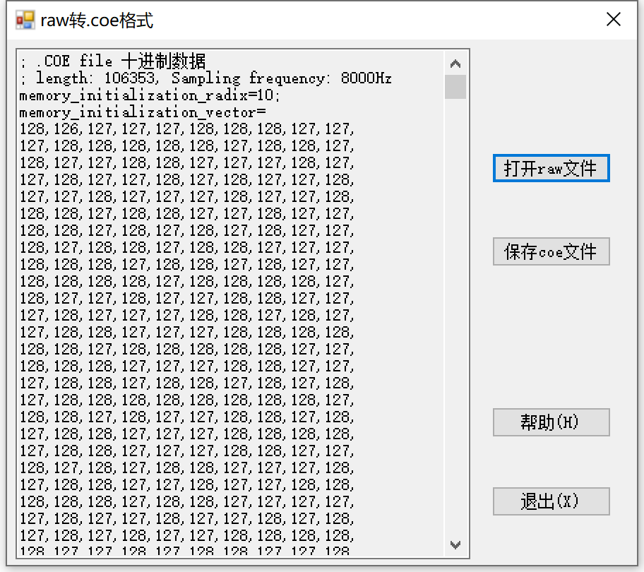
raw2coe 文件
数据长度：106,353

Slide 17
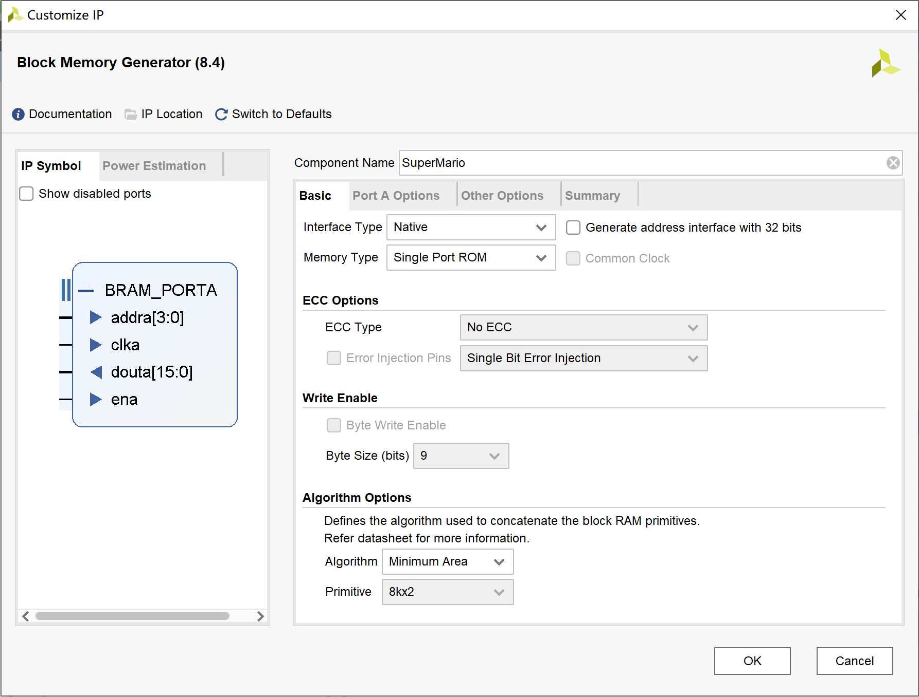
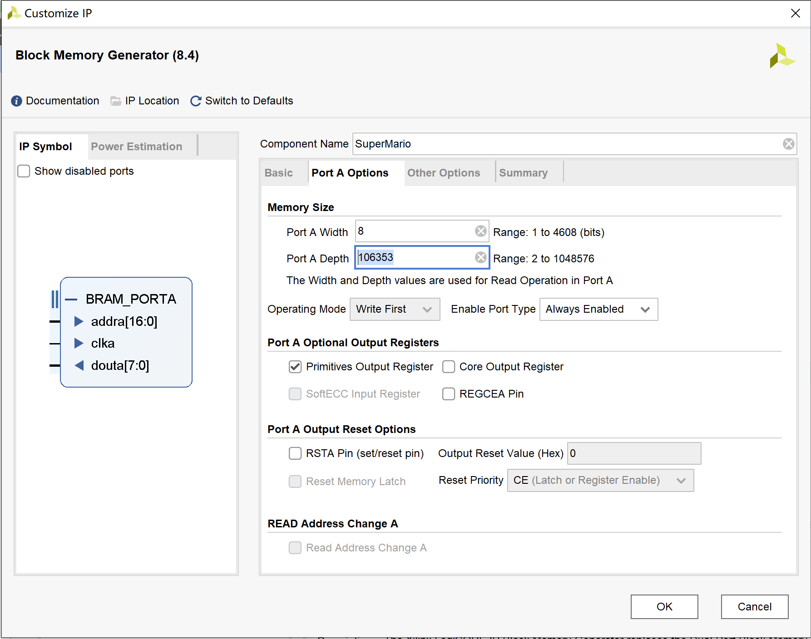
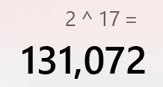
音频 BRAM
② Bit-mapped
② Bit-mapped
块内存
编码：无符号8-bit
数据长度：106,353

Slide 18
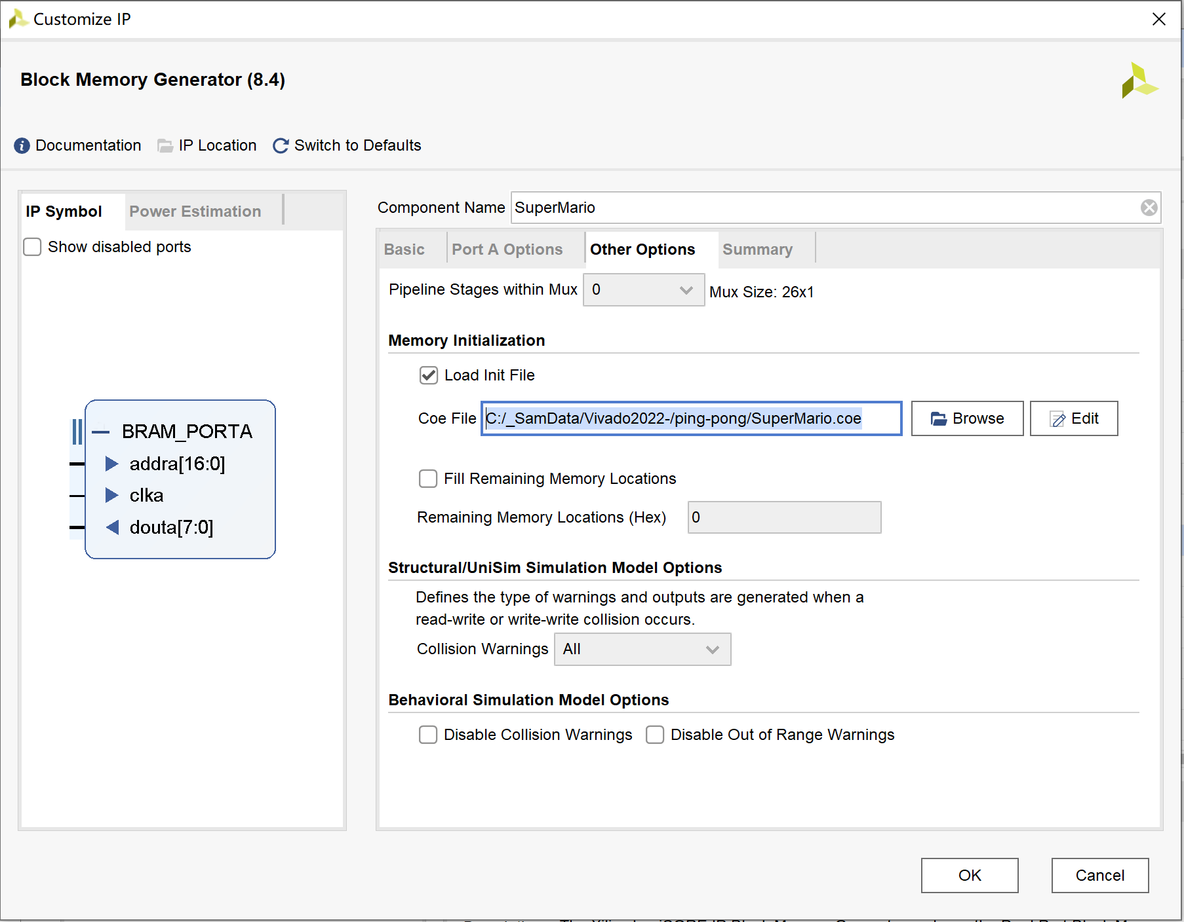

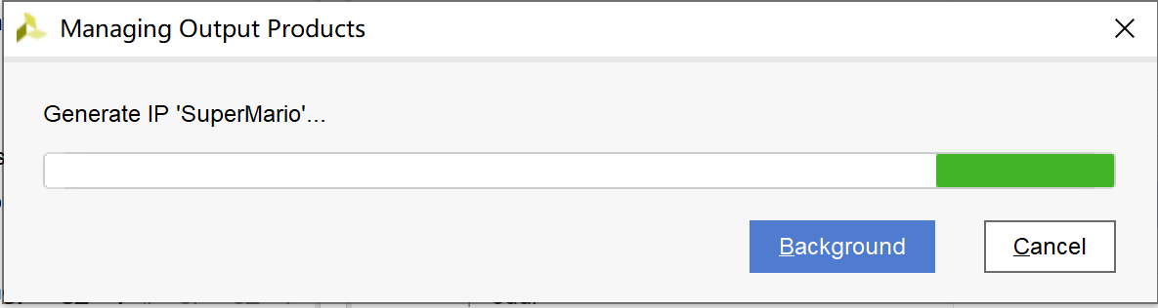
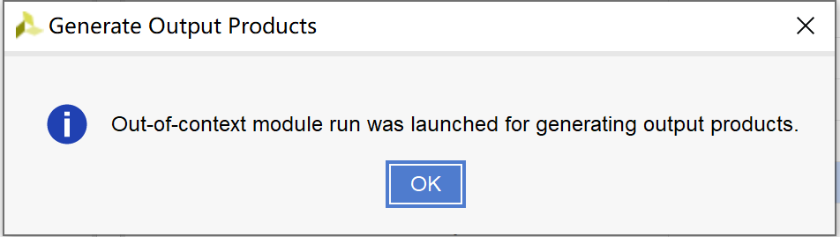
导入.coe音频数据
② Bit-mapped

Slide 19
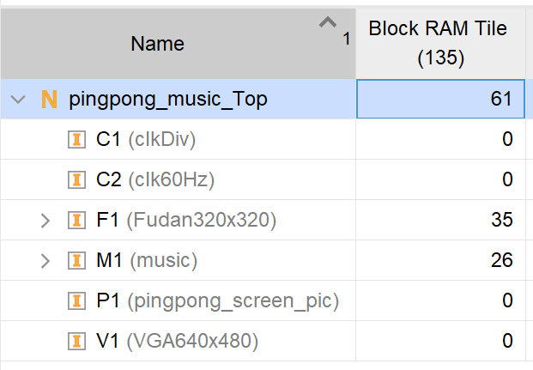
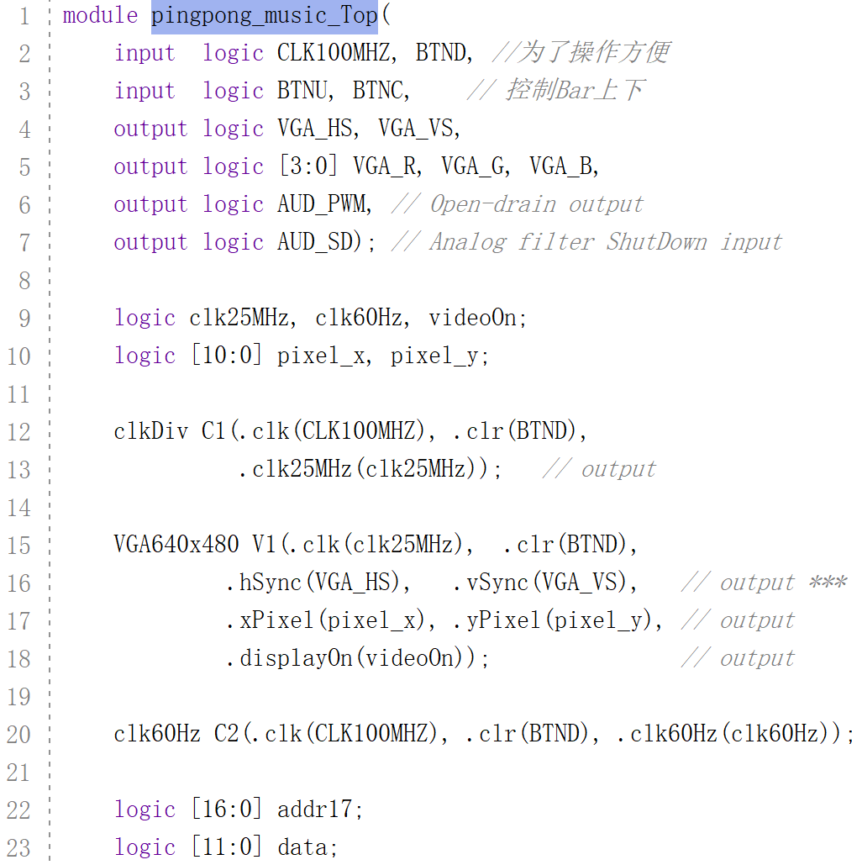
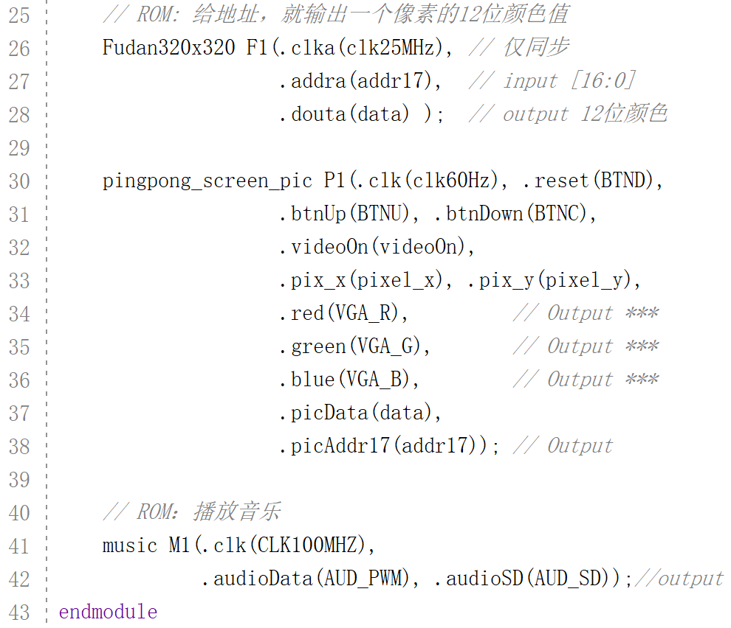
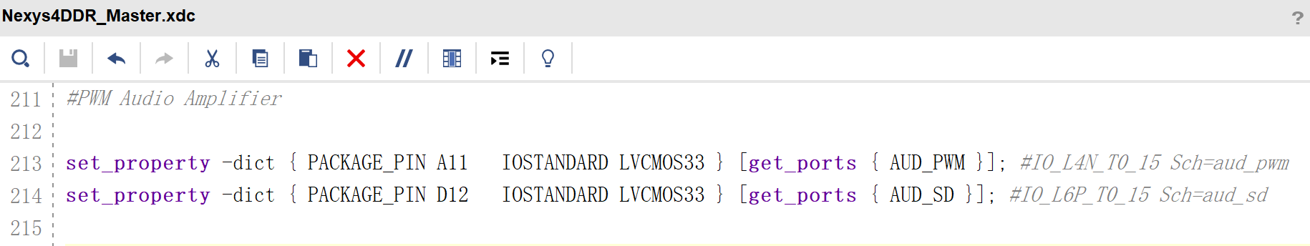
乒乓球：音乐顶层代码
② Bit-mapped
Notes:
module pingpong_music_Top(
input logic CLK100MHZ, BTND, //为了操作方便
input logic BTNU, BTNC, // 控制Bar上下
output logic VGA_HS, VGA_VS,
output logic [3:0] VGA_R, VGA_G, VGA_B,
output logic AUD_PWM, // Open-drain output
output logic AUD_SD); // Analog filter ShutDown input
logic clk25MHz, clk60Hz, videoOn;
logic [10:0] pixel_x, pixel_y;
clkDiv C1(.clk(CLK100MHZ), .clr(BTND),
.clk25MHz(clk25MHz)); // output
VGA640x480 V1(.clk(clk25MHz), .clr(BTND),
.hSync(VGA_HS), .vSync(VGA_VS), // output ***
.xPixel(pixel_x), .yPixel(pixel_y), // output
.displayOn(videoOn)); // output
clk60Hz C2(.clk(CLK100MHZ), .clr(BTND), .clk60Hz(clk60Hz));
logic [16:0] addr17;
logic [11:0] data;
// ROM: 给地址，就输出一个像素的12位颜色值
Fudan320x320 F1(.clka(clk25MHz), // 仅同步
.addra(addr17), // input [16:0]
.douta(data) ); // output 12位颜色
pingpong_screen_pic P1(.clk(clk60Hz), .reset(BTND),
.btnUp(BTNU), .btnDown(BTNC),
.videoOn(videoOn),
.pix_x(pixel_x), .pix_y(pixel_y),
.red(VGA_R), // Output ***
.green(VGA_G), // Output ***
.blue(VGA_B), // Output ***
.picData(data),
.picAddr17(addr17)); // Output
// ROM：播放音乐
music M1(.clk(CLK100MHZ),
.audioData(AUD_PWM), .audioSD(AUD_SD));//output
endmodule

Slide 20
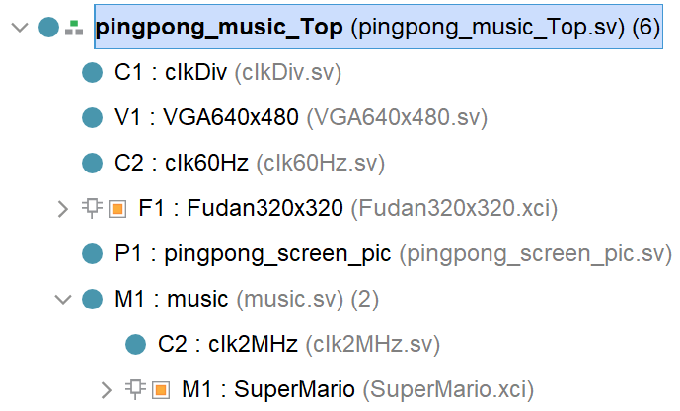
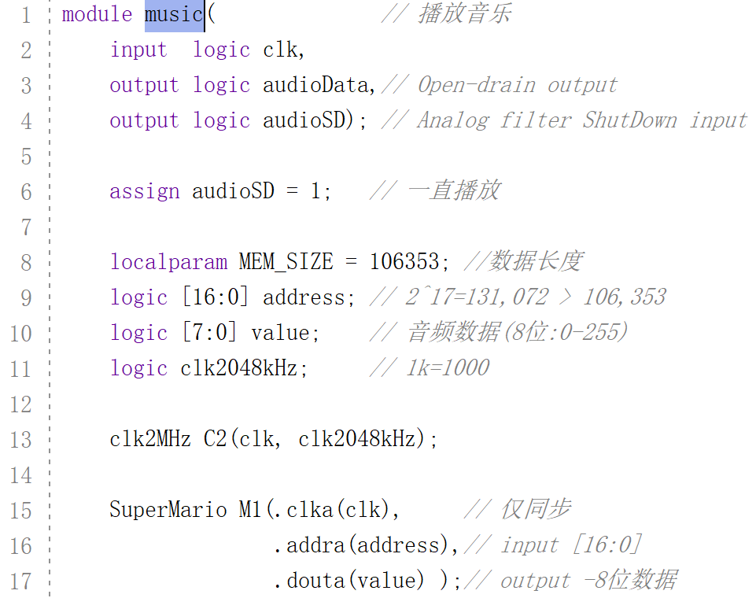
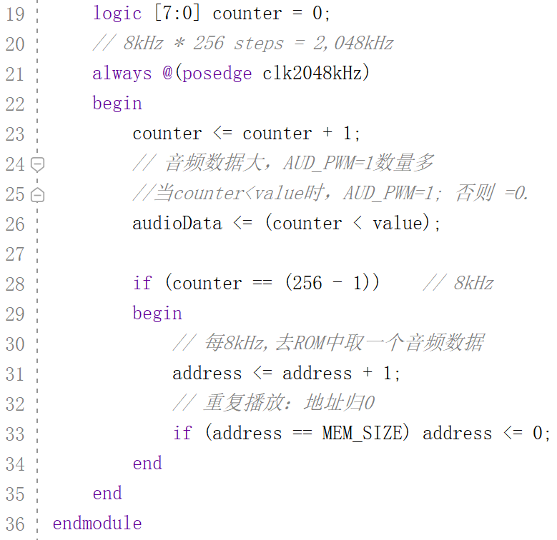
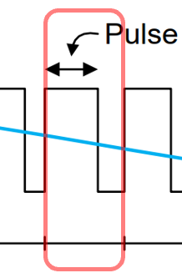
乒乓球：音乐模块代码
② Bit-mapped
每8kHz取
一个数据
每个8kHz中
有256个2048kHz
Notes:
module music( // 播放音乐
input logic clk,
output logic audioData,// Open-drain output
output logic audioSD); // Analog filter ShutDown input
assign audioSD = 1; // 一直播放
localparam MEM_SIZE = 106353; //数据长度
logic [16:0] address; // 2^17=131,072 > 106,353
logic [7:0] value; // 音频数据(8位:0-255)
logic clk2048kHz; // 1k=1000
clk2MHz C2(clk, clk2048kHz);
SuperMario M1(.clka(clk), // 仅同步
.addra(address),// input [16:0]
.douta(value) );// output -8位数据
logic [7:0] counter = 0;
// 8kHz * 256 steps = 2,048kHz
always @(posedge clk2048kHz)
begin
counter <= counter + 1;
//当counter<value时，AUD_PWM=1; 否则 =0.
audioData <= (counter < value);
if (counter == (256 - 1)) // 8kHz
begin
// 每8kHz,去ROM中取一个音频数据
address <= address + 1;
// 重复播放：地址归0
if (address == MEM_SIZE) address <= 0;
end
end
endmodule

Slide 21
【作业4】乐器播放
用FPGA播放你喜欢的一小段乐曲。

Slide 22
Text
3
ping-pong

Slide 23
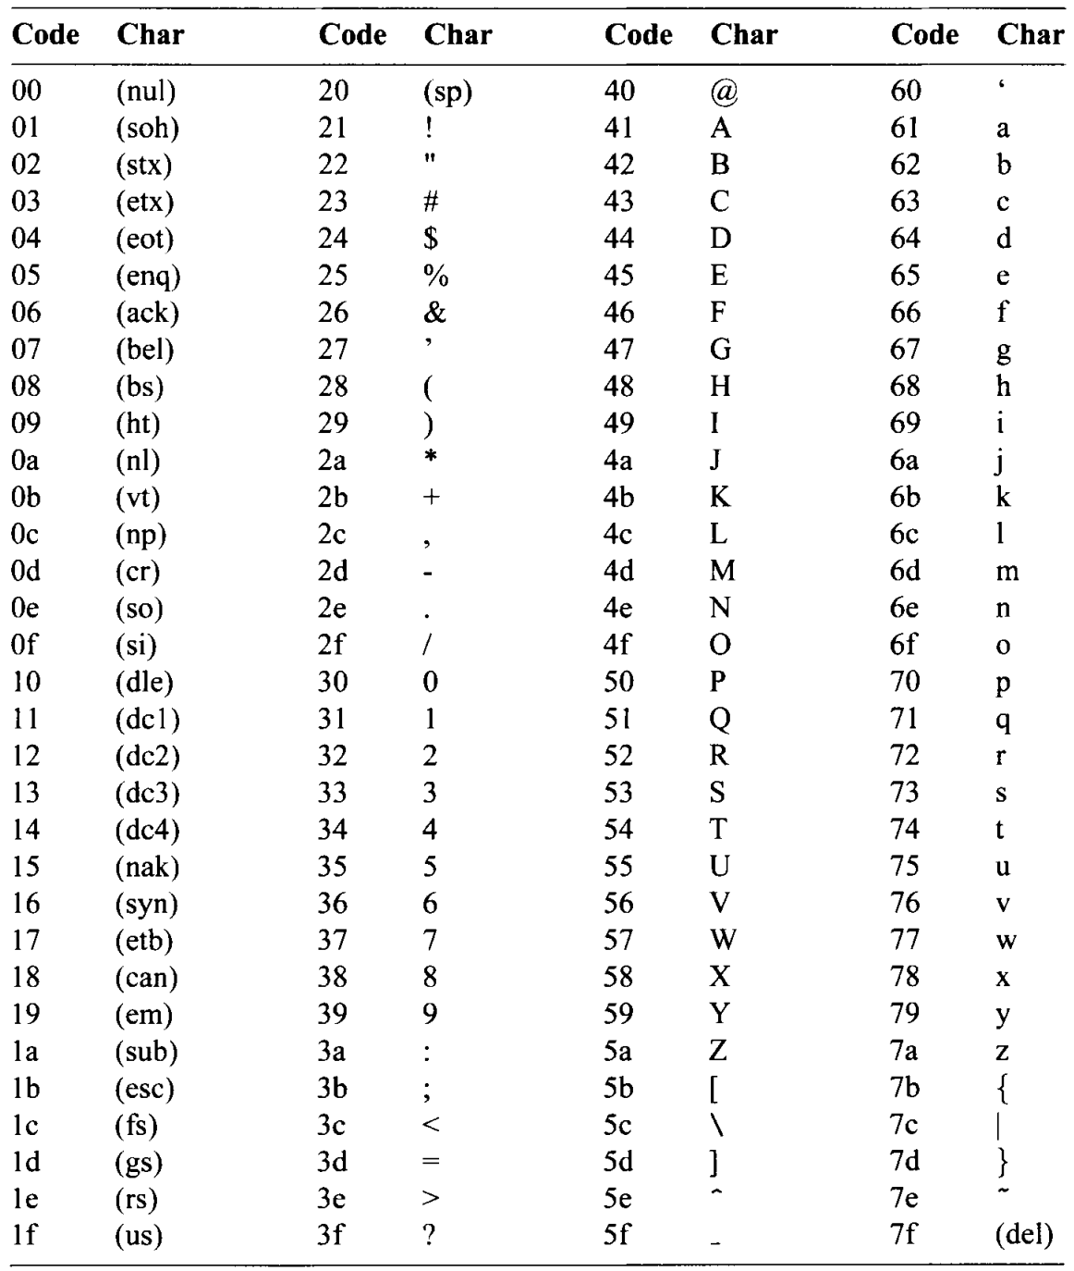
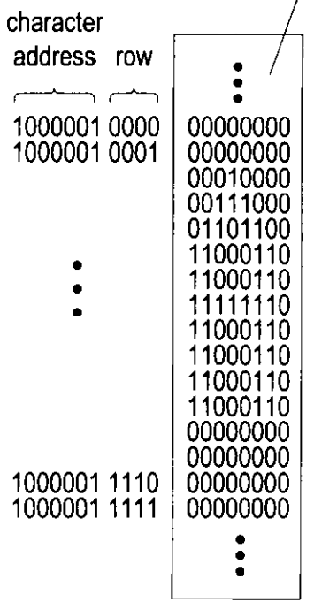
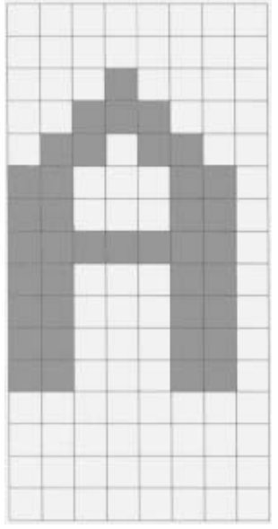
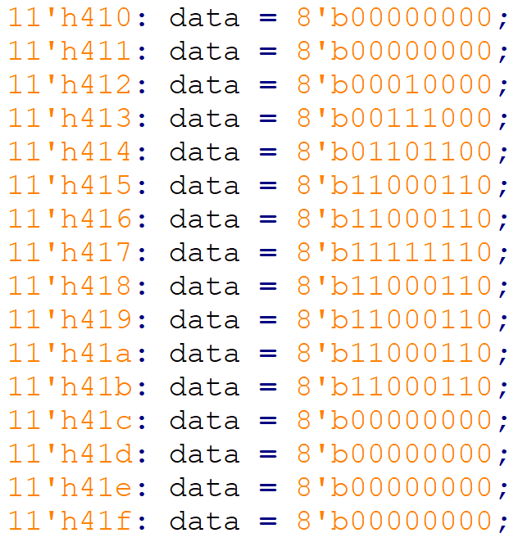

128个7-bit ASCII字符
③ Tile-mapped
2048=
$2^{7+4} ×$8 ROM
字符
data
8 pixel
16
pixel

Slide 24
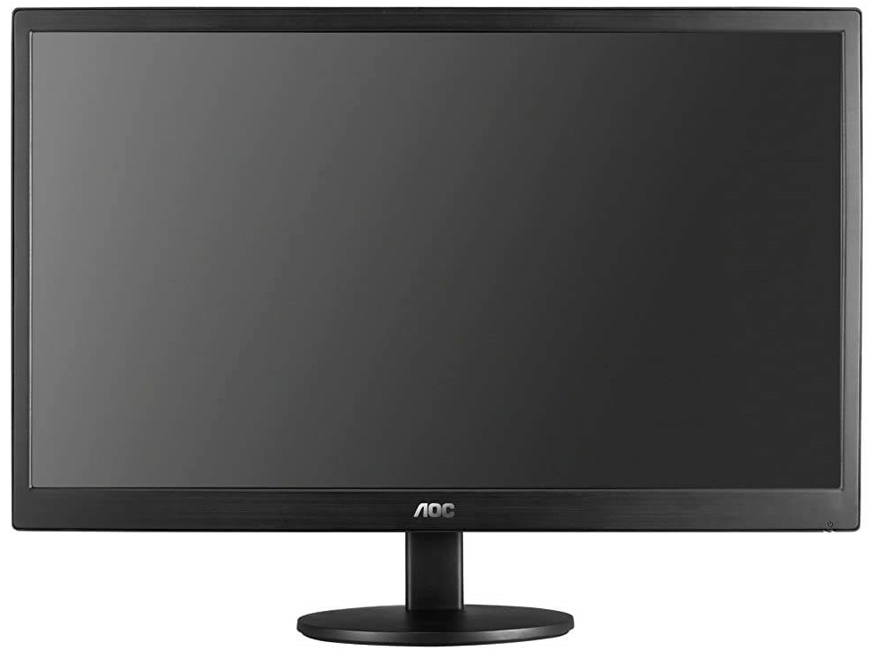
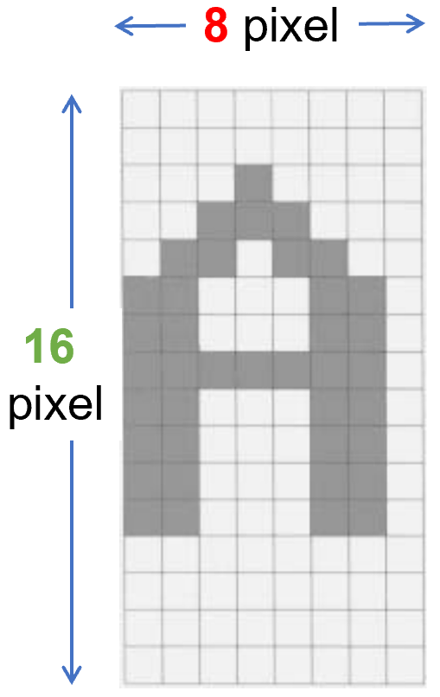
字符 与 屏幕
③ Tile-mapped
xText[2:0]
(…000_0000000, 0…0)₂
(…000_0001000, 0…0)₂
(…100_1111000, 0…0)₂
(0…0, …0_00000000 )₂
80 个
(0…0, …0_00010000 )₂
25个
480 pixel
(0…0, …1_10000000 )₂
640 pixel
rowAddr = yText[3:0]

Slide 25
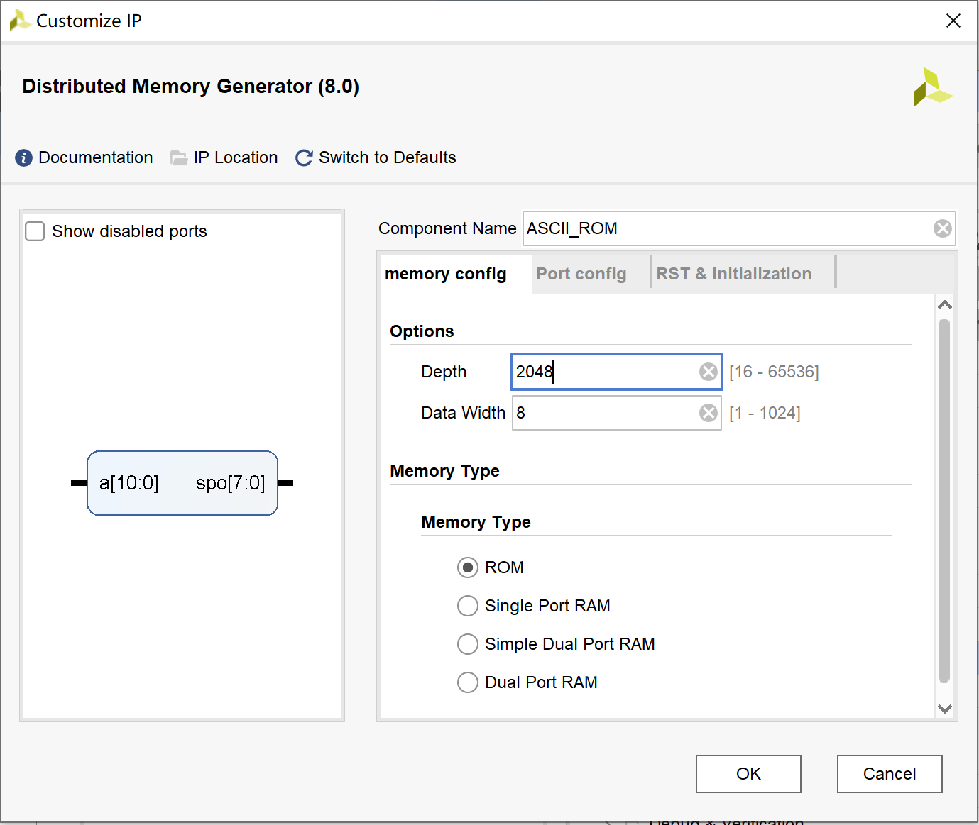
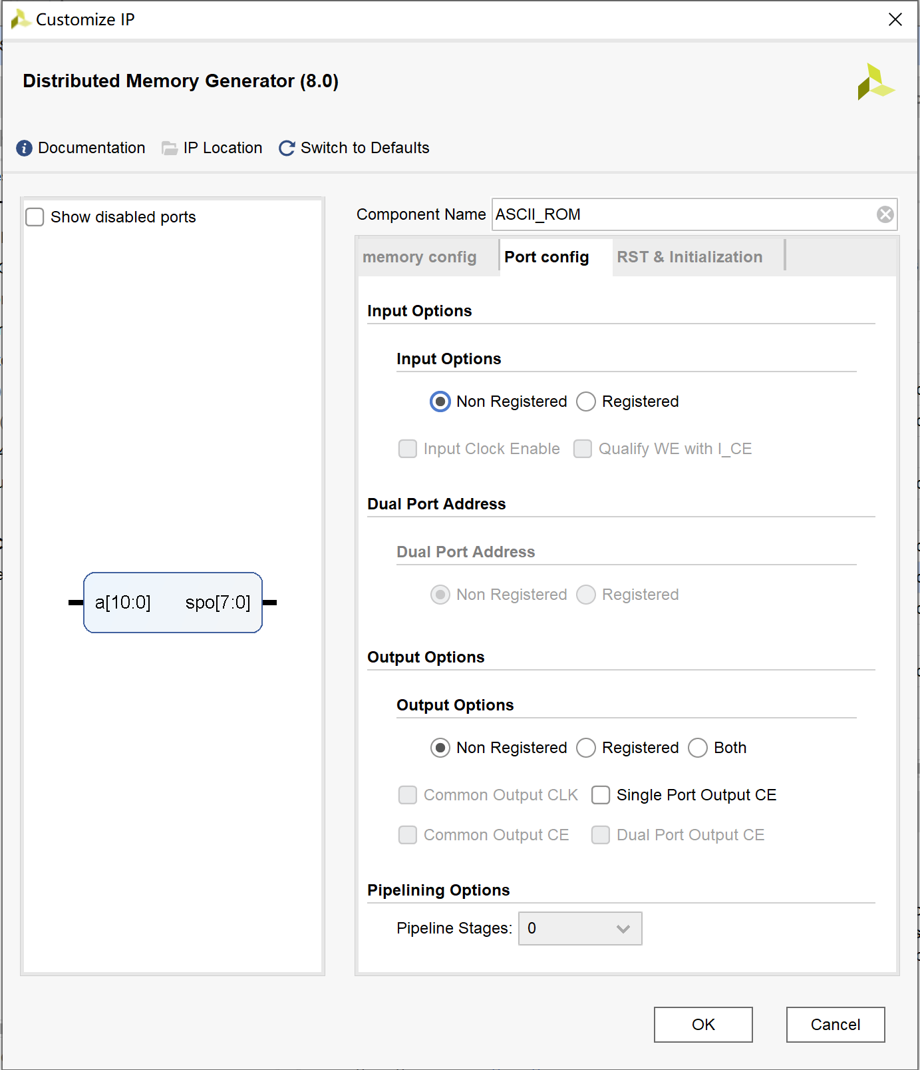

用DRAM存放ASCII
③ Tile-mapped
分布式内存

Slide 26






ASCII- DRAM
③ Tile-mapped
.coe文件
……………………
………………

Slide 27




显示得分 Score:01
③ Tile-mapped
仅在这里显示得分
满屏反复显示得分
数字0-9的ASCII码前3位=011
Notes:
module pingpong_screen_text(
input logic clk, reset, //clk: 屏幕60Hz刷新频率
input logic btnUp, btnDown, //控制Bar上下移动
input logic videoOn,
input logic [10:0] pix_x, pix_y, //屏幕坐标
output logic [3:0] red, green, blue,
input logic [11:0] picData, //每个像素用12位表示色彩
output logic [16:0] picAddr17);//320x320=102,400bit.(2^17=131,072)
localparam
MAX_X = 640, MAX_Y = 480, //(0.0) to (640-1,480-1)
// 屏幕参数
H_SYNC = 96, // horizontal sync width
H_BACK = 48, // left border (back porch)
H_SYNC_START = H_SYNC + H_BACK, //行显示后沿 = 144(96+48)
V_SYNC = 2, // vertical sync lines
V_TOP = 29, // vertical top border
V_SYNC_START = V_SYNC + V_TOP, //场显示后沿 = 31(2+29)
// === wall ===
WALL_X_L = H_SYNC_START + 30, // left boundary
WALL_X_R = H_SYNC_START + 40, // right boundary
// === bar ===
BAR_X_L = H_SYNC_START + 600, // left boundary
BAR_X_R = H_SYNC_START + 605, // right boundary
BAR_Y_SIZE = 70, // bar 的高度
BAR_Y_T = V_SYNC_START + MAX_Y/2 - BAR_Y_SIZE/2, //Top=204
BAR_Y_B = BAR_Y_T + BAR_Y_SIZE -1, // bottom boundary
BAR_V = 4, // 每次移动 bar 的距离
// === ball ===
BALL_SIZE = 8,
BALL_X_L = H_SYNC_START + 580, // left boundary
BALL_X_R = BALL_X_L + BALL_SIZE - 1, // right boundary
BALL_Y_T = V_SYNC_START + MAX_Y/2 -BALL_SIZE/2,//top boundary
BALL_Y_B = BALL_Y_T + BALL_SIZE - 1, // bottom boundary
BALL_V = 2; // 每次移动 ball 的距离
logic wallOn, barOn, ballOn, picOn, textOn;
logic [3:0] wall_r, wall_g, wall_b;
logic [3:0] bar_r, bar_g, bar_b;
logic [3:0] ball_r, ball_g, ball_b;
logic [3:0] pic_r, pic_g, pic_b;
// (wall) : pixel within wall
assign wallOn = (WALL_X_L <= pix_x) && (pix_x <= WALL_X_R);
assign wall_r = 4'b0000;
assign wall_g = 4'b0000;
assign wall_b = 4'b1111; // blue
// (bar) : pixel within bar
logic [10:0] bar_y_t, bar_y_b; // bar top, bottom boundary
// new bar y-position
always @(posedge clk, posedge reset)
begin
if (reset)
begin
bar_y_t <= BAR_Y_T;
end
else if (btnDown & (bar_y_b <= (V_SYNC_START+MAX_Y-1-BAR_V)))
bar_y_t <= bar_y_t + BAR_V; // move down
else if (btnUp & (bar_y_t >= (V_SYNC_START+BAR_V)))
bar_y_t <= bar_y_t - BAR_V; // move up
end
assign bar_y_b = bar_y_t + BAR_Y_SIZE - 1;
assign barOn = ((BAR_X_L<=pix_x) && (pix_x<=BAR_X_R) &&
(bar_y_t<=pix_y) && (pix_y<=bar_y_b)); //变量
assign bar_r = 4'b0000;
assign bar_g = 4'b1111; // green
assign bar_b = 4'b0000;
// （round ball）
logic [10:0] ball_x_l, ball_x_r; // ball left, right boundary
logic [10:0] ball_y_t, ball_y_b; // ball top, bottom boundary
logic [10:0] ball_dx , ball_dy ; // ball x, y 增量
logic [3:0] textBalls0, textBalls1; // 得分个位,十位
// new ball x,y-position
always @(posedge clk, posedge reset) begin
if (reset) begin
ball_x_l <= BALL_X_L;
ball_y_t <= BALL_Y_T;
ball_dx <= -1 * BALL_V;
ball_dy <= -1 * BALL_V;
textBalls0 <= 4'b0000; //得分个位
textBalls1 <= 4'b0000; //得分十位
end
else begin
ball_x_l <= ball_x_l + ball_dx; // 小球按clk节拍一直在向左移动
ball_y_t <= ball_y_t + ball_dy; // 小球按clk节拍一直在向上移动
// ------------------ ball bounce back -----------------------
if (ball_y_t <= V_SYNC_START) //reach top screen
ball_dy <= BALL_V;
else if (ball_y_b >= V_SYNC_START + MAX_Y) //reach bottom screen
ball_dy <= -1 * BALL_V;
else if (ball_x_l <= WALL_X_R) //reach left wall
begin
ball_dx <= BALL_V;
end
else if ((ball_x_r >= BAR_X_L) && //reach right bar
(ball_x_r <= BAR_X_R) &&
(ball_y_b >= bar_y_t) && (ball_y_t <= bar_y_b))
begin
ball_dx <= -1 * BALL_V;
ball_x_l <= BAR_X_L - BALL_SIZE;//防止连续3次触发下行 hit+1
textBalls0 <= textBalls0 + 1; //仅16进制+1
end
else if (ball_x_r >= H_SYNC_START + MAX_X) //reach right screen
ball_dx <= -1 * BALL_V;
end
end
assign ball_x_r = ball_x_l + BALL_SIZE - 1;
assign ball_y_b = ball_y_t + BALL_SIZE - 1;
logic [2:0] rom_addr, rom_col; // ROM中8行、8列
logic rom_bit; // ROM中每个像素值
logic [7:0] rom_data;
always_comb // round ball image ROM
case (rom_addr)
3'h0: rom_data = 8'b0011_1100; // ****
3'h1: rom_data = 8'b0111_1110; // ******
3'h2: rom_data = 8'b1111_1111; // ********
3'h3: rom_data = 8'b1111_1111; // ********
3'h4: rom_data = 8'b1111_1111; // ********
3'h5: rom_data = 8'b1111_1111; // ********
3'h6: rom_data = 8'b0111_1110; // ******
3'h7: rom_data = 8'b0011_1100; // ****
endcase
assign rom_col = pix_x[2:0] - ball_x_l[2:0]; // ROM列
assign rom_addr = pix_y[2:0] - ball_y_t[2:0]; // ROM行
assign rom_bit = rom_data[rom_col]; //ROMaddr行中col列值
// pixel within ball
assign ballOn = ((ball_x_l<=pix_x) && (pix_x<=ball_x_r) && //变量
(ball_y_t<=pix_y) && (pix_y<=ball_y_b)) & //变量
rom_bit; // round ball
assign ball_r = 4'b1111; // red
assign ball_g = 4'b0000;
assign ball_b = 4'b0000;
// Fudan picture
logic [10:0] C1, R1; //图片左上角坐标（C1, R1）
assign C1 = (MAX_X - 320) / 2; //水平居中=160
assign R1 = (MAX_Y - 320) / 2; //垂直居中=80
logic [10:0] xPic, yPic; //图片内坐标
assign xPic = pix_x - H_SYNC_START - C1;
assign yPic = pix_y - V_SYNC_START - R1;
// read picture data from ROM
assign picAddr17 = 320 * yPic + xPic;
assign picOn = ((pix_x > H_SYNC_START+C1) &&
(pix_x < H_SYNC_START+C1+320) &&
(pix_y > V_SYNC_START+R1) &&
(pix_y < V_SYNC_START+R1+320));
assign pic_r = picData[11:8]; // 4bits red
assign pic_g = picData[7:4]; // 4bits green
assign pic_b = picData[3:0]; // 4bits blue
// (Text) 得分文字: 16x8点阵 "Score:??"
logic [10:0] C2, R2; //图片左上角坐标（C2, R2）
assign C2 = 500;
assign R2 = 10;
logic [10:0] xText, yText; //Text内坐标
assign xText = pix_x - H_SYNC_START - C2 - 1;
assign yText = pix_y - V_SYNC_START - R2 - 1;
logic [10:0] txtAddr; //{charAddr, rowAddr}
logic [6:0] charAddr; //字符地址
logic [3:0] rowAddr; //行地址
logic [0:7] textData; //字符ROM顺序从小到大!!
logic One_bit; //每个字符一行中的每1位数据
always @(*)
case (xText[6:3]) // xText[2:0]为1个字
4'h0: charAddr = 7'h53; // S
4'h1: charAddr = 7'h63; // c
4'h2: charAddr = 7'h6f; // o
4'h3: charAddr = 7'h72; // r
4'h4: charAddr = 7'h65; // e
4'h5: charAddr = 7'h3a; // :
4'h6: charAddr = {3'b011, textBalls1}; // 十位数
4'h7: charAddr = {3'b011, textBalls0}; // 个位数
endcase
assign rowAddr = yText[3:0]; // 每个字共16行
assign txtAddr = {charAddr, rowAddr};
// 从ROM中获取字符每行8位数据textData
ASCII_ROM A1(.a(txtAddr), .spo(textData));
// 提取出每个字符一行中的每1位数据
assign One_bit = textData[xText[2:0]];
// 16x8点阵 "Score:??"
assign textOn = ((pix_x > H_SYNC_START+C2) &&
(pix_x < H_SYNC_START+C2+8*8) && //8字符*8bits
(pix_y > V_SYNC_START+R2) &&
(pix_y < V_SYNC_START+R2+16)) && //16bits高
One_bit ; // 像素=1？
always_comb // ===== rgb 输出 ======
if (~videoOn)
begin
red = 4'b0000; // blank
green = 4'b0000; // blank
blue = 4'b0000; // blank
end
else if (wallOn)
begin
red = wall_r;
green = wall_g;
blue = wall_b;
end
else if (ballOn)
begin
red = ball_r;
green = ball_g;
blue = ball_b;
end
else if (barOn)
begin
red = bar_r;
green = bar_g;
blue = bar_b;
end
else if (picOn)
begin
red = pic_r;
green = pic_g;
blue = pic_b;
end
else if (textOn)
begin // black
red = 4'b0000;
green = 4'b0000;
blue = 4'b0000;
end
else
begin // gray background
red = 4'b1110;
green = 4'b1110;
blue = 4'b1110;
end
endmodule

Slide 28



全屏显示效果

Slide 29



字体缩放 Score:01
③ Tile-mapped
将文本内坐标向左移动一位，
xText[2:0] → xText[3:1]
yText[3:0] → yText[4:1]
意味着(xText[1], yText[1])为(1,1) (1,0) (0,1) (0,0)时，对应着相同的字体像素值。
显示区域也相应扩大
仅在这里显示得分
满屏反复显示得分
数字0-9的ASCII码前3位=011
Notes:
module pingpong_screen_textBig(
input logic clk, reset, //clk: 屏幕60Hz刷新频率
input logic btnUp, btnDown, //控制Bar上下移动
input logic videoOn,
input logic [10:0] pix_x, pix_y, //屏幕坐标
output logic [3:0] red, green, blue,
input logic [11:0] picData, //每个像素用12位表示色彩
output logic [16:0] picAddr17);//320x320=102,400bit.(2^17=131,072)
localparam
MAX_X = 640, MAX_Y = 480, //(0.0) to (640-1,480-1)
// 屏幕参数
H_SYNC = 96, // horizontal sync width
H_BACK = 48, // left border (back porch)
H_SYNC_START = H_SYNC + H_BACK, //行显示后沿 = 144(96+48)
V_SYNC = 2, // vertical sync lines
V_TOP = 29, // vertical top border
V_SYNC_START = V_SYNC + V_TOP, //场显示后沿 = 31(2+29)
// === wall ===
WALL_X_L = H_SYNC_START + 30, // left boundary
WALL_X_R = H_SYNC_START + 40, // right boundary
// === bar ===
BAR_X_L = H_SYNC_START + 600, // left boundary
BAR_X_R = H_SYNC_START + 605, // right boundary
BAR_Y_SIZE = 70, // bar 的高度
BAR_Y_T = V_SYNC_START + MAX_Y/2 - BAR_Y_SIZE/2, //Top=204
BAR_Y_B = BAR_Y_T + BAR_Y_SIZE -1, // bottom boundary
BAR_V = 4, // 每次移动 bar 的距离
// === ball ===
BALL_SIZE = 8,
BALL_X_L = H_SYNC_START + 580, // left boundary
BALL_X_R = BALL_X_L + BALL_SIZE - 1, // right boundary
BALL_Y_T = V_SYNC_START + MAX_Y/2 -BALL_SIZE/2,//top boundary
BALL_Y_B = BALL_Y_T + BALL_SIZE - 1, // bottom boundary
BALL_V = 2; // 每次移动 ball 的距离
logic wallOn, barOn, ballOn, picOn, textOn;
logic [3:0] wall_r, wall_g, wall_b;
logic [3:0] bar_r, bar_g, bar_b;
logic [3:0] ball_r, ball_g, ball_b;
logic [3:0] pic_r, pic_g, pic_b;
// (wall) : pixel within wall
assign wallOn = (WALL_X_L <= pix_x) && (pix_x <= WALL_X_R);
assign wall_r = 4'b0000;
assign wall_g = 4'b0000;
assign wall_b = 4'b1111; // blue
// (bar) : pixel within bar
logic [10:0] bar_y_t, bar_y_b; // bar top, bottom boundary
// new bar y-position
always @(posedge clk, posedge reset)
begin
if (reset)
begin
bar_y_t <= BAR_Y_T;
end
else if (btnDown & (bar_y_b <= (V_SYNC_START+MAX_Y-1-BAR_V)))
bar_y_t <= bar_y_t + BAR_V; // move down
else if (btnUp & (bar_y_t >= (V_SYNC_START+BAR_V)))
bar_y_t <= bar_y_t - BAR_V; // move up
end
assign bar_y_b = bar_y_t + BAR_Y_SIZE - 1;
assign barOn = ((BAR_X_L<=pix_x) && (pix_x<=BAR_X_R) &&
(bar_y_t<=pix_y) && (pix_y<=bar_y_b)); //变量
assign bar_r = 4'b0000;
assign bar_g = 4'b1111; // green
assign bar_b = 4'b0000;
// （round ball）
logic [10:0] ball_x_l, ball_x_r; // ball left, right boundary
logic [10:0] ball_y_t, ball_y_b; // ball top, bottom boundary
logic [10:0] ball_dx , ball_dy ; // ball x, y 增量
logic [3:0] textBalls0, textBalls1; // 得分个位,十位
// new ball x,y-position
always @(posedge clk, posedge reset) begin
if (reset) begin
ball_x_l <= BALL_X_L;
ball_y_t <= BALL_Y_T;
ball_dx <= -1 * BALL_V;
ball_dy <= -1 * BALL_V;
textBalls0 <= 4'b0000; //得分个位
textBalls1 <= 4'b0000; //得分十位
end
else begin
ball_x_l <= ball_x_l + ball_dx; // 小球按clk节拍一直在向左移动
ball_y_t <= ball_y_t + ball_dy; // 小球按clk节拍一直在向上移动
// ------------------ ball bounce back -----------------------
if (ball_y_t <= V_SYNC_START) //reach top screen
ball_dy <= BALL_V;
else if (ball_y_b >= V_SYNC_START + MAX_Y) //reach bottom screen
ball_dy <= -1 * BALL_V;
else if (ball_x_l <= WALL_X_R) //reach left wall
begin
ball_dx <= BALL_V;
end
else if ((ball_x_r >= BAR_X_L) && //reach right bar
(ball_x_r <= BAR_X_R) &&
(ball_y_b >= bar_y_t) && (ball_y_t <= bar_y_b))
begin
ball_dx <= -1 * BALL_V;
ball_x_l <= BAR_X_L - BALL_SIZE;//防止连续3次触发下行 hit+1
textBalls0 <= textBalls0 + 1; //仅16进制+1
end
else if (ball_x_r >= H_SYNC_START + MAX_X) //reach right screen
ball_dx <= -1 * BALL_V;
end
end
assign ball_x_r = ball_x_l + BALL_SIZE - 1;
assign ball_y_b = ball_y_t + BALL_SIZE - 1;
logic [2:0] rom_addr, rom_col; // ROM中8行、8列
logic rom_bit; // ROM中每个像素值
logic [7:0] rom_data;
always_comb // round ball image ROM
case (rom_addr)
3'h0: rom_data = 8'b0011_1100; // ****
3'h1: rom_data = 8'b0111_1110; // ******
3'h2: rom_data = 8'b1111_1111; // ********
3'h3: rom_data = 8'b1111_1111; // ********
3'h4: rom_data = 8'b1111_1111; // ********
3'h5: rom_data = 8'b1111_1111; // ********
3'h6: rom_data = 8'b0111_1110; // ******
3'h7: rom_data = 8'b0011_1100; // ****
endcase
assign rom_col = pix_x[2:0] - ball_x_l[2:0]; // ROM列
assign rom_addr = pix_y[2:0] - ball_y_t[2:0]; // ROM行
assign rom_bit = rom_data[rom_col]; //ROMaddr行中col列值
// pixel within ball
assign ballOn = ((ball_x_l<=pix_x) && (pix_x<=ball_x_r) && //变量
(ball_y_t<=pix_y) && (pix_y<=ball_y_b)) & //变量
rom_bit; // round ball
assign ball_r = 4'b1111; // red
assign ball_g = 4'b0000;
assign ball_b = 4'b0000;
// Fudan picture
logic [10:0] C1, R1; //图片左上角坐标（C1, R1）
assign C1 = (MAX_X - 320) / 2; //水平居中=160
assign R1 = (MAX_Y - 320) / 2; //垂直居中=80
logic [10:0] xPic, yPic; //图片内坐标
assign xPic = pix_x - H_SYNC_START - C1;
assign yPic = pix_y - V_SYNC_START - R1;
// read picture data from ROM
assign picAddr17 = 320 * yPic + xPic;
assign picOn = ((pix_x > H_SYNC_START+C1) &&
(pix_x < H_SYNC_START+C1+320) &&
(pix_y > V_SYNC_START+R1) &&
(pix_y < V_SYNC_START+R1+320));
assign pic_r = picData[11:8]; // 4bits red
assign pic_g = picData[7:4]; // 4bits green
assign pic_b = picData[3:0]; // 4bits blue
// (Text) 得分文字: 16x8点阵 "Score:??"
logic [10:0] C2, R2; //图片左上角坐标（C2, R2）
assign C2 = 500;
assign R2 = 10;
logic [10:0] xText, yText; //Text内坐标
assign xText = pix_x - H_SYNC_START - C2 - 1;
assign yText = pix_y - V_SYNC_START - R2 - 1;
logic [10:0] txtAddr; //{charAddr, rowAddr}
logic [6:0] charAddr; //字符地址
logic [3:0] rowAddr; //行地址
logic [0:7] textData; //字符ROM顺序从小到大!!
logic One_bit; //每个字符一行中的每1位数据
always @(*)
case (xText[7:4]) // xText[3:0]为1个字
4'h0: charAddr = 7'h53; // S
4'h1: charAddr = 7'h63; // c
4'h2: charAddr = 7'h6f; // o
4'h3: charAddr = 7'h72; // r
4'h4: charAddr = 7'h65; // e
4'h5: charAddr = 7'h3a; // :
4'h6: charAddr = {3'b011, textBalls1}; // 十位数
4'h7: charAddr = {3'b011, textBalls0}; // 个位数
default:charAddr=7'hXX;
endcase
assign rowAddr = yText[4:1]; // 每个字共16行
assign txtAddr = {charAddr, rowAddr};
// 从ROM中获取字符每行8位数据textData
ASCII_ROM A1(.a(txtAddr), .spo(textData));
// 提取出每个字符一行中的每1位数据
assign One_bit = textData[xText[3:1]];
// 32x16点阵 "Score:??"
assign textOn = ((pix_x > H_SYNC_START+C2) &&
(pix_x < H_SYNC_START+C2+8*8*2) && //8字符*8bits*2
(pix_y > V_SYNC_START+R2) &&
(pix_y < V_SYNC_START+R2+16*2)) && //16bits高 * 2
One_bit ; // 像素=1？
always_comb // ===== rgb 输出 ======
if (~videoOn)
begin
red = 4'b0000; // blank
green = 4'b0000; // blank
blue = 4'b0000; // blank
end
else if (wallOn)
begin
red = wall_r;
green = wall_g;
blue = wall_b;
end
else if (ballOn)
begin
red = ball_r;
green = ball_g;
blue = ball_b;
end
else if (barOn)
begin
red = bar_r;
green = bar_g;
blue = bar_b;
end
else if (picOn)
begin
red = pic_r;
green = pic_g;
blue = pic_b;
end
else if (textOn)
begin // black
red = 4'b0000;
green = 4'b0000;
blue = 4'b0000;
end
else
begin // gray background
red = 4'b1110;
green = 4'b1110;
blue = 4'b1110;
end
endmodule

Slide 30
【作业5】完整的乒乓球游戏
Score：21 Ball：0
每次开始拥有5个球，
球拍未接到即丢失1个球；
完善2位十进制计分显示；
游戏结束时显示Game Over;
用FSM有限状态机控制。
Game Over

